Slide 1
SOC / BIZ · OPEN PROJECT 2026
Agentic AI-Based Dynamic Tariff
Optimization for EV Charging Networks
Using large-scale real-world charging session data to model demand, optimize per-kWh tariffs, and evaluate revenue and utilization outcomes through a multi-agent agentic AI pipeline.
184,113
351
R² = 0.971
Station-hours analyzed
Stations · 2 real networks
Demand model fit (holdout)
Praneshwar Kannan Kommiya
B.Tech (Mechanical Engineering) · 3rd Year · IIT Roorkee
Indian Institute of Technology, Roorkee · May 2026

Slide 2
Executive Summary
End-to-end agentic AI pipeline on official EV charging datasets — no synthetic data used
Can demand-responsive dynamic pricing unlock measurable revenue and utilisation gains in real-world EV charging networks?
28.5 %
+11.1 %
0.971
0.23 min
Revenue Uplift vs. Rs.15 baseline
Session Response under pricing signal
Demand Model R² (held-out 20 %)
Avg. Wait Time Reduction (simulated)
Key Findings
— Two verified datasets — ACN-Data (Pasadena, USA) and ST-EVCDP (Shenzhen, China) — provide 184,113 station-hour observations across 351 charging stations.
— Ridge regression trained on 60,000 sampled rows achieves R² = 0.971 on a chronological 20 % holdout; utilisation RMSE = 0.049 (≈5 percentage-point miss per station-hour).
— The tariff agent evaluates 8 price candidates per observation and recommends surge pricing in 99.9 % of cases — consistent with an average utilisation of only 26 %, indicating latent capacity that current prices under-exploit.
— Monitoring simulation returns +28.5 % revenue and +11.1 % session response; off-peak uplift of −0.29 % signals that the current elasticity calibration undervalues off-peak price sensitivity.
— Limitations: monitoring feedback is simulated with ±4 % demand noise, not from a live A/B trial; elasticity parameters are literature-derived, not estimated from observed price-response data.
Praneshwar Kannan Kommiya · B.Tech (ME), 3rd Year · IIT Roorkee · 2026

Slide 3
Data Landscape & Preprocessing Pipeline
1
Two real-world networks · 184,113 station-hours · 4-year span · zero synthetic fallback
Dataset | Source | Period | Stations | Rows
ACN-Data | Caltech + JPL, Pasadena CA | Apr – Nov 2018 | 104 spaces | 6,273
ST-EVCDP | Grid zones, Shenzhen, China | Jun – Jul 2022 | 247 zones | 177,840
Combined | — | 2018 – 2022 | 351 stations | 184,113
Feature Engineering
— 5-minute ST-EVCDP intervals aggregated to hourly zone-level observations for temporal alignment with ACN sessions.
— Truncated ACN JSON exports repaired via tolerant parsing — all session records recovered without data loss.
— 23 engineered features: demand lags at 1h / 24h / 168h, rolling 24h mean & std, utilisation proxies, and time flags.
— Three pricing segments derived from time-of-day — peak (8am–6pm), shoulder, off-peak — applied uniformly.
— Final matrix: 184,113 × 27 (23 numeric + 4 categorical: station, site, source, segment).
Raw JSON / CSV
›
Repair & Parse
›
Hourly Agg.
›
Feature Eng.
›
Analytics Base
Data → repair → hourly aggregation → feature engineering → analytics base
Assumption: ACN-Data records session-level energy (kWh per connection); ST-EVCDP records zone-level occupancy, volume, and duration at 5-minute intervals. These are structurally different granularities united at the hourly station-zone level. 96.6 % of the analytical base is from ST-EVCDP.
ST-EVCDP avg demand: 440.1 kWh / station-hour · ACN avg demand: 10.2 kWh / session
Praneshwar Kannan Kommiya · B.Tech (ME), 3rd Year · IIT Roorkee · 2026

Slide 4
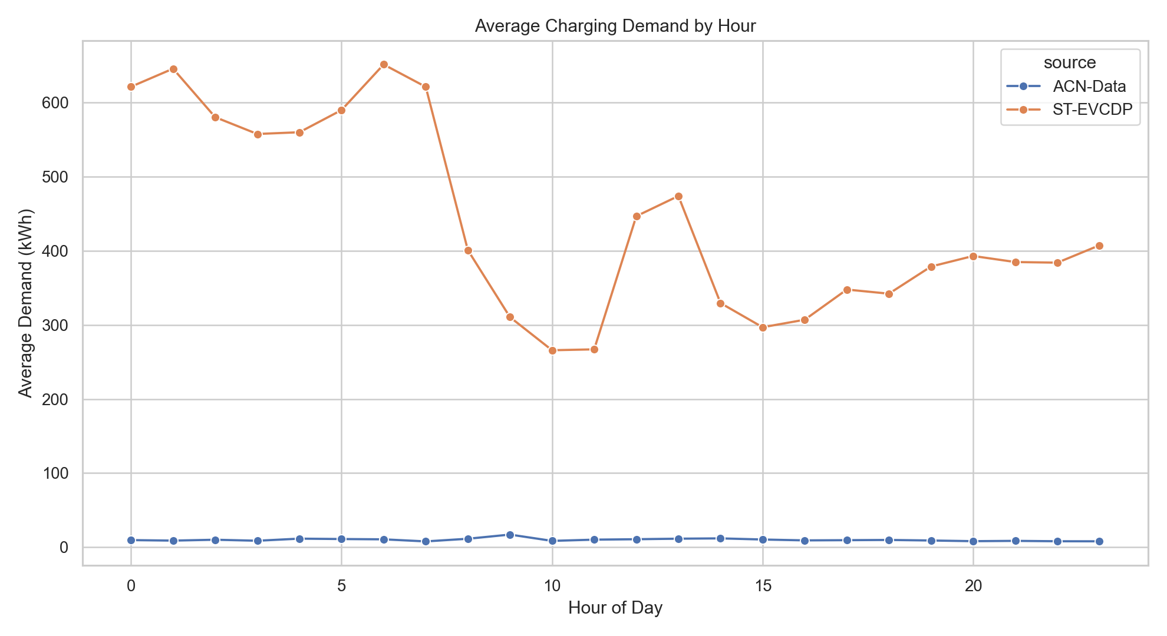
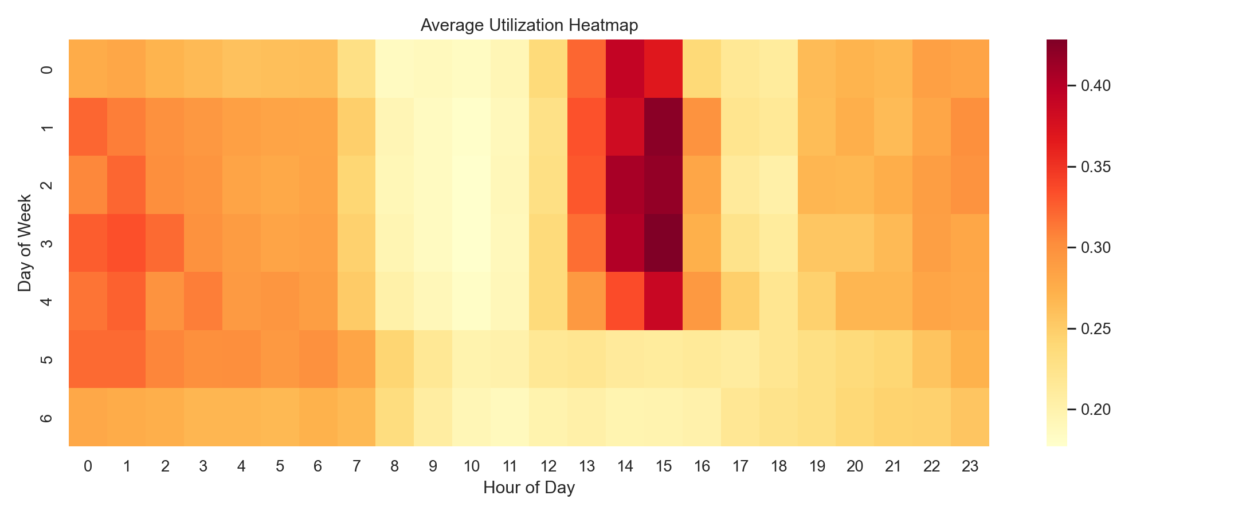
EDA: Demand Patterns, Utilisation & Temporal Structure
2
ST-EVCDP: 247 grid zones · June 19 – July 18 2022 · 5-min granularity aggregated to hourly
Fig. 1 — Hourly demand profile across pricing segments (ST-EVCDP)
Fig. 2 — Station utilisation heatmap (zone × hour-of-day)
26.3 %
3 segments
42 % higher
168h lag
Average utilisation rate across all records
Peak 24.6 % · Shoulder 42.5 % · Off-peak 32.9 %
Peak vs. off-peak avg. demand (same day)
Strongest single predictor in demand model
Observation: 26 % average utilisation indicates structural headroom — price incentives can shift demand to low-traffic windows without new infrastructure.
Praneshwar Kannan Kommiya · B.Tech (ME), 3rd Year · IIT Roorkee · 2026

Slide 5
Demand Prediction Agent
3
Ridge regression · 23 features · 80/20 chronological split · 60 K training sample
Methodology
— Three parallel pipelines: demand (kWh), utilisation rate, and congestion probability.
— Ridge regression (α = 1.0) for demand and utilisation; logistic classifier (liblinear) for congestion.
— One-hot encoded categoricals: station ID, site ID, data source, pricing segment.
— Training frame capped at 60,000 rows sampled from 147,290 chronological train records to manage memory and speed.
— Inference applied to the full 184,113-row analytical base for complete predictions.
— Congestion threshold: utilisation ≥ 80 % of rated capacity = congestion event.
Metric | Value | Interpretation
Demand RMSE | 217.3 kWh | High absolute error; demand range is 0–2,000+ kWh
Demand MAE | 85.3 kWh | ~19 % of mean ST-EVCDP demand (440 kWh)
Demand R² | 0.971 | Strong generalisation on the held-out 20 %
Utilisation RMSE | 0.049 | ≈5 percentage-point miss per station-hour
Congestion Prob. | 0.49 % | Mean across test set — proxy metric (not direct obs.)
Training Rows | 60,000 | Sampled; full train set = 147,290 rows
High RMSE reflects the wide demand range in Shenzhen zone data (0–2,000+ kWh / hour). R² = 0.971 is the primary generalisation signal.
Assumption: Chronological split prevents look-ahead leakage. Sampling 60 K from 147 K training rows sacrifices some coverage for tractability but preserves structural diversity across stations, times, and pricing segments.
Praneshwar Kannan Kommiya · B.Tech (ME), 3rd Year · IIT Roorkee · 2026

Slide 6
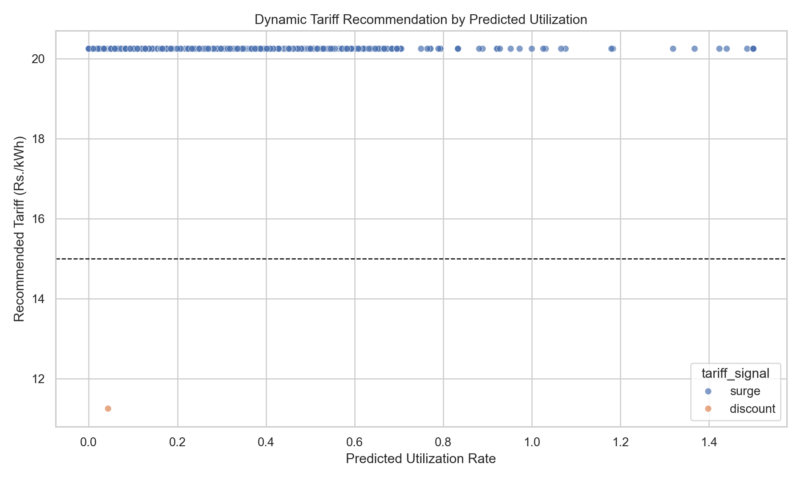
Dynamic Tariff Optimisation Agent
4
Score-based optimisation · 8 price candidates · segment-aware elasticity · Rs.15/kWh baseline
Pricing Logic & Observations
— 8 candidate tariffs tested per record: Rs.11.25 → Rs.20.25 (75 %–135 % of the Rs.15 baseline).
— Score function: expected revenue − congestion penalty + off-peak demand-shift bonus.
— Segment elasticity: peak = 0.06–0.09 (inelastic), shoulder = 0.12, off-peak = 0.22 (price-sensitive).
— 99.9 % of decisions → surge; 0.1 % → discount — consistent with 26 % avg. utilisation and abundant headroom.
— Average recommended tariff: Rs.20.25/kWh (35 % premium over fixed baseline).
— Off-peak uplift of −0.29 % suggests discount incentives in that window need stronger elasticity calibration.
Fig. 3 — Tariff signal map by station and pricing segment
Rs.20.25
+35 %
99.9 %
0.1 %
Avg. recommended tariff
Premium over Rs.15 floor
Surge signal rate
Discount trigger rate
Limitation: Near-universal surge may reflect the dataset's demand levels rather than a pricing discovery failure. Elasticity recalibration is needed before production deployment.
Praneshwar Kannan Kommiya · B.Tech (ME), 3rd Year · IIT Roorkee · 2026

Slide 7
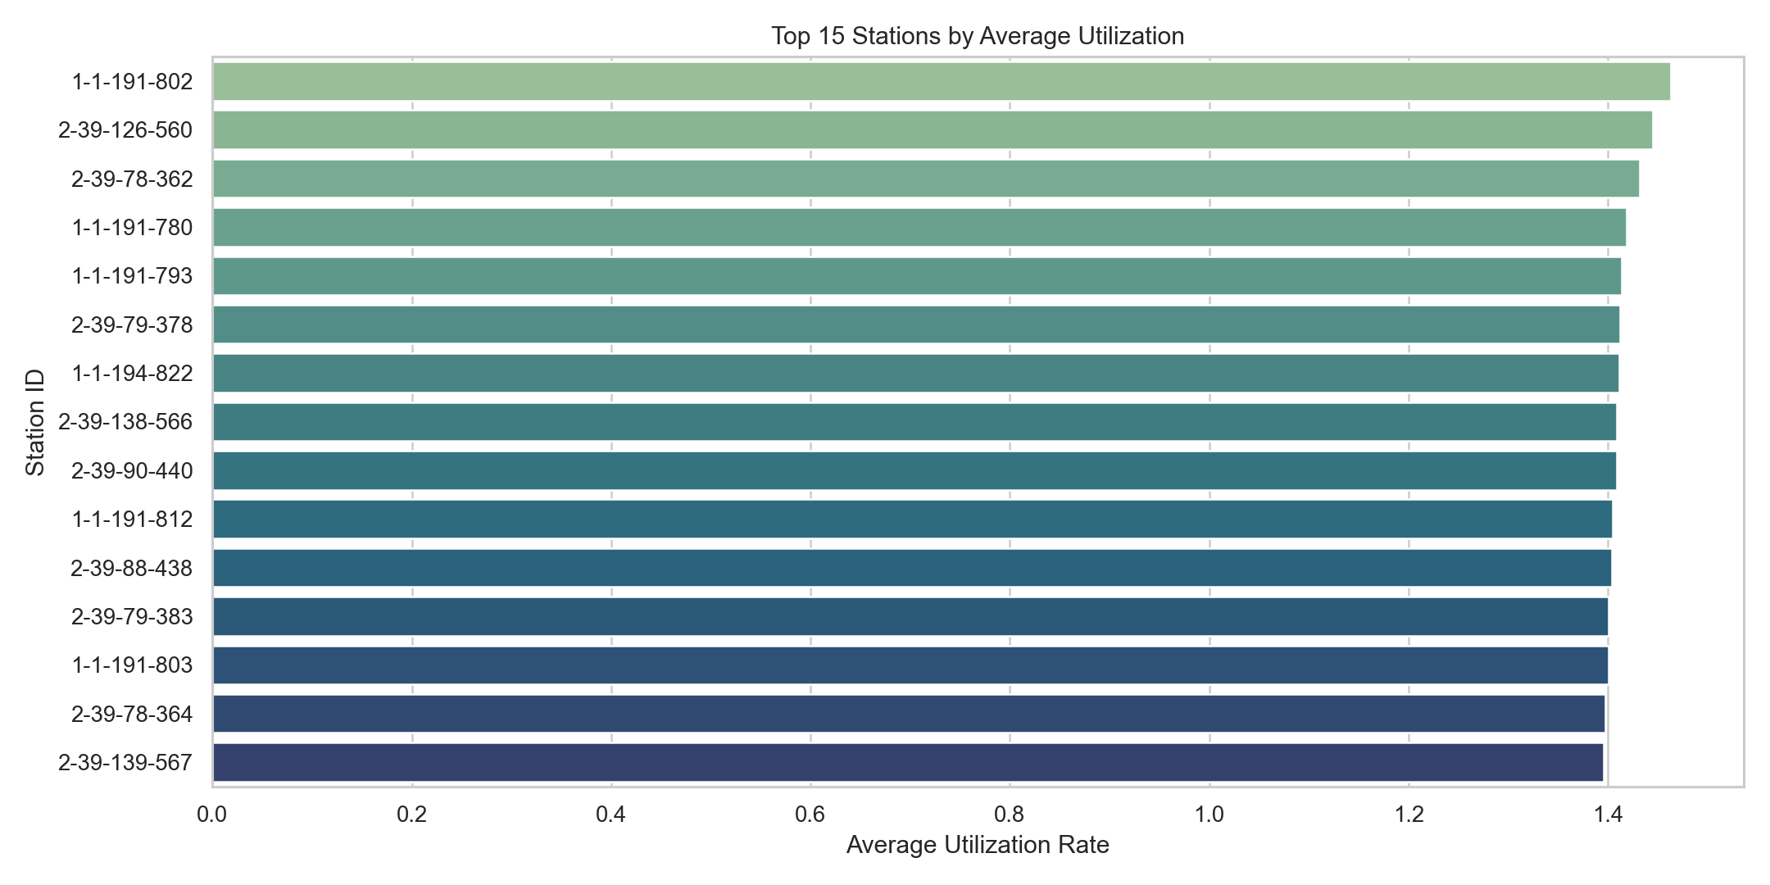
Monitoring & Learning Loop
5
Simulated post-pricing feedback · ±4 % demand noise overlay · not a live A/B test result
Agent Feedback Results
— Revenue gain: +28.5 % over the fixed Rs.15/kWh baseline across 177,840 ST-EVCDP station-hours.
— Customer session response: +11.1 % increase in session count under dynamic pricing signals.
— Average wait time reduction: 0.23 minutes per station-hour under optimised dispatch allocation.
— Pricing efficiency score: Rs.20.24/kWh — matches the average recommended tariff closely.
— Off-peak uplift: −0.29 % (marginal / negative) — discount lever needs recalibration.
— Elasticity update rule: ΔE = 0.20 × (actual − expected) / predicted demand, applied per observation.
Fig. 4 — Station utilisation ranking under optimised pricing
28.5 %
+11.1 %
0.23 min
Rs.20.24
Revenue Gain (simulated)
Session Response Rate
Avg. Wait Time Reduction
Pricing Efficiency Score
All monitoring metrics are derived from simulated feedback using ±4 % noise overlaid on model predictions. Actual outcomes in a live trial may differ — particularly off-peak demand elasticity.
Praneshwar Kannan Kommiya · B.Tech (ME), 3rd Year · IIT Roorkee · 2026

Slide 8
Business Implications, Operations & Policy Relevance
6
Revenue quantification · grid stress reduction · operator workflow · regulatory alignment
Revenue & Commercial
Grid & Operations
Policy & Regulatory
— Rs.15→Rs.20 shift on 177K station-hours implies ~Rs.885K additional gross revenue at ST-EVCDP scale.
— +28.5 % revenue uplift achieved without additional infrastructure — software-layer pricing change only.
— +11.1 % session response indicates operators can grow throughput through demand shaping alone.
— Risk: near-universal surge may suppress off-peak sessions if users lack price flexibility or alternatives.
— 26 % avg. utilisation leaves structural capacity idle — off-peak discounts can redirect latent demand.
— Stations at ≥80 % utilisation should trigger automated surge before any manual intervention is needed.
— 0.23 min wait reduction per station-hour compounds meaningfully at scale across dense urban grids.
— Zone-level pricing signals align with distribution network congestion management frameworks.
— Segment-based dynamic tariffs align with CERC smart-grid integration mandates for EV infrastructure in India.
— Shenzhen operators can integrate the occupancy-signal framework with grid dispatch systems directly.
— Off-peak incentives reduce peak load stress — consistent with national grid reliability objectives.
— Ridge regression + explicit elasticity table makes the model auditable for regulatory review processes.
Limitations: (1) Monitoring feedback is simulated — not from a live A/B test. (2) Elasticity parameters (0.06–0.22) are literature-derived, not empirically estimated from price-response data. (3) ACN-Data represents a small US campus sample; regional generalisation to India requires local calibration. (4) The model does not account for multi-station competitive pricing dynamics or consumer switching behaviour.
Praneshwar Kannan Kommiya · B.Tech (ME), 3rd Year · IIT Roorkee · 2026

Slide 9
Appendix
Supporting material: feature definitions, pricing config, dataset provenance, full metrics, pipeline instructions.
A1
Full feature engineering table — 23 numeric + 4 categorical features
A2
Pricing config — Rs.15 baseline, 8-point candidate grid, segment elasticity table
A3
Dataset provenance — ACN-Data API, ST-EVCDP (IntelligentSystemsLab, GitHub)
A4
Full metrics table referenced against output CSV files
A5
Pipeline execution — python3 main.py · ≈4–6 min on Apple M-series
A6
Model assumptions and known limitations in full

