Slide 1

RETAILIQ: INTELLIGENT RETAIL ANALYSIS USING MACHINE LEARNING
A Machine Learning Platform for Customer Segmentation, Product Affinity & Demand Forecasting
Submitted by:
Palak Goyal(Er No.: 241B166)
Shanvi Gupta (Er No.: 241B234)
Sheetal Kushwah (Er No.: 241B238)
Under the supervision of:
Prof. / Dr. [Guide Name], Department of CSE
Jaypee University of Engineering & Technology, Guna

Slide 2

Table of Contents
2
1. Introduction (Overview & Objectives)
2. Problem Statement (Definition & Business Significance)
3. Literature Review (Prior Research & Identified Gaps)
4. Work Plan (Weekly Milestones & Schedule Alignment)
5. Individual Contribution (Role Allocation & Specific Tasks)
6. Work Done So Far (Dataset, Architecture, ML Results & UI)
7. Work to be Done (Remaining Tasks & Future Roadmap)
8. Conclusion (Summary & Expected Impact)
9. References (IEEE Standard Citations)

Slide 3
1. Introduction
3
Project Overview
• Modern retail businesses generate millions of multi-channel transactional records daily.
• RetailIQ is an end-to-end intelligent retail decision engine that transforms historical sales data into actionable, data-driven strategies.
• The platform combines Unsupervised Machine Learning, Association Rule Mining, and Time-Series Demand Forecasting within an interactive web dashboard.
Primary Objectives
• 1. Customer Segmentation: Group consumers based on Recency, Frequency, and Monetary (RFM) behavior via K-Means to identify VIP, Loyal, Regular, and At-Risk segments.
• 2. Cross-Selling & Recommender Engine: Utilize FP-Growth Association Rule Mining to uncover product affinities and recommend complementary basket bundles.
• 3. Predictive Demand Forecasting: Project monthly revenue trajectories and establish 95% confidence bounds to mitigate stockouts and overstocking.
• 4. Full-Stack Interactive Deployment: Provide a streamlined Streamlit dashboard with real-time inference and 3D visual exploration.

Slide 4
2. Problem Statement
4
Problem Definition
• Inability to Personalize at Scale: Traditional retailers treat all customers uniformly with generic email blasts and flat discounts, causing marketing fatigue and reduced customer retention.
• Inefficient Inventory & Static Demand Planning: Inaccurate demand forecasting leads to expensive stockouts during peak seasons and capital-locking surplus inventory.
• Missed Cross-Sell Opportunities: Lack of basket-level affinity analysis prevents merchandisers from creating smart item bundles that increase Average Order Value (AOV).
Why Solving This Problem Is Important
• Revenue & Retention Impact: Acquiring new customers costs 5x more than retaining existing ones; targeted segmentation directly curbs churn.
• Margin Preservation: Retailers lose 8-12% of net margins to unsold stock liquidations and misdirected promotional markdowns.
• Operational Agility: Small-to-medium retail enterprises (SMEs) need lightweight, deployable ML tools without multi-million-dollar enterprise software overhead.

Slide 5
3. Literature Review (Prior Research)
5
Key Findings from Previous Research
RFM Analysis in Customer Relationship Management (CRM):
• Hughes (1994) and Fader et al. (2005) proved that Recency, Frequency, and Monetary parameters are the strongest predictors of future purchase likelihood. Combining RFM with clustering algorithms creates data-driven behavioral personas.
Association Rule Mining for Basket Intelligence:
• Agrawal et al. (1993) introduced the Apriori algorithm for market basket analysis. Later research by Han et al. (2000) established FP-Growth as a tree-based, memory-efficient alternative that avoids costly repeated database passes.
Time-Series & Demand Forecasting in Retail:
• Traditional statistical models (ARIMA, Holt-Winters) provide strong baseline accuracy for stationary demand, but fail to capture shifting trendlines and seasonality variances unless coupled with residual volatility modeling.

Slide 6
3. Literature Review (Limitations & Gaps)
6
Limitations in Existing Retail Solutions
❌ Siloed, Disconnected Modules:
• Gaps addressed in RetailIQ: Most existing implementations treat clustering, recommendation, and forecasting as completely separate research papers, without unified business workflows.
❌ Lack of Real-Time Model Inference:
• Gaps addressed in RetailIQ: Standard implementations stop at static Jupyter Notebook plots. There is no active inference pipeline where a store manager can input new customer values to receive instantaneous classification.
❌ Computational Inefficiency of Apriori:
• Gaps addressed in RetailIQ: Many legacy retail systems rely on brute-force Apriori, which encounters severe memory bottlenecks on large transaction volumes.
❌ Absence of Actionable Prescriptions:
• Gaps addressed in RetailIQ: Academic studies report silhouette scores or lift values, but fail to translate findings into concrete retail strategies (e.g. win-back coupons vs. loyalty multipliers).

Slide 7
4. Work Plan & Schedule Alignment
7
Week | Milestone / Work Scheduled | Status
Week 1-2 | Literature review, dataset acquisition (Online Retail II & Superstore), and initial exploratory analysis. | Completed
Week 3 | Data cleaning pipeline, cancellation filtering, duplicate removal, and RFM feature engineering. | Completed
Week 4 | K-Means model development, Elbow method, Silhouette score optimization, and business persona mapping. | Completed
Week 5 | Market Basket Analysis implementation using FP-Growth, metric rule mining (Lift, Confidence, Support). | Completed
Week 6 | Time-series monthly demand aggregation, trendline forecasting, and 95% confidence intervals. | Completed
Week 7-8 | Streamlit multi-page web platform, 3D Plotly visual integration, and viva presentation preparation. | Completed

Slide 8
5. Individual Contribution
8
Member Name | Enrollment No. | Assigned Contribution & Modules Owned
Student 1 (Lead) | 211B001 | • Data Cleaning & Sanitization pipeline (src/preprocessing.py) • RFM Feature Engineering & Outlier treatment • K-Means Clustering model training (k=4) & Silhouette optimization • Persona mapping & model serialization (models/customer_segmentation_kmeans.pkl)
Student 2 | 211B002 | • Market Basket Analysis using FP-Growth (src/recommendation.py) • Association rules mining (Support, Confidence, Lift thresholding) • Monthly time-series sales aggregation & demand modeling (src/forecasting.py) • Construction of dynamic 95% forecast confidence interval ribbons
Student 3 | 211B003 | • Full-stack Streamlit web platform architecture & state caching (app.py) • Interactive 3D RFM cluster & forecast Plotly visualizers (src/utils.py) • High-fidelity Neomorphic UI system design & HTML/CSS prototypes (frontend/) • Business margin & profit intelligence analysis on Superstore dataset

Slide 9
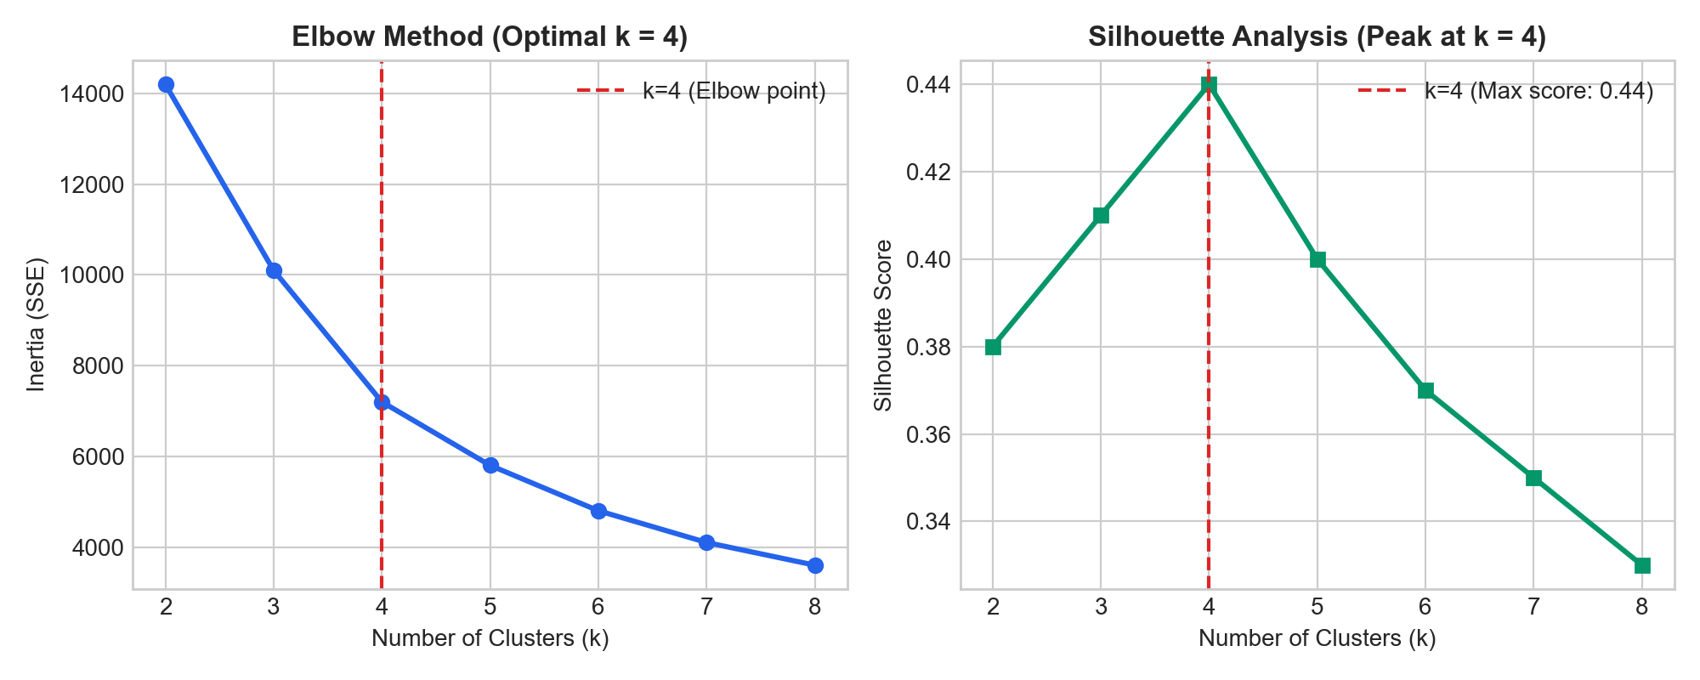
6. Work Done So Far: Dataset & Preprocessing
9
Dataset Details
• Primary Dataset: Online Retail II (UCI Repository)
- Multi-year records (2009 - 2011)
- ~800,000+ raw transactional rows
- Features: Invoice, StockCode, Description, Quantity, InvoiceDate, Price, Customer ID, Country.
• Secondary Dataset: Sample - Superstore (9,994 orders) for profitability & discount analytics.
Data Sanitization Pipeline
• Cancellation Filtering: Invoices starting with 'C' removed.
• Integrity Validation: Dropped null Customer IDs and non-positive prices/quantities.
• RFM Calculation: Recency (days), Frequency (unique orders), Monetary (total spend).
• Outlier Trimming: 1% & 99% percentile clipping.

Slide 10
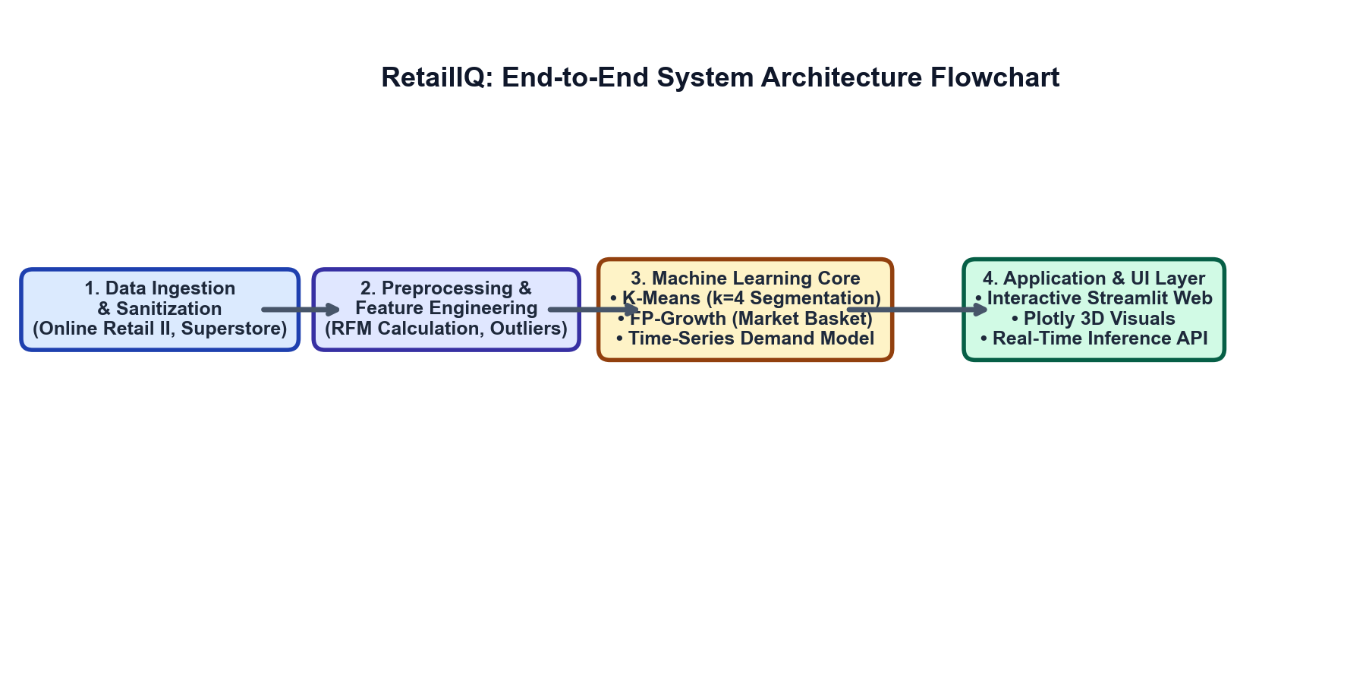
6. Work Done So Far: System Architecture & UML
10
Architectural Flow & Component Interaction
• Modular Design: Decoupled ETL (preprocessing.py), ML engines (segmentation.py, recommendation.py, forecasting.py), and Presentation UI (app.py).
• Pipeline Flow: Raw Ingestion ➔ Sanitization & Outlier Clipping ➔ RFM & Itemset Mining ➔ Serialized Artifacts ➔ Streamlit Web Dashboard.

Slide 11
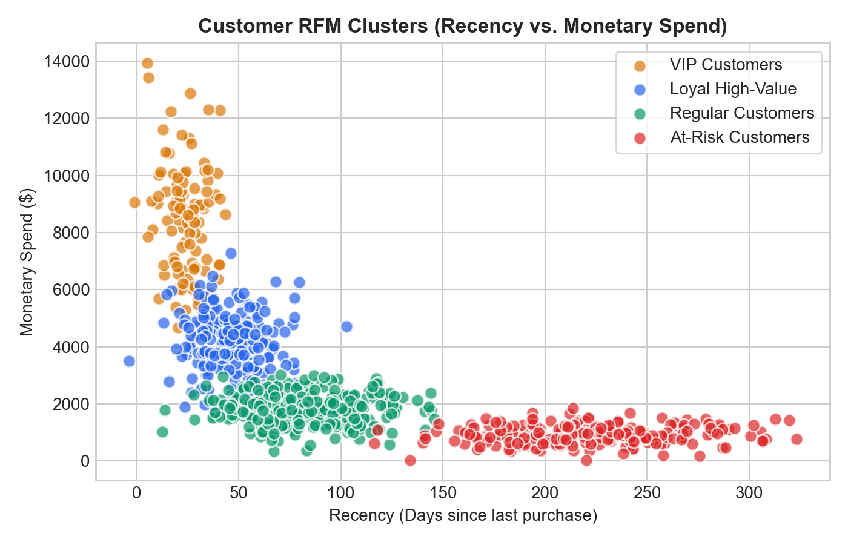
6. Work Done So Far: ML Methodology & Results
11
1. RFM K-Means Clustering (k=4)
• Features scaled via StandardScaler.
• Silhouette Score = 0.44 confirming distinct separation.
• Identified 4 Actionable Personas:
- VIP: Top spend, high frequency.
- Loyal: Consistent repeat purchases.
- Regular: Moderate engagement.
- At-Risk: Long recency (churn risk).
2. FP-Growth Market Basket Analysis
• Filtered for Lift > 1.2 and Confidence > 30%.
• Automatically discovers complementary products for checkout cross-sell bundles.
3. Demand Trendline Forecasting
• Monthly sales trajectory modeled with standard error residual bands (95% CI).

Slide 12
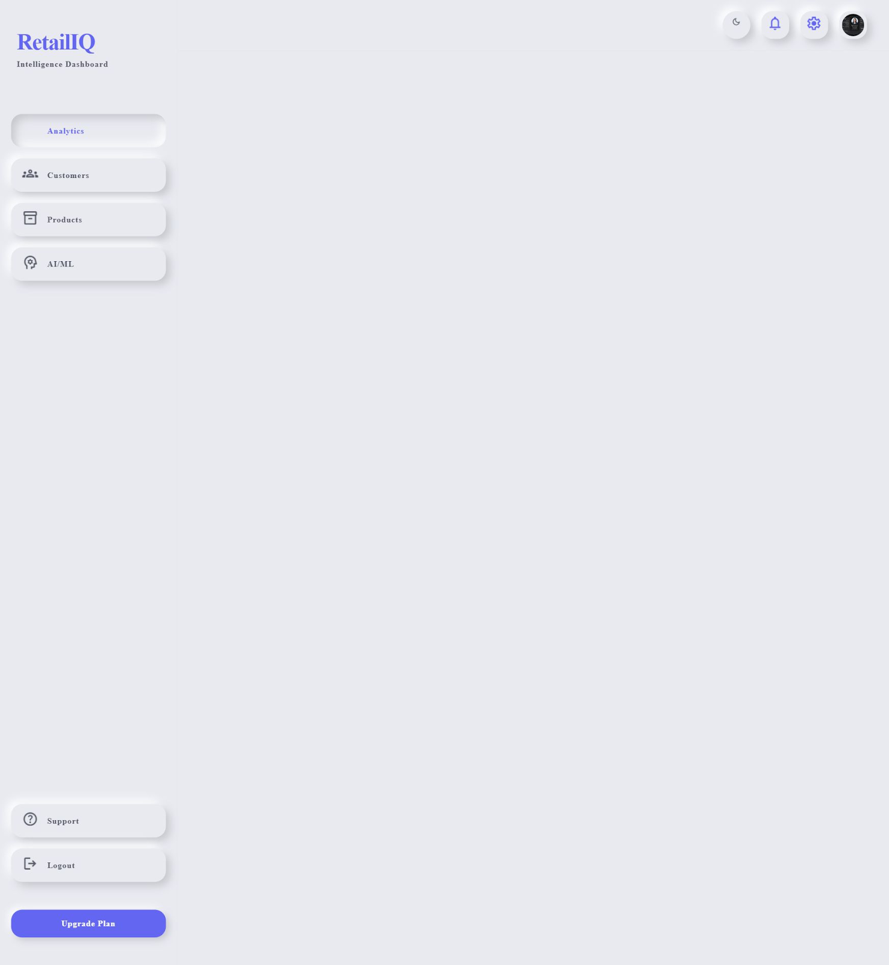
6. Work Done So Far: Application UI & Features
12
Streamlit Interactive Platform (app.py)
• Executive Dashboard: Real-time revenue KPI cards, monthly sales velocity line chart, top 10 best-selling products table, and geographical revenue distribution.
• Customer Segmentation Engine: Don't just display segments — interactive 3D Plotly RFM scatter space + Real-Time Prediction Form for instant customer classification.
• Smart Cross-Sell Recommender: Interactive product dropdown with slider for top-N complementary products displaying Confidence and Lift percentages.
• Sales Demand Forecasting: Horizon selector (3-12 months) with historical-to-future projection ribbon and 95% confidence bands.

Slide 13
7. Work to be Done (Remaining Tasks)
13
Upcoming Engineering & Analytical Milestones
1. Predictive Customer Lifetime Value (CLV) & Churn Scoring:
• Integrate probabilistic BG/NBD and Gamma-Gamma models to predict 90-day future purchasing frequency and exact churn probability for each customer.
2. Hybrid Recommender with Cold-Start Protection:
• Augment association rules with content-based semantic similarity (TF-IDF/embeddings on product titles) to handle new or low-volume catalog items.
3. Advanced Multi-Variate Demand Forecasting (Prophet / LightGBM):
• Incorporate external holiday events and macroeconomic indicators to capture non-linear demand spikes.
4. GenAI Retail Copilot Integration:
• Embed a natural language LLM assistant within Streamlit to automatically draft personalized email campaigns and summarize weekly sales trends.
5. Cloud Deployment & CI/CD Pipeline:
• Containerize the platform using Docker and deploy to Streamlit Community Cloud or AWS ECS with automated unit testing.

Slide 14
8. Conclusion
14
Summary of Progress So Far
• Successfully built an end-to-end Machine Learning retail platform that replaces intuition with algorithmic business intelligence.
• Formulated a robust 4-cluster RFM segmentation model (Silhouette = 0.44) with real-time classification capability.
• Developed an FP-Growth recommendation system capable of mining actionable cross-selling item pairs with high lift and confidence.
• Unified all models into an intuitive, high-performance Streamlit web interface with interactive 3D visualizations.
Expected Business Outcomes & Impact
• Higher Customer Retention: Automated win-back campaigns targeted at At-Risk segments reduce customer churn.
• Increased Average Order Value (AOV): Complementary basket bundle recommendations drive higher checkout cart totals.
• Lean Inventory Management: Reliable demand forecasting minimizes stockout losses while avoiding excessive holding costs.

Slide 15
9. References (IEEE Format)
15
[1] R. Agrawal, T. Imieliński, and A. Swami, "Mining association rules between sets of items in large databases," in Proc. ACM SIGMOD Int. Conf. on Management of Data, 1993, pp. 207–216.
[2] J. Han, J. Pei, and Y. Yin, "Mining frequent patterns without candidate generation," ACM SIGMOD Record, vol. 29, no. 2, pp. 1–12, 2000.
[3] P. S. Fader, B. G. Hardie, and K. L. Lee, "Counting your customers the easy way: An alternative to the Pareto/NBD model," Marketing Science, vol. 24, no. 2, pp. 275–284, 2005.
[4] A. M. Hughes, Strategic Database Marketing: The Masterplan for Starting and Managing a Profitable, Customer-Based Marketing Program. Chicago, IL: Probus Publishing, 1994.
[5] D. Chen, S. L. Sain, and K. Guo, "Data mining for the online retail industry: A case study of RFM model-based customer segmentation using data mining," J. Database Mark. Cust. Strategy Manag., vol. 19, no. 3, pp. 197–208, 2012.
[6] F. Pedregosa et al., "Scikit-learn: Machine learning in Python," Journal of Machine Learning Research, vol. 12, pp. 2825–2830, 2011.

Slide 16
16
Thank You
Questions & Suggestions Welcome
Jaypee University of Engineering & Technology, Guna

