Slide 1

EDA for IPL Series Data
Submitted By:
Palak Bohra

Slide 2
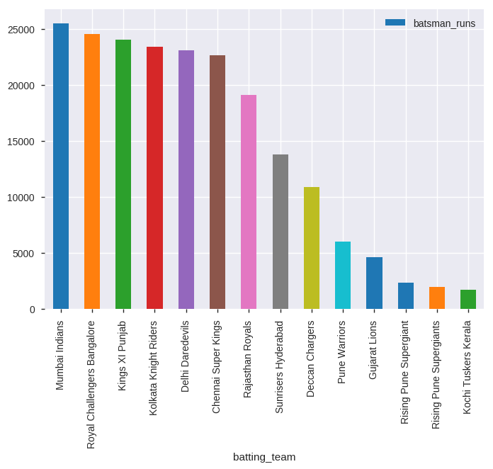
Which team secured most runs in IPL series?
Mumbai Indians secured most runs over IPL series from 2008 to 2018.

Slide 3
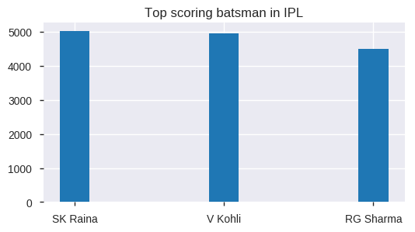
Who were the top three run scoring batsman in IPL?
Overall, SK Raina scored most runs in IPL series.

Slide 4
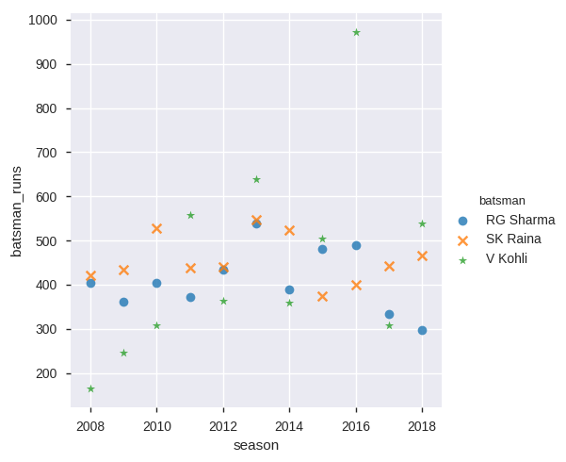
How did the top three batsmen performed over different seasons ?
Virat Kohli performed quite well in 2016.

Slide 5
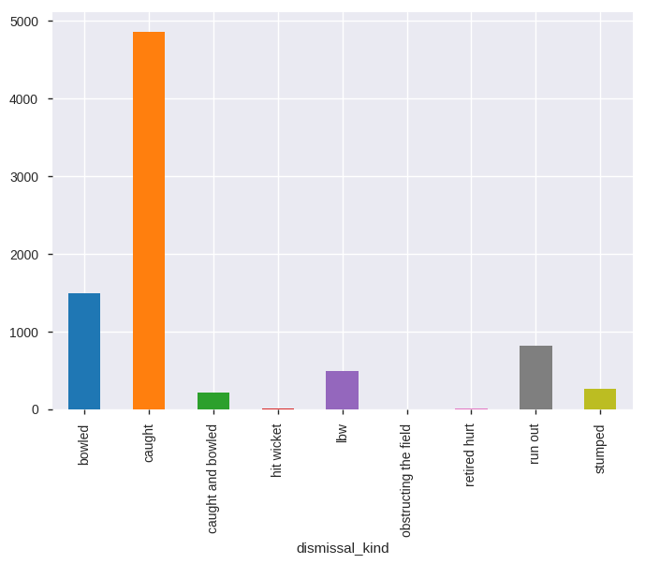
What are the most ways in which players got dismissed ?
Most of the players were dismissed by getting caught.

Slide 6
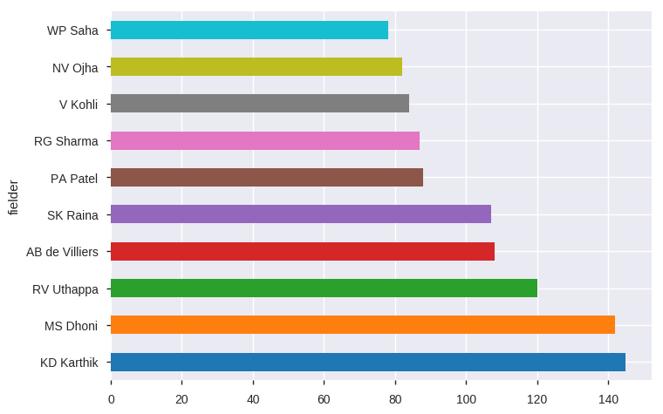
Which fielder dismissed the players most ?
KD Karthik dismissed the players most.

Slide 7
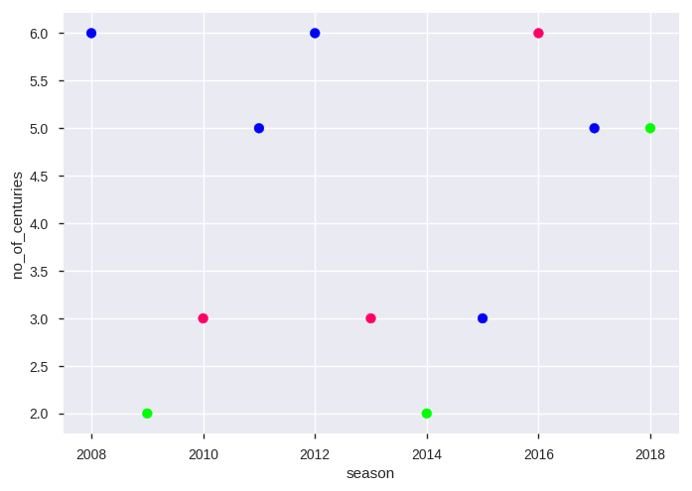
Number of centuries scored in every season
2008, 2012 and 2016 saw most number of centuries i.e. 6.

Slide 8
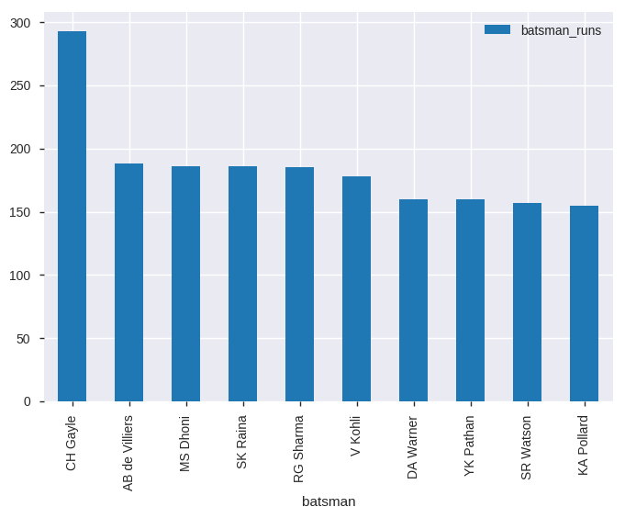
Which players hit most sixes ?
Chris Gayle hit most sixes in IPL series.

Slide 9
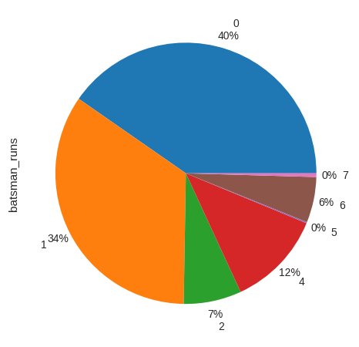
How many runs are more likely to occur over no ball?
40% of the players were not able to score any runs on no ball.

Slide 10
Number of centuries scored in every season
2008, 2012 and 2016 saw most number of centuries i.e. 6.

