Slide 1

EDA for IPL Series Data
Submitted By:
Palak Bohra

Slide 2
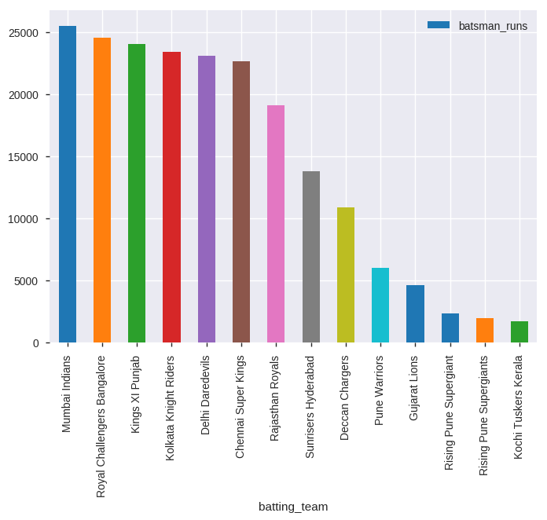
Which team scored most runs in IPL series?
Mumbai Indians secured most runs over IPL series from 2008 to 2018.

Slide 3
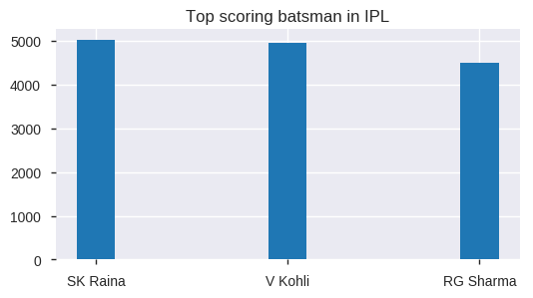
Who were the top three run scoring batsman in IPL?
Overall, SK Raina scored most runs in IPL series.

Slide 4
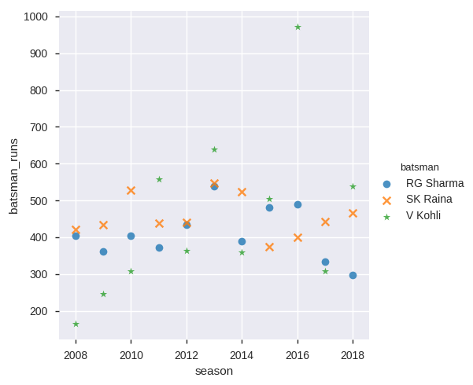
How did the top three batsmen performed over different seasons ?
Virat Kohli performed quite well in 2016.

Slide 5
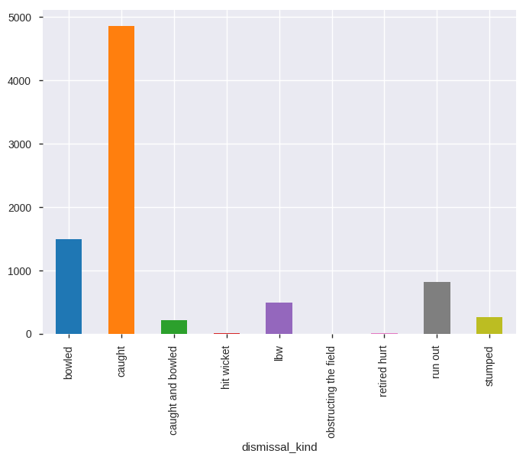
What are the most ways in which players got dismissed ?
Most of the players were dismissed by getting caught.

Slide 6
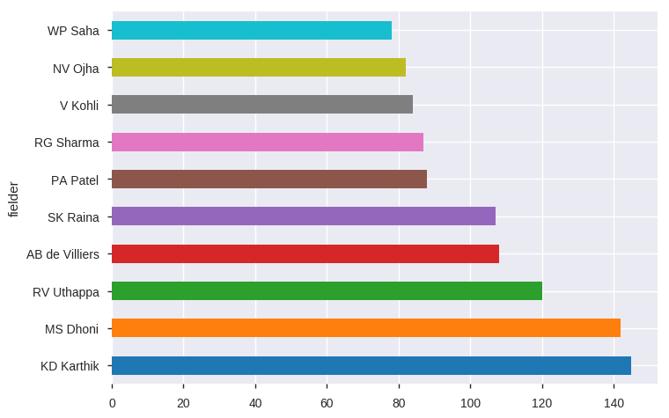
Which fielder dismissed the players most ?
KD Karthik dismissed the players most.

Slide 7
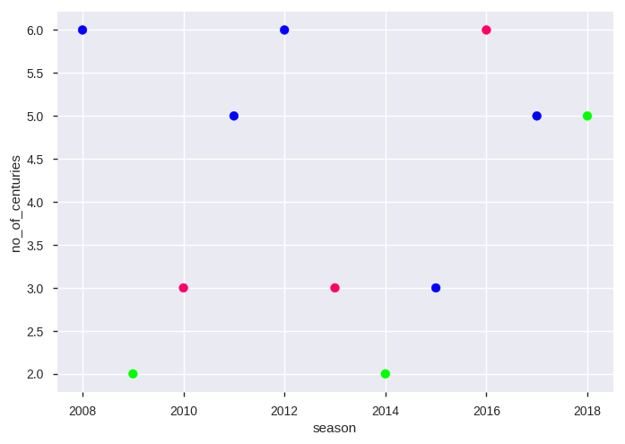
Number of centuries scored in every season
2008, 2012 and 2016 saw most number of centuries i.e. 6.

Slide 8
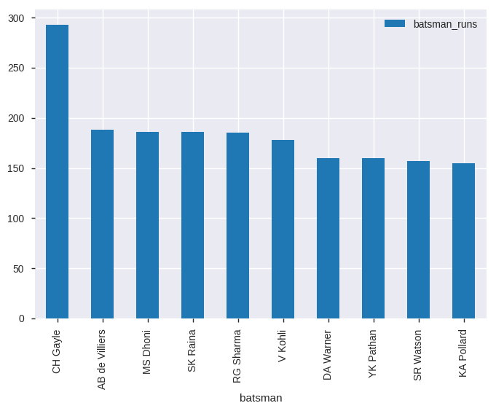
Which players hit most sixes ?
Chris Gayle hit most sixes in IPL series.

Slide 9
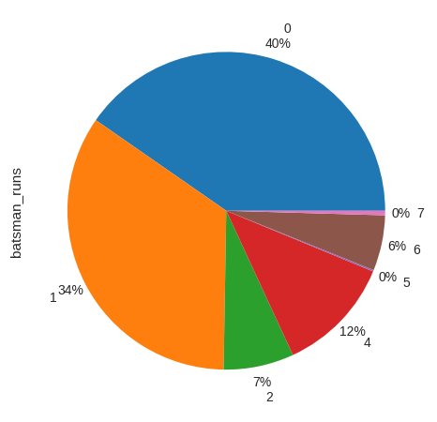
How many runs are more likely to occur over no ball?
40% of the players were not able to score any runs on no ball.

