Slide 1
DevOps Lifecycle

Slide 2
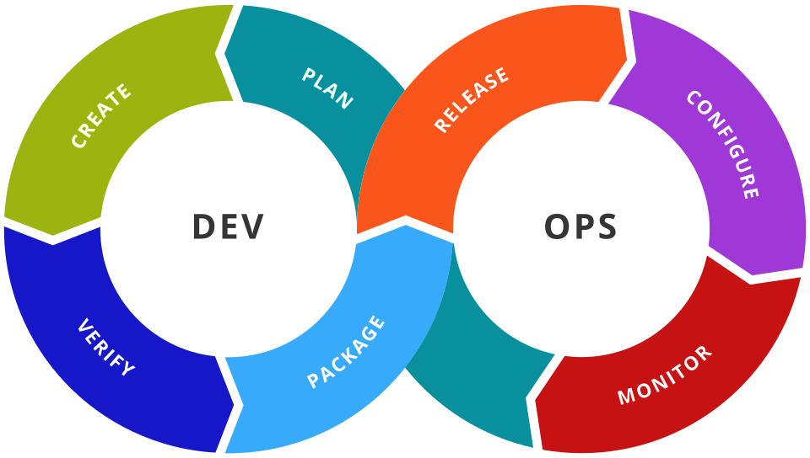
PLANNING
Planning is the first stage where project goals, requirements, and tasks are defined before development begins.

Slide 3
TRELLO
AZURE BOARDS
JIRA
PLANNING TOOLS

Slide 4

JIRA
Jira is an Issue Tracking and Agile Project Management tool.
Developed by Atlassian in 2002.
Used to plan, organize, assign and track project work.
Supports Scrum and Kanban methodologies.
Widely used in software development teams.

Slide 5
FEATURES
Issue & bug tracking
Scrum and Kanban boards
Sprint & backlog management
Customizable workflows
Dashboards and reports
Integration with GitHub, Bitbucket, Jenkins, etc.

Slide 6
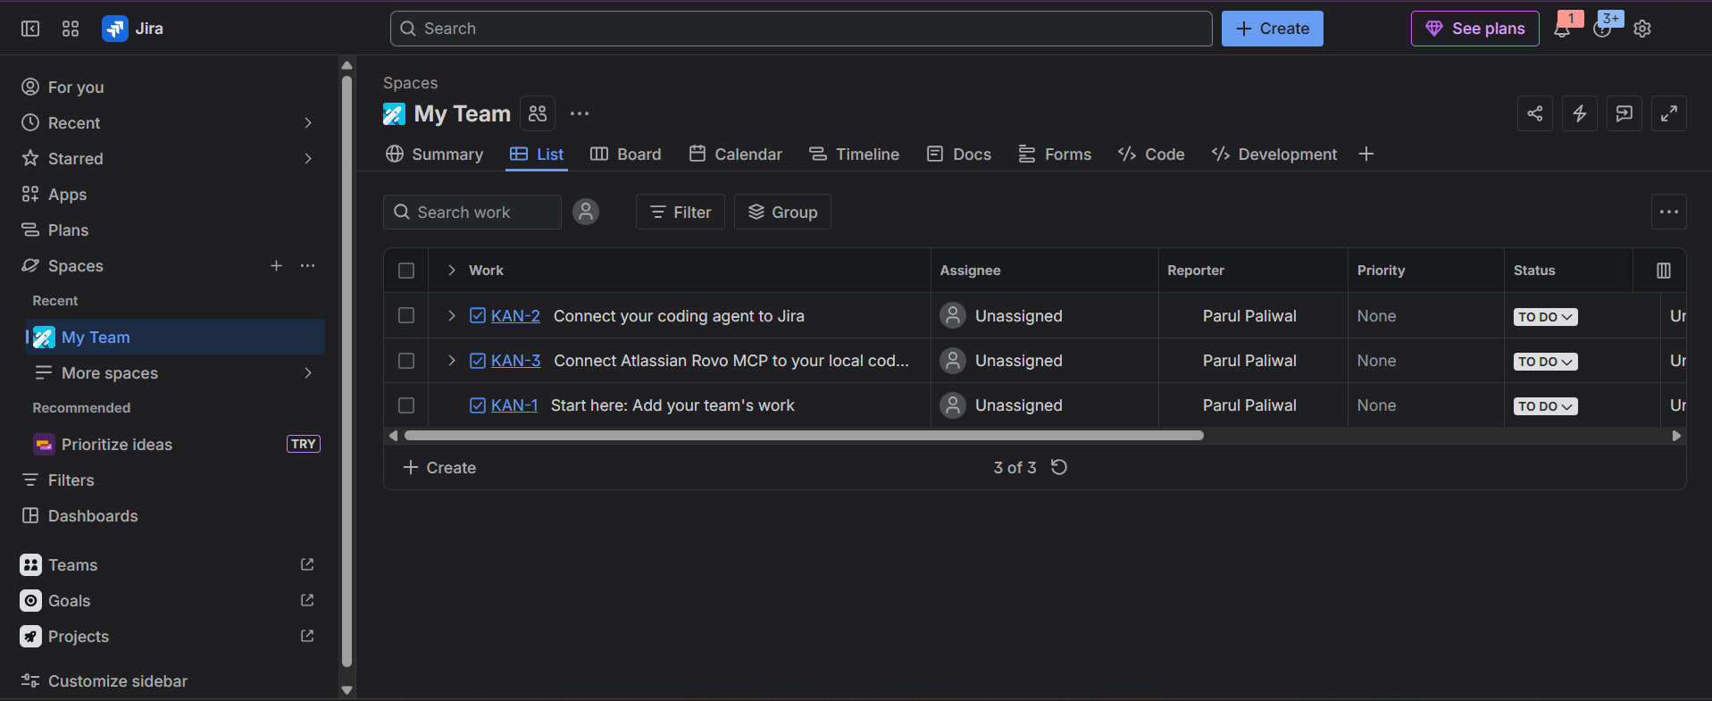
JIRA INTERFACE

Slide 7
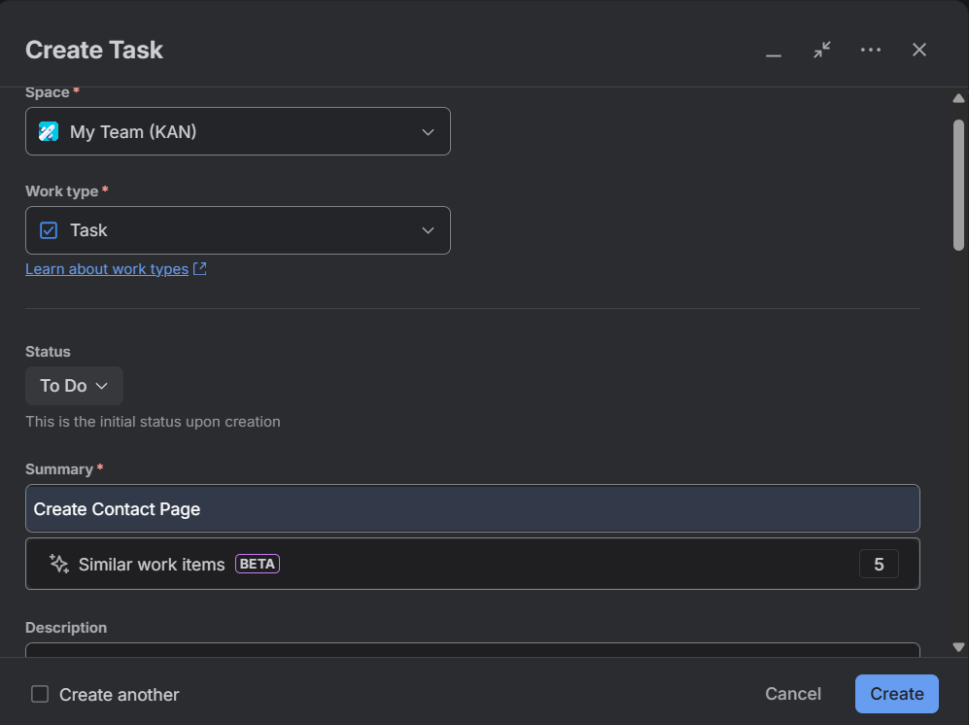
Create Task

Slide 8
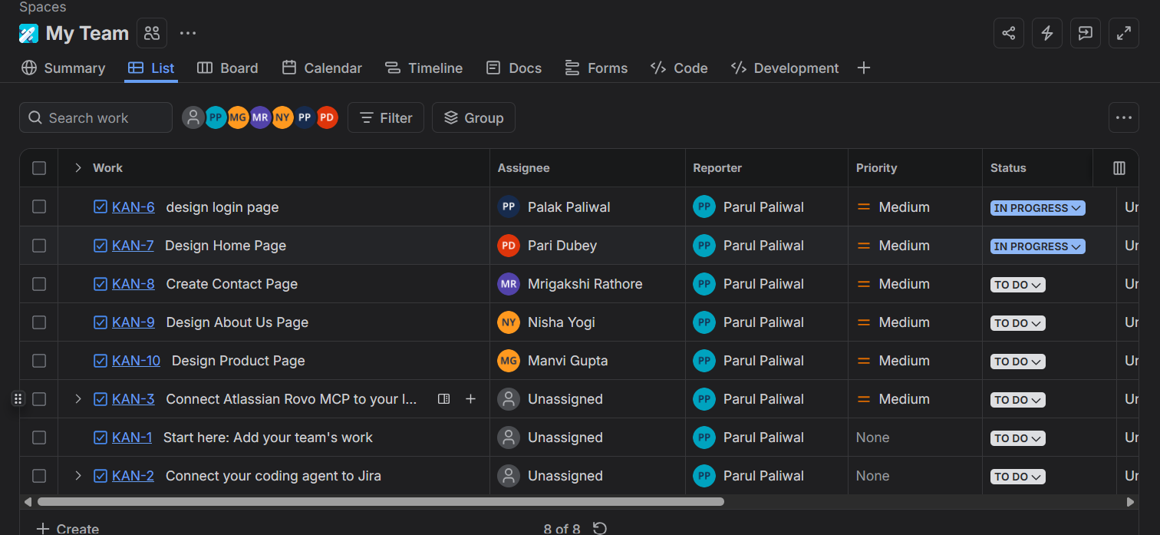
Task Management

Slide 9
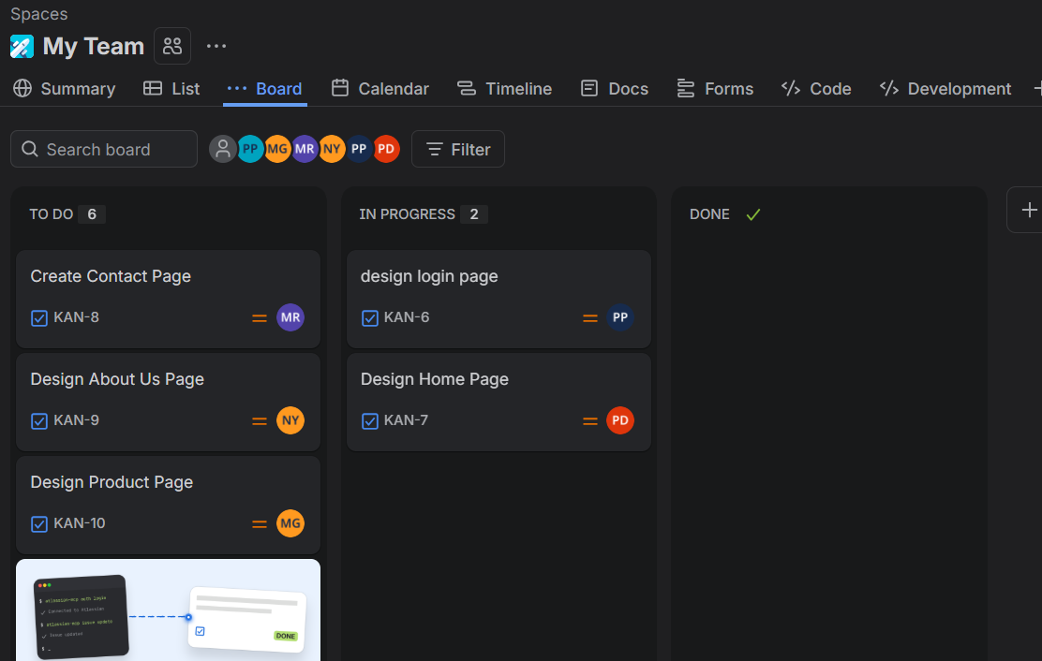
Jira Workflow
Kanban Board View
✔ To Do
Task is yet to start.
⬇
🟡 In Progress
Task is under
development.
⬇
✅ Done
Task is completed.

Slide 10

Trello
Trello is a free, web-based project management and productivity tool that helps individuals and teams organize tasks visually using boards, lists, and cards.

Slide 11
Trello Features
Boards, Lists & Cards
Drag-and-drop interface
Due dates & Checklists
Labels & Attachments
Comments & Collaboration
Calendar (Planner) view
Integrations with Slack, Email & Google Calendar

Slide 12
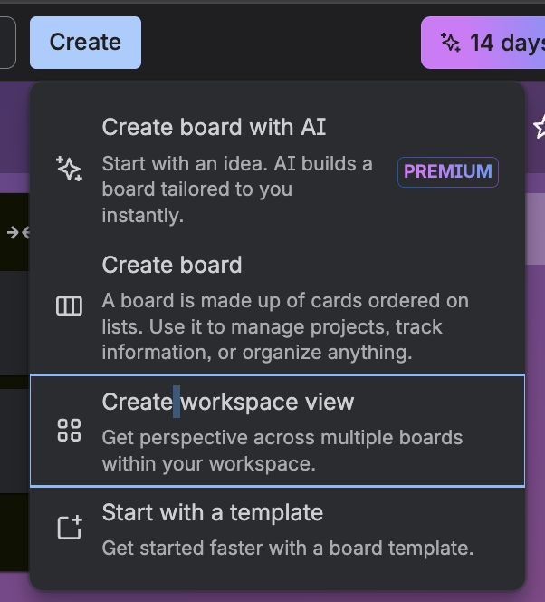
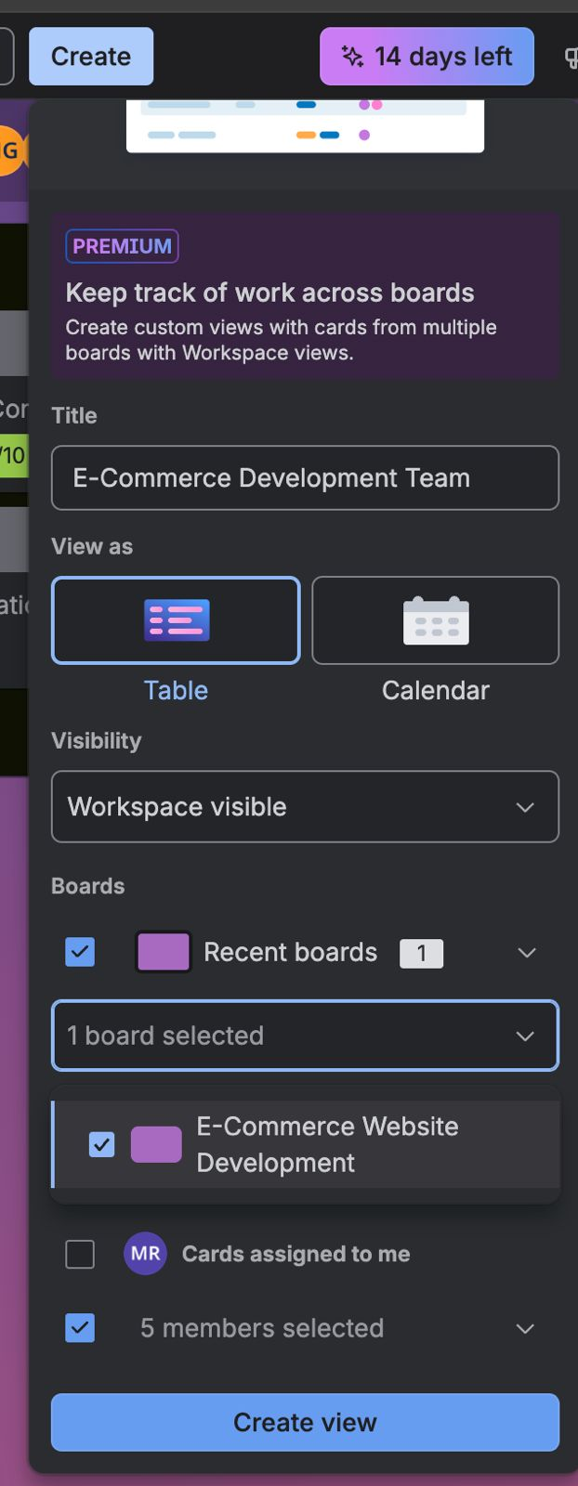
Trello Workspace

Slide 13
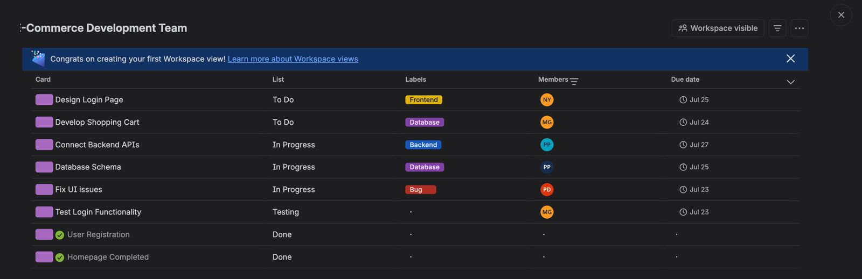
Trello Workspace

Slide 14
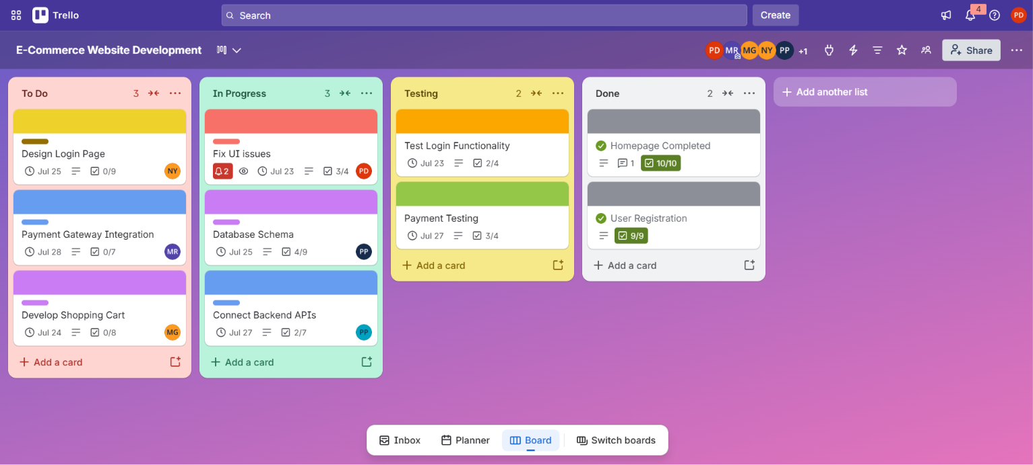
Trello Board

Slide 15
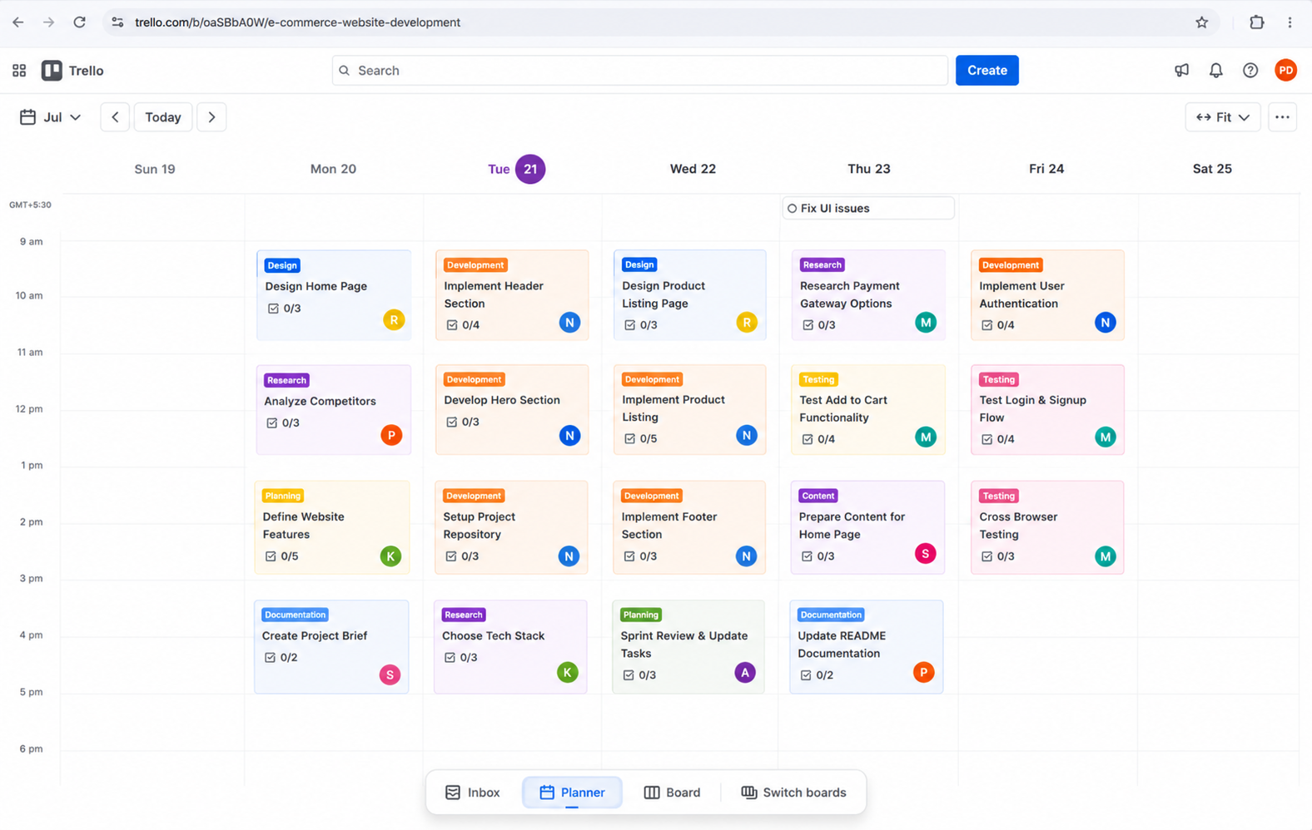
Planner

Slide 16
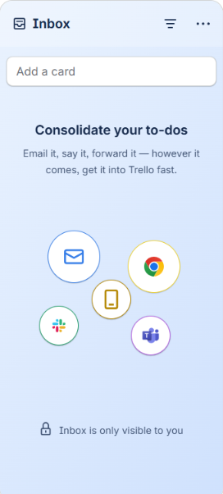

Inbox

Slide 17
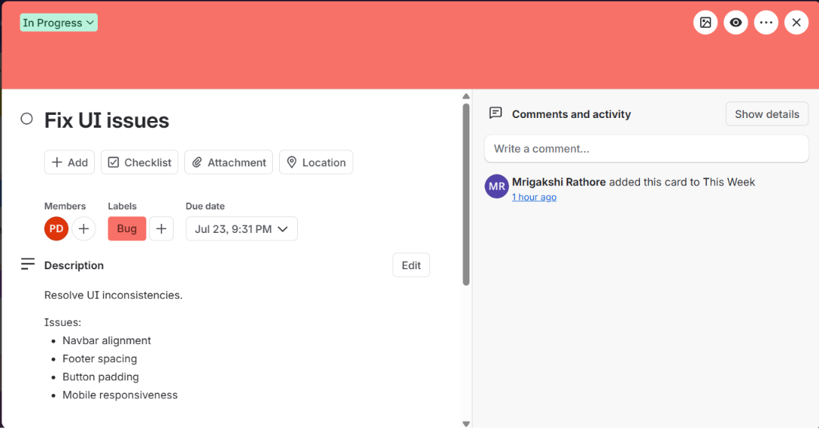
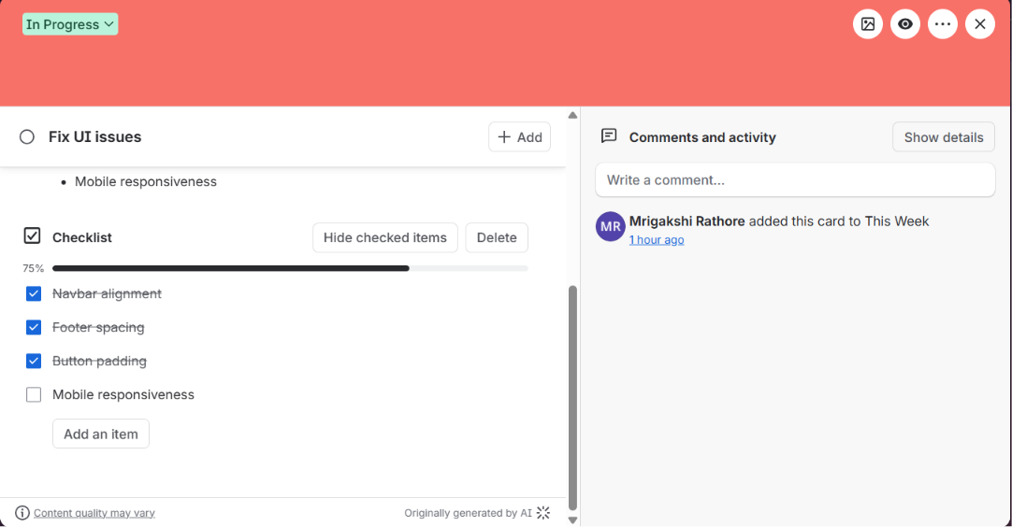
Cards

Slide 18


Which Tool Should You Choose?
Trello
Jira
BEST FOR
BEST FOR
Students
Freelancers
Small startups
Software dev teams
Agile projects
Scrum teams
WHY?
WHY?
Easy to learn
Simple interface
Drag-and-drop boards
Free for basic projects
Sprint planning
Backlog management
Issue tracking
Advanced reporting

