Slide 1

Ramrao Adik Institute of Technology
Department of Computer Engineering
TE MINI Project Presentation
On
“Focus Room Web App with AI Prompt”
By
21CE1412 Janhvi Raut
21CE1305 Pratik Bhat
21CE1307 Palak Tiwari
21CE1391 Nityanand Bankar
Guided by
Dr. Digambar Puri

Slide 2
Introduction
Platforms that combine several elements like the pomodoro timer, calendar, to-do lists, motivational quotations, and sticky notes into a single dashboard have become increasingly popular in the productivity website market.
The idea of this project came from seeing how people struggle in today's fast paced work environment. There is a need for tools that can help people work faster and at the same time allow them to juggle their duties in view of myriad distractions and apparent loss of time.
To address this need, the Focus Room project seeks to offer an all-inclusive solution which combines essential productivity utilities with functions such as an AI model integration.

Slide 3
Literature Survey of the existing systems
﻿Forest App: The Forest app is a popular productivity tool that helps users stay focused and manage distractions. Users plant virtual trees that grow over a set period (often 25 minutes) during which they must stay focused on their task. If they leave the app, the tree dies, encouraging uninterrupted work periods.
Focus@Will: Focus @Will is a music streaming service that uses neuroscience-based music selections to enhance focus and productivity
Freedom: Freedom is an app that blocks distracting websites, apps, and notifications across devices to help users maintain focus and manage digital distractions.
Noisli: Noisli is a background noise generator that provides customizable soundscapes to enhance focus and relaxation. Users can mix different ambient sounds.
Brain.fm: Brain.fm is a music streaming service that uses AI-generated music to enhance focus, relaxation and sleep.

Slide 4
Limitations of existing systems
﻿
Lack personalization
Offering only a one-size-fits-all approach to enhancing focus.
Demand for systems that adapt to individual work preferences and attention spans for maximum effectiveness.
Many existing systems are paid, requiring a subscription for full access to features.
Evidence-based practices are essential for developing better solutions.
Web applications require developers to prioritize personalization, fully integrate with existing utilities.

Slide 5
Problem statement
The idea behind the Focus Room Web App is to deal with these challenges by providing a single platform to handle tasks, time, and concentration. Additionally, it will offer smart assistance through an integrated AI prompt system. By using technologies like React, JavaScript, Node js, CSS and HTML. The app will have a user-friendly interface that can be accessed on different devices and platforms.
Seamless Integration of Productivity Tools
Implementation of AI-Powered Prompt System
User-Centric Design and Experience
Customization and Personalization Features

Slide 6
System Design
Front-end: HTML, CSS, and React.js for structure, style, and interactivity respectively.
Components like short break timer, calendar, to-do list, etc., built using React.js for speed and usability.
Back-end: JavaScript and Node.js for smooth performance and concurrent operations.
Node.js handles server-side logic, data management, and API interaction efficiently.
API Integration: Gemini API linked with our AI prompt for communication via a chat box.
User Authentication: Google Firebase ensures secure login with Google accounts.
Performance Optimization: Vite.js facilitates quick setup and hot reloading for React and JavaScript apps.

Slide 7
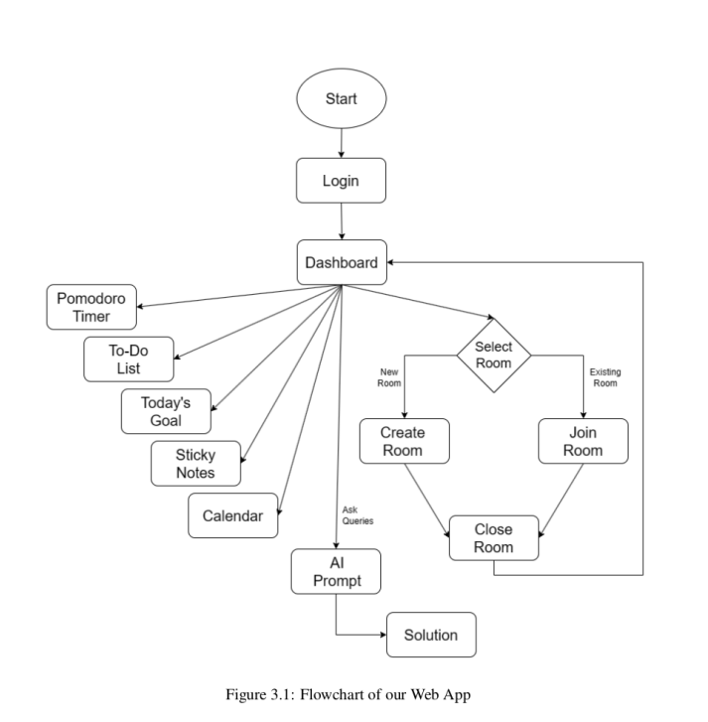
Proposed Framework

Slide 8
Proposed methodology /Techniques
﻿The methodology for developing the productivity platform integrates several key techniques to create a cohesive user experience. Essential elements including the Pomodoro timer, calendar, to-do list, quotes, sticky notes, and the Focus Room are first developed and integrated, then prioritized using a modular strategy for flexibility and scalability.
The technologies are utilized to implement features such as the Pomodoro timer, calendar, to-do list, quotes, sticky notes, and the Focus Room.
JavaScript, accounting for the implementation, enables dynamic functionality and interactivity within the platform, while CSS, contributing is employed for styling and visual enhancements. HTML, with a minimal contribution, structures the content of the platform.

Slide 9
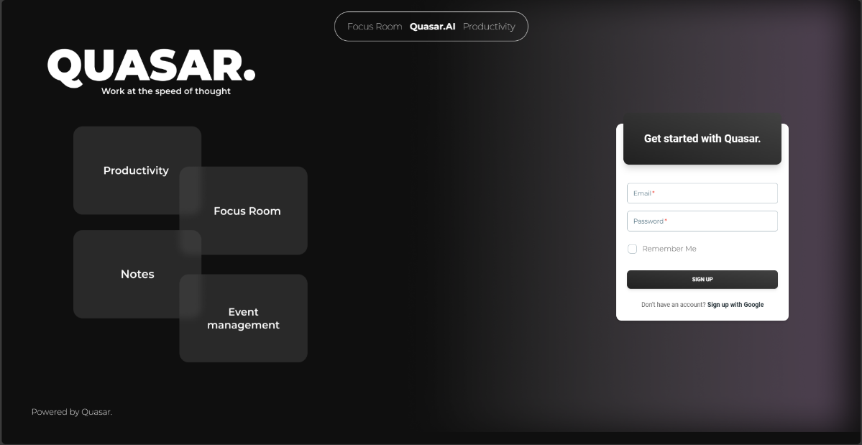
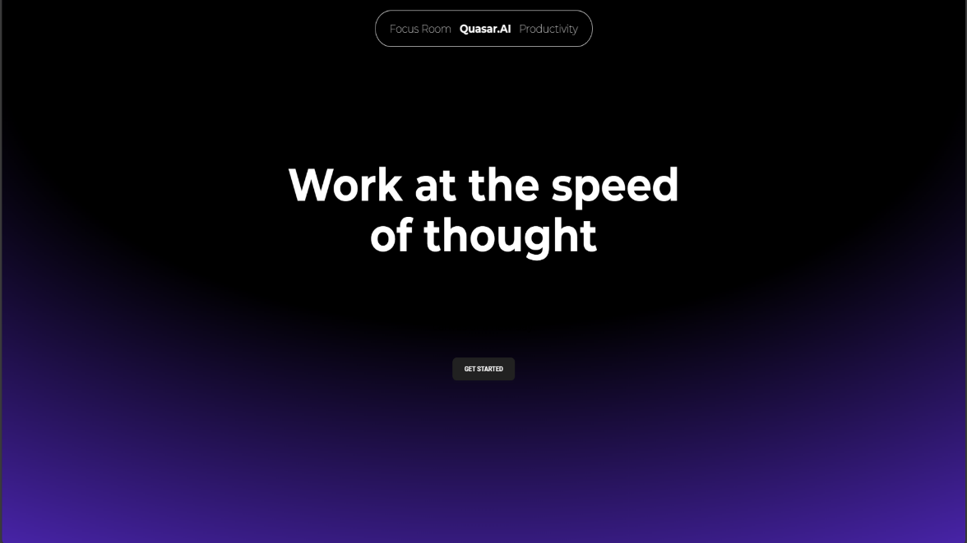
Results
Login Page
Website Page

Slide 10
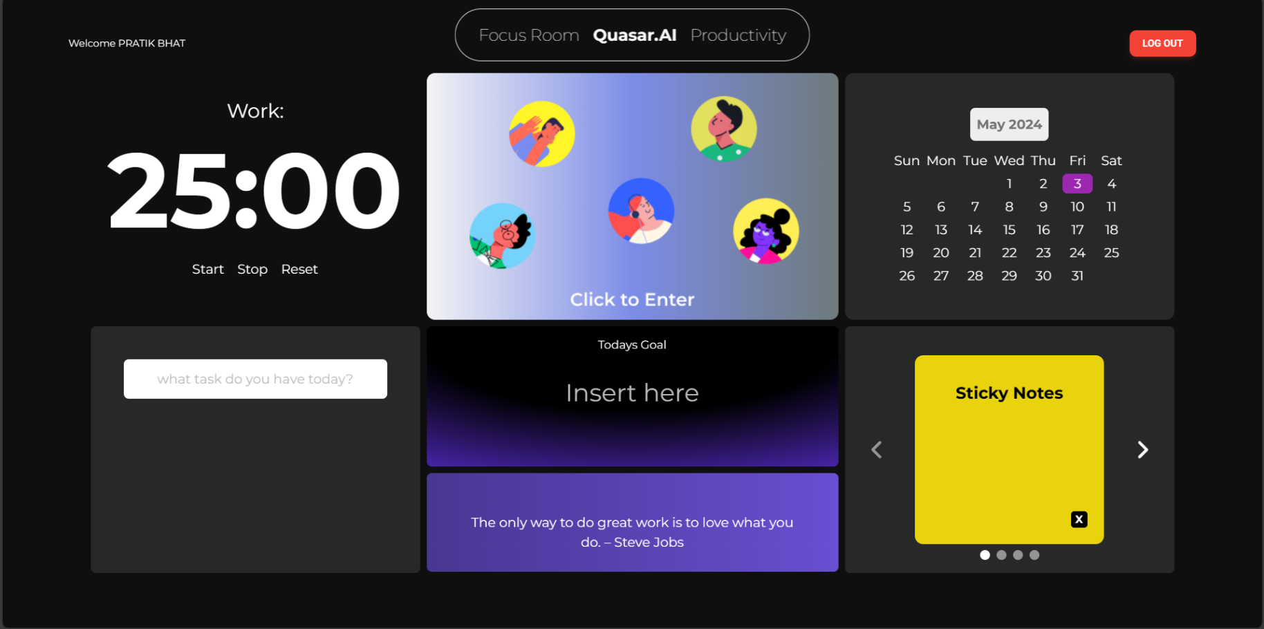
Results
Dashboard

Slide 11
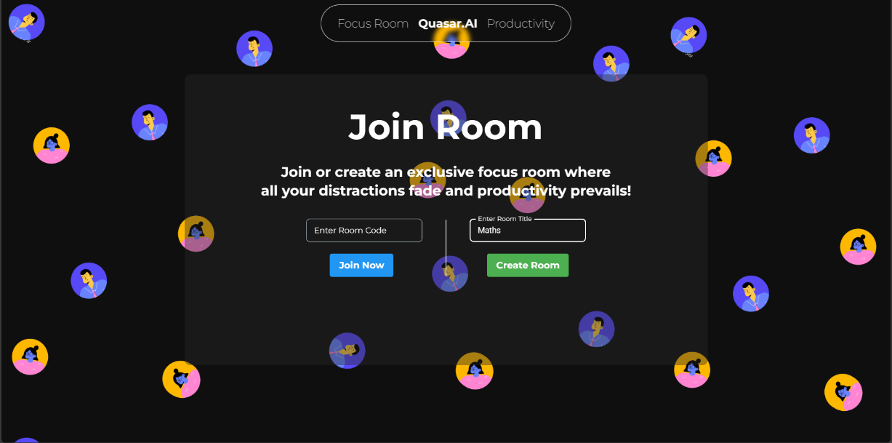
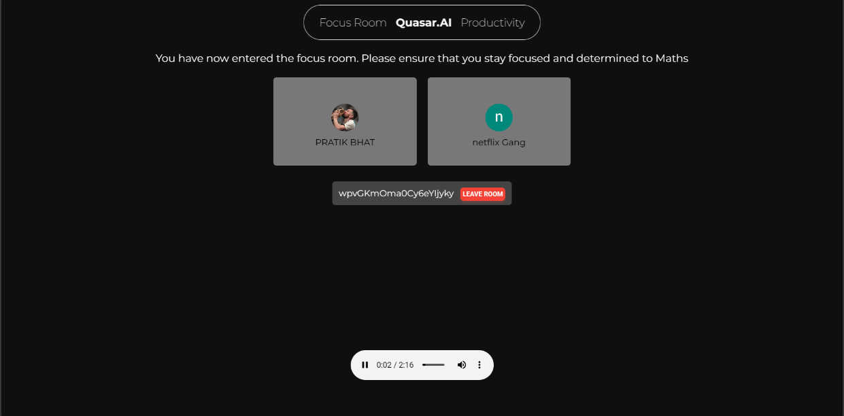
Results
Focus room create/join
Multiple users in same room

Slide 12
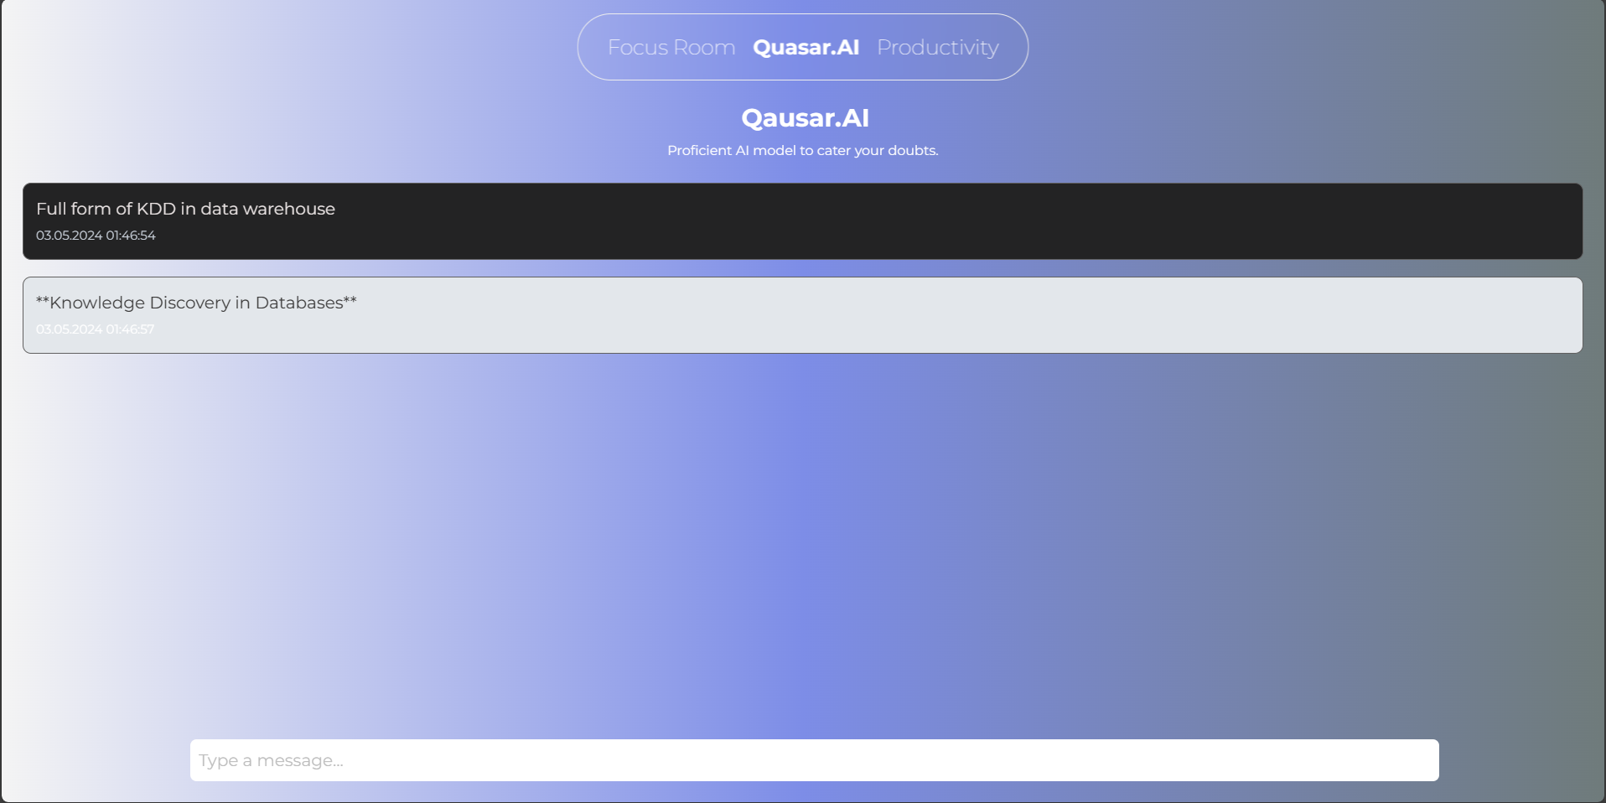
Results
Our AI Prompt Quasar

Slide 13
Technologies used
Frontend:
HTML
CSS
REACT JS
Backend :
JAVASCRIPT
NODE JS
Deployment :
Vite JS - Development Environment deployment

Slide 14
Conclusion and Future Work
CONCLUSION
The development represents a significant technological endeavor aimed at addressing the complex challenges of modern productivity and task management. By leveraging a tech stack comprising React js, JavaScript, Node js, CSS and HTML. Users find it easier to concentrate more because they are shielded from outside distractions.
Our analysis’s findings show that the program has made significant progress toward raising user engagement, raising the accuracy of question resolution, and giving users a learning experience

Slide 15
Future Work
Real-Time Collaboration: To promote cooperative learning and information sharing, incorporate real-time collaboration tools including group discussions, in-room chat window, audio and video conferencing, and collaborative document editing.
Examine domain adaptation techniques to optimize the AI model for particular sectors or topic areas, guaranteeing precise solutions catered to the requirements of consumers.
Usage Analytics: Usage analytics and user behavior tracking to obtain insights into user interaction patterns, feature usage, and areas of user interest.
Advanced Natural Language Processing (NLP) approaches: To improve the AI prompt feature's capacity to respond to questions, investigate advanced NLP approaches.
Multilingual Support: Expand the AI model's language support to allow users with a variety of linguistic backgrounds to take advantage of the application.

Slide 16
References
Peek L, Fothergill A: Using focus groups: lessons from studying daycare centers, 9/11, and Hurricane Katrina. Qual Res. 2009;9(1):31–59. 10.1177/1468794108098029
Carey MA: Focus Groups-What Is the Same, What Is New, What Is Next? Qual Health Res. 2016;26(6):731-3. 10.1177/1049732316636848
Stewart K, Williams M: Researching online populations: the use of online focus groups for social research. Qual Res. 2005;5(4):395–416. 10.1177/1468794105056916
Murray PJ: Using virtual focus groups in qualitative research.Qual Health Res. 1997;7(4):542- 9 10.1177/104973239700700408

Slide 17
Thank You

