Slide 1
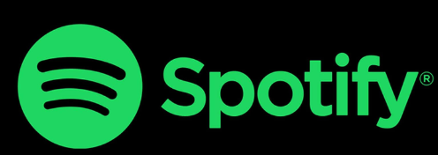
Spotify top 100 from 2000-2022
This dataset provides spotify’s top 100 songs playlist from year
2000-2022

Slide 2
Executive Summary:
Taylor Swift is the most popular artist of all time.
Whereas Drake the most number of songs on top 100 playlist in all the last years combined.
Pop is the most popular genre of all times.
Louder songs tend to have more energy.
More Acoustic songs have lesser energy.
The average duration of tracks has decreased during the last 22 years.
There were rarely any songs released in 2020 due to COVID.
People prefer loud, more energetic, and danceable songs to listen to on spotify.

Slide 3
Columns:
Year- The year that the song came into top 100 songs of that year.
Danceability- A measure of how suitable a song is for dancing.
Energy- A measure of the intensity and activity in a song..
Loudness- The overall volume of a song, typically measured in decibels (dB).
Speechiness- A measure of the presence of spoken words in a song.
Acousticness- A measure of the acoustic quality of a song, indicating the proportion of acoustic sound in the audio.
Instrumentalness- A measure of the presence of instrumental music in a song.
Liveness- A measure of whether a song was performed live or in a studio.
Valence- A measure of the positivity or happiness of a song.
Tempo- The tempo or beats per minute (BPM) of a song, indicating the speed or pace of the music.
duration_ms- The duration of the song in milliseconds (ms), representing the length of the track in terms of time.
time_signature- The time signature of a song, indicating the rhythmic structure, such as 4/4 or 3/4, which determines the number of beats in a measure.

Slide 4
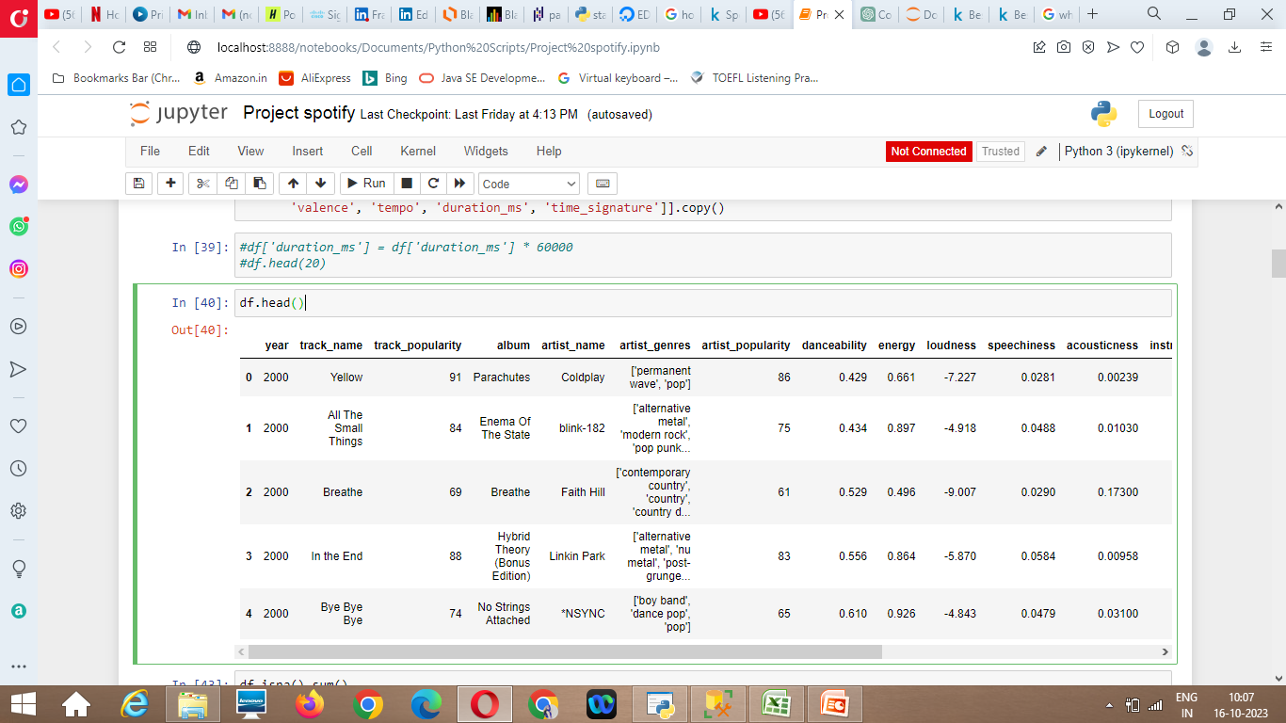
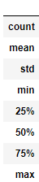
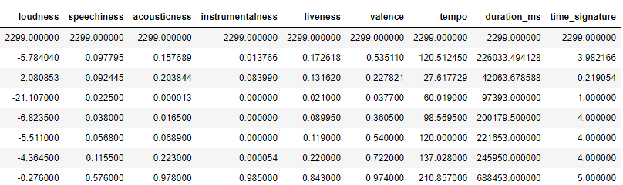
Dataset Overview:
Dataset source- https://www.kaggle.com/datasets/josephinelsy/spotify-top-hit-playlist-2010-2022
Dataset shape- 2300 X 18 (2300 rows and 18 columns)
Dataset describing-
df.describe()

Slide 5
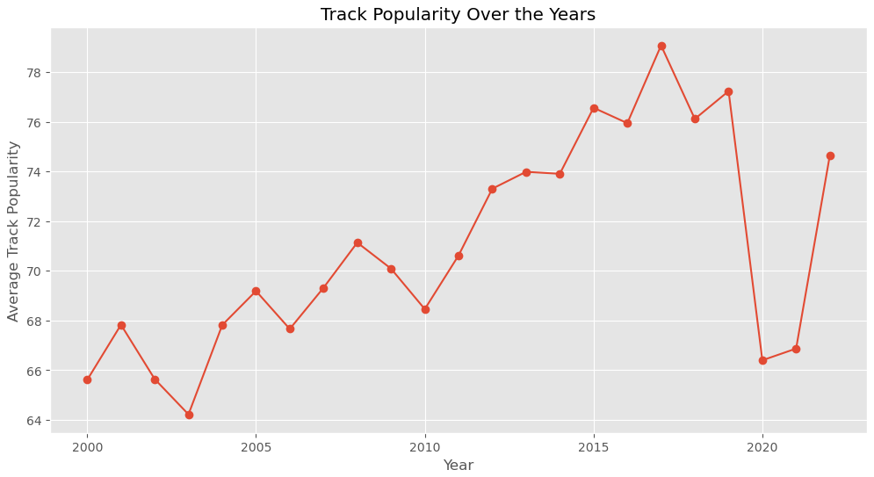
Track popularity graph over the last 22 years
We see a significant dip in the year 2020, this was the year that Covid 19 was introduces and it made a huge impact on all the markets around the world, there were lockdowns and no artists released any new songs in that year.

Slide 6
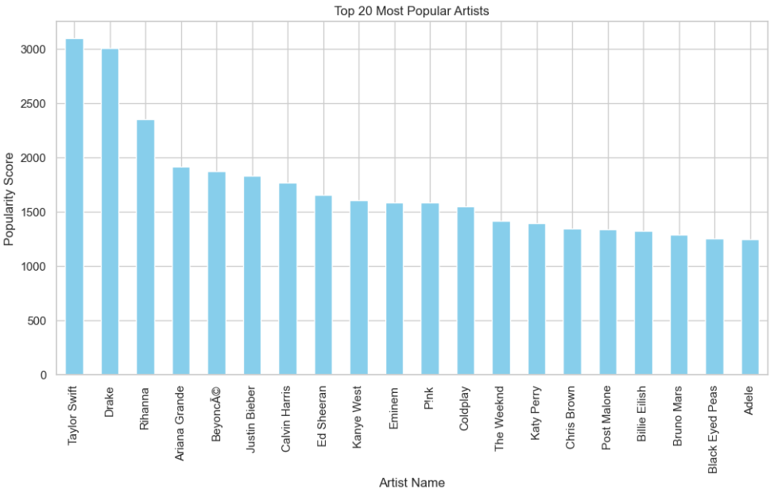
Top 20 most popular artists of all time
Taylor Swift is the most popular artist of all times
Followed by Drake and Rihanna

Slide 7
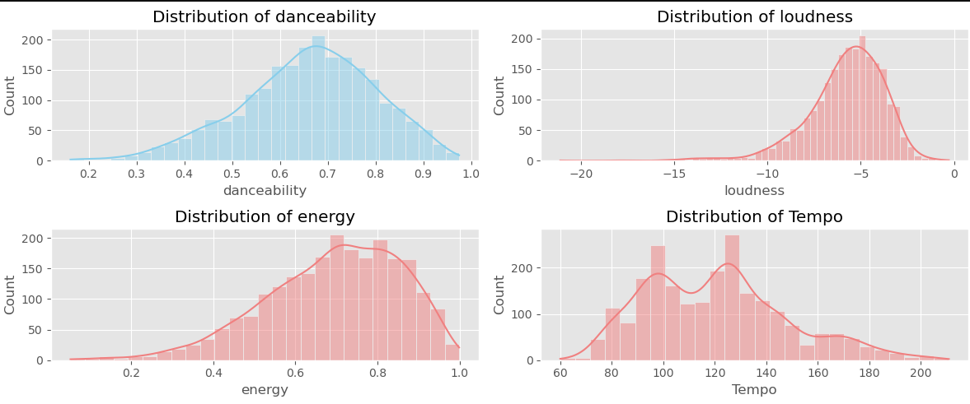
Characteristics of the track
The shift in danceability towards right represents that people prefer songs that they can dance to.
The loudness graph represents that people prefer very loud songs, mostly pop.
The energy graph also represents that people prefer high energy songs.
Tempo is beats per minute(BPM) of a song so people prefer 100 and 130bpm the most.

Slide 8
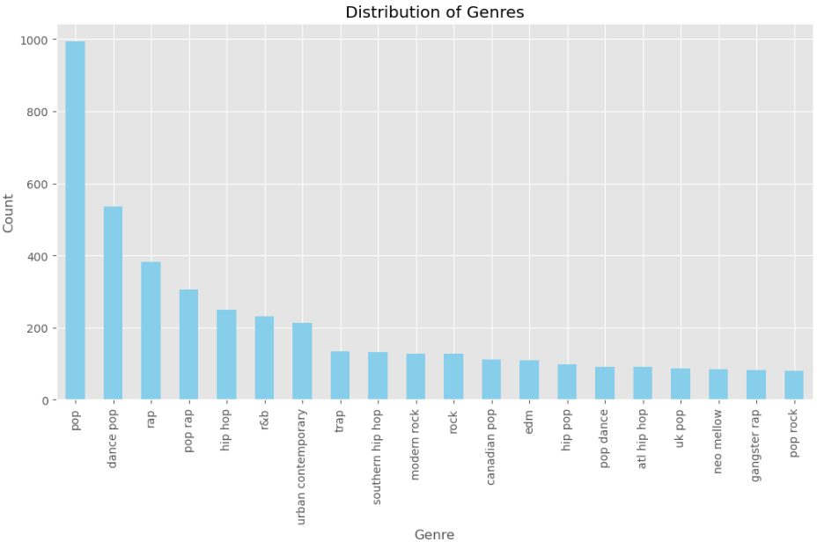
Top 20 genres of all time
Pop is the most popular genre that spotify users like

Slide 9
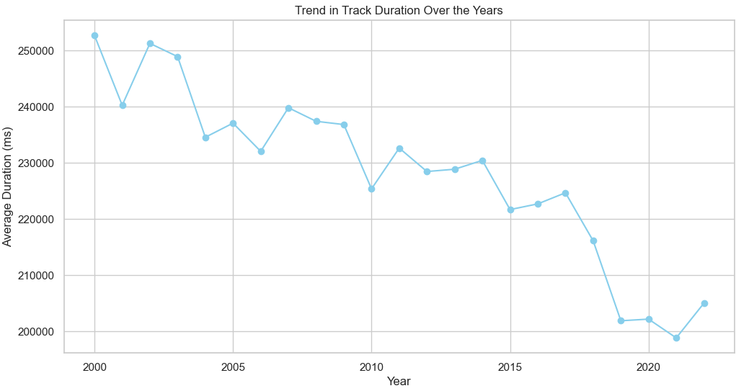
Average track duration over the years
People have started listening to shorter songs more now as compared to in 2000s
The average song duration now is almost 3.4 minutes which was almost 4.2 minutes in 2000

Slide 10
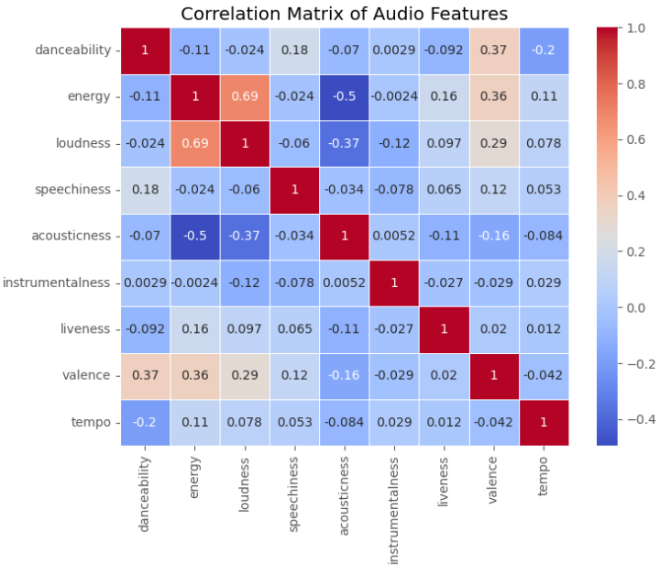
Correlation between audio features
Positive correlation- If features are positively correlated then they are directly proportional to each other
Negative correlation- If features are negatively correlated then they are inversely proportional to each other
No correlation- If correlation is close to 0
then there is no relation between the
features
More energy= more loudness
Less energy= more accousticness

Slide 11
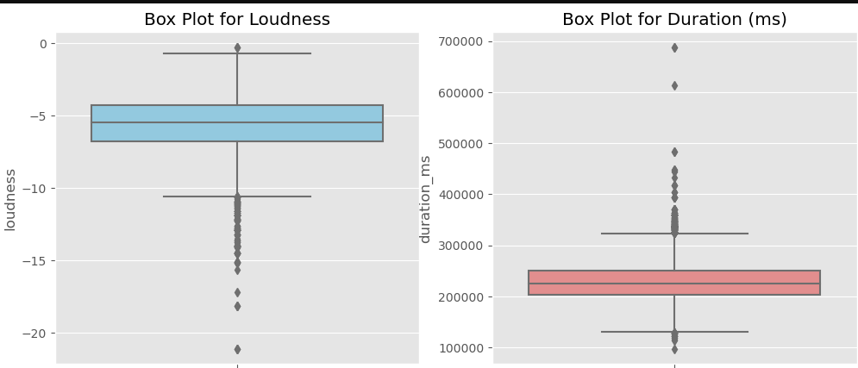
Trends in Track Features:
Loudness:
Most amount of tracks are under the loudness of -7 to -4 db
Duration(ms):
Most of the tracks have a duration of 3.33 to 4.16 minutes

Slide 12
THANK YOU!

