Slide 1

EMOTION ANALYSIS
Project Presentation
By
Darshika Rathod
Mrunal Tukan
Sanika purbuj
Palak kulsrestha
Guided By
Dr. Anupama Budhewar
Department of Computer Science & Engineering, MITSoE, Loni Kalbhor

Slide 2
Outline
1 INTRODUCTION
2 CONCEPTS AND METHODS
3 LITERATURE SURVEY
4 RESEARCH GAP
5 PROJECT PLAN
6 SOFTWARE REQUIREMENT SPECIFICATION
RESULT ANALYSIS
RISK ANALYSIS
9 RESULTS
10 SOFTWARE TESTING
11 CONCLUSION AND FUTURE WORK
BIBLIOGRAPHY
ANNEXURE A: List of Publications and Research Paper (In its Original formats)
ANNEXURE B: Plagiarism Report
Department of Computer Science & Engineering, MITSoE, Loni Kalbhor

Slide 3
1. Introduction
Emotion analysis, also known as sentiment analysis, is the process of identifying and interpreting human emotions from text data. This exciting field combines techniques from natural language processing and machine learning to gain insights into the emotional state of individuals or groups. In this document, we will explore the importance of emotion analysis, its applications, challenges, methodologies, and the promising future it holds.
Department of Computer Science & Engineering, MITSoE, Loni Kalbhor

Slide 4
2. CONCEPTS AND METHODS
Convolutional Neural Networks (CNN): CNNs are effective in learning and capturing spatial patterns from images, making them suitable for extracting features from facial images in emotion recognition tasks.
OpenCV (Open Source Computer Vision Library): OpenCV is a popular library for computer vision tasks. OpenCV can be used to detect and extract facial features, such as eyes, nose, and mouth, which are important in emotion recognition.
Keras: In an emotion recognition mini project, Keras can be used for building and training deep learning models.
Tensorflow: Building an emotion recognition mini project using TensorFlow involves creating s deep learning model to recognize emotions in images or videos.
Numpy: in an emotion recognition mini project, numpy can be used for various data processing tasks such as defining the model architecture, compiling the model, processing the data, training the model and evaluating the model
Department of Computer Science & Engineering, MITSoE, Loni Kalbhor

Slide 5
3.LITERATURE SURVEY
Emotion analysis, also known as affective computing, is the process of identifying, understanding, and interpreting human emotions from various sources of data. In this section, we define emotion analysis and discuss its significance in different domains.
This section also covers the data collection and analysis methods employed in emotion analysis research.
Deep learning-based approaches utilize algorithms and statistical models to train computer systems to recognize and classify emotions. These methods often involve the use of annotated emotion-labeled datasets for training and validation.
Department of Computer Science & Engineering, MITSoE, Loni Kalbhor

Slide 6
4.RESEARCH GAP
Advantages of CNNs in Human Behavior Analysis | Disadvantages of CNNs in Human Behavior Analysis
Effective Feature Extraction: CNNs are highly adept at automatically learning and extracting relevant features from complex data, making them well-suited for tasks like facial expression recognition and gesture analysis | Overfitting Potential: If not properly regularized or if the dataset is limited in size, CNNs can be prone to overfitting, where the model learns to perform well on the training data but struggles with unseen data
Spatial Hierarchies: CNNs are designed to understand spatial hierarchies in data, which is particularly valuable in tasks where the arrangement of features, such as facial landmarks, plays a crucial role. | Computationally Intensive: Training large CNN models can be computationally demanding and may require powerful hardware resources, making them less accessible for some researchers or applications with limited resources
Translation Invariance: CNNs have the ability to recognize patterns regardless of their position in an image, which is advantageous in tasks like facial recognition where the position of facial features may vary. | Limited Interpretablility: Understanding the inner workings of a CNN and interpreting the learned features can be challenging, making it harder to gain insights into why certain decisions are made.
Department of Computer Science & Engineering, MITSoE, Loni Kalbhor

Slide 7
Advantages of CNNs in Human Behavior Analysis | Disadvantages of CNNs in Human Behavior Analysis
Capability for Deep Learning: CNNs can be easily extended to deep architectures, allowing for the modeling of intricate relationships and complex patterns in the data, which is crucial for tasks like emotion recognition. | Data Dependency: CNNs typically require large amounts of labeled data for training, which may not always be readily available, especially in specialized domains or for specific demographic groups.
Transfer Learning Potential: Pre-trained CNN models on large datasets (e.g., ImageNet) can be fine-tuned for specific behavior analysis tasks, providing a significant head start and potentially improving performance | Sensitivity to Hyperparameters: Selecting appropriate hyperparameters for CNN architectures, such as the number of layers, filter sizes, and learning rates, can be a non-trivial task and may require experimentation
Adaptability to Multimodal Data: CNNs can be extended to handle multiple types of data (e.g., images, audio, text) simultaneously, enabling a more comprehensive analysis of behavior in scenarios involving multiple modalities | Limited Contextual Understanding: While CNNs excel at local feature extraction, they may struggle with understanding global context or relationships between different parts of an image, which can be important in behavior analysis.

Slide 8
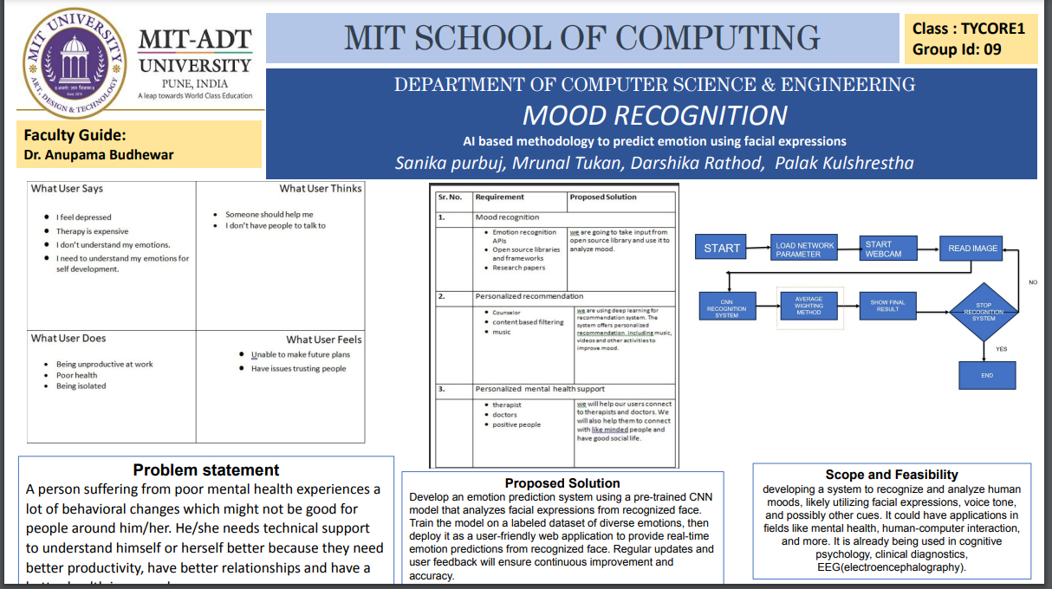
5. PROJECT PLAN
Department of Computer Science & Engineering, MITSoE, Loni Kalbhor

Slide 9
6. SOFTWARE REQUIREMENT SPECIFICTION
Utilization of python libraries such as TensorFlow and Keras.
Implementation of the Convolutional Neural Network (CNN) algorithm.
Focused on deep learning techniques development primarily in Python.
Capability to handle a variety of image and data processing tasks with precision and scalability.
Department of Computer Science & Engineering, MITSoE, Loni Kalbhor

Slide 10
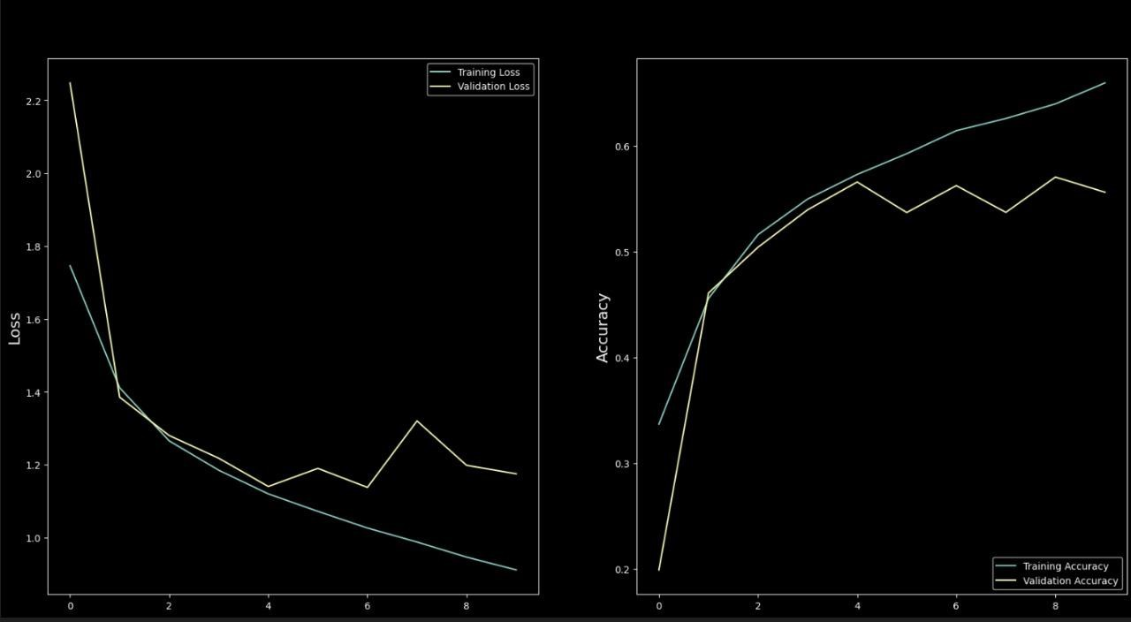
7. RESULT ANALYSIS
The experimental results show that a high accuracy is reached with a small amount of training data, especially kaggle dataset, which achieves an accuracy of 95.49%.
Its supposed to give out 98% accuracy as per 2020 data census. The accueacy of the graph has only grown as compared to the losses over the year.
Department of Computer Science & Engineering, MITSoE, Loni Kalbhor

Slide 11
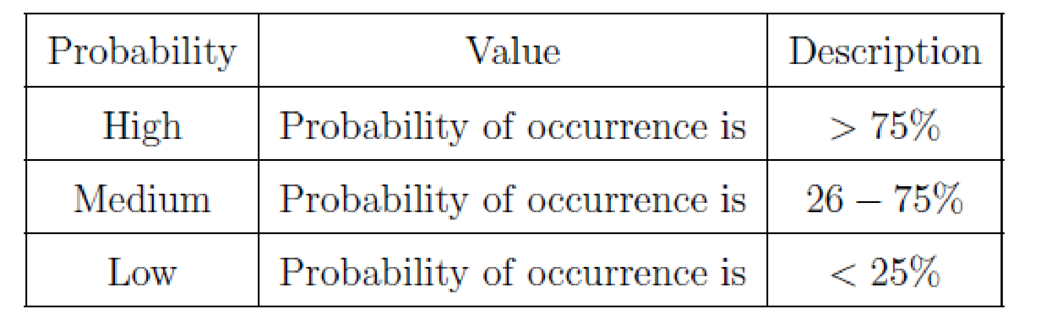
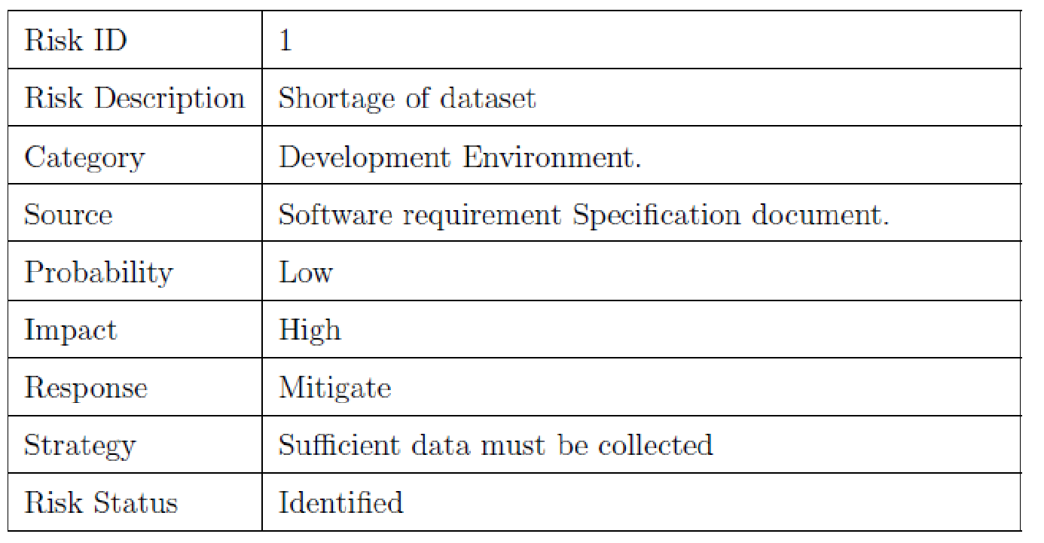
8. RISK ANALYSIS
Risk probability definitions
Department of Computer Science & Engineering, MITSoE, Loni Kalbhor

Slide 12
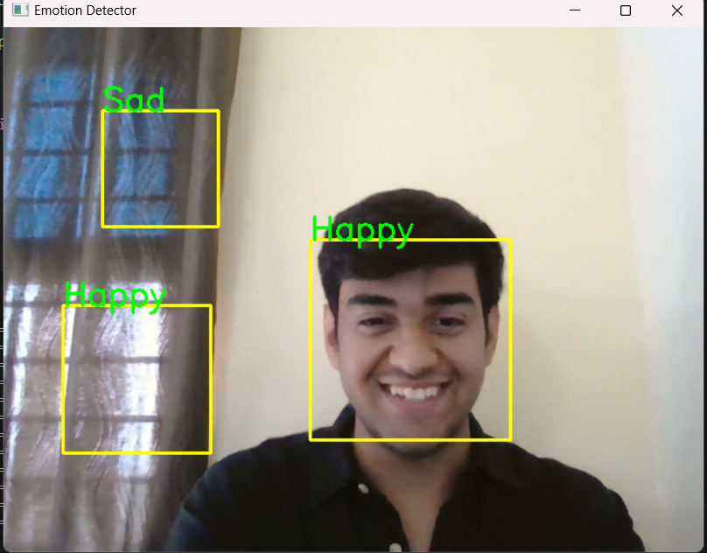
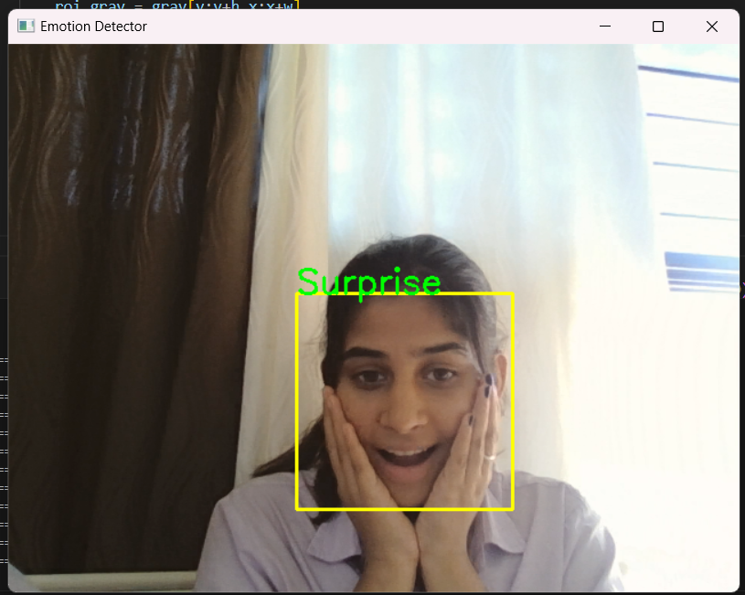
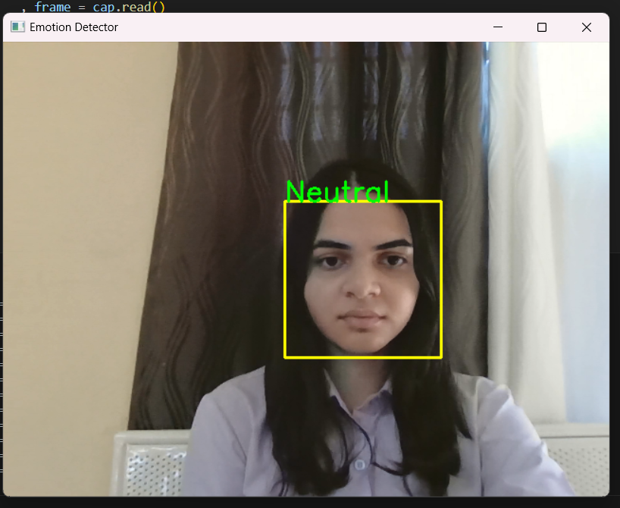
9. RESULT
Department of Computer Science & Engineering, MITSoE, Loni Kalbhor

Slide 13
10. SOFTWARE TESTING
Unit Testing: We can conduct unit testing to verify the correctness of individual components of our CNN model.
Integration Testing: the test how these components interact with each other. This can help us uncover any issues that may arise during the integration process.
Functional Testing: Functional testing will check the overall functionality of our application.
Performance Testing: It is essential to evaluate the performance of our CNN model to ensure it can handle large datasets and process them efficiently.
User Acceptance Testing:
conducting user acceptance testing will involve users evaluating the application from their perspective.
Department of Computer Science & Engineering, MITSoE, Loni Kalbhor

Slide 14
11. CONCLUSION AND FUTURE WORK
In conclusion, our mini project on Human Behaviour Analysis using CNN will utilize the power of Convolutional Neural Networks to detect and analyse various human actions.
Through software testing, we aim to ensure the reliability and accuracy of our application by implementing rigorous testing methodologies such as unit testing, integration testing, functional testing, performance testing, and user acceptance testing, we can ensure the robustness of our system.
This will enhance the overall user experience by accurately analysing and interpreting human behaviours.
Through continuous improvement and refinement, we aim to develop a powerful and efficient tool that can be used in various fields such as surveillance, security, and healthcare.
Department of Computer Science & Engineering, MITSoE, Loni Kalbhor

Slide 15
References
[1] F. Jia and L. Z. Kong, “Intrusion Detection Algorithm Based on Convolutional Neural Network,” "Beijing Ligong Daxue Xuebao/Transaction Beijing Inst. Technol., vol. 37, no. 12, pp. 1271–1275, 2017, doi: 10.15918/j.tbit1001-0645.2017".12.011.
[2] L. Mohammadpour, T. C. Ling, C. S. Liew, and C. Y. Chong, “A Convolutional Neural Network for Network Intrusion Detection System,” "Proc. Asia-Pacific Adv. Netw., vol. 46, no. 0, pp. 50–55", 2018.
[3] U. Gur Çekmez et al., “Derin Ö˘ grenme ile A˘ g Anomali Tespiti Network Anomaly Detection with Deep Learning Ozgur Koray Sahingoz,” 2018, pp. 1–4.
[4] A. Chawla, B. Lee, S. Fallon, and P. Jacob, “Host Based Intrusion Detection System with Combined CNN/RNN Model,” "Lect. Notes Comput. Sci. (including Subser. Lect. Notes Artif. Intell. Lect. Notes Bioinformatics), vol. 11329 LNAI", pp. 149–158, 2019.
[5] S. Naseer and Y. Saleem, “Enhanced network intrusion detection using deep convolutional neural networks,” "KSII Trans. Internet Inf. Syst., vol. 12, no. 10, pp. 5159–5178, 2018, doi: 10.3837/tiis.2018".10.028.
Department of Computer Science & Engineering, MITSoE, Loni Kalbhor

Slide 16
Thank You
Department of Computer Science & Engineering, MITSoE, Loni Kalbhor

Slide 17
Questions
Department of Computer Science & Engineering, MITSoE, Loni Kalbhor

