Slide 1
Create new folder: mkdir expressnote
Go to folder: cd expressnote
Initialise npm (with basic json file) : npm init –yes
Install express: npm i express

Slide 2
Client-Server Architechture
App itself is client and talks to server or say backend and ask for data. That’s communication between client and server and is done using HTTP Protocol (rules).
Server exposes its services via http protocol. Client calls the services by sending http requests and here comes REST(Representation State Transfer).

Slide 3
CRUD Operations
HTTP provides support to server for operations:
Create
Read
Update
Delete
HTTP request format:
http://<domain_name>/api/<resources>

Slide 4
HTTP Methods
GET : Getting data
POST : Creating data
PUT : Updating data
DELETE : Deleting data

Slide 5
GET
Request: api/customer
Response: (an object having customer array)
[
{ id: 1, name: ‘’ },
{ id: 2, name: ‘’ }
]
For request of customer with id, only the object with that id will appear.

Slide 6
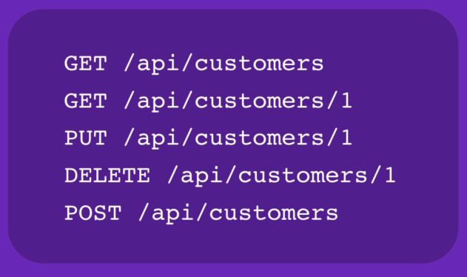

Slide 7
NODEMON
Install using command: npm i –g nodemon
Run every file using nodemon isntead of node.
Advantage: We don’t need to restart our server again and again after making the changes.

Slide 8
App.put
Look to the resource.
If resource is not existing : return 404.
Else if existing, if invalid: return 400 –Bad request.
Else if Valid:
extract resource from database.
update resources
return resource

