Slide 1
Technical Presentation
Prepared By : Palak Shah

Slide 2

Delivery Date Prediction System
DATA 245 : Machine Learning Course
eBay 2021 University Machine Learning Competition
Predicting accurate delivery dates
Provide hassle free customer experience by perfect delivery dates.

Slide 3

Introduction
In the case of eBay, most transactions are carried out between individual sellers and buyers
The shipment date is largely left to the sole decision of each individual seller, resulting in a high degree of variability.

Slide 4
Literature Review
Logistics supplier Aramex uses machine learning to predict delivery times
Machine model has increased the accuracy of delivery predictions by 74%.
Describe a multi-leg approach in which the shipping process is divided into multiple steps to be estimated individually.
For instance, the time from seller to processing hub is estimated separately from the time from customs to buyer in international transactions.

Slide 5
Literature Review
Another study, Predicting Package Delivery Time For Motorcycles In Nairobi details how modifying the input variables for the model can help the model narrow in on important features.
This study uses XGBoost, a supervised regression model, to predict the estimated time of delivery of a motorcycle-transported delivery in Nairobi.
There is also a discussion of examining the results through the specific lens of a delivery date – it is better to predict late than early – and thus an optimized model should account for this by reprimanding a model harsher for predicting an early time, as opposed to a late time

Slide 6
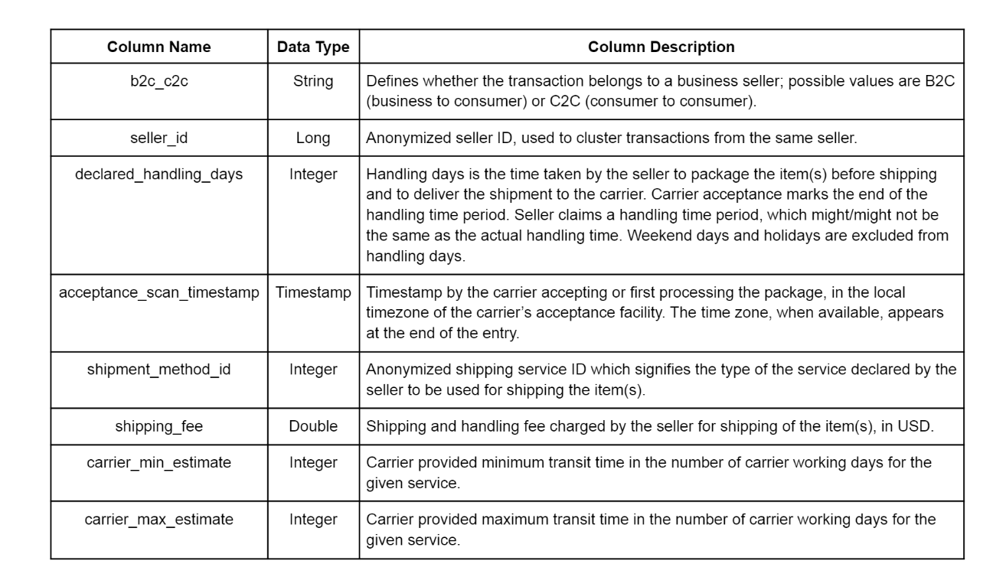
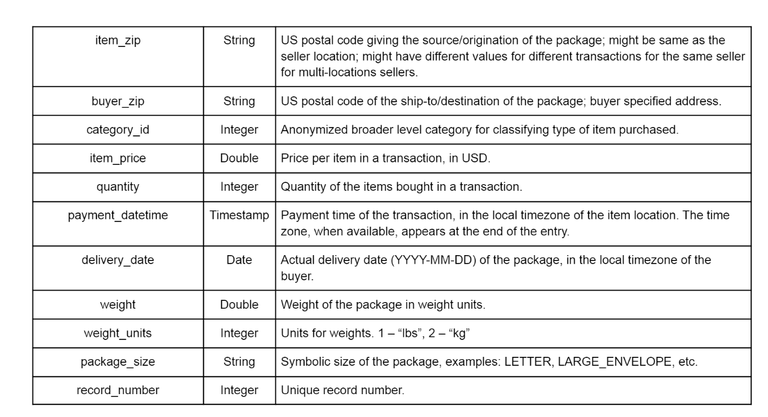
Dataset
Dataset provided by eBay.
15 million shipment records
A validation dataset containing 2.5 million shipment records.
Each shipment record contains 19 features.
Dataset Reference: Ebay

Slide 7
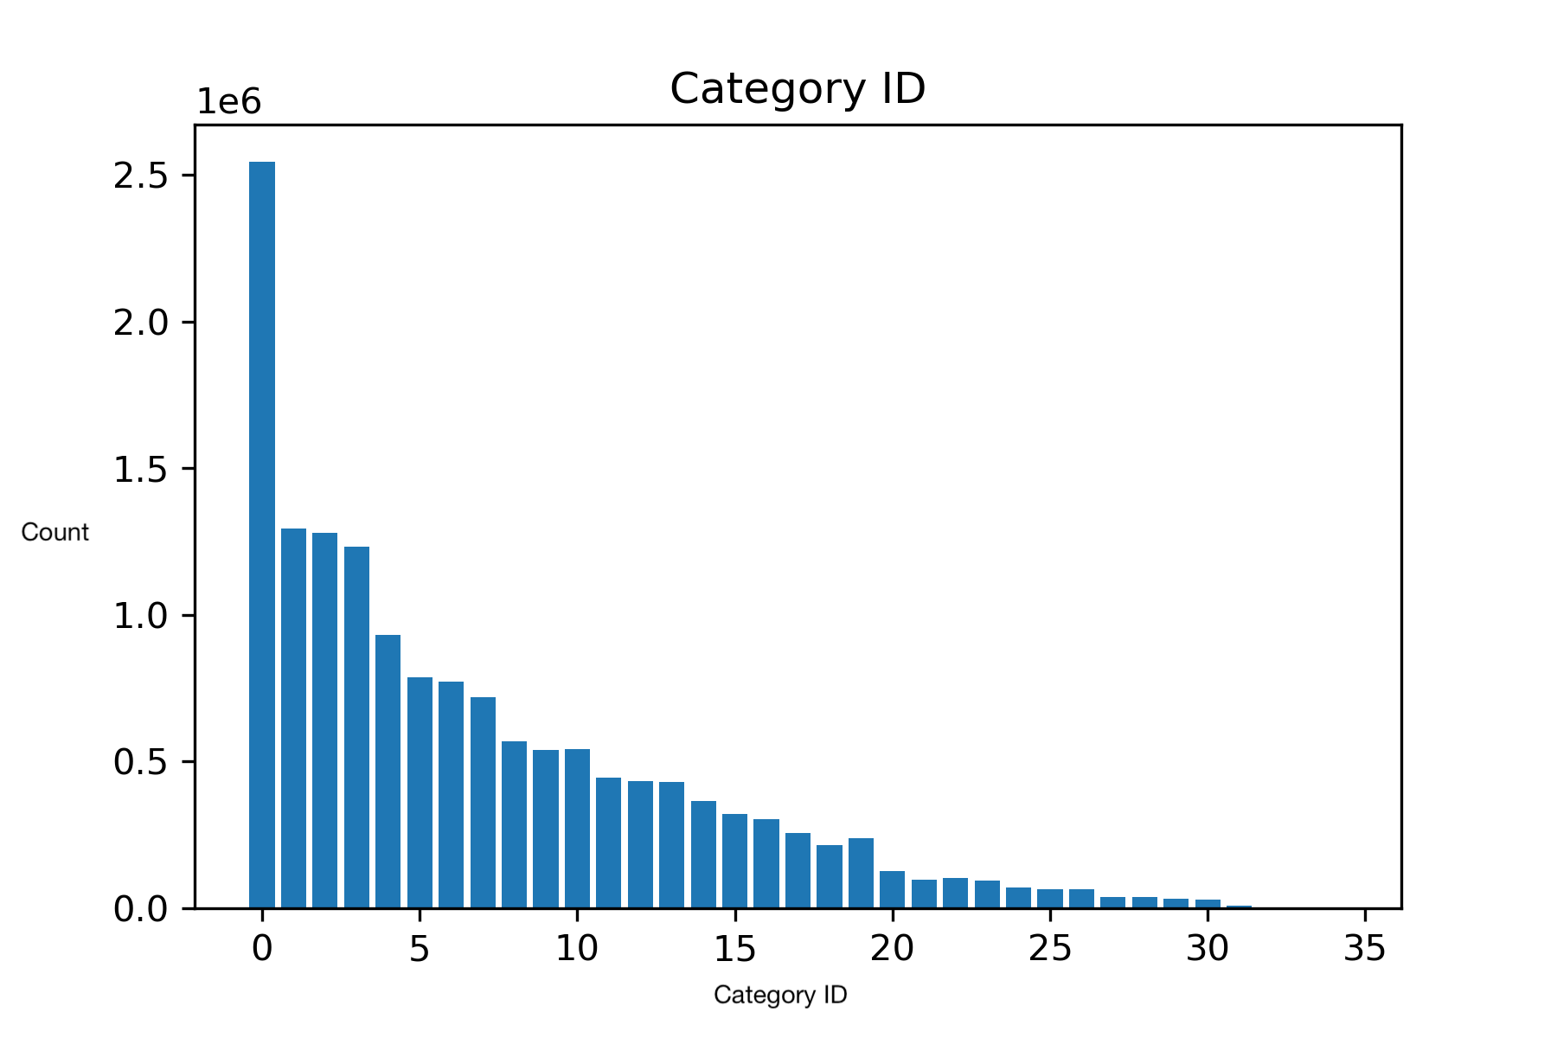
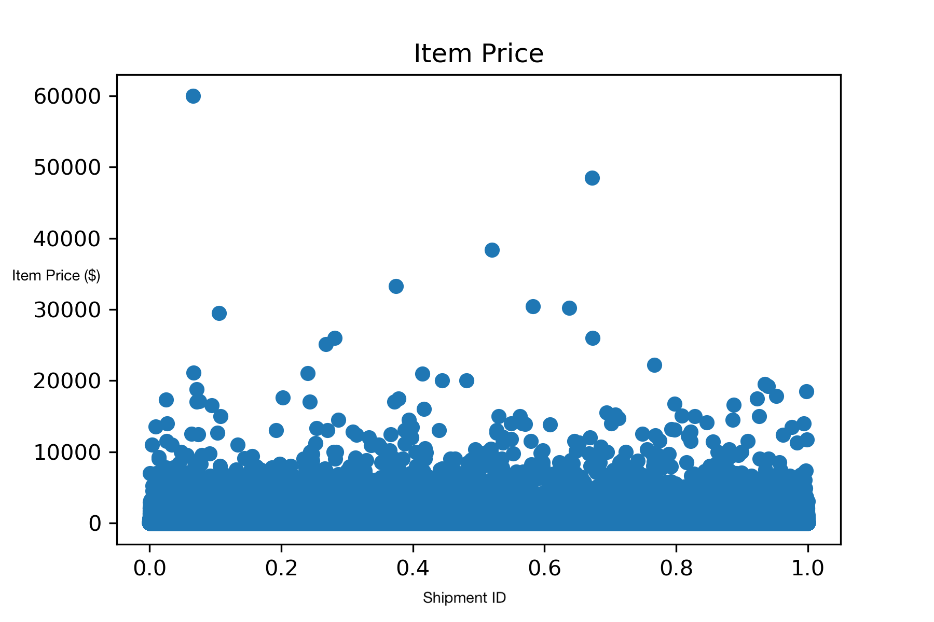
Exploratory Data Analysis

Slide 8
Goal
Cleaning our data
Creating new features
Determining feature importance
Create a model that can accurately predict the delivery time

Slide 9

Data Cleaning
Use
Use weight_units to convert all weights to the same unit
Convert
Convert all times to the time zone of the buyer
Replace
Replace missing weight values with the average weight by category ID
Encode
Encode package size and b2c, c2c as discrete numeric values
Replace
Replace missing carrier_min_estimate and carrier_max_estimate with averages from the same shipment_method_id.

Slide 10
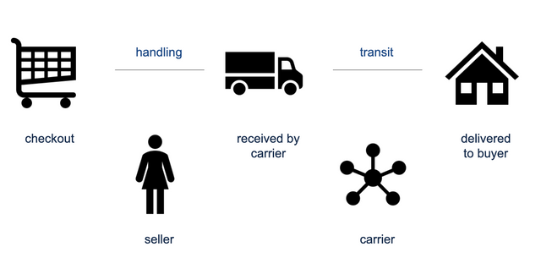
Creating New Features
handling time (acceptance_scan_timestamp - payment_datetime)
shipment time (delivery_date - acceptance_scan_timestamp)
total time (delivery_date - payment_datetime)
Quantify distance between buyer and seller using zipcode
Image Reference: Ebay

Slide 11
Feature Importance
Features | Standard Linear Regression (SR) | Lasso Regression (LR)
b2c_c2c | 0.2635 | 0
shipping_fee | 0.003 | 0
carrier_min_estimate | 0.2217 | 0
carrier_max_estimate | 0.4032 | 0
category_id | 0.0183 | 0.005
item_price | -0.0001 | 0.001
quantity | 0.003 | 0
weight | -0.0000095 | 1.9E-06

Slide 12
Linear Regression Model
Model | Test Set Loss
Benchmark random classifier loss | 0.75
Standard Linear Regression (SR) | 0.82
Lasso Regression (LR) | 0.89

Slide 13
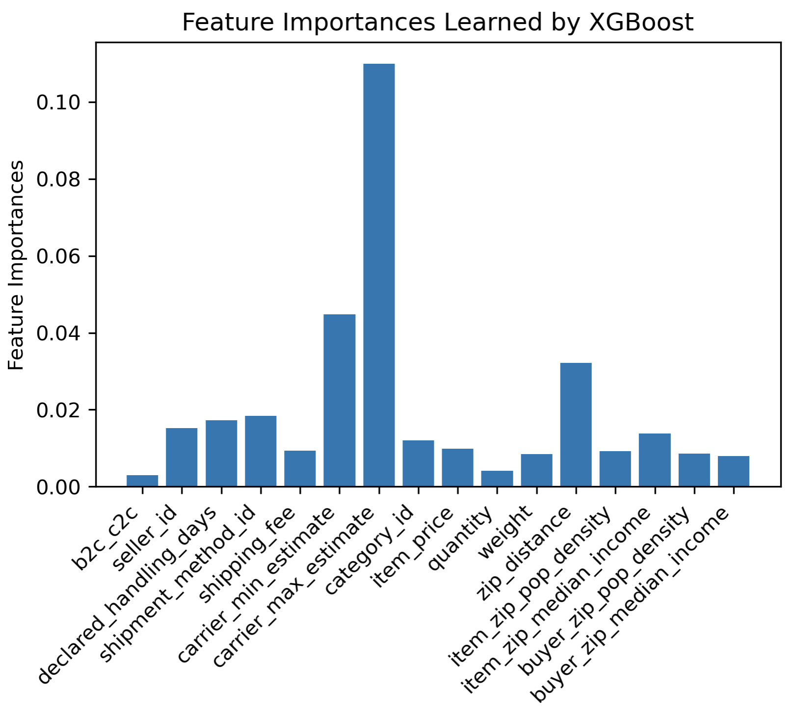
XGBOOST
Feature | Feature Importance
b2c_c2c | 0.015656
seller_id | 0.047507
declared_handling_days | 0.042284
shipment_method_id | 0.035131
shipping_fee | 0.028294
carrier_min_estimate | 0.044301
carrier_max_estimate | 0.055198
item_zip | 0.059736
buyer_zip | 0.028275
category_id | 0.022790
item_price | 0.042802
quantity | 0.047650
weight | 0.057305
package_size | 0.020258

Slide 14
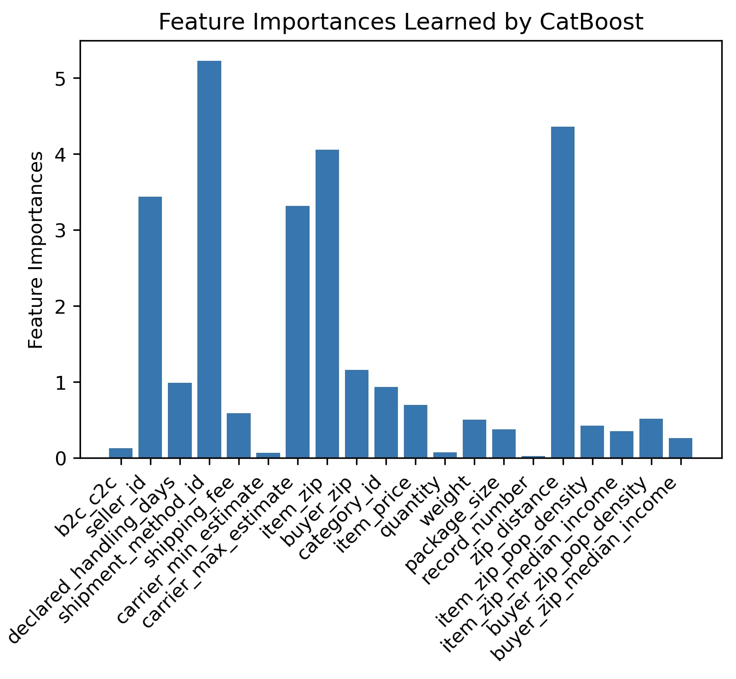
CATBOOST
Feature | Feature Importance
b2c_c2c | 0.129
seller_id | 3.44
declared_handling_days | 0.993
shipment_method_id | 5.32
shipping_fee | 0.591
carrier_min_estimate | 0.07
carrier_max_estimate | 3.32
item_zip | 4.06
buyer_zip | 1.16
category_id | 0.938
item_price | 0.701
quantity | 0.075
weight | 0.503
package_size | 0.380
record_number | 0.267
zip_distance | 4.36
item_zip_pop_density | 0.426
item_zip_median_income | 0.352
buyer_zip_pop_density | 0.518
buyer_zip_median_income | 0.266
handling_days | 72.1

Slide 15
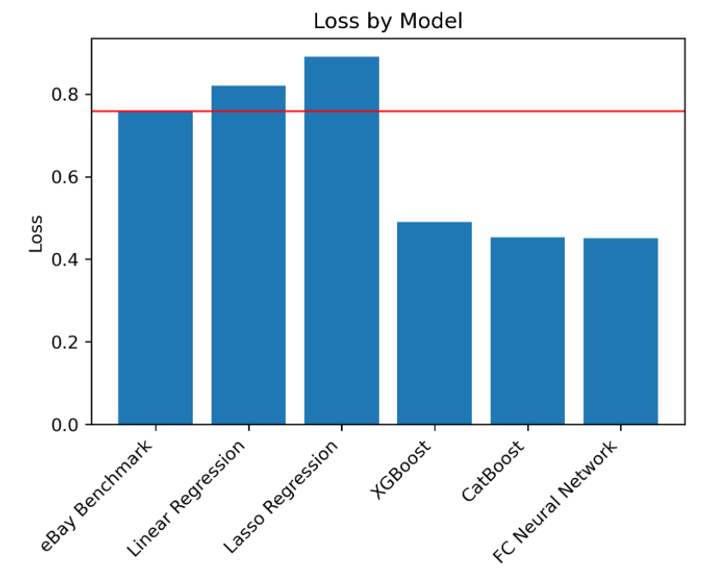
Loss Function
After training our models, we used the loss function provided by eBay of which the baseline (random guessing) loss is 0.759 (the weighted average absolute error of the delivery predictions in days).
This loss function is essentially an average of how many days the prediction was off by, where late predictions are weighted more heavily than early predictions.
Our goal was to obtain a loss that is significantly lower than 0.759 for our model.

Slide 16
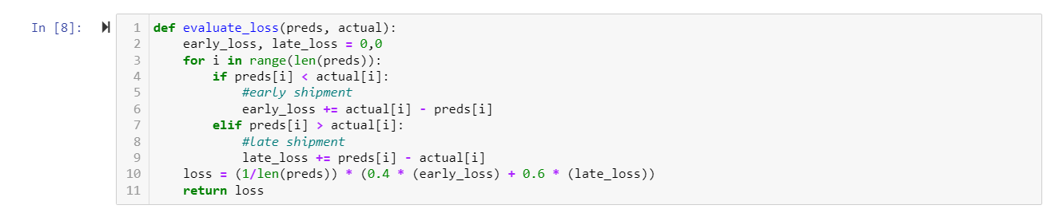
Implementing early_loss and late_loss and providing different penalties

Slide 17
Results
Model | Loss
Linear Regression Model | 0.82
XGBoost | 0.50
CatBoost | 0.453

Slide 18
Ethics Discussion
A greater environmental cost such as more trucks on the road, air quality issues, and package waste.
The delivery drivers face long shifts without stops to prioritize fast shipping
If our model is wrong and mis predicts delivery times to be way earlier than they can be delivered, the actual delivery workers might get wrongfully punished for not meeting the predicted time.

Slide 19
References
Guo, K. (2020). Application of Machine Learning and Real-time Feedback System to Predict Arriving Time. Journal of Physics: Conference Series, 1684, 012039. https://doi.org/10.1088/1742-6596/1684/1/012039
Liu, J., Hwang, S., Yund, W., Boyle, L. N., & Banerjee, A. G. (2018). Predicting Purchase Orders Delivery Times Using Regression Models With Dimension Reduction. Volume 1B: 38th Computers and Information in Engineering Conference. Published. https://doi.org/10.1115/detc2018-85710
Salari, N., Liu, S., & Shen, Z. J. M. (2020). Real-Time Delivery Time Forecasting and Promising in Online Retailing: When Will Your Package Arrive? SSRN Electronic Journal. Published. https://doi.org/10.2139/ssrn.3701337
Gyulai, D., Pfeiffer, A., Nick, G., Gallina, V., Sihn, W., & Monostori, L. (2018). Lead time prediction in a flow-shop environment with analytical and machine learning approaches. IFAC-PapersOnLine, 51(11), 1029–1034. https://doi.org/10.1016/j.ifacol.2018.08.472
5. Evaluating state of the art in ai. EvalAI. (n.d.). Retrieved November 29, 2021, from https://eval.ai/web/challenges/challenge-page/1205/overview

