Slide 1

CareSlot
Clinic appointment system - DevOps final project
Palak Agrawal · 24BCS10504 · Session 21 capstone
Notes:
Hi, I'm Palak. This is CareSlot, my DevOps capstone: a clinic appointment system, and the full delivery chain around it - tests, containers, a security gate, Terraform on AWS, Kubernetes with Helm and Argo CD, autoscaling and monitoring.

Slide 2
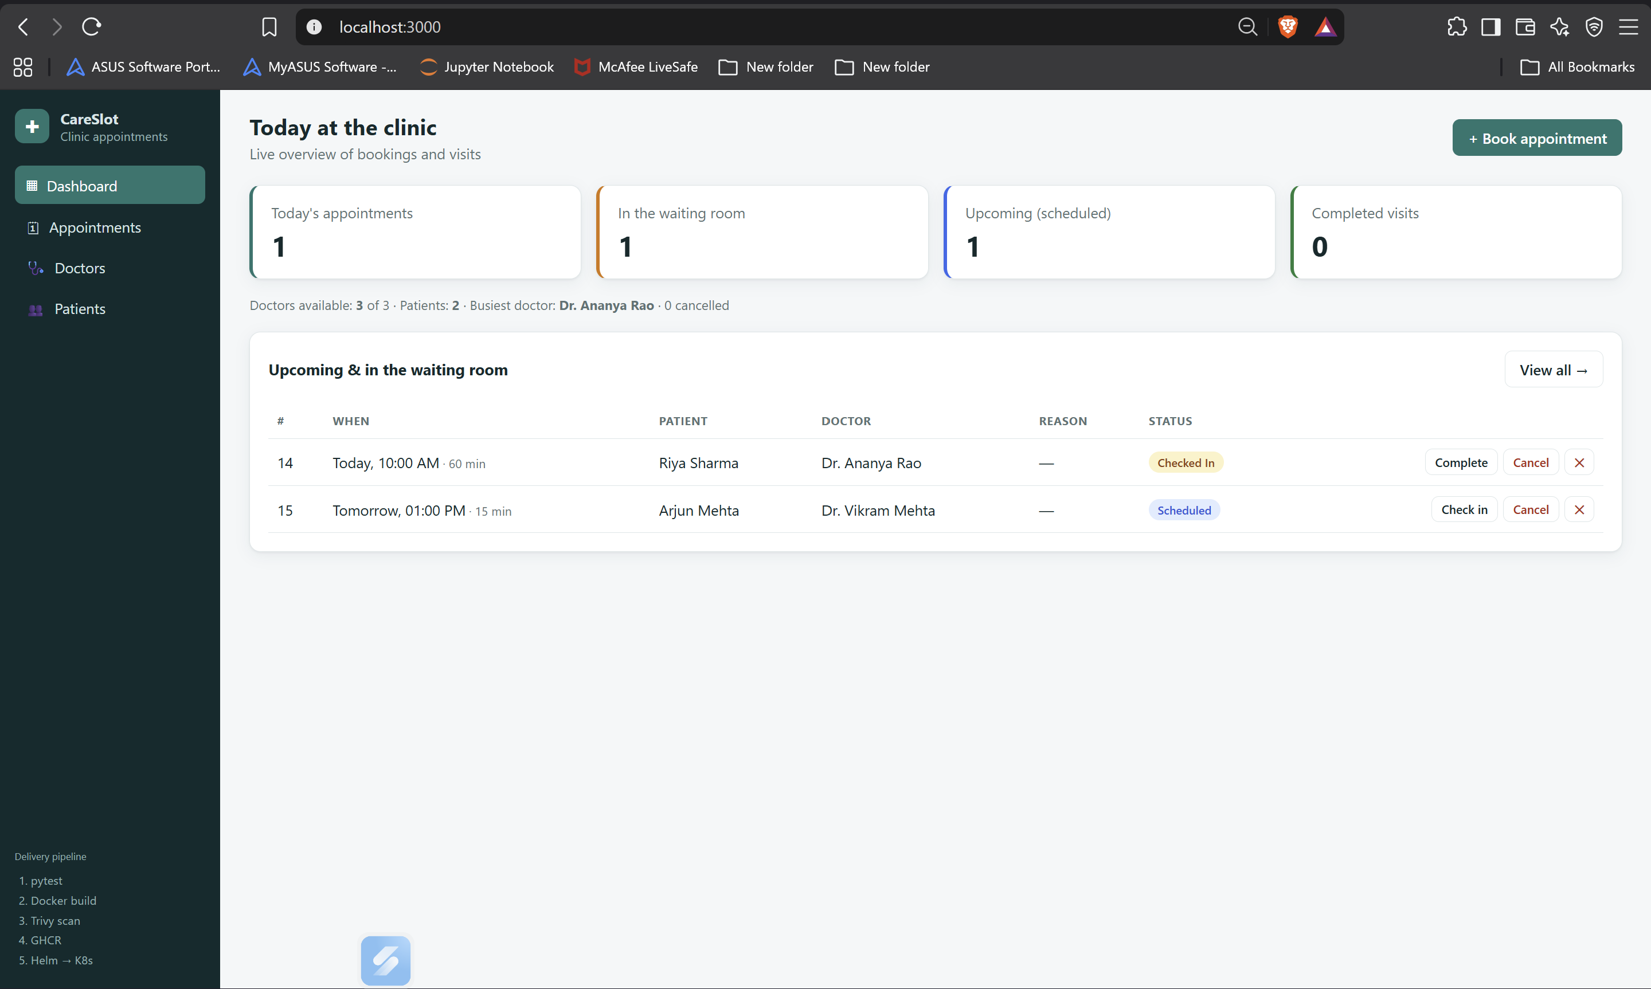
What CareSlot does
Reception registers patients (10-digit mobile, optional email and date of birth)
Manages the doctor roster and availability
Books visits: SCHEDULED → CHECKED IN → COMPLETED or CANCELLED
Blocks double booking of a doctor or a patient, bookings in the past and edits to finished visits
Live dashboard; works on phones
45
0
53
14
automated tests (pytest)
vulnerabilities in both images
AWS resources from Terraform
REST endpoints, 3 resources + stats
Notes:
Reception uses it to register patients, manage doctors and book appointments. The backend enforces the rules: no overlapping bookings for a doctor or a patient, nothing in the past, and finished visits are read-only. The numbers at the bottom are the project in short.

Slide 3








Tech stack
Frontend
Backend
Database
Testing
React 19 · Vite 8 · Nginx (non-root)
FastAPI · SQLAlchemy 2 · Pydantic · Alembic
PostgreSQL 16 · EBS gp3 volume
pytest - 45 tests · ruff lint
Containers
CI/CD
Infrastructure
Kubernetes & ops
Docker · Compose · Alpine · multi-stage
GitHub Actions · GHCR · Trivy · gitleaks
Terraform · AWS VPC · EKS 1.36
Helm · Ingress · HPA · Argo CD · Prometheus · Grafana
Notes:
The stack, layer by layer: React and Nginx in front, FastAPI with SQLAlchemy and Alembic behind, PostgreSQL for data, pytest for tests, Docker images built and scanned in GitHub Actions, Terraform for AWS, and Kubernetes with Helm, Argo CD, Prometheus and Grafana to run it.

Slide 4
Architecture
AWS ap-south-1 · VPC 10.20.0.0/16 · EKS 1.36 (2 × m7i-flex.large)
Frontend ×2
React on Nginx
Prometheus + Grafana
monitoring
/
Browser
user
AWS load balancer
public subnets
ingress-nginx
Ingress rules
/api
Backend ×2-6
FastAPI · HPA
PostgreSQL
StatefulSet + PVC
GitHub repo
Helm chart + values
watches
Argo CD
GitOps sync
Notes:
Traffic comes in through an AWS load balancer to ingress-nginx. The Ingress sends slash-api to the FastAPI backend and everything else to the React frontend. The backend talks to PostgreSQL on a persistent EBS volume. Prometheus scrapes the backend's metrics, and Argo CD keeps the whole namespace in sync with Git.

Slide 5
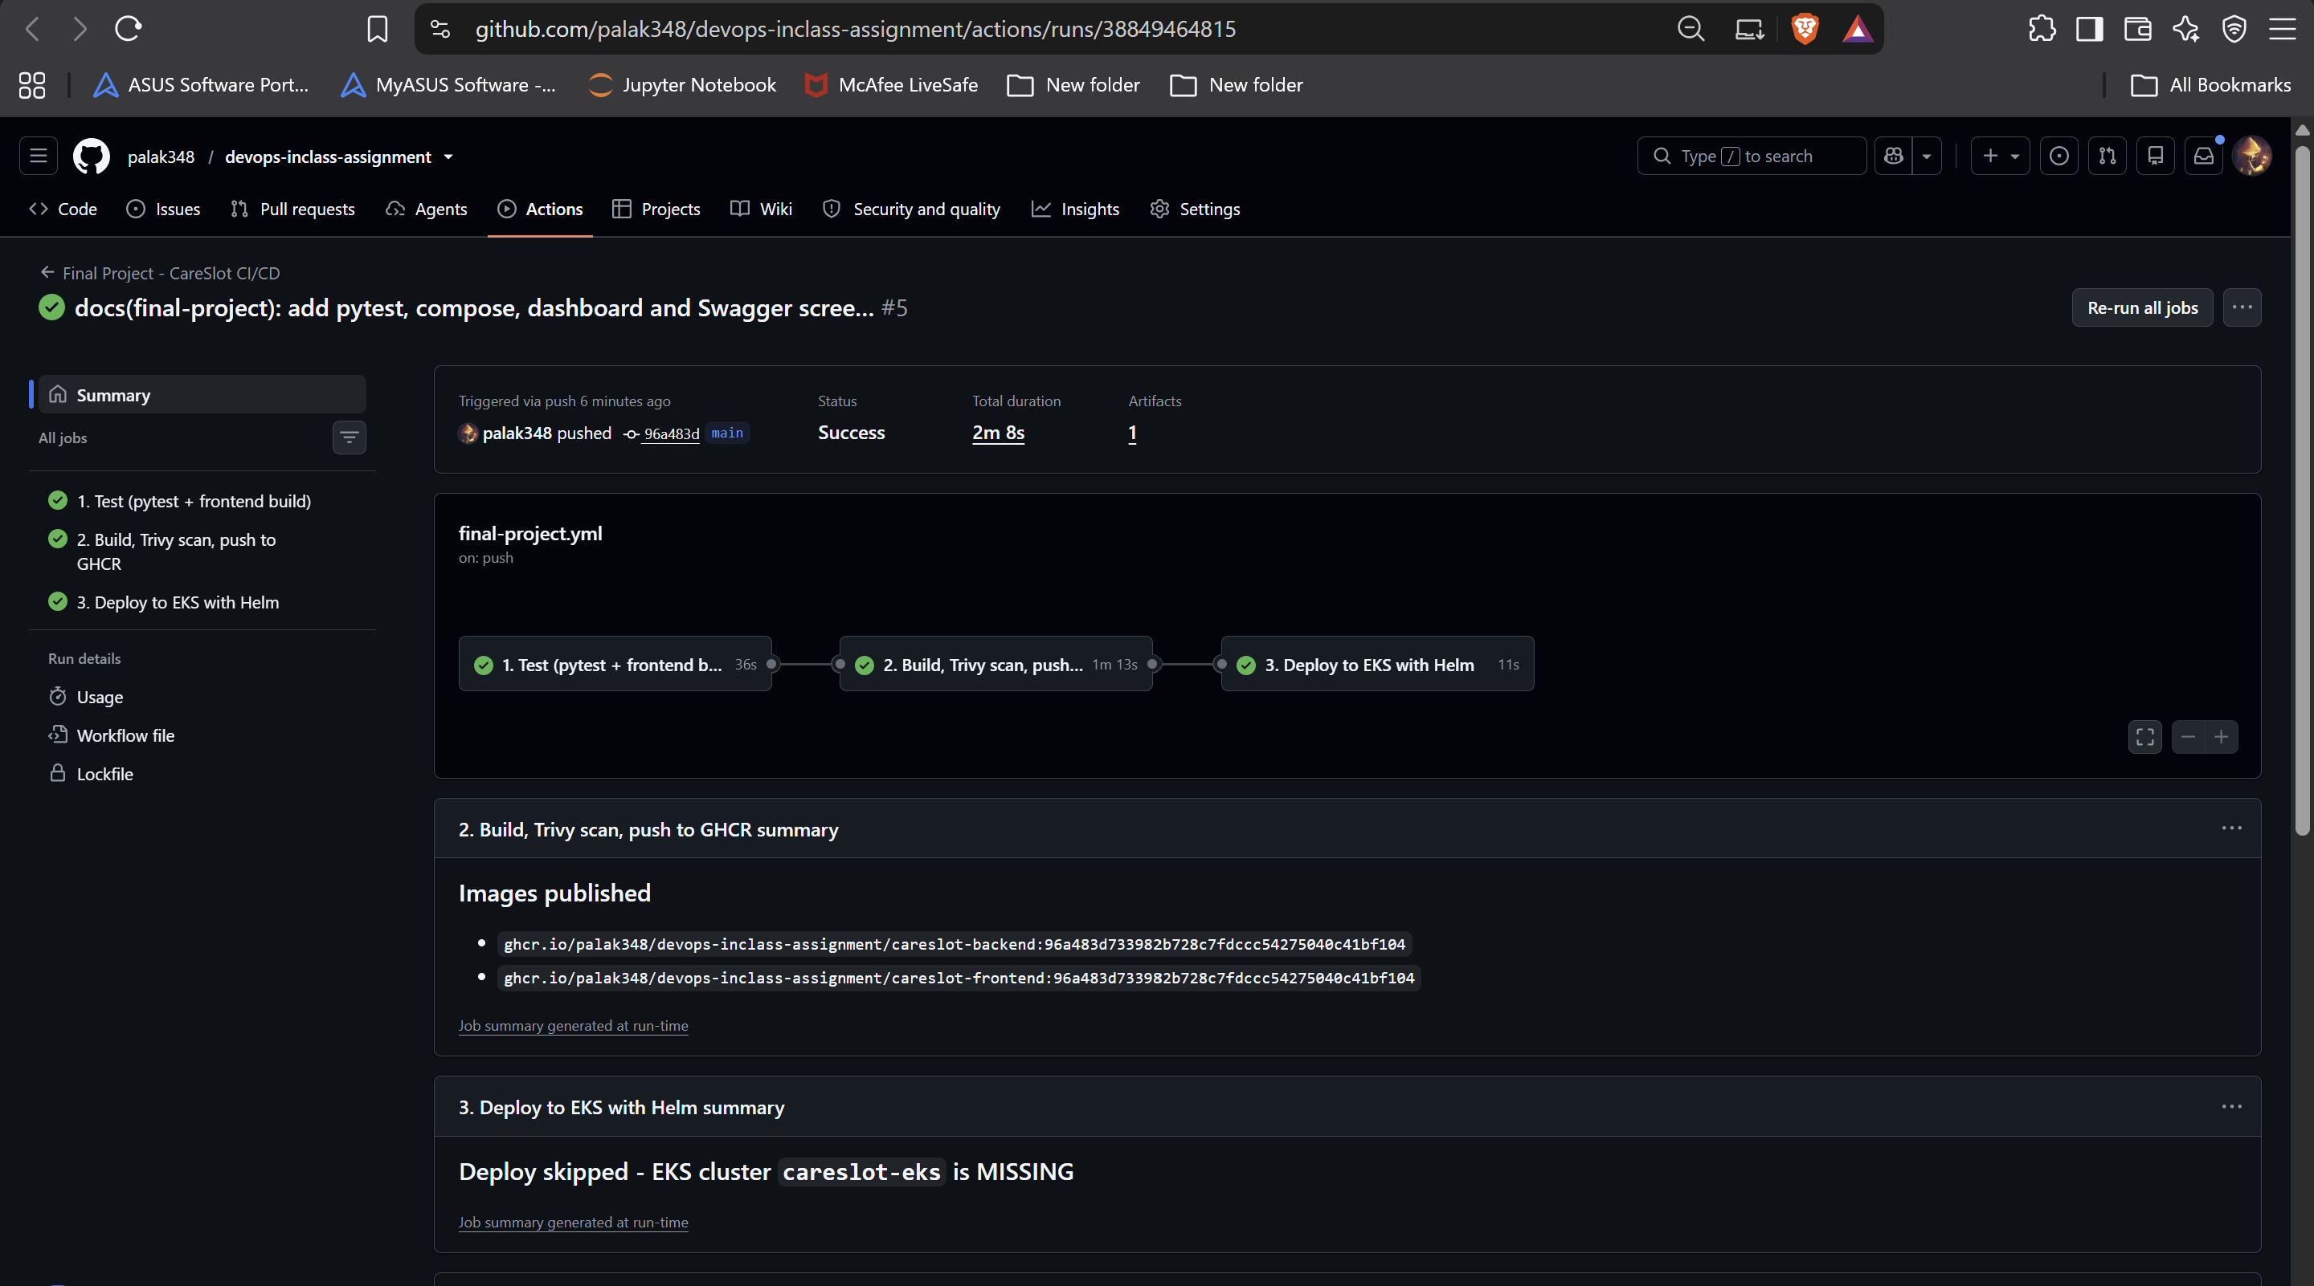
CI/CD flow
1
2
3
4
5
6
7
git push
Test
Build
Trivy gate
GHCR
GitOps commit
Argo CD
to main
ruff · 45 tests · Alembic · React build
2 Docker images
fail on any HIGH/CRITICAL
tag = commit SHA
SHA → values-eks.yaml
syncs to EKS
What stops a bad change
A failing test or lint error stops the run - no image is built
A HIGH or CRITICAL CVE fails the Trivy gate - nothing is pushed
Images are tagged with the commit SHA, never latest
Deploy = a Git commit: Argo CD rolls it out, CI waits until it is Healthy
Notes:
Every push to main runs the pipeline. Job one tests: lint, 45 tests, migrations on a real PostgreSQL and the React build. Job two builds both images and scans them with Trivy before they can be pushed. Job three is GitOps: it writes the commit SHA into the Helm values in Git, and Argo CD on EKS deploys it.

Slide 6
Infrastructure as code - Terraform
VPC 10.20.0.0/16 · ap-south-1 (Mumbai)
53
~$0.40
ap-south-1a
ap-south-1b
Public subnet
10.20.101.0/24 · LB · NAT
Public subnet
10.20.102.0/24 · LB
resources created by terraform apply
per hour, measured running cost
Modules: terraform-aws-modules/vpc 6.7.3 + eks 21.29.0
EKS 1.36 in standard support (extended support costs 6×)
Free-plan account: only Free-Tier-eligible nodes - verified with a real launch
No KMS key or log group, so terraform destroy leaves nothing billable
No credentials in code; tfvars.example documents the variables
Private subnet
10.20.1.0/24
Private subnet
10.20.2.0/24
EKS node
m7i-flex.large
EKS node
m7i-flex.large
+ internet gateway · managed node group · EBS CSI add-on
Notes:
Terraform builds the network and the cluster: a VPC with two public and two private subnets in two availability zones, one NAT gateway, and EKS 1.36 with two m7i-flex.large nodes in the private subnets. That's 53 resources from one apply, and one destroy removes all of them.

Slide 7

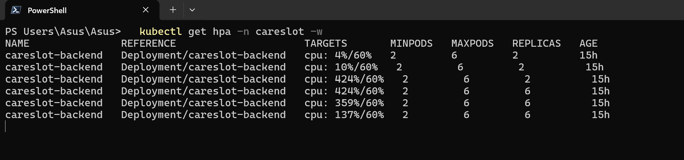




Kubernetes setup
Helm chart careslot
Autoscaling, measured
Deployments, ClusterIP Services, StatefulSet + PVC, probes
Ingress
/api → backend, / → frontend, behind the AWS load balancer
HPA
backend 2-6 Pods on CPU 60 %
2 → 6
Synced
Argo CD (GitOps)
backend Pods when CPU reached 424 % of request
Argo CD Application · Healthy
automated sync, prune and self-heal from Git
Local: minikube + plain Helm · AWS: EKS + Argo CD
Hardening
non-root, capabilities dropped, Pod Security restricted
Notes:
The app is one Helm chart. On EKS, Argo CD owns it: it renders the chart from Git and keeps the cluster equal to it. The Ingress splits API and frontend traffic, and the autoscaler took the backend from two to six Pods under load, then back down.

Slide 8
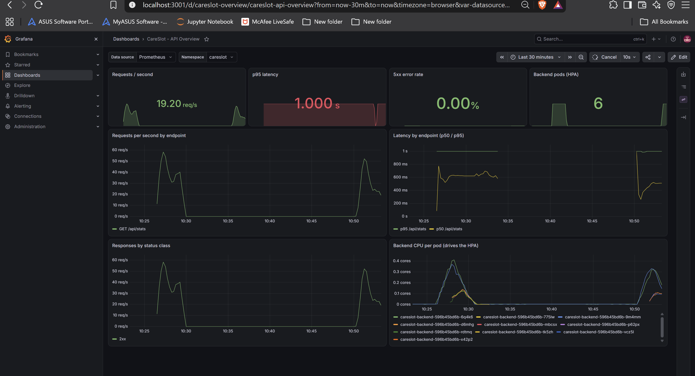
Observability
FastAPI exposes /metrics (Prometheus format)
A ServiceMonitor makes Prometheus scrape every backend Pod - targets UP
Grafana dashboard: requests/s, p95 latency, 5xx error rate, Pods, CPU
Installed with kube-prometheus-stack; dashboard shipped in the Helm chart
Under load: 19 req/s, 0.00 % errors, 6 backend Pods
Notes:
For monitoring, the backend publishes Prometheus metrics. A ServiceMonitor tells Prometheus to scrape every backend Pod, and Grafana turns them into a dashboard - here during a load test: request rate, latency, zero errors, and the extra Pods the autoscaler added.

Slide 9
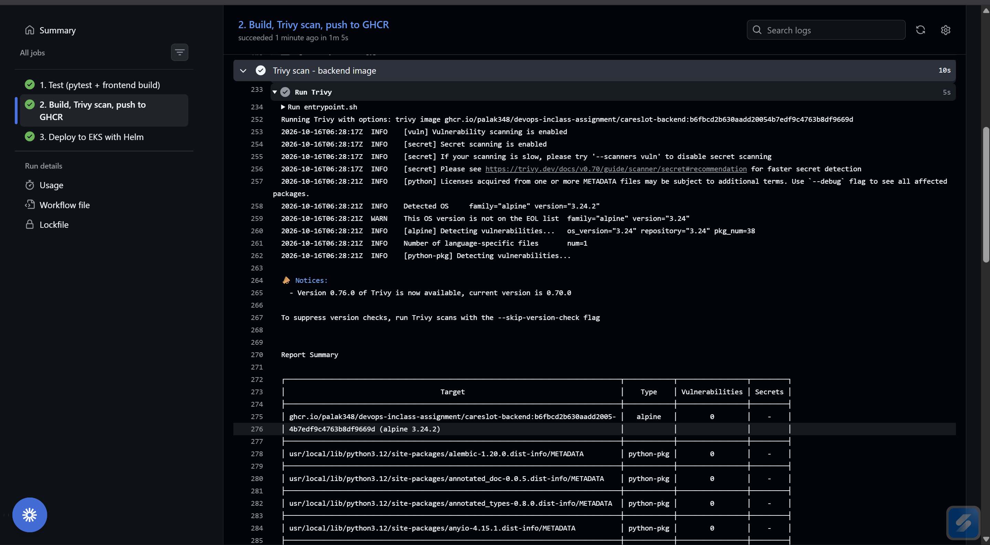

Security in the pipeline
44 → 0
5 → 0
3 / 3
HIGH CVEs in the backend image (Debian → Alpine, pip removed)
gitleaks findings in the full git history (reviewed demo strings)
containers run as non-root (uid 10001, 101, 70)
Trivy scans both images before push and fails on any HIGH or CRITICAL CVE - even unfixed ones
Example fixed: CVE-2026-85091, a heap overflow in zlib, removed by apk upgrade during the build
No secrets in Git: AWS keys only in aws configure and GitHub secrets; DB and Grafana passwords generated in-cluster
Read-only root filesystem for the backend, all Linux capabilities dropped, Pod Security restricted
CI run: Trivy Report Summary - alpine 3.24.2, 0 vulnerabilities
Notes:
Security runs in the pipeline. The backend image started with 44 HIGH vulnerabilities from Debian; moving to Alpine and removing pip brought both images to zero, so the gate can block every HIGH or CRITICAL finding. gitleaks checks the whole history, and every container runs as non-root.

Slide 10

Key learnings
Verify the account, not the docs
Defaults can break storage
GitOps changes chart design
A Free-plan AWS account can only launch Free-Tier types - t3.medium was blocked; a 1-minute real launch proved m7i-flex.large works.
The EKS module's IMDS hop limit of 1 left the EBS CSI driver without credentials; hop limit 2 fixed the database volume.
Argo CD renders charts without Helm lookup, so the random DB password needed an existing Secret.
Don't hide CVEs, remove them
Test in a real browser
Plan the teardown
ignore-unfixed hid 44 HIGH CVEs; a smaller base image and no pip removed them.
A headless browser run found a date-picker bug that blocked bookings - unit tests had passed.
Load balancers created by Kubernetes block terraform destroy - uninstall them first.
Notes:
What I learned: check what your own account allows instead of trusting general docs; module defaults can quietly break things like storage; GitOps changes how you design a chart; remove vulnerabilities rather than ignoring them; test in a real browser; and plan the teardown as carefully as the setup.

Slide 11

Thank you
Next steps: login and roles · HTTPS with a domain · Amazon RDS · S3 Terraform state · alerting
github.com/palak348/devops-inclass-assignment
Notes:
Next steps for a real clinic would be login and roles, HTTPS on a proper domain, a managed RDS database, shared Terraform state and alerting. Everything I showed is in the repository. Thank you.

