Slide 1
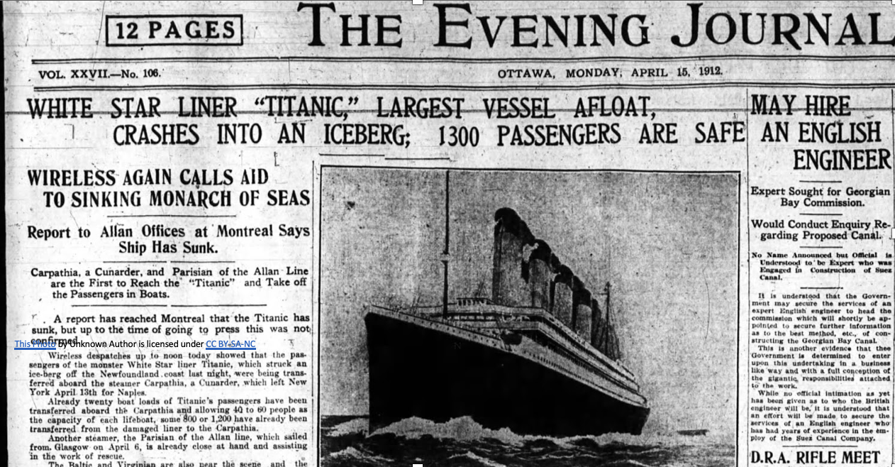
Titanic Survival Prediction
Using Data Cleaning and Naive Bayes Classification
Group No. 6
1.Palak Tiwari
2.Radhika
3.Rudransh Mishra
4.Rudrika Singhal
5.Roushan Kumar

Slide 2
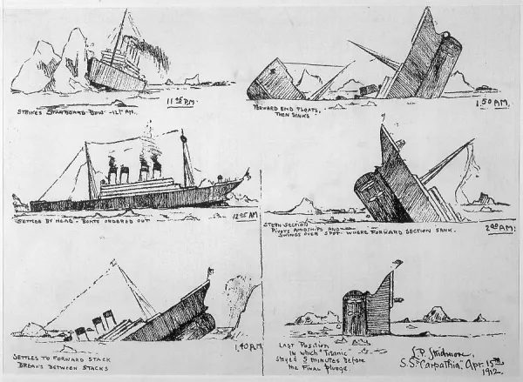
Problem Statement
Objective
Importance
Predict Titanic passenger survival using available data.
Understanding disaster outcomes aids historical and risk analysis.
Machine Learning
Uncovers hidden survival patterns beyond human intuition.

Slide 3
Introduction to the Dataset
Source & Size
Key Features
Target
Kaggle Titanic Dataset with 891 rows, 12 columns.
Pclass, Sex, Age
Survived (binary: 0 = no, 1 = yes)
SibSp, Parch, Fare
Embarked

Slide 4
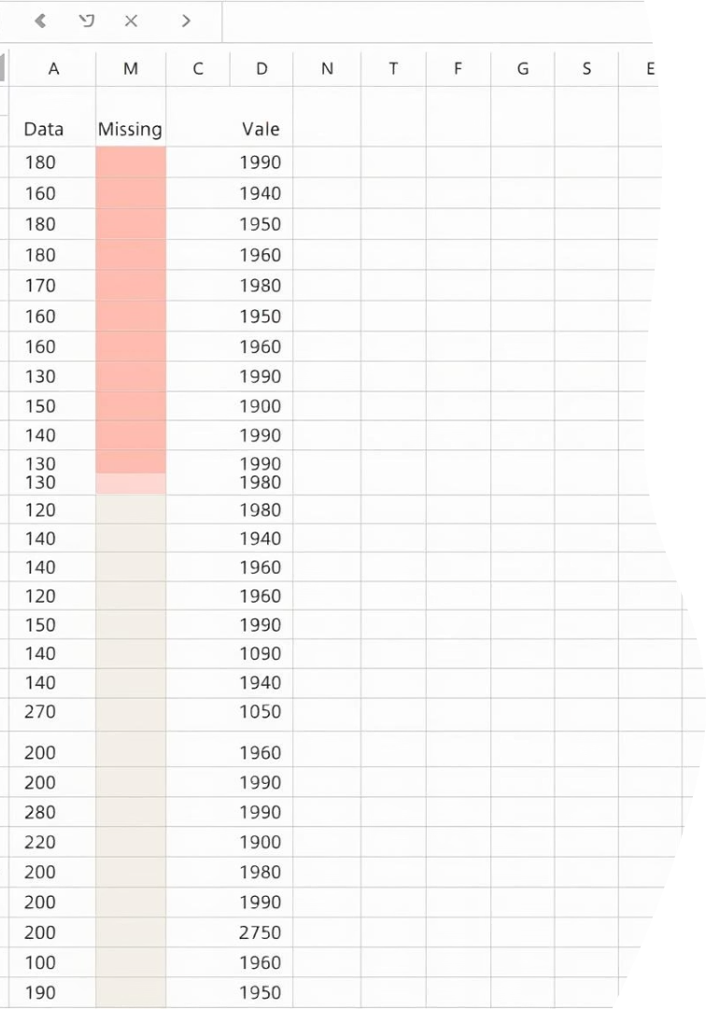
Challenges in Raw Data
Missing Values
Categorical Variables
Gaps in Age, Cabin, Embarked reduce model accuracy.
Sex and Embarked require encoding for modeling.
Outliers & Inconsistencies
Irregular fares and cabin entries need addressing.

Slide 5
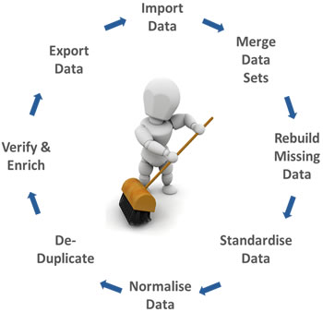




Data Cleaning Steps
Fill Missing Values
Age by median, Embarked by mode.
Drop Irrelevant Columns
Cabin and Ticket removed to reduce noise.
Encode Categorical Data
Convert Sex and Embarked into numeric codes.
Normalize Features
Optional scaling applied for numerical stability.

Slide 6
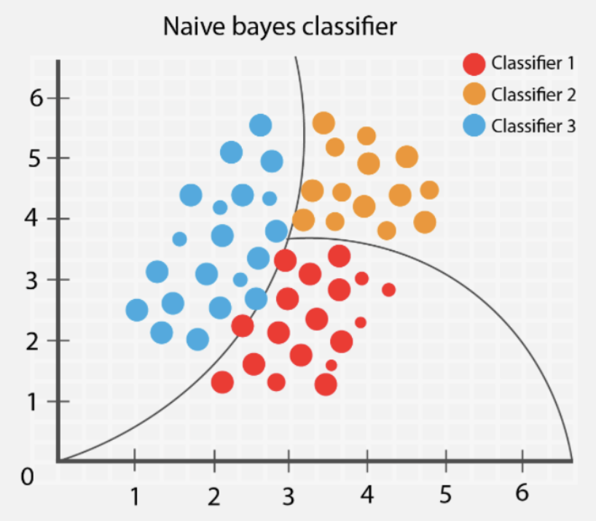
Why Naive Bayes?
Simple & Fast
Efficient with small to moderate datasets.
Good with Categorical Data
Handles discrete variables naturally.
Feature Independence
Assumes independent predictors, simplifying computation.
Model Variant
Gaussian or Multinomial Naive Bayes depending on data encoding.

Slide 7
Feature Selection
Selected Features
Feature Importance
Pclass
Sex and Pclass show strong survival correlation.
Sex
Age and Fare contribute moderate predictive value.
Age
SibSp
Parch
Fare
Embarked

Slide 8

Model Building Process
Train-Test Split
80% data for training, 20% for validation.
Training
Naive Bayes model fit to cleaned data.
Testing
Evaluate model predictions on unseen data.
Tools Used
Python, pandas, scikit-learn, NumPy.

Slide 9
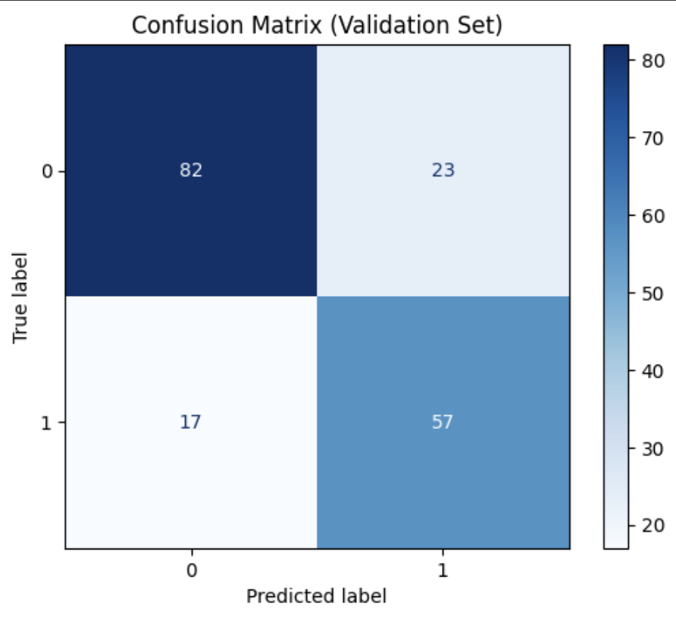
Evaluation Metrics Explained
Recall
Accuracy
Ratio of correct predictions over total.
True positives divided by all actual positives.
Precision
F1-Score
True positives divided by all predicted positives.
Harmonic mean of precision and recall.

Slide 10
Model Performance
Confusion Matrix
Key Metrics
Model Comparison
Shows TP, TN, FP, FN counts for survival predictions.
Accuracy: ~77%
Naive Bayes performs comparably to logistic regression and decision trees.
Precision: ~75%
Recall: ~77%
F1-Score: ~75%

Slide 11
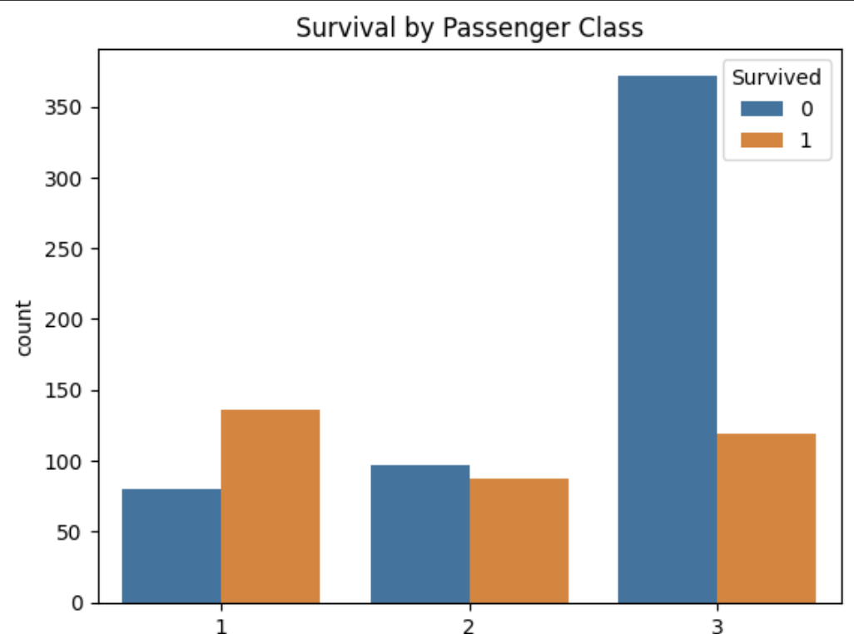
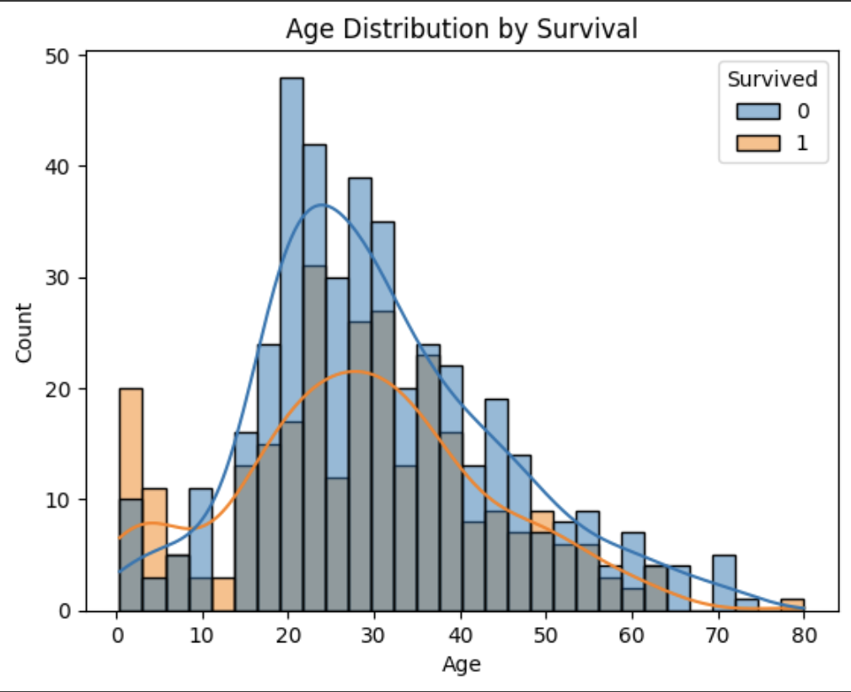
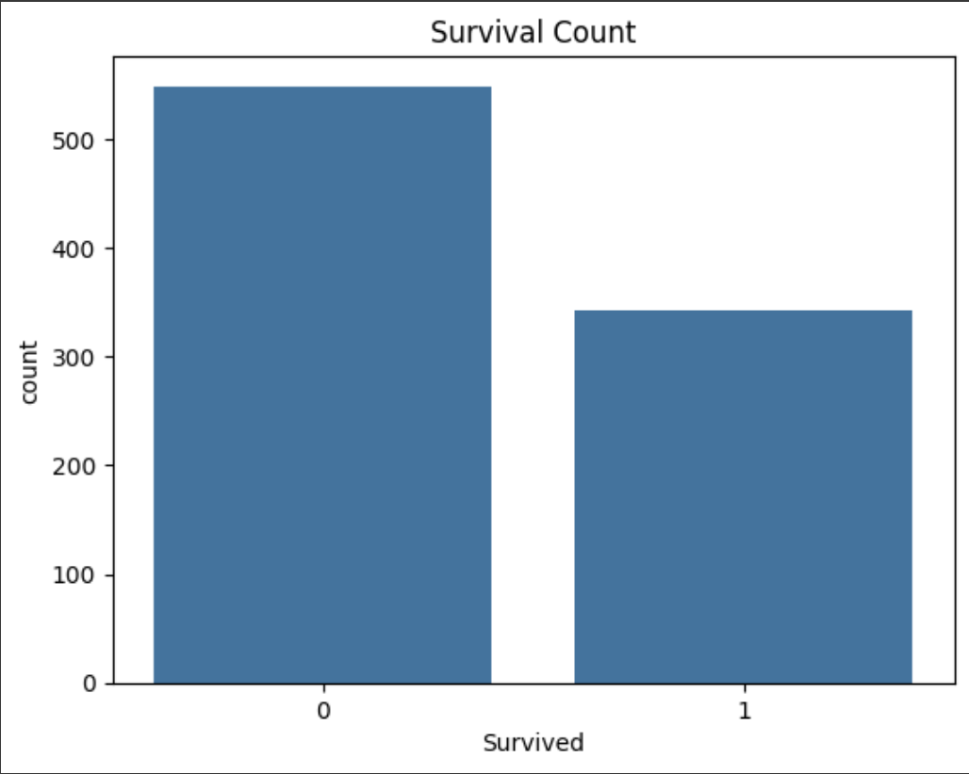
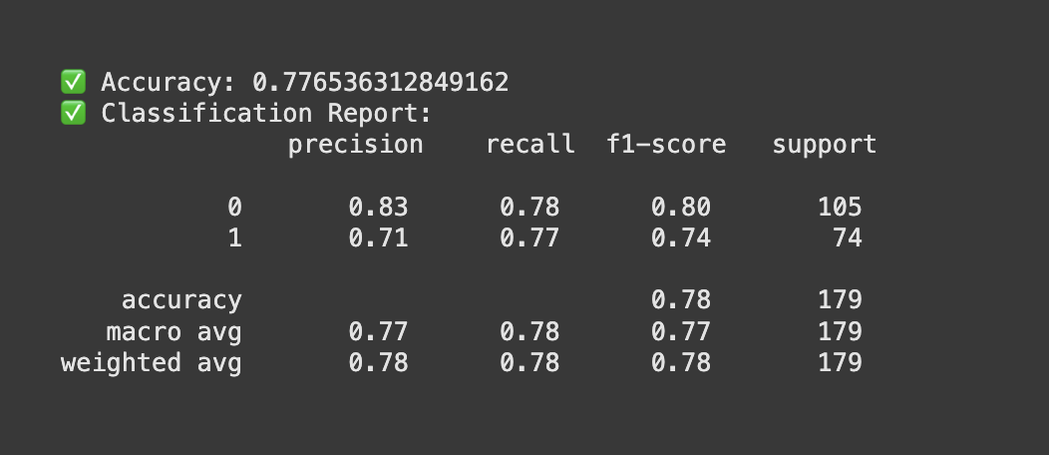
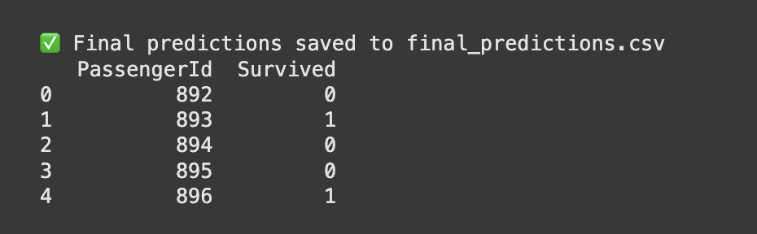
Result\Output

Slide 12

References

