Slide 1
Breast cancer Classification using Transfer Learning
Prof. Nik Bear Brown
MS – IS
Palak Agrawal
Vinoth Punniyamoorthy
Ayushi Sachdeva

Slide 2
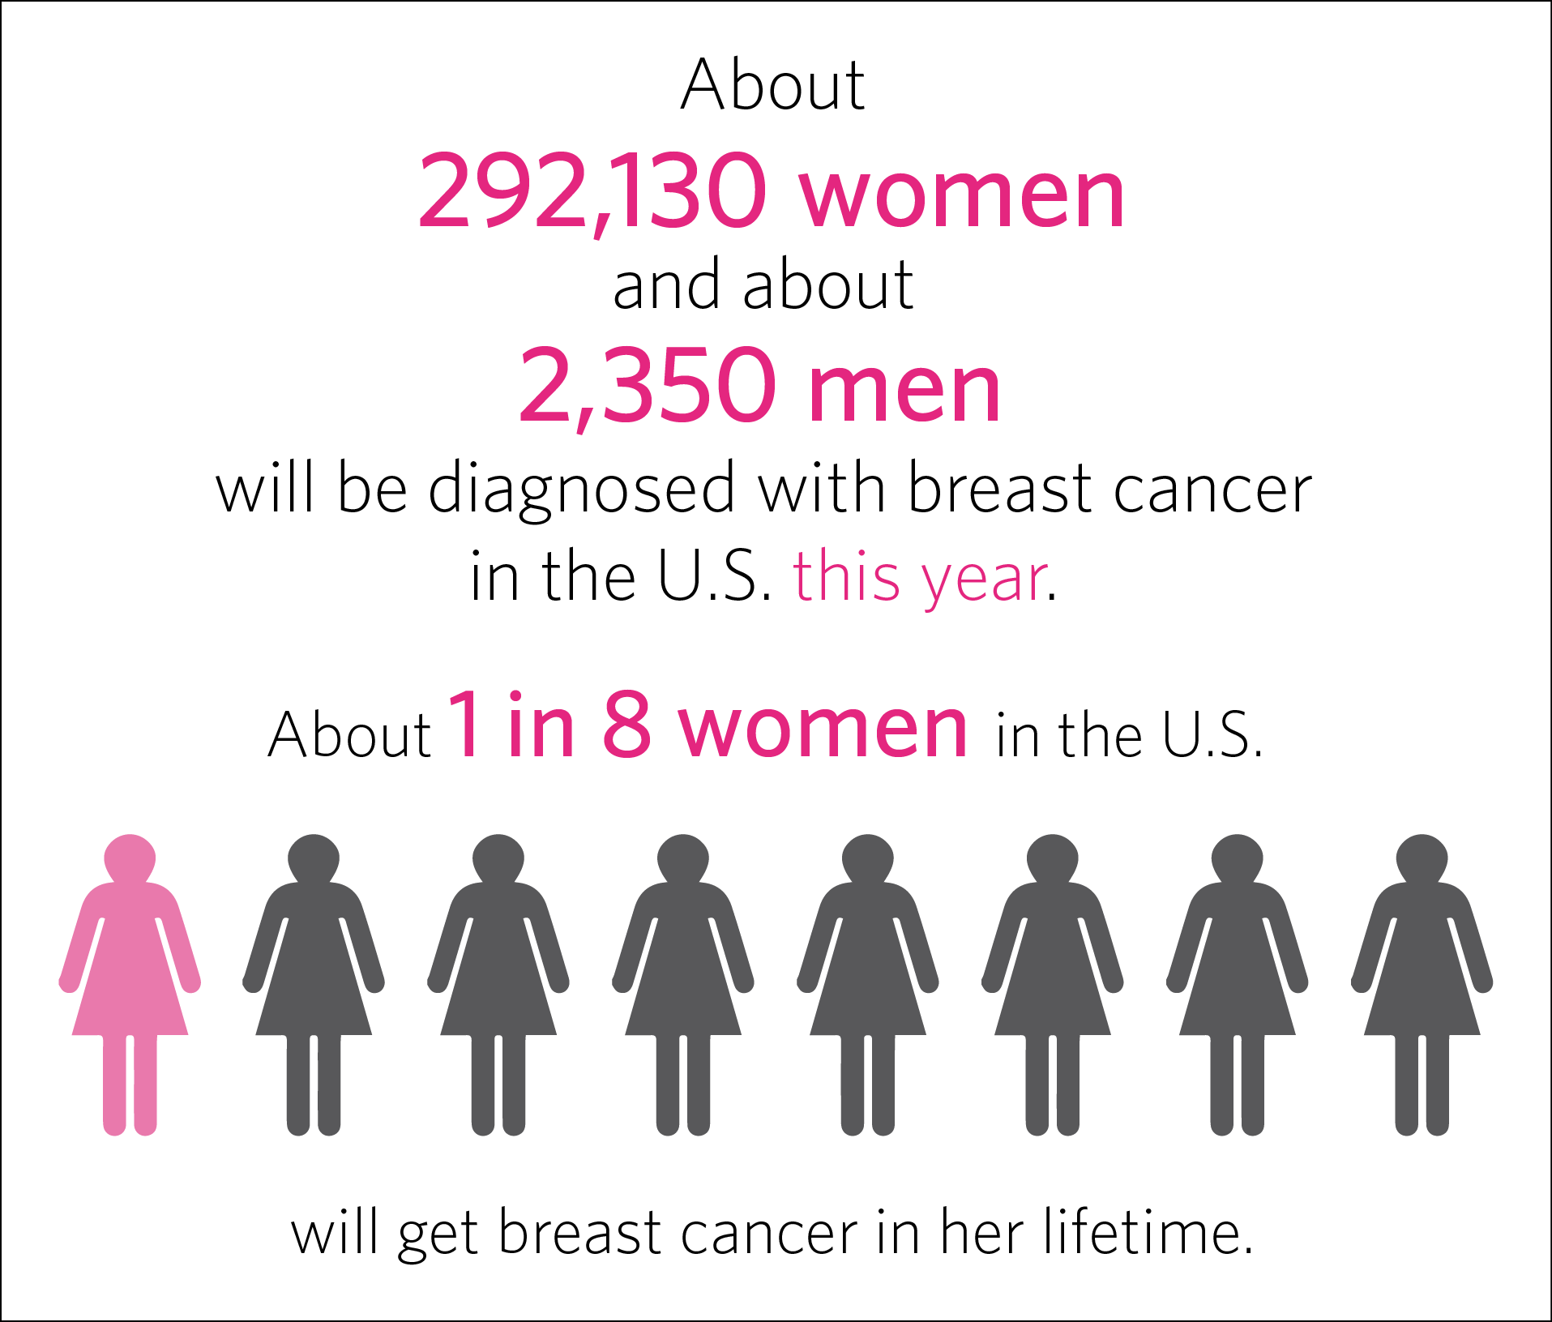
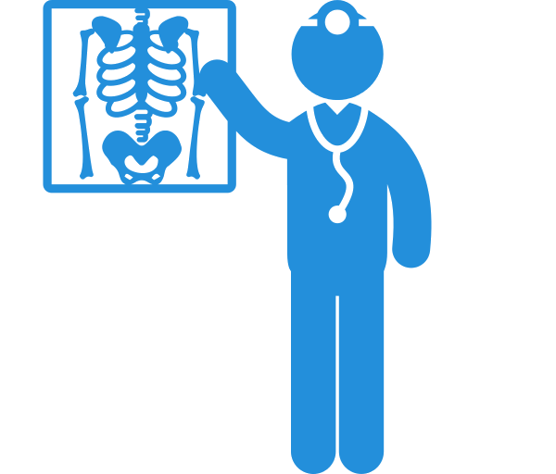
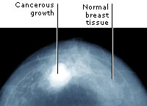

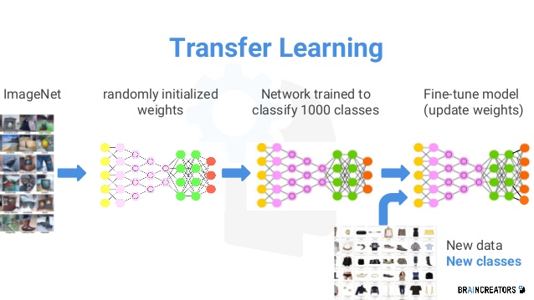
Introduction
Leading cause of cancer-related mortality in women.
Imperative early detection and treatment, increased Computer Aided Diagnosis Systems.
Diagnosis on breast ultrasound is a Subjective and dependent on experience of Radiologist.
To collaborate with experience of radiologist, building a model using the Google Inception V3 and Transfer Learning

Slide 3
Dataset
Curated Breast Imaging Subset of Digital Database for Screening Mammography (DDSM) - Source
The DDSM is a database of 2,620 scanned film mammography studies
It has a data of 6671 total patients
Mammography (MG) modality is used.
The data was split for all Mass and Calcification cases separately.
Category | Number of cases
Benign | 1105
Benign without Call-back | 578
Malign | 1198

Slide 4
Transfer Learning
Machine learning method which utilizes a pre-trained model.
Google’s Inception-v3 is Image recognition model which is pre-trained.
It consists of two parts:
Extracts feature with a Convolutional Neural Network.
Classify them with fully-connected layers.
We will reuse the feature extraction part and re-train the classification part with our dataset.

Slide 5

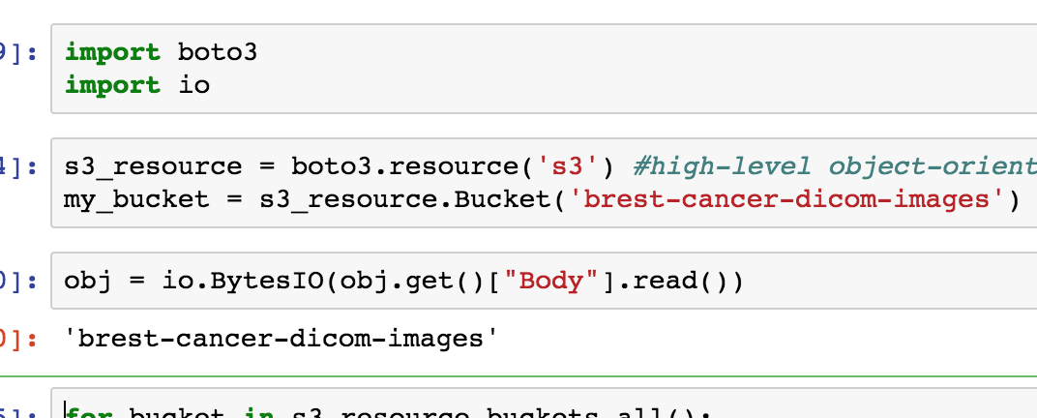
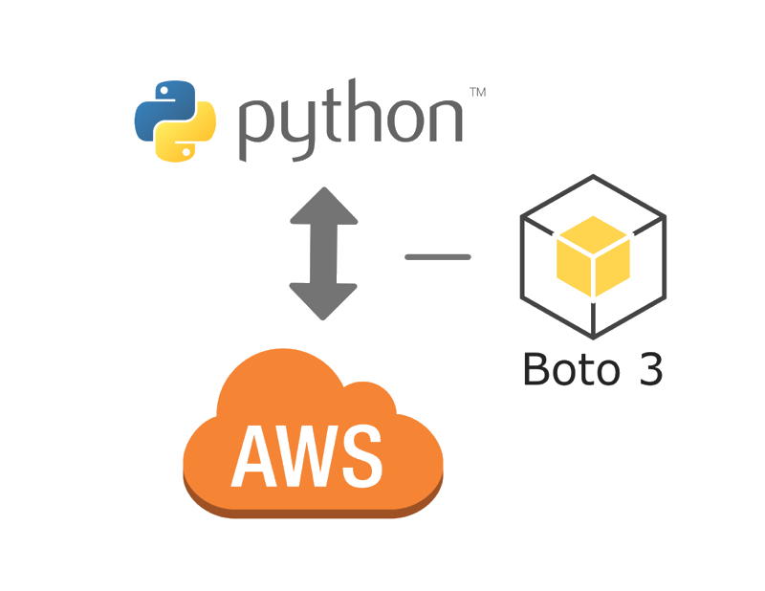
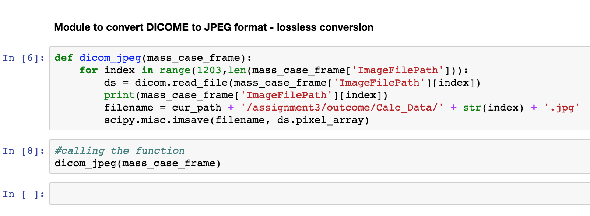
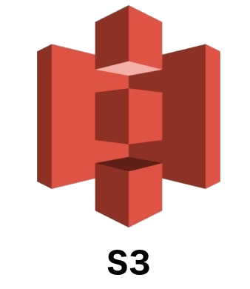
Working

Slide 6
Working
Downloaded DICOM images and converted to JPEG format
All the images have two views:
Cranial Caudal – CC
Medio-Lateral Oblique – MLO
Used below libraries till now:
OpenCV (CV2) – Optimized library for numerical operations with a MATLAB-style syntax which uses Numpy
DICOM – Digital Imaging and COmmunications in Medicine. It is used to exchange, store and communicate with digital medical images
Scipy – Contains linear algebra modules, as well as many other numerical algorithms. It is used for scientific mathematical computing
Boto3 - Itis the Amazon Web Services (AWS) SDK for Python

Slide 7
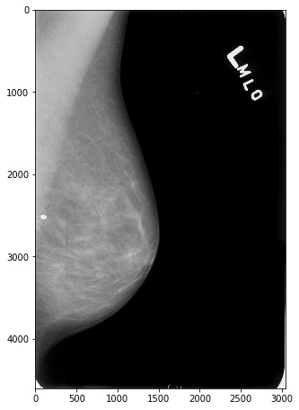
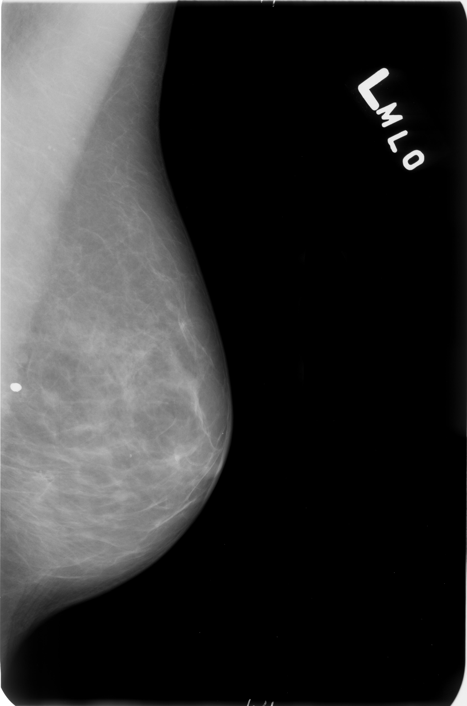
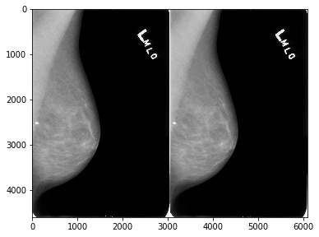
Pre-Processing
2
cv2.IMREAD_GREYSCALE
Gives single channel grey scaled image.
1
3
Original Image
cv2.medianblur
Convolving the image with a Low Pass Filter and removing the noise

Slide 8
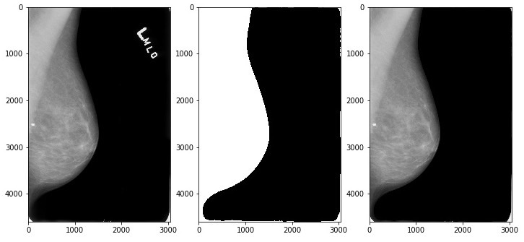
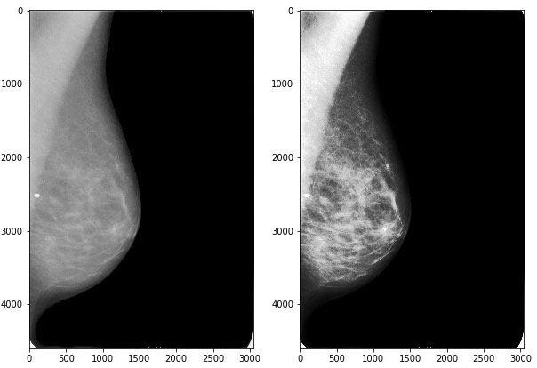
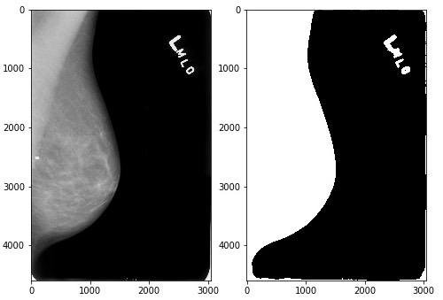
Pre-Processing
5
Artifact Suppression
To remove artifact name/number
6
4
cv2.equalizeHist
Histogram Equalization - Contrast Enhancement
cv2.Threshold - THRESH_BINARY
Converts everything to white or black

Slide 9
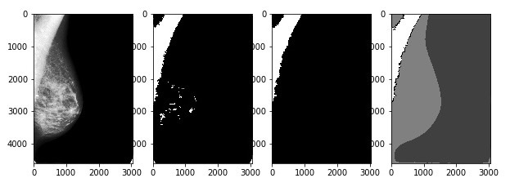
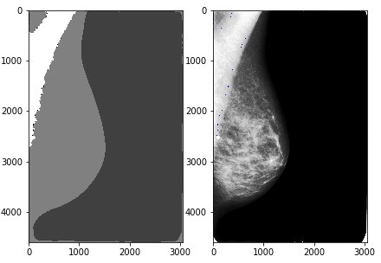
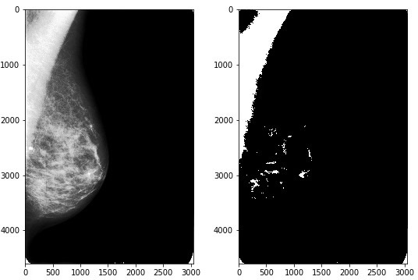
Pre-Processing
cv2.erode & cv2.dilate
Diminish the feature and increase the object area
7
8
6
Watershed
Marking and Segmenting the morphologically transformed image
cv2.Threshold - THRESH_BINARY
Converts equalized image to black or white

Slide 10
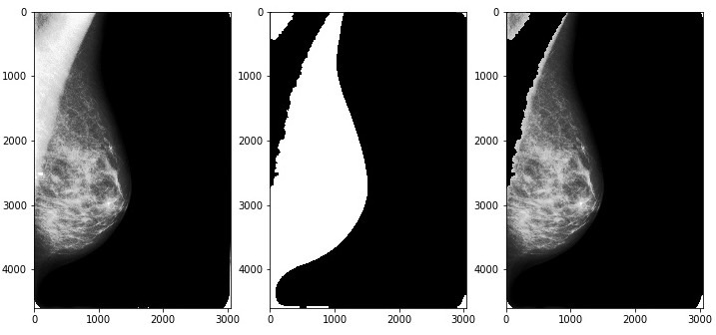
Pre-Processing
9
Morphological Transformation and Masking
Again image is eroded and dilated using
cv2.morphologyEx - MORPH_OPEN
Masking is done using
cv2.bitwise_and

Slide 11
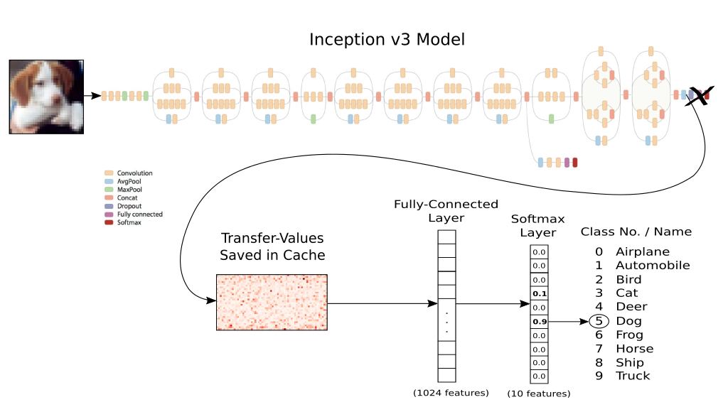
Upcoming
Feed processed images to convolutional neural network
Extract the features with CNN
Use transfer learning to classify the breast cancer
Planning to use TensorFlow framework for numerical computation

Slide 12

Thanks!
Any questions?
You can find me us at:
Agrawal.pala@husky.neu.edu
Sachdeva.ay@husky.neu.edu
Punniyamoorthy.v@husky.neu.edu

