Slide 1
Breast cancer Identification using Transfer Learning
Prof. Nik Bear Brown
MS – IS
Palak Agrawal
Vinoth Punniyamoorthy
Ayushi Sachdeva

Slide 2
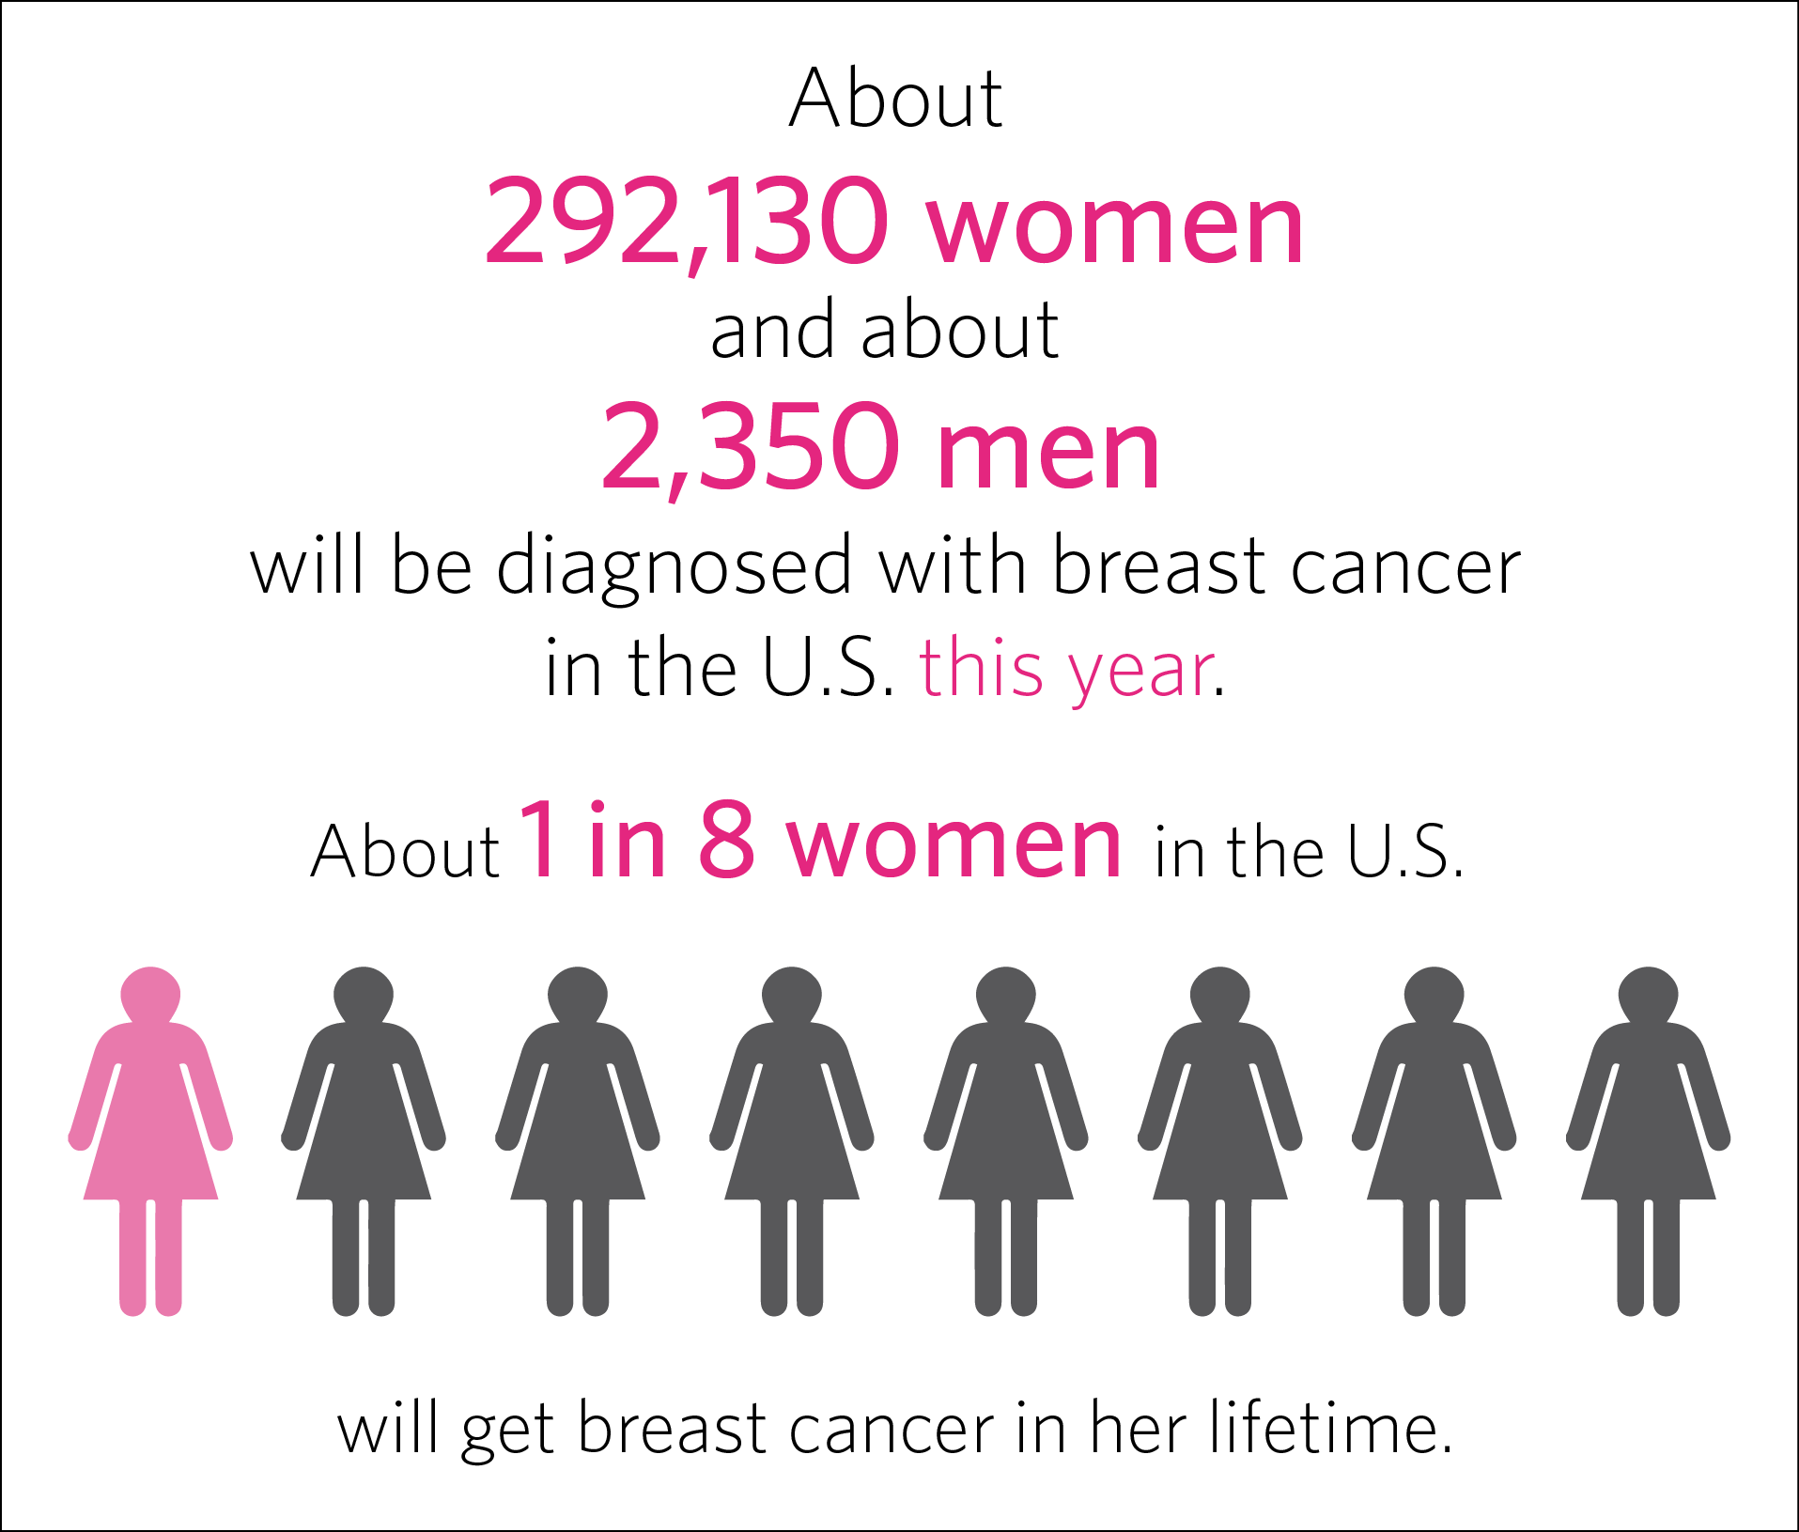
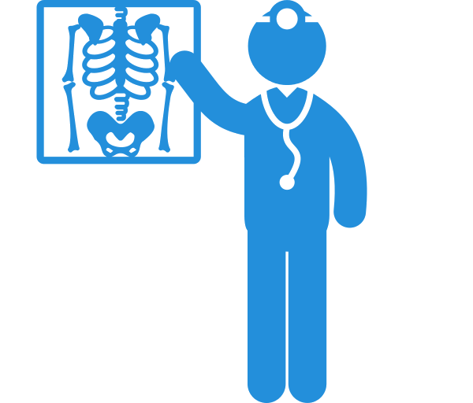
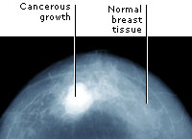

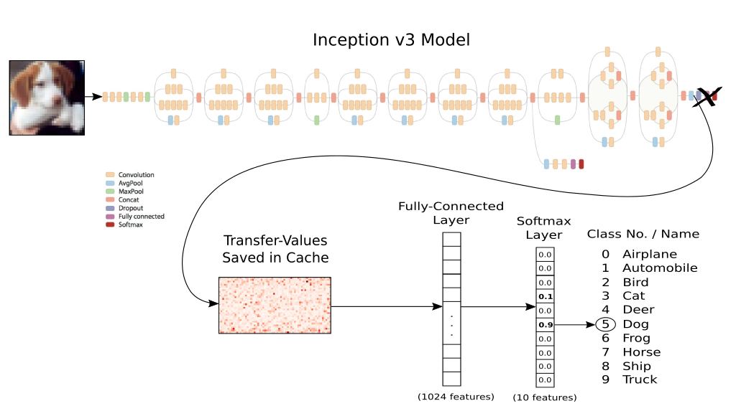
Introduction
Leading cause of cancer-related mortality in women.
Imperative early detection and treatment, increased Computer Aided Diagnosis Systems.
Diagnosis on breast ultrasound is a Subjective and dependent on experience of Radiologist.
To collaborate with experience of radiologist, building a model using the Google Inception V3 and Transfer Learning

Slide 3
Dataset
Curated Breast Imaging Subset of Digital Database for Screening Mammography (DDSM)
The DDSM is a database of 2,620 scanned film mammography studies
It has a data of 6671 total patients
Mammography (MG) modality is used.
The data was split for all Mass and Calcification cases separately.
Category | Number of cases
Benign | 1105
Benign without Call-back | 578
Malign | 1198

Slide 4
Transfer Learning
Machine learning method which utilizes a pre-trained model.
Google’s Inception-v3 is Image recognition model which is pre-trained.
It consists of two parts:
Extracts feature with a Convolutional Neural Network.
Classify them with fully-connected layers.
We will reuse the feature extraction part and re-train the classification part with our dataset.

Slide 5
Working
Downloaded DICOM images and converted to JPEG format.
All the images have two views:
Cranial Caudal – CC
Medio-Lateral Oblique – MLO
Using below libraries:
OpenCV (CV2) – Optimized library for numerical operations with a MATLAB-style syntax which uses Numpy
DICOM – Digital Imaging and COmmunications in Medicine. it is used to exchange, store and communicate with digital medical images
Scipy – Contains linear algebra modules, as well as many other numerical algorithms. It is used for scientific mathematical computing

Slide 6
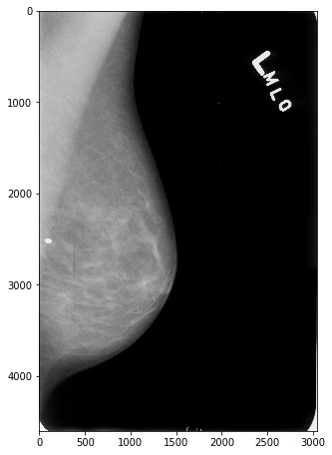
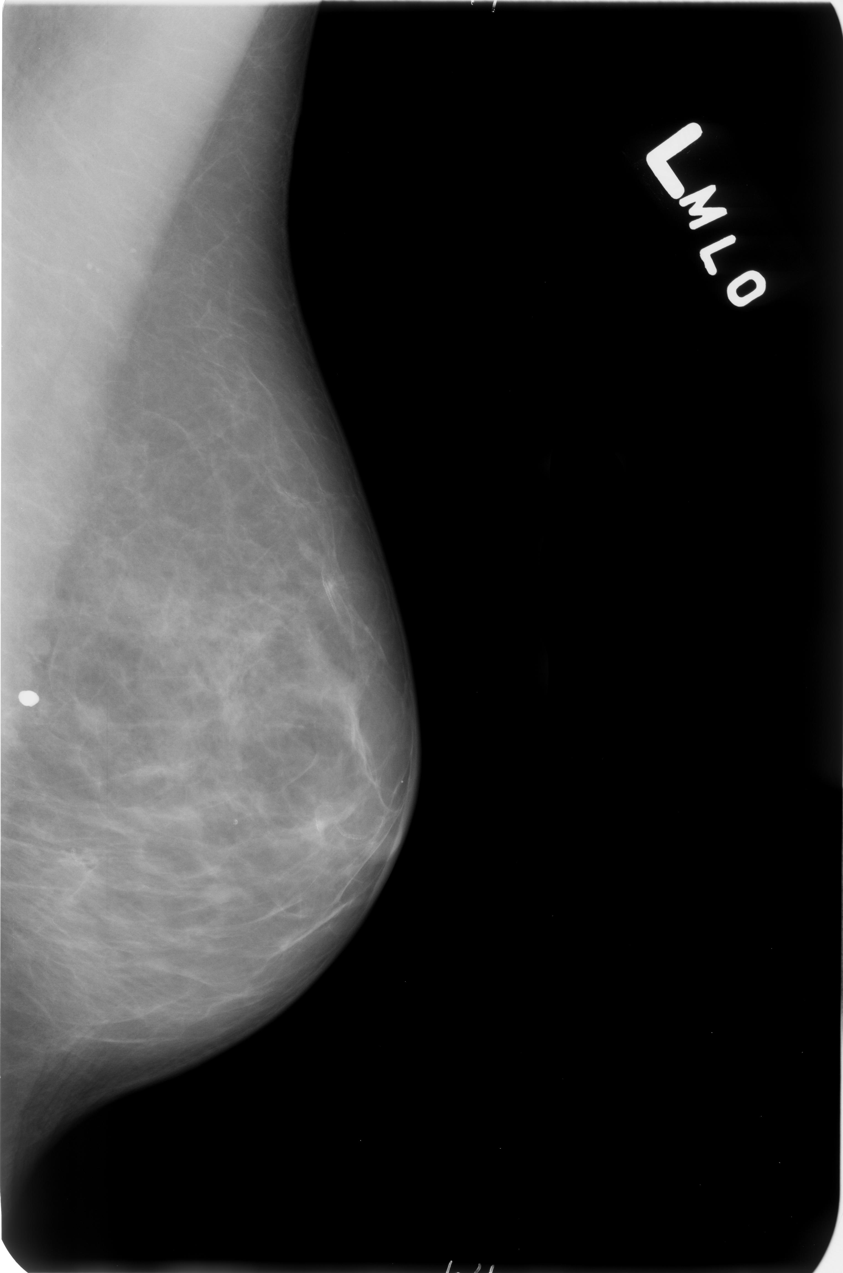
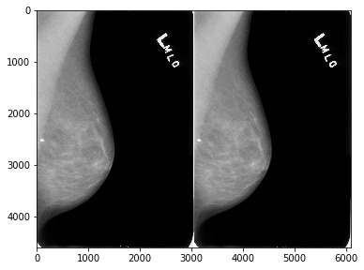
Pre-Processing
2
cv2.IMREAD_GREYSCALE
Gives single channel grey scaled image.
1
3
Original Image
cv2.medianblur
Convolving the image with a Low Pass Filter and removing the noise

Slide 7
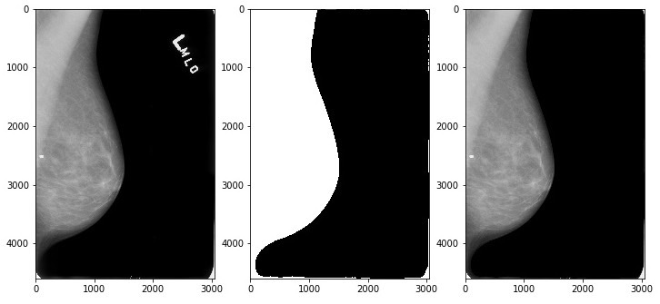
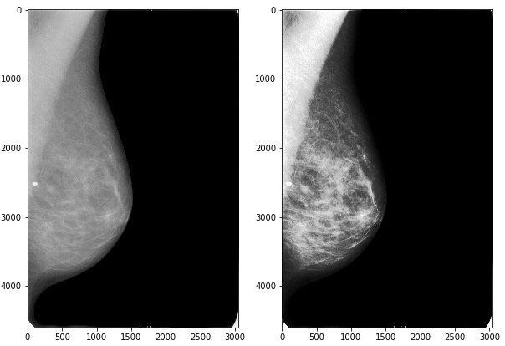
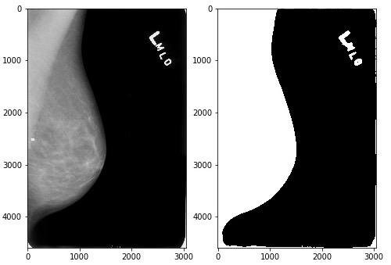
Pre-Processing
5
Artifact Suppression
To remove artifact name/number
6
4
cv2.equalizeHist
Histogram Equalization - Contrast Enhancement
cv2.Threshold - THRESH_BINARY
Converts everything to white or black

Slide 8
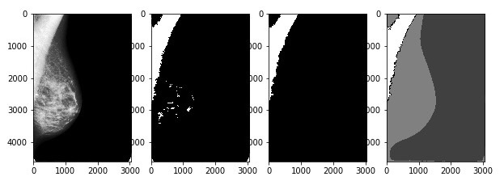
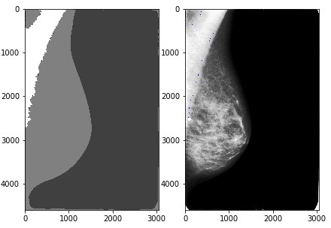
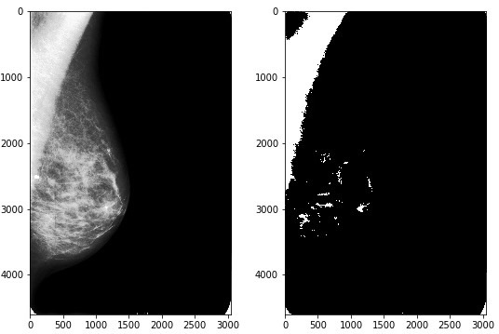
Pre-Processing
cv2.erode & cv2.dilate
Diminish the feature and increase the object area
7
8
6
Watershed
Marking and Segmenting the morphologically transformed image
cv2.Threshold - THRESH_BINARY
Converts equalized image to black or white

Slide 9
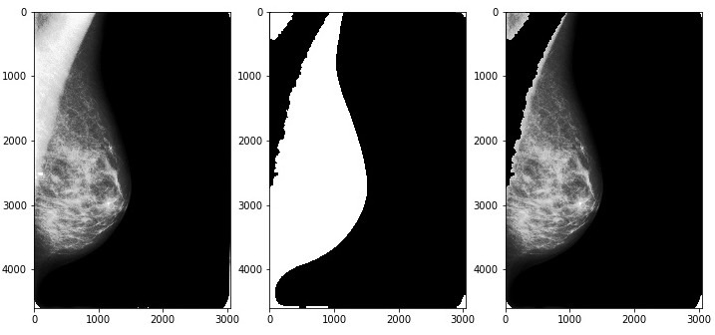
Pre-Processing
9
Morphological Transformation an Masking
Again image is eroded and dilated using
cv2.morphologyEx - MORPH_OPEN
Masking is done using
cv2.bitwise_and

Slide 10
Upcoming
Curated

Slide 11

Thanks!
Any questions?
You can find me us at:
Agrawal.pala@husky.neu.edu
Sachdeva.ay@husky.neu.edu
Punniyamoorthy.v@husky.neu.edu

