Slide 1
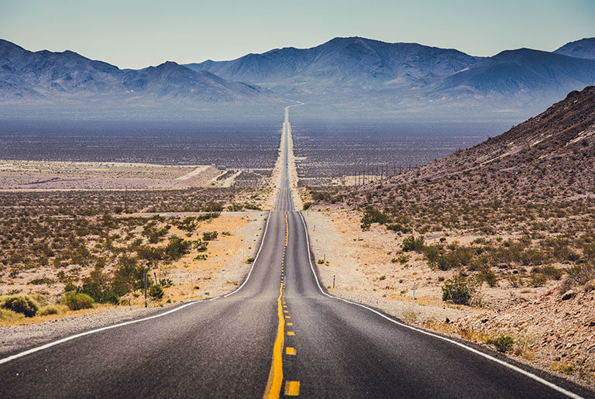
TravellerExperience
Made by:
Alexandur Rangelov
Ivan Stefanov

Slide 2
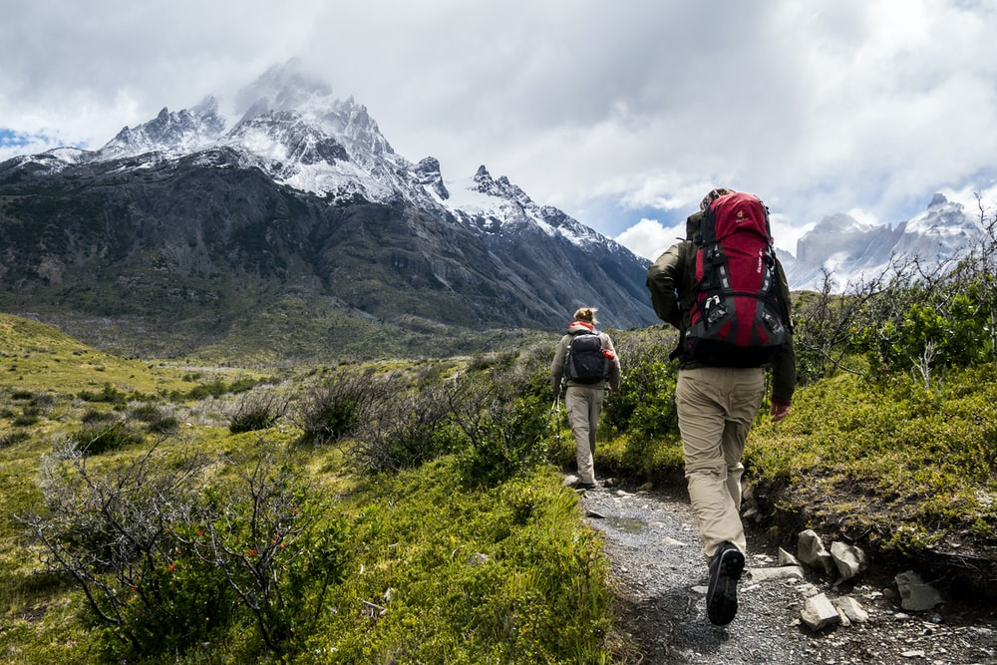
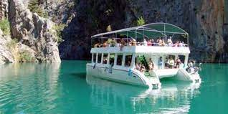
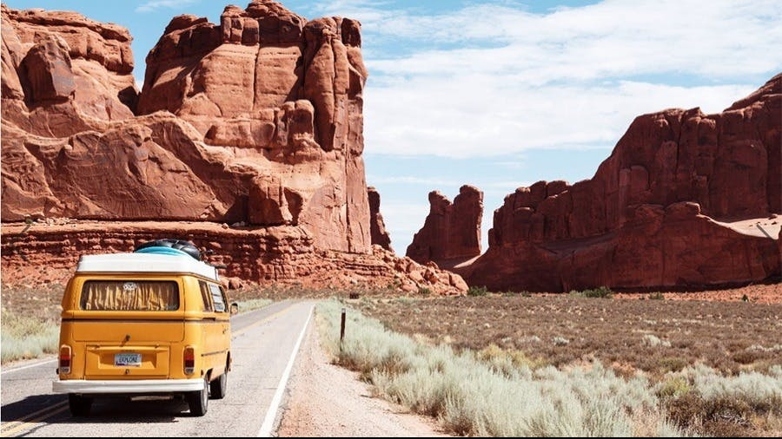
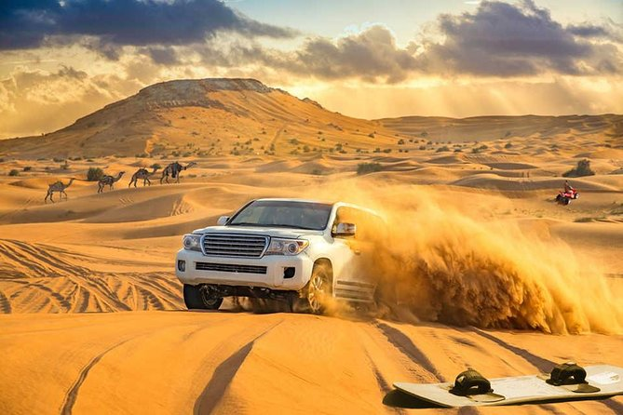
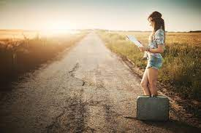
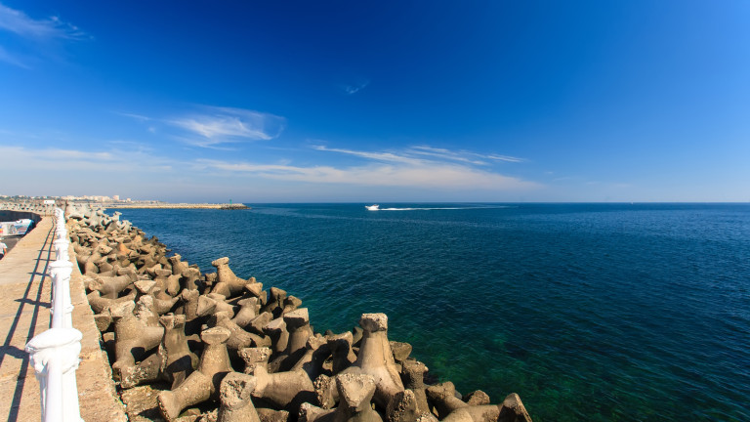

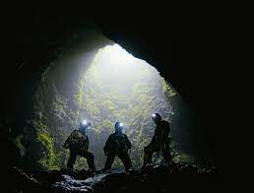

This is unique platform
for sharing
travelling experiences

Slide 3

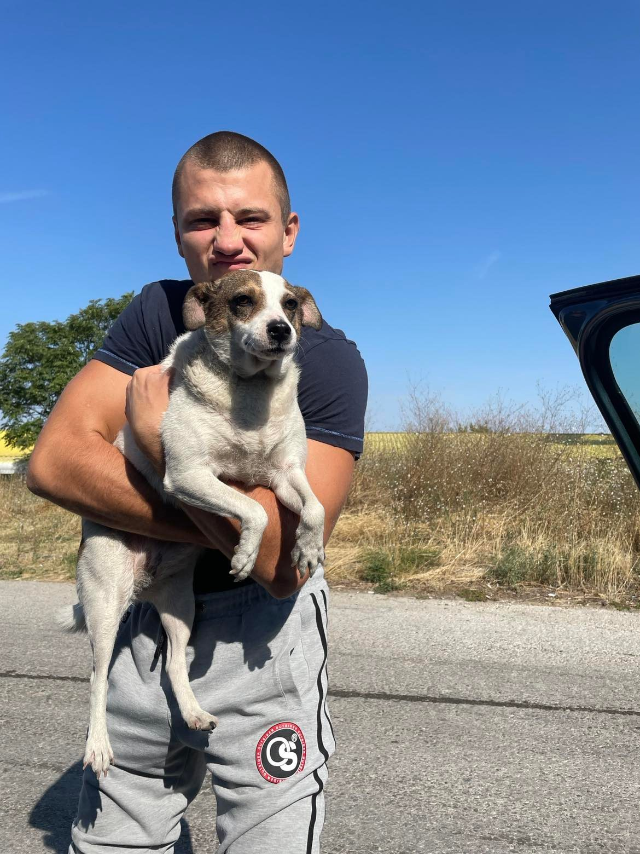
New born IT talents from “IT TALENTS” season 13
ABOUT US
Alexandur Rangelov
Ivan Stefanov

Slide 4
Main functionality
Registration and login
Uploading posts with description, photos/video, location
Newsfeed filtered by like, category, date
Subscription
Post categories
Browsing uploaded posts
Like/Dislike of post
Tag users on post
Creation of comment for post
Like/Dislike of comment
Showing location via latitude and longitude

Slide 5
What we used?
Technologies and API’s
Software
Java 17
InteliJ IDEA
Spring Boot
Postman
Spring Rest
Maven
Git
Hibernate
MySQL Workbench
JPA
MySQL
Bcrypt
Lombok
Java Mail
Swagger
OpenCage

Slide 6
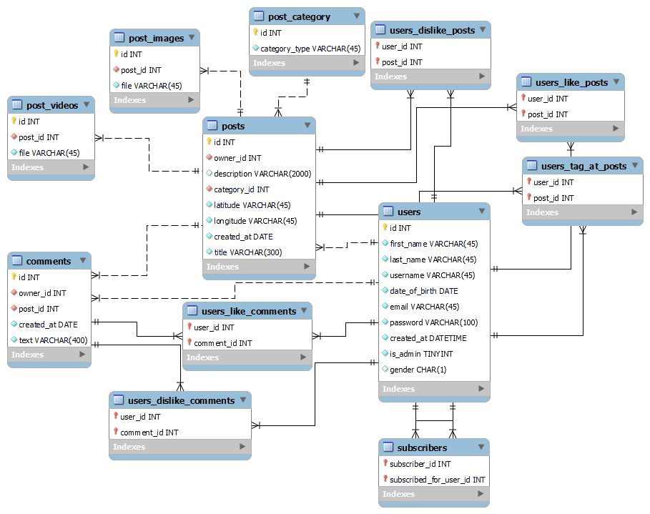
Database Diagram

Slide 7
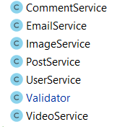
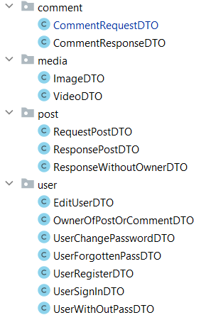
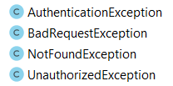
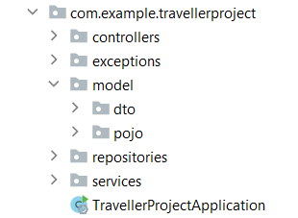
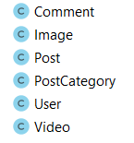
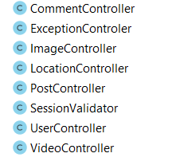
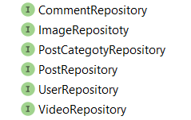
Class Diagram
Services
Exceptions
DTO
Pojo
Controllers
Repositories

Slide 8
DEMO
Now let’s see how everything works.

