Slide 1
Text Condensation
Automatic summarization transforms complexity into clarity

Slide 2
Problem Statement
Solution
In today's digital age, the volume of textual information is rapidly increasing, making it challenging for individuals to process and extract key insights from lengthy documents, articles, or reports. Manual summarization is time-consuming and prone to human error, highlighting the need for an automated solution.
Retention of critical information. Easy readability and coherence. Quick processing of extensive data sources. This project focuses on implementing extractive summarization to address the problem by identifying and extracting the most relevant sentences from the text, ensuring the summarized content is both informative and succinct.

Slide 3
Methodology
Scrape Data: Fetch text from Wikipedia using BeautifulSoup.
Preprocess Text: Clean and tokenize the text with NLTK.
Analyze Frequency: Calculate word frequencies and remove stopwords.
Score Sentences: Rank sentences based on word frequencies.
Generate Summary: Extract top sentences and create a summary

Slide 4





Technology Stack
1. Programming Language:
2. Libraries & Frameworks:

Slide 5



Technology Stack
3. Tools & Platforms:
4. Data Source:
5. Others:

Slide 6
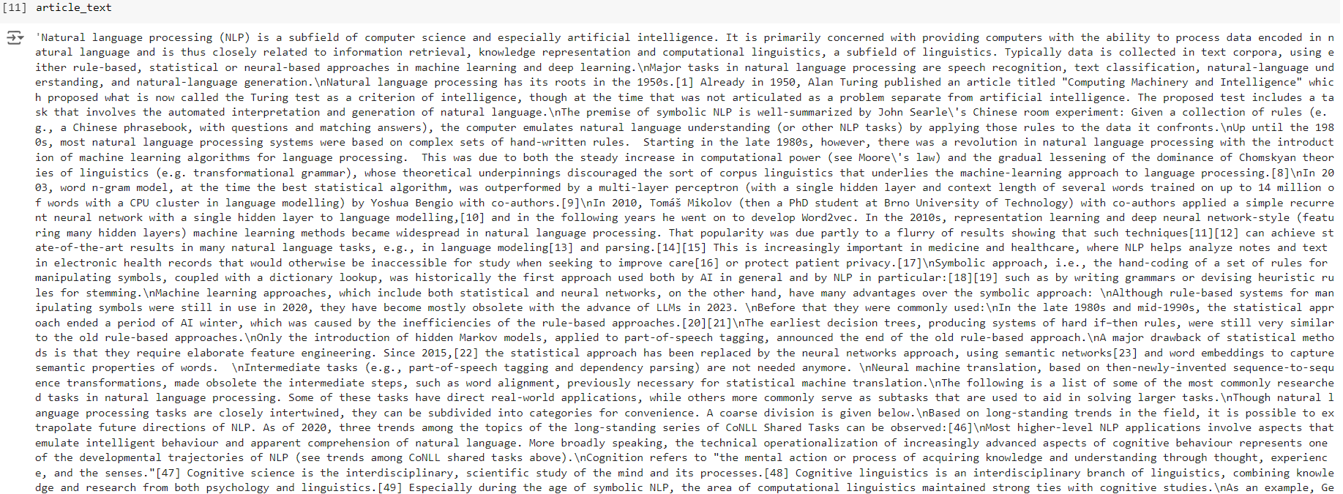
Input

Slide 7
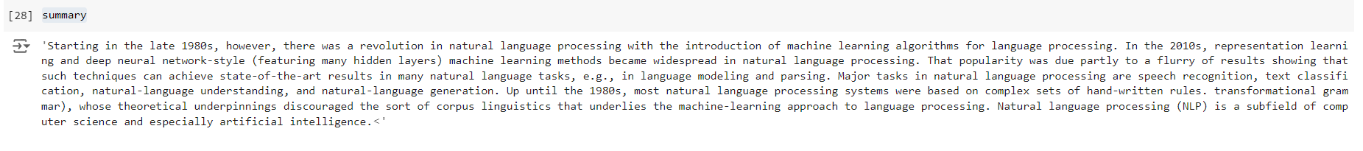
Output

Slide 8
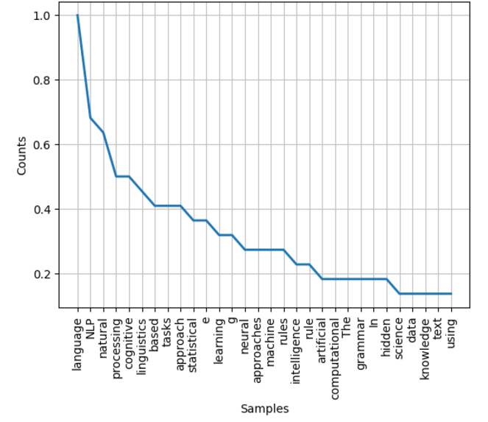
Word Frequency Analysis

Slide 9
Thank You

