Slide 1
3CP05: PROGRAMMING LAB CREDIT CARD FRAUD DETECTION
PROJECT BY:
19CP066: HEMANG PAREKH
19CP067: JAINIL PATEL
19CP072: MEET PATEL

Slide 2
Topic of Discussion
Fraud and its Types
Rule Based approach to Detect Fraud
Data Science Technique
Challenges
Demo

Slide 3

What is Fraud? Fraud is an illegal act of deception used to illegally deprive another person or entity or money, property or legal rights.
A typical organization loses 5% of revenue to fraud
2480 cases of fraud in 18 public sectors of banks involving Rs 31,898.63crore: RTI
In 2017-18 total 911 credit card frauds amounting Rs 65.26crore: RBI

Slide 4



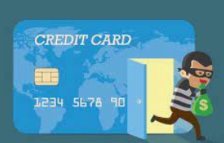
Types of Fraud
Online fraud:
Credit card fraud:
Threat
Threat of inventory:

Slide 5
Rule based Approach
Algorithms written by fraud analysts.
Based on strict rules
Changes for detecting a new fraud are done manually
Increase in customers and data, increases human effort.
Time consuming and costly.
Cannot recognize hidden patterns
Cannot respond to new situation, not trained on or explicitly programmed.

Slide 6

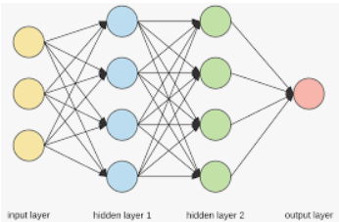
Data Science Approach
Machine learning
Deep neutral network(DNN)

Slide 7
Data Science Approach
Machine learning approach
ML encompasses a large collection of algorithms and technique used in classification, regression, clustering and anomaly detection.
Supervised learning:
data labeling, unbalanced data
Unsupervised learning:
PCA, K-means Clustering

Slide 8
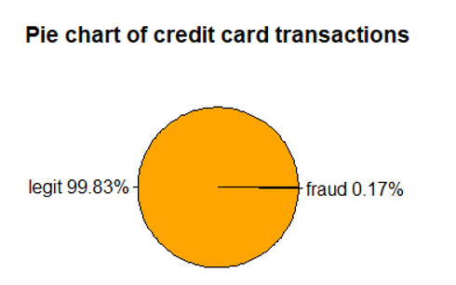
Challenges in Fraud Detection
Unbalanced Data
Less than 0.5% credit card transaction are fraud
Operational Efficiency
Less than 8 sec to flag a transaction
Incorrect Flagging
Avoid harassing real customers

Slide 9
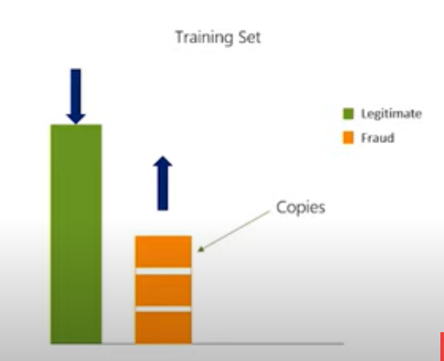
Dealing with Unbalanced Data
SAMPLING METHODS
Training Set
Random over sampling
Random under sampling
Both

Slide 10
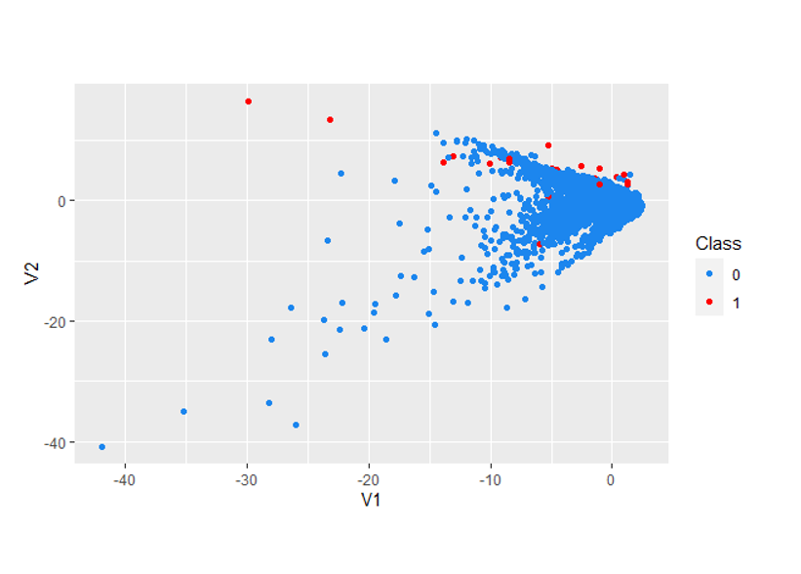
Scatter Plot of class distribution for original data set

Slide 11
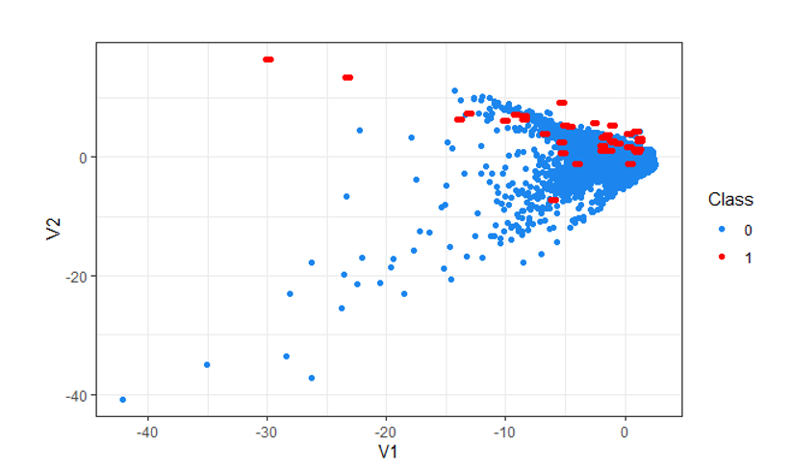
Scatter Plot of class distribution for over-sampling

Slide 12
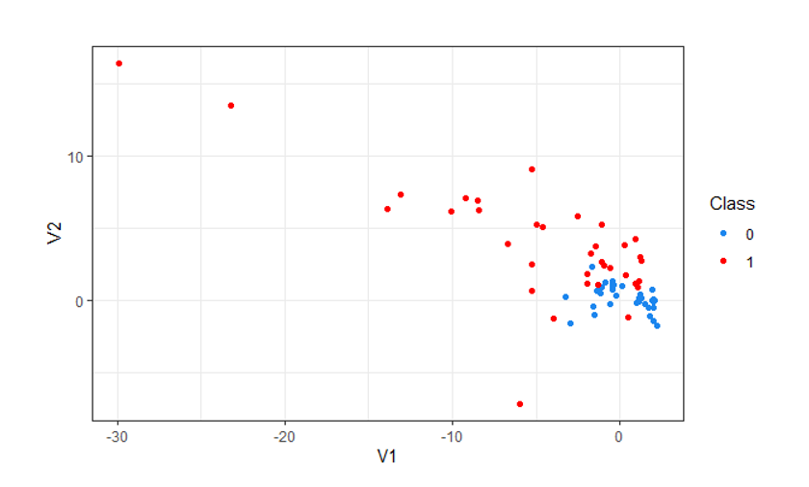
Scatter Plot of class distribution for under-sampling

Slide 13
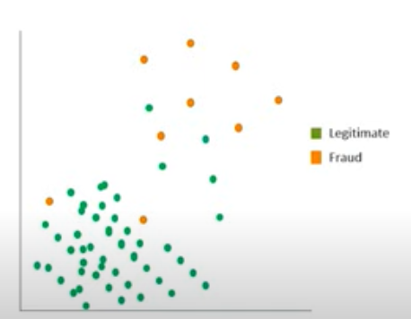
Dealing with Unbalanced Data
Sampling Methods
Scatter plot
Synthetic Minority Over-Sampling Technique(SMOTE)
Over-sampling minority class(i.e fraud) by creating synthetic fraud cases.

Slide 14
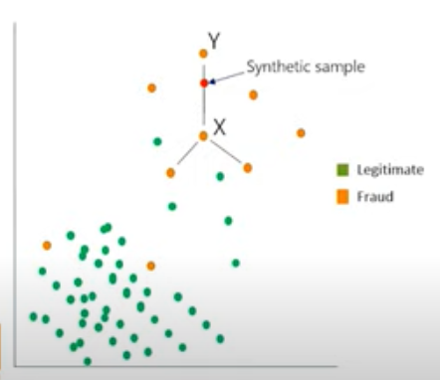
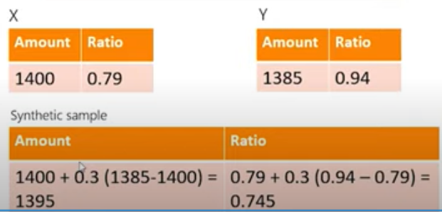
Dealing with Unbalanced Data
SMOTE
Scatter Plot

Slide 15
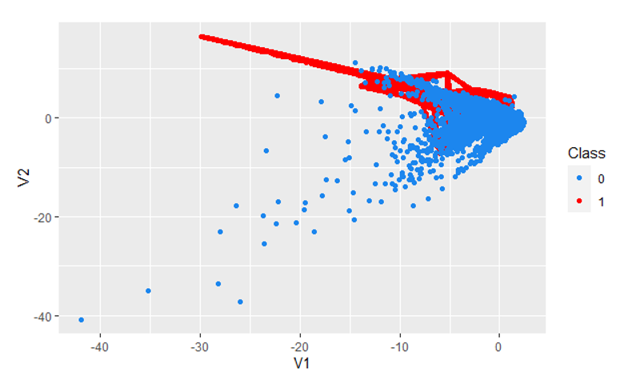
Scatter Plot of class distribution using SMOTE

