Slide 1
Manifest
Manifest your growth with us

Slide 2
Overview:
Our platform is a dynamic, all-in-one solution designed to guide, empower, and connect entrepreneurs at every stage of their business journey. By combining cutting-edge AI technology, expert insights, and a collaborative community, this website provides everything entrepreneurs need to solve doubts, refine their strategies, and grow their businesses effectively.
Our website is designed to be an all-in-one platform for entrepreneurs, providing valuable tools, resources, and guidance throughout every stage of their business journey. Whether you're a newcomer just starting your venture or an experienced entrepreneur seeking to scale, our platform is here to help you navigate challenges, make informed decisions, and ultimately succeed.
In essence, our website is a comprehensive hub for everything an entrepreneur needs to succeed, from expert advice and mentorship to practical tools for planning, funding, and growing a business. It is designed to empower entrepreneurs, helping them take the next step with confidence, knowledge, and support.

Slide 3
Core features:
AI-Powered Business Advisor:
  Instant, intelligent answers to common entrepreneurial questions. The AI system offers personalized guidance tailored to your business, helping you navigate key decisions from registration to marketing.
Expert Q&A Forum:
  A vibrant community where entrepreneurs can ask questions and get answers from industry experts, seasoned mentors, and fellow business owners. Users can vote on the best responses, ensuring the most valuable insights rise to the top.
  potential co-founders who have complementary skills and share the same vision and goals.

Slide 4
3.Market Research & Trend Analysis Tool:
Market Research & Trend Analysis Tool: Provides insights into industry trends and opportunities, powered by AI.
Market Sizing: Helps estimate the total market potential, evaluating revenue opportunities and market growth.
Competition Analysis: Tracks and analyzes competitors, identifying strengths, weaknesses, and opportunities to gain a competitive edge.
Customer Segmentation: Analyzes customer base to create targeted marketing strategies, improving retention and satisfaction.
Revenue Benchmarking: Compares your revenue with industry standards, helping set financial goals and assess business growth.

Slide 5
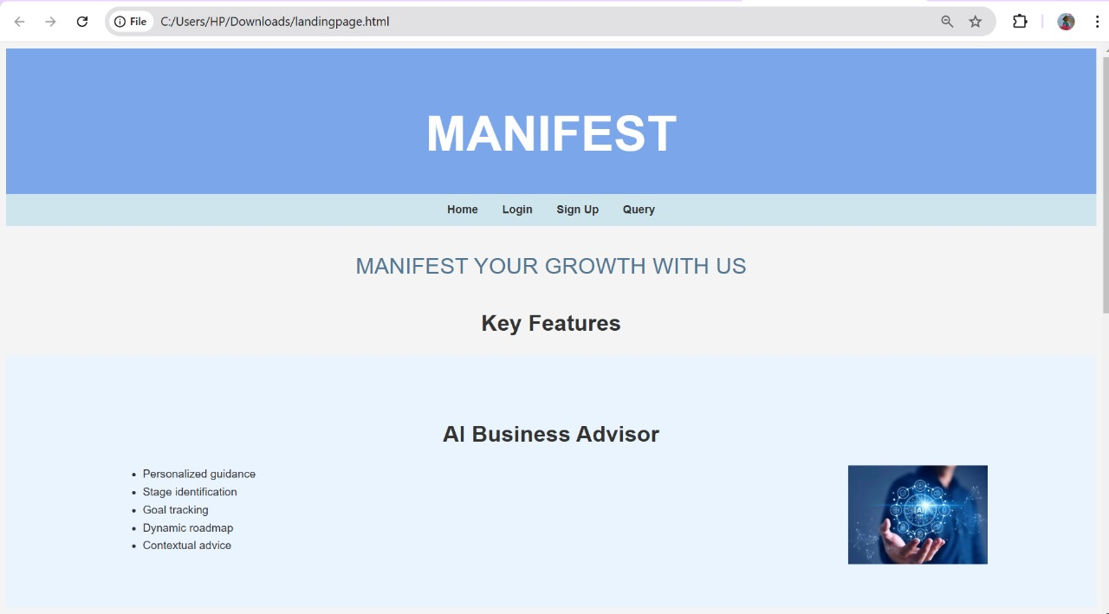

Slide 6
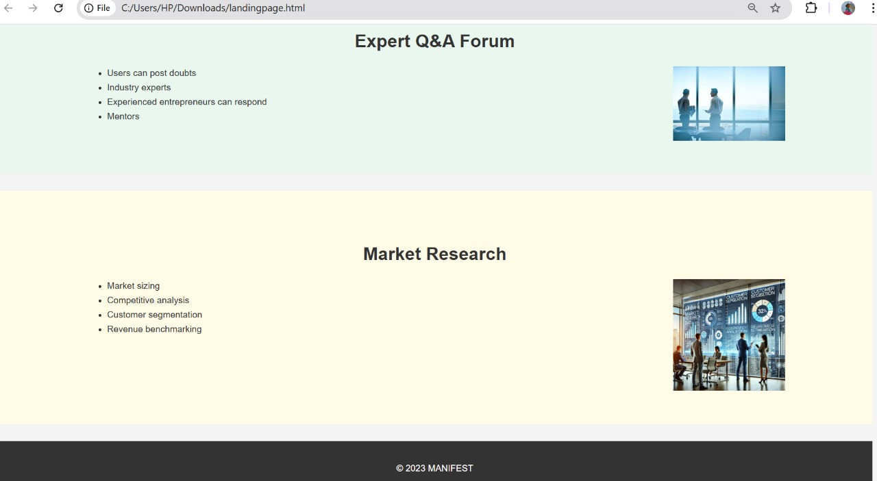

Slide 7
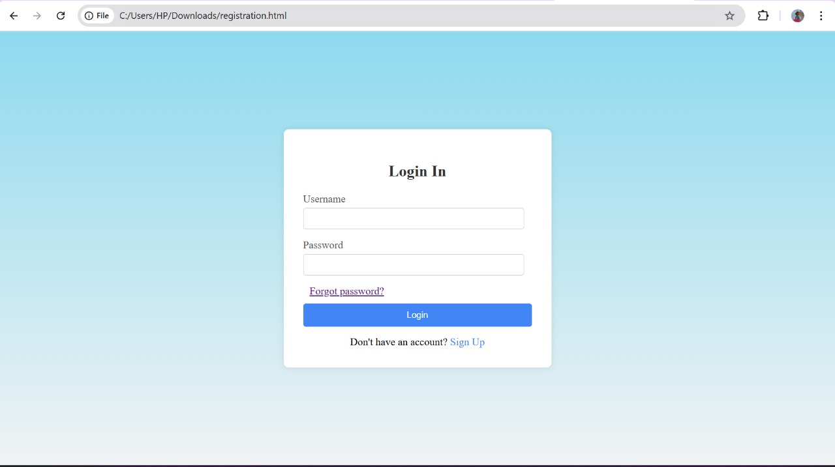

Slide 8
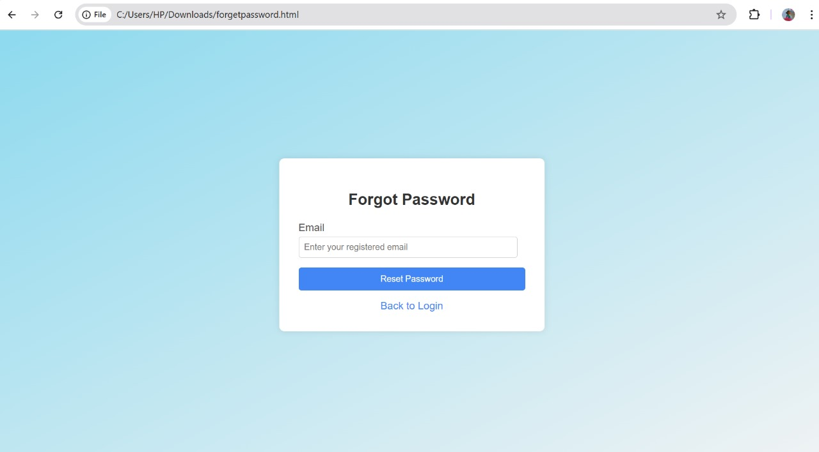

Slide 9
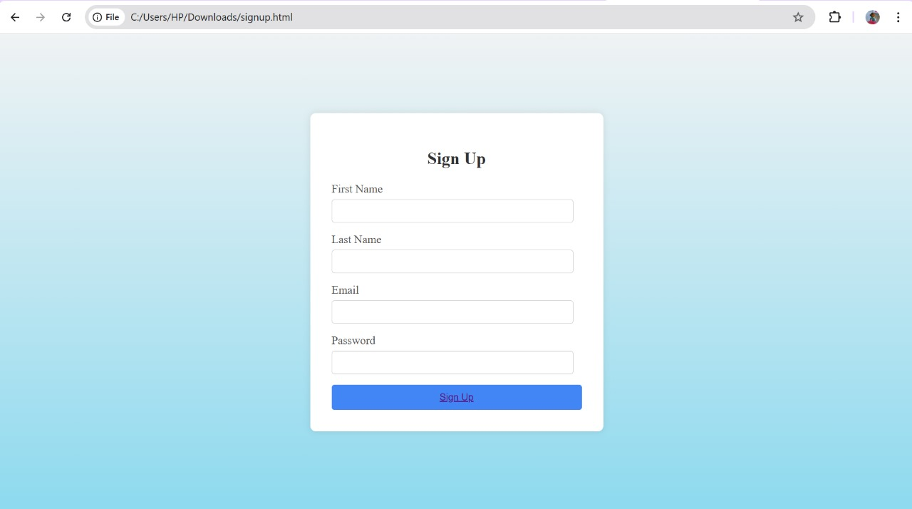

Slide 10
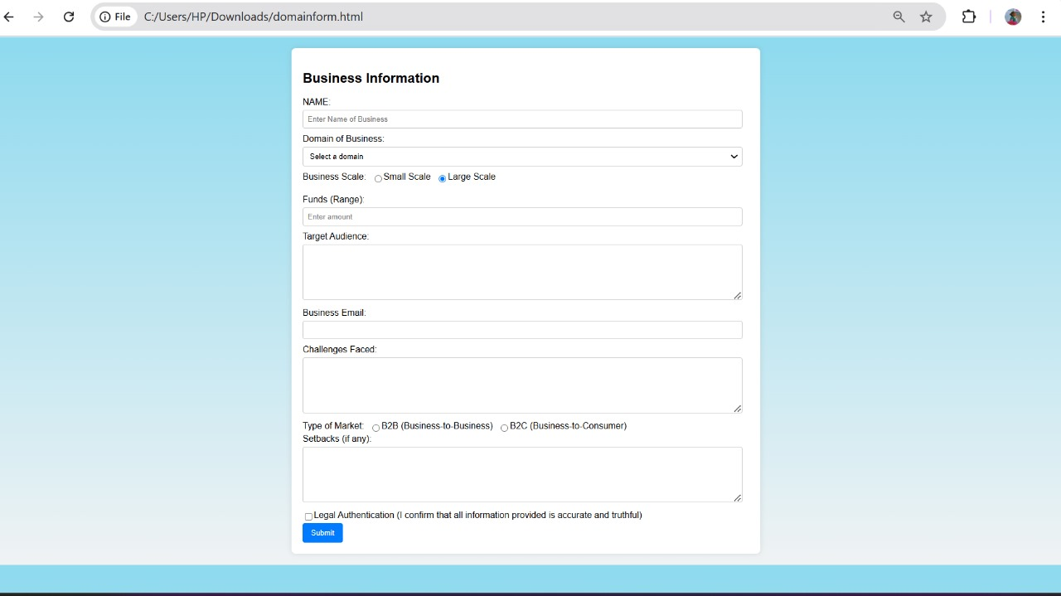

Slide 11
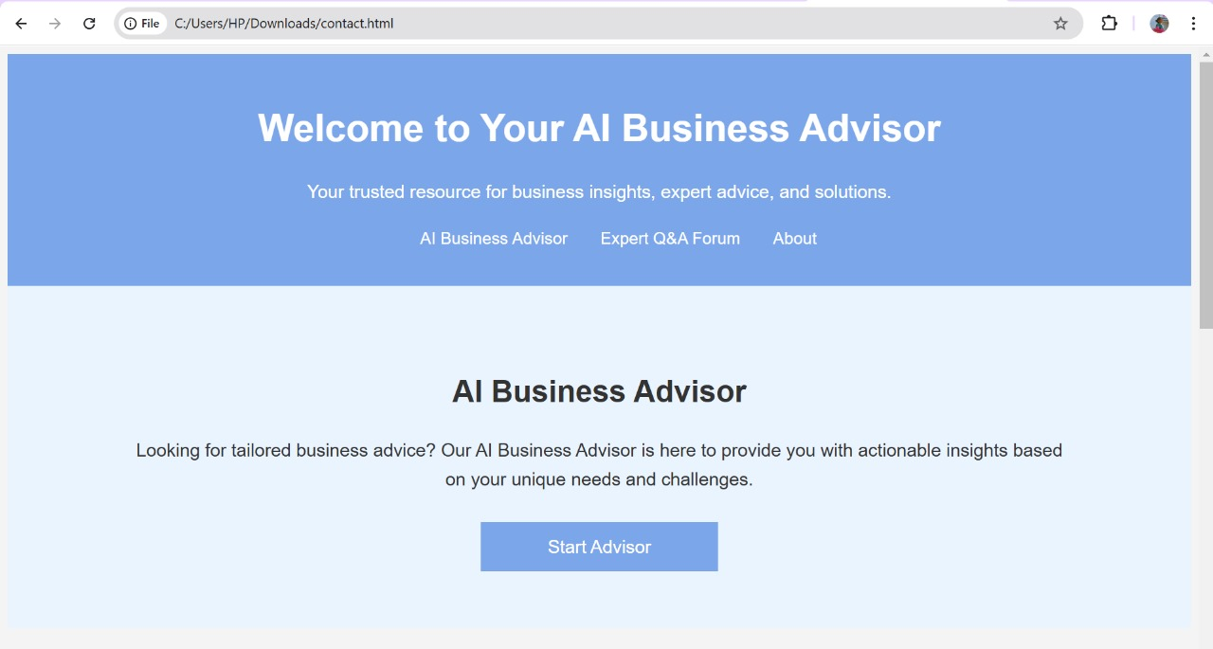

Slide 12
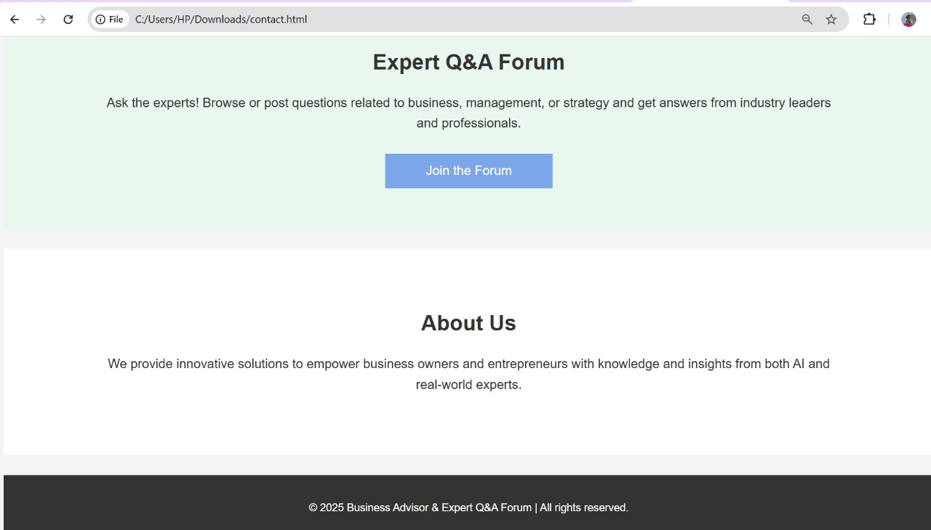

Slide 13
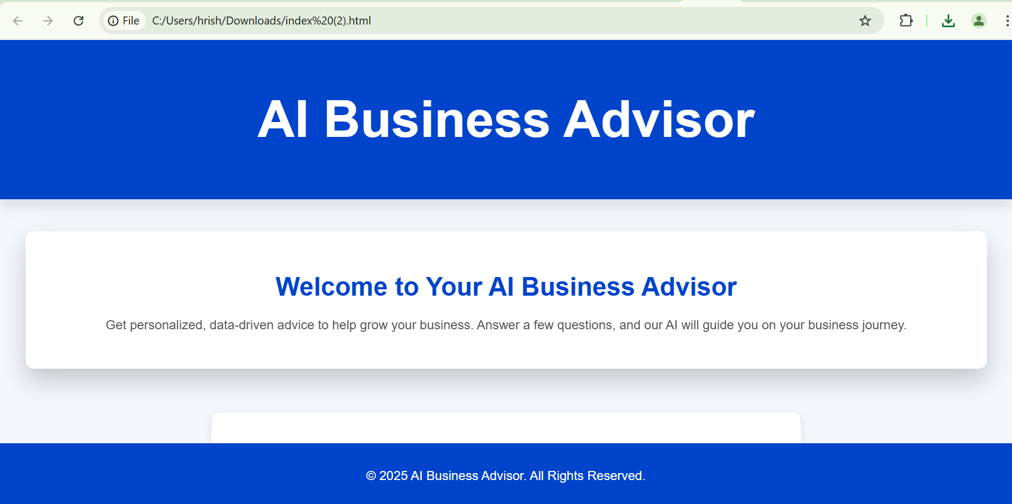

Slide 14
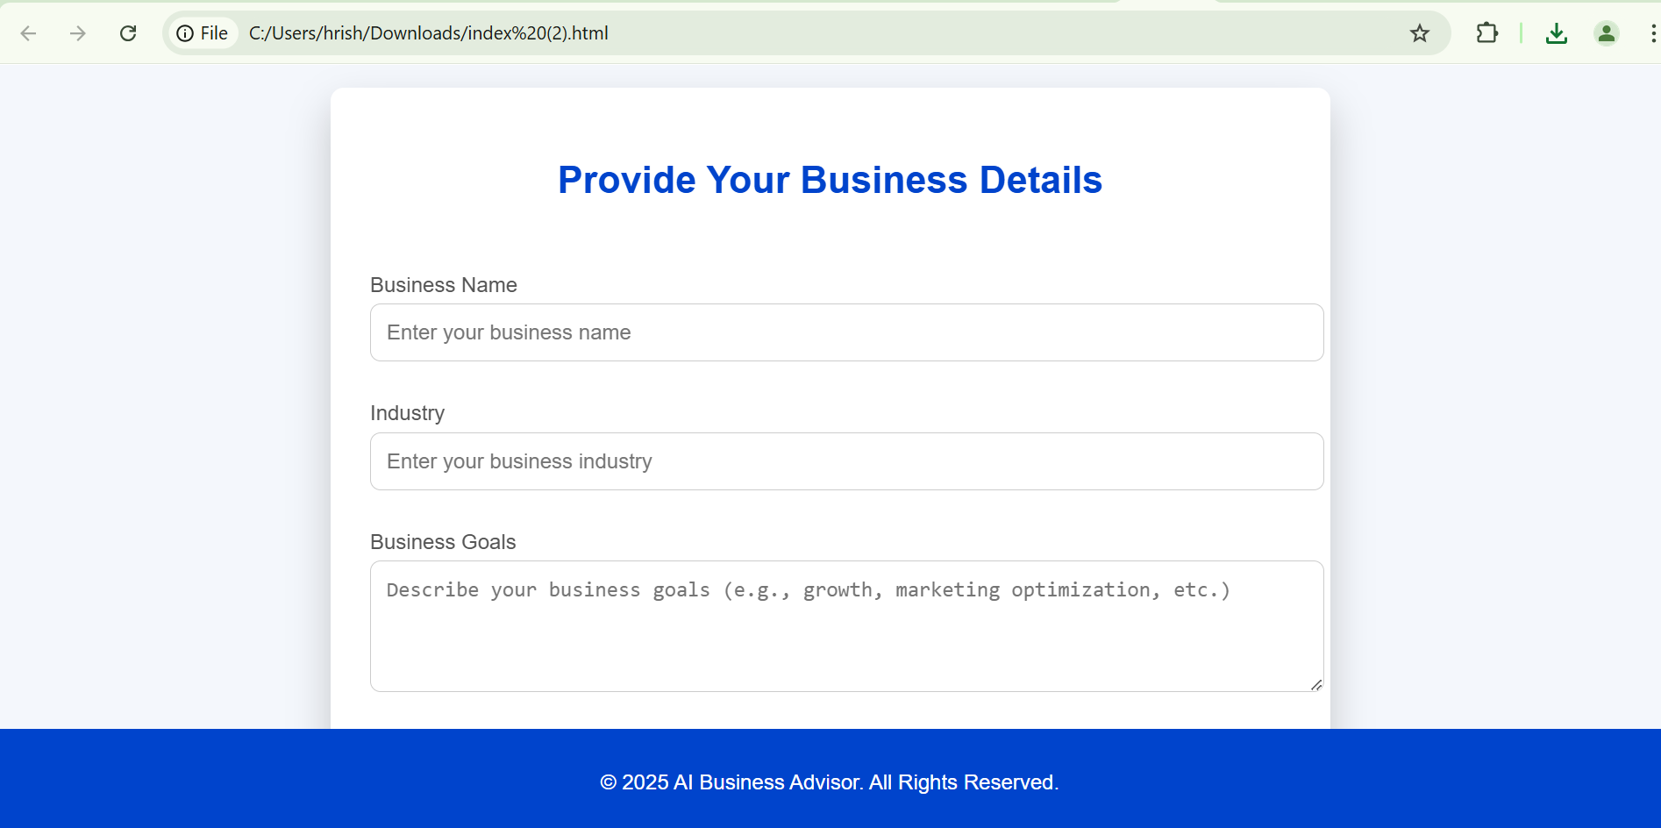

Slide 15
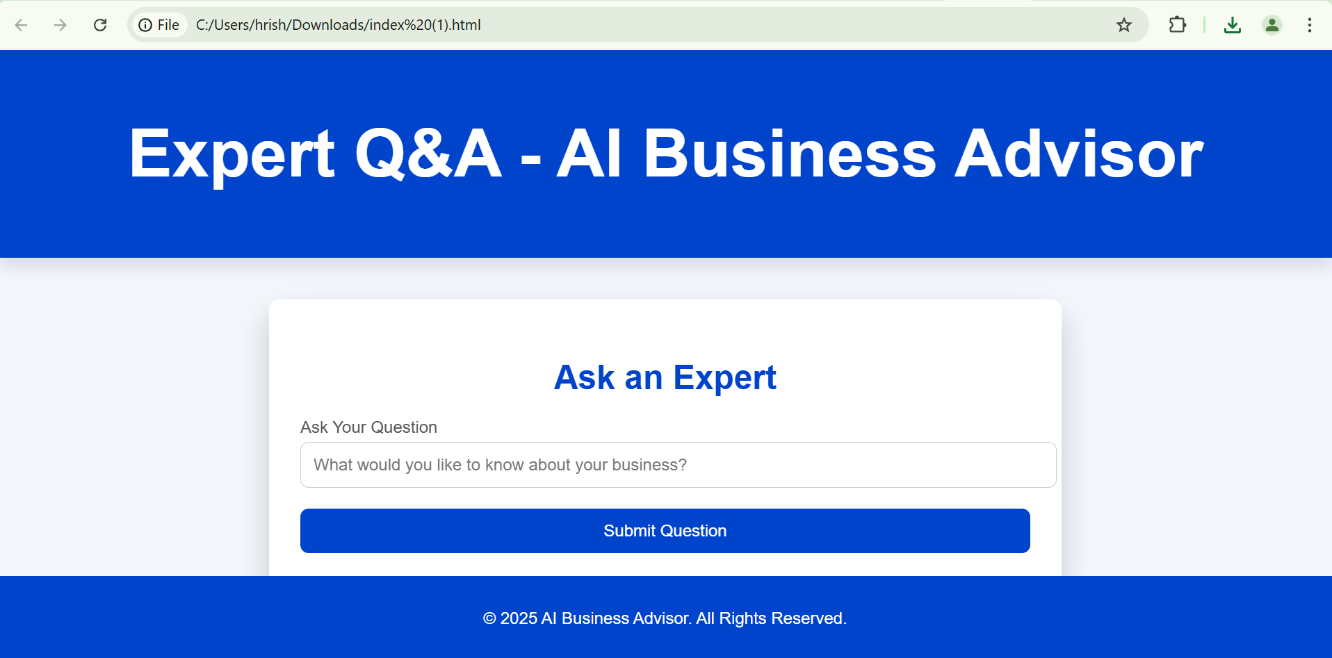

Slide 16
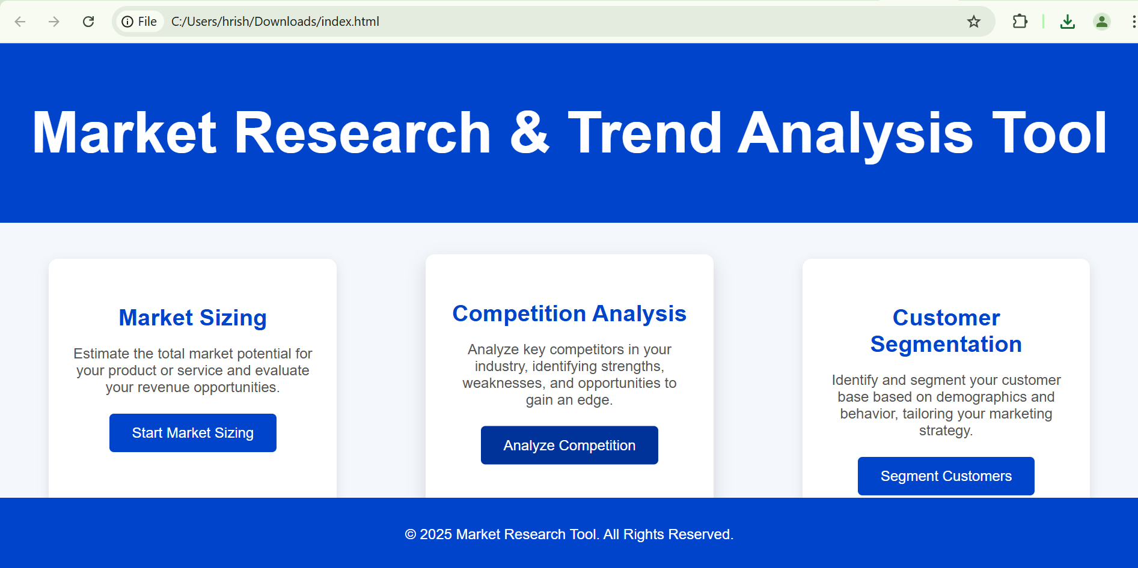

Slide 17
