Slide 1
DATABASE DESIGN (S511)
PRESENTED BY : Palak Jain
GUIDED BY : Prof. Kyle Jones

Slide 2
DATA DICTIONARY
Part 1
PREPARE ENTITY RELATION DIAGRAM
Part 2
CREATE DATABASE
Part 3
RETRIEVE DATA
Part 4

Slide 3
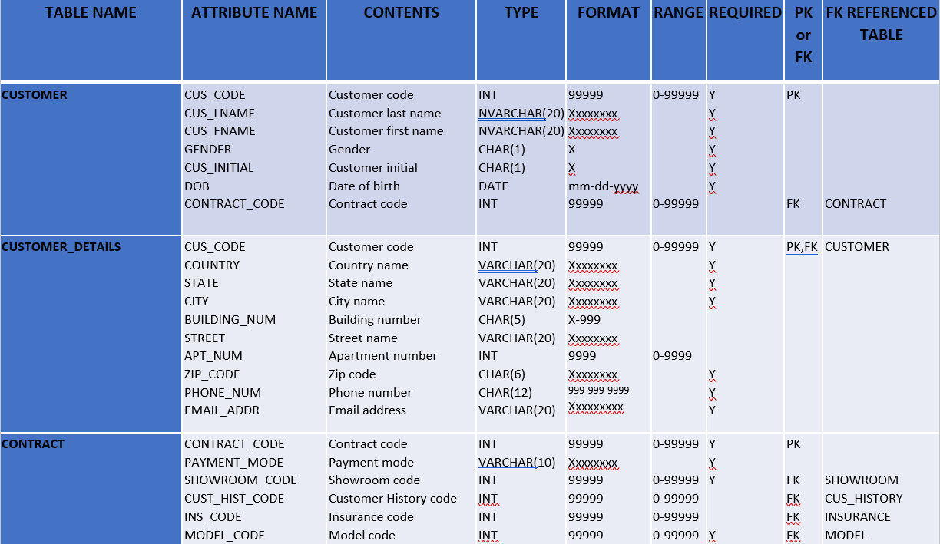
Part1:
DATA DICTIONARY

Slide 4
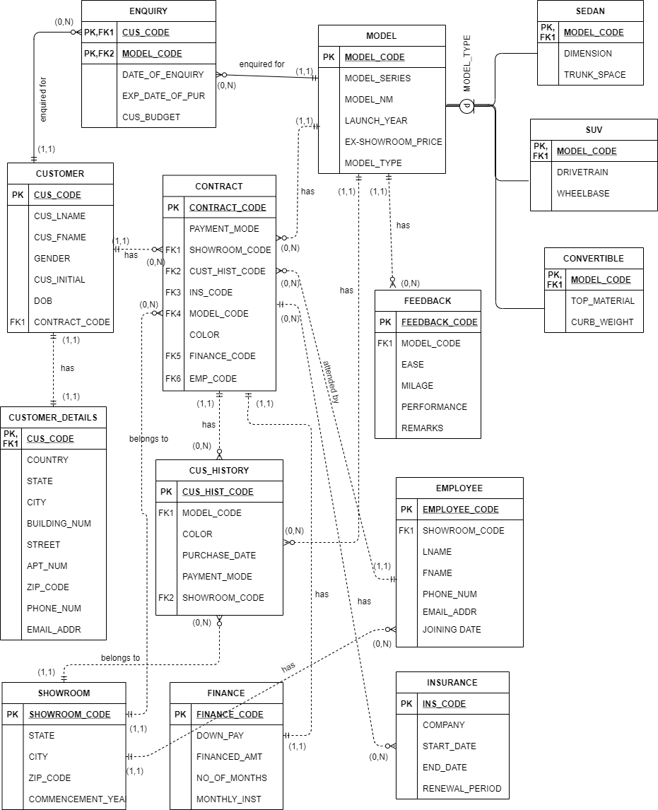
Part2:
ENTITY
RELATIONSHIP
DIAGRAM

Slide 5
Important steps in creating database :
Create all the required tables with proper constraints.
2) Create relationships between tables.
Part3:
CREATE DATABASE

Slide 6
Objective:
To answer following questions and analyze data.
1) How many cars have been sold from showrooms in a particular city?
2) How many cars have been sold by all the employees individually?
3) Which employee sold the maximum number of cars?
4) Which employee sold the maximum number of cars in a particular city?
5) How many contracts have been financed in a particular showroom?
6) How many enquiries are there in record by a particular customer?
7) Which car model is best selling model?
and many more…
Part4:
RETRIEVE DATA

Slide 7
How many cars have been sold from showrooms in a particular city?
SELECT
COUNT(CONTRACT.CONTRACT_CODE) AS TOTAL_SELL
FROM
CONTRACT
INNER JOIN
SHOWROOM
ON
CONTRACT.SHOWROOM_CODE = SHOWROOM.SHOWROOM_CODE
WHERE
SHOWROOM.CITY="Dallas";
Part4:
RETRIEVE DATA

Slide 8
2) How many cars have been sold by all the employees individually?
SELECT
CONTRACT.EMP_CODE AS E_CODE,
COUNT(CONTRACT_CODE) AS COUNT_OF_SELL
FROM
CONTRACT
GROUP BY
CONTRACT.EMP_CODE;
Part4:
RETRIEVE DATA

Slide 9
3) Which employee sold the maximum number of cars?
SELECT
E_CODE,
COUNT_OF_SELL
FROM
(SELECT
CONTRACT.EMP_CODE AS E_CODE,
COUNT(CONTRACT_CODE) AS COUNT_OF_SELL
FROM
CONTRACT
GROUP BY
CONTRACT.EMP_CODE)
WHERE
COUNT_OF_SELL = ( SELECT MAX(COUNT_OF_SELL) AS MAX_SELL FROM
(SELECT
CONTRACT.EMP_CODE AS E_CODE,
COUNT(CONTRACT_CODE) AS COUNT_OF_SELL
FROM
CONTRACT
GROUP BY
CONTRACT.EMP_CODE));
Part4:
RETRIEVE DATA

Slide 10
Thank you !
I convey my sincere gratitude to the Prof. Jones for his proper guidance and encouragement on every step of database design. I also want to thank all my classmates for all the discussions through out the course.
Palak Jain
paljain@iu.edu

