Slide 1
TECHFEST 2K15
A PRESENTATION ON
ACQUANETEE
TEAM ID : AQ1116
TEAM MEMBERS:
SOURABH NAHATA
JUHI SHARMA
KHUSHBOO MANDHANIYA
PALAK JAIN
INSTITUTE OF ENGINEERING AND TECHNOLOGY ,DAVV (INDORE).

Slide 2
OUR IDEOLOGY FOR THE PROJECT
INSPIRATION
INNOVATION
IMPlEMENTATION

Slide 3
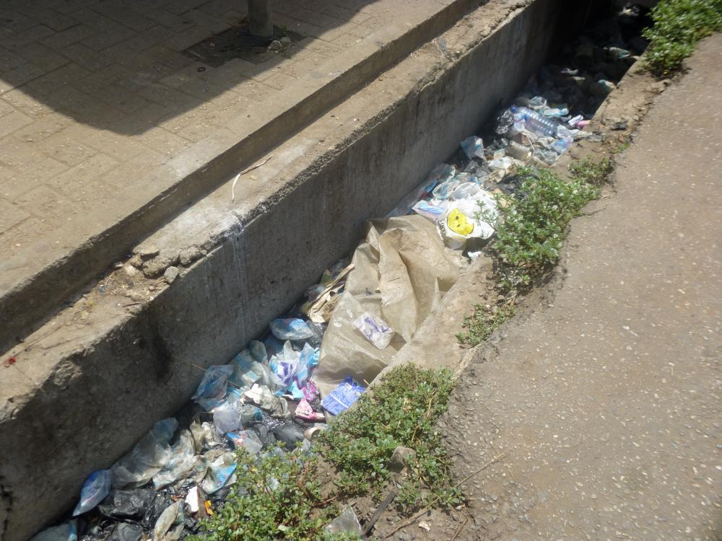
Generally, we come across this type of scenario in our locality, which has provoked us to work upon this project and to come up with a solution to this problem.
Our main focus is to design a system which can reduce or remove the problem of chocking in the sewage channels. The system is designed in such a way that it posses all the following properties:-
Easy to manufacture Easy to handle.
Energy efficient. Cost effective.
Can be used for long time.

Slide 4
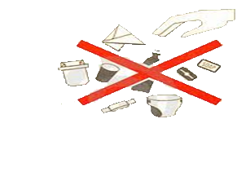
Main causes
The most common reasons found for such blockages are:
Disposal of solid waste in the channel(fermentable, cloth, plastic and paper).
Accumulation of silt or dumped debris.
Improper maintenance of drainage /sewer system.
Poor and unplanned solid waste management and insensitive attitude among the upstream residents.

Slide 5
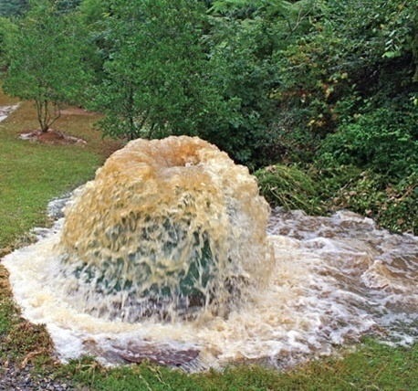
ISSUES AND
CHALLENGES
1. Over flowing of sewage in and around streets due to undersize existing sewerage lines.
2. Frequent choking & overflowing / mixing with drinking water lines.
Damaged sewer lines/appurtenances.
3. Encroachments on Sewers resulting in-accessibility for cleaning and maintenance

Slide 6
DESIGNING T&T SYSTEM
Notes:
The design of system
I suppose almost everyone can relate to the figures above . From the breathtaking subject engineering drawing.....
Here in the front view we can see that there is a rotating shaft . As the name suggests will keep on rotating .
Next we see a cylinder in actual view and here concentric crcles are connected to the centre of the rotating shaft with the help of belt. So if the rotating shaft keeps on rotating this cylinder would definitely rotate with the shaft.
Now talking about the circular part covering the shaft the quarter at bottom left is made of a netted material. And the semicircular part on the upper side is made of a thin sheet of material . Now you can see that there is an opening in the central part n line to the centre of the rotating shaft on the right side of the body their lies a opening where we can apply a box specially made for the purpose of collecting the blocking materials. The dotted part on the base represents the material of base is a perforated sheet. Now along the base line of the body we can see a block rectangular in side view and triangular in top view so basically it is a prism type shape. Now moving on right side from here there is a gate which have the base region made of the plane sheet and upper region made of perforated sheet.

Slide 7
ROTATING SHAFT
CHOCKING REMOVER
BODY
COLLECTING BOX
FLOW GATES
Notes:
Isme toh bass mann se batti de dena bindass

Slide 8
Working of T&T system
The rotating shaft keeps on rotating with the help of flowing water. As any solid waste comes, it gets trapped by the perforated sieve. And then shaft’s blade move the solid waste to the over head waste collecting pit. After that the waste could be remove manually from time to time. And thereby decreasing the chocking of the channels.
Notes:
Now lets check out how the system works :-
Jitta isme likha hai usse elabrate kar k smjha dena

Slide 9
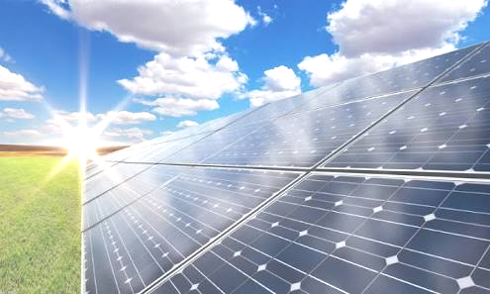
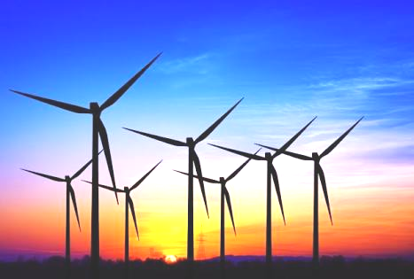
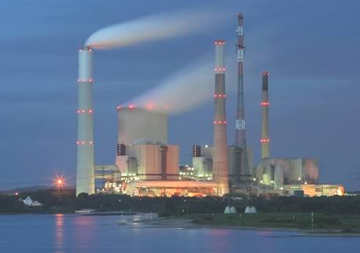
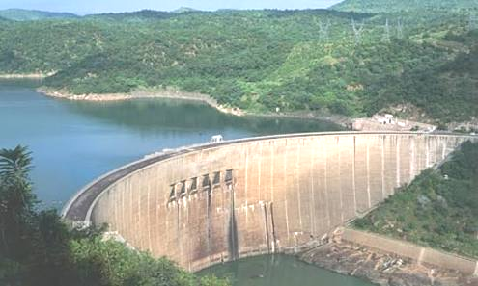
_{ENERGY+}
?
0 ENERGY

Slide 10

HYBRID T&T SYSTEM
LOW SPEED SHAFT
GEAR BOX
CONTROLLER
GENERATOR
HIGH SPEED SHAFT

Slide 11
Different analysis of hybrid T&T system
1) Energy generation increases along the flow of sewage line.
>> The net outlet of sewage from a normal house is nearly 200 litres/day.
>> Hence the flow of sewage along the flow of sewage line increases.
>> This results in increase of energy generation along the flow of sewage line.
2) The minimum energy that Hybrid T&T system generates (in 24 hrs) is sufficient to light up a 5watt bulb for next 24 hours. The maximum energy that this system can generate (in 24 hrs ) is sufficient to light up three 12watt bulbs for next 24 hours.
3) This system require very less maintenance.
4) The cost of hybrid T&T system is not much high. For a system to be applied in .
Notes:
Jitta likha as it is chapp dena

Slide 12
COMPARISON of hybrid T&T system WITH OTHER ENERGY GENERATING SYSTEMS
  HYBRID T&T SYSTEM
    LOW COST/SYSTEM (INSTALLATION INCLUDED)
    CAN BE INSTALLED IN ANY PART OF THE WORLD
    REMOVES THE PROBLEM OF CHOCKING
  SOLAR ENERGY GENERATOR
    COST IS HIGH
    CAN BE INSTALLED ONLY WHERE SUNLIGHT IS PRESENT
    NO OTHER USAGE
  WIND ENERGY GENERATOR
    COST IS HIGH
    CAN BE INSTALLED ONLY WHERE WIND SPEED IS HIGH
    NO OTHER USAGE

Slide 13
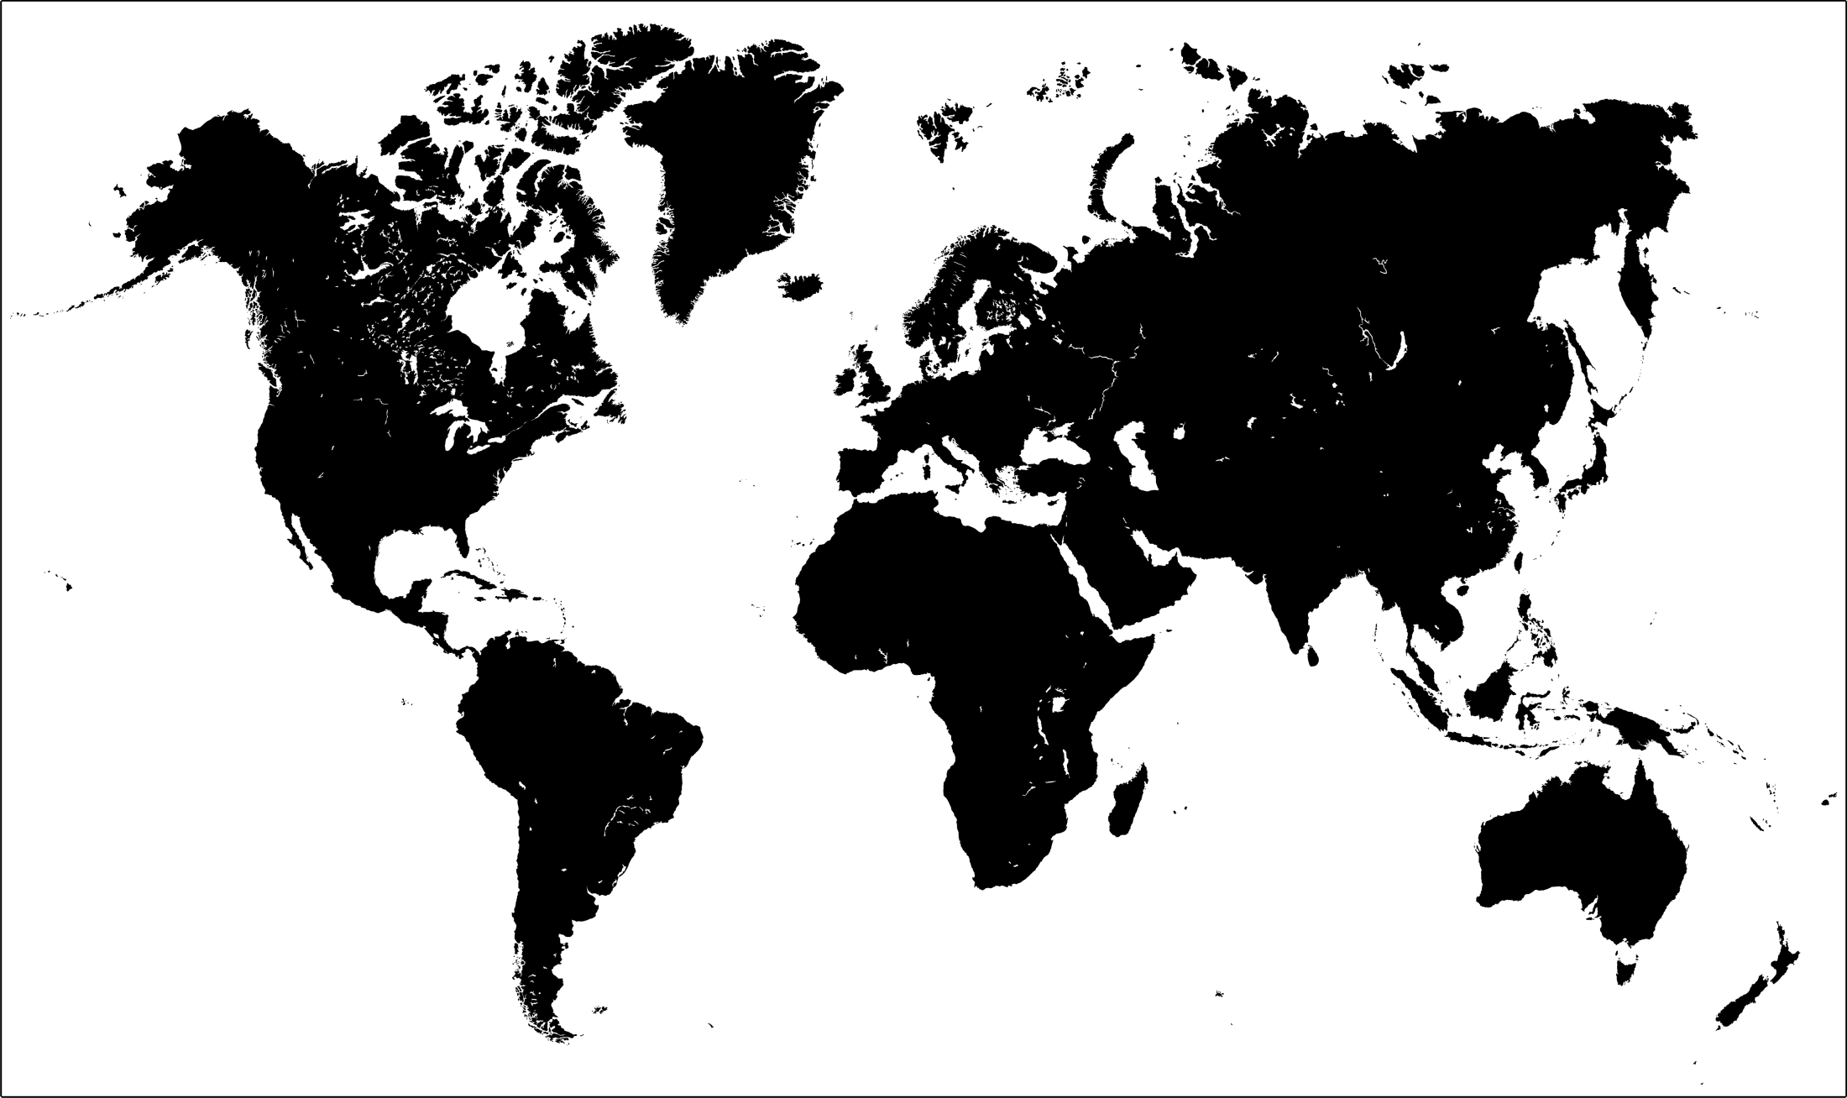
IF WE INSTALL THE HYBRID T&T SYSTEM IN WHOLE WORLD THEN WE CAN REDUCE THE USAGE OF COAL POWERED ELECTRICITY GENERATORS THERE BY REDUCING THE USAGE OF COAL . THIS WOULD REDUCE THE RATE OF GLOBAL WARMING. AND HENCE TOWARDS A SAFER ECOSYSTEM.

Slide 14
THANK YOU

