Slide 1

Data Analytics Project Presentation
Water Quality Prediction Using ML Algorithm
Team members
Palak Jain
Akshya Ramesh
Vijay Mittal
Raj Zaveri

Slide 2
Introduction
Water the essential element
Sources
Water quality and usage
Modelling techniques
Background work and research

Slide 3
Problem Description
Water Quality degrading
Necessity to check water quality standards before use
Water Potability based on pH value, sulphate level in water etc.

Slide 4
About the Dataset
Measurements
  ppm: parts per million
  g/L: microgram per litre
  mg/L: milligram per litre
10 Columns
    pH level
    Hardness: Capacity of water to precipitate soap in mg/L
    Solids: Total dissolved solids in ppm,
    Amount of Chloramines in ppm,
    Amount of Sulphates dissolved in mg/L
    Electrical conductivity of water in S/cm
    Amount of organic carbon in ppm
    Amount of Trihalomethanes in g/L
    Measure of light emitting property of water in NTU
    Potability

Slide 5

Pre-Processing
Cleaning: Removed records with more than 1 null value
Null value replacement: Replaced values in records with mean values
Pre-Processing: Oversampling to balance dataset

Slide 6
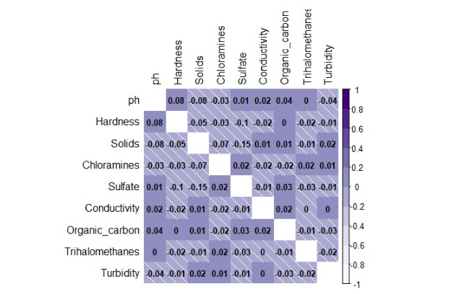
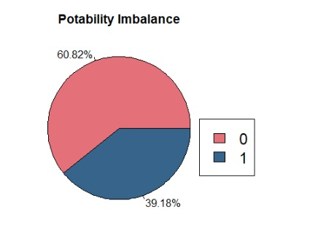
Exploratory Data Analysis

Slide 7
Modelling Methods
Logistic regression
QDA
Random Forest
SVM
K-nearest Classifier
Random Forest
with K-fold CV

Slide 8
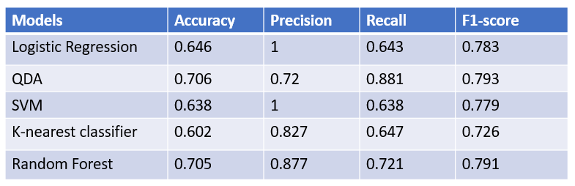
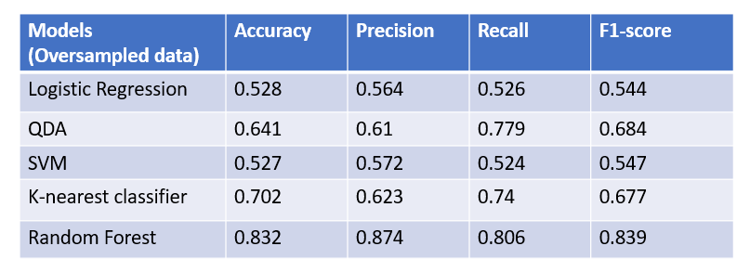
Results
ORIGINAL DATASET
OVERSAMPLED DATASET

Slide 9
Model Results Comparison
Logistic regression
Accuracy :0.528 Precision :0.564 Recall :0.526 F1 Score:0.544
QDA
Accuracy :0.641 Precision :0.61 Recall :0.779 F1 Score:0.684
Random Forest
Accuracy :0.832 Precision :0.874 Recall :0.806 F1 Score:0.839
K-Nearest Classifier
Accuracy :0.702 Precision :0.623 Recall :0.74 F1 Score:0.677
SVM
Accuracy :0.527 Precision :0.572 Recall :0.524 F1 Score:0.547

Slide 10
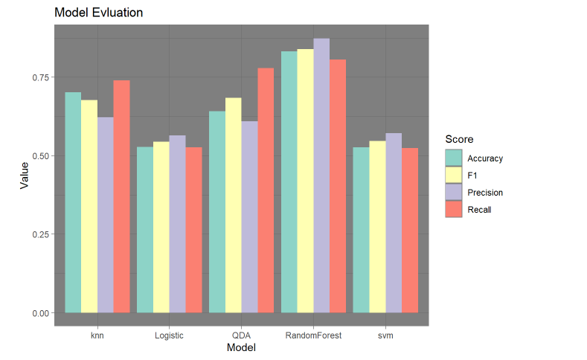

Slide 11
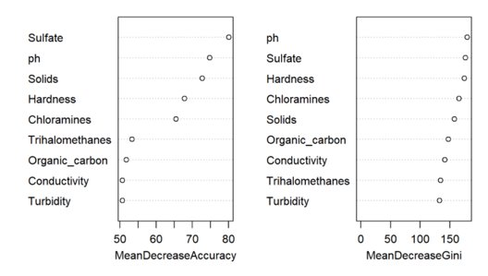
Feature Importance
pH
Sulfate
Hardness
Solid
Chloramines

Slide 12
K-fold CV in Random Forest
  Performed 7-Fold Cross-Validation for the Random forest model.
  Built the model with only the 5 important features
Models (Over Sampled Data) | Accuracy | Precision | Recall | F1-Score
Random Forest | 0.832 | 0.874 | 0.806 | 0.839
Random Forest with K-Fold CV | 0.828 | 0.849 | 0.814 | 0.831

Slide 13
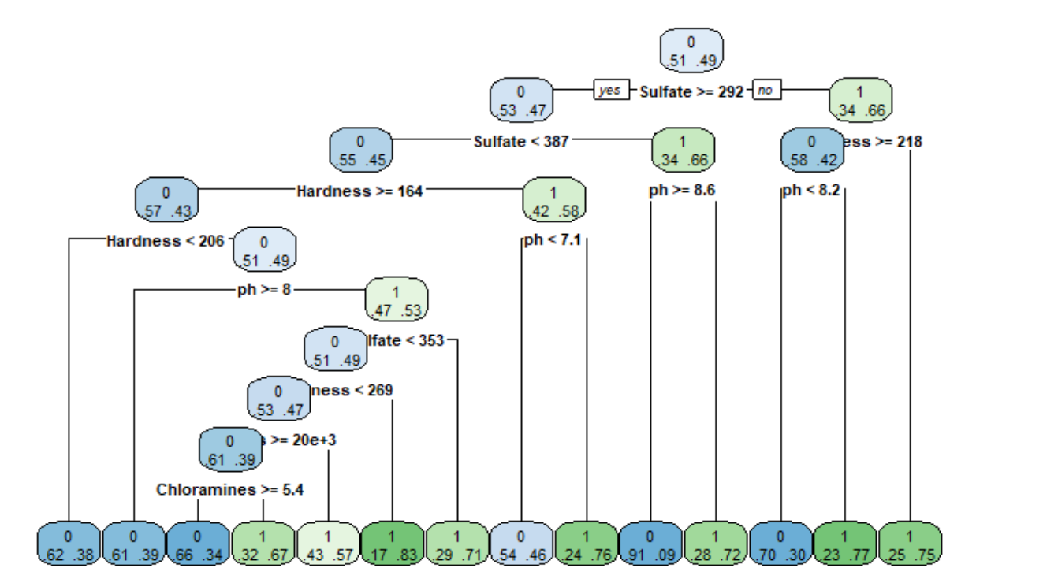
Tree Plot
Displays the Tree for the best Fit
  Blue Node – Potability 0
  Green Node - Potability 1

Slide 14
Discussion/Future Work
Improve our model accuracy by using a larger data set
Use deep learning methods in the future with more data and features

Slide 15

THANK YOU

