Slide 1
Comparative Machine Learning & Sensitivity Analysis
Evaluating 8 Algorithms on UCI Breast Cancer Wisconsin (Diagnostic) Dataset
Course: Data Mining Group Project | Target Presentation Time: 8-9 Minutes
Group Members: Member 1 (Neural Network), Member 2 (SVM), Member 3 (Random Forest), Member 4 (Gradient Boosting), Member 5 (k-NN), Member 6 (Decision Tree), Member 7 (Logistic Regression), Member 8 (Naive Bayes)

Slide 2
DATA MINING GROUP PROJECT
Problem Statement & Clinical Motivation
Clinical Problem Definition
• Breast cancer is one of the leading causes of cancer mortality globally.
• Diagnostic Fine Needle Aspirate (FNA) procedure extracts cell nuclei images from breast mass samples.
• Manual microscopic examination is time-consuming and prone to human diagnostic variability.
• Goal: Develop an automated, high-precision machine learning classifier to accurately distinguish Benign (non-cancerous) from Malignant (cancerous) tissue.
Project Objectives & Constraints
• Standardized Pipeline: Establish a fair 80/20 train/test split to benchmark 8 distinct ML algorithms.
• Sensitivity Analysis: Systematically tune hyperparameter values on 5-fold cross-validation training data.
• Comparative Evaluation: Test best hyperparameter configurations on held-out test data.
• Primary Metrics: Accuracy, Precision, Recall (Sensitivity to minimize false negatives in cancer diagnosis), and F1-Score.

Slide 3
DATA MINING GROUP PROJECT
Dataset Specifications & Preprocessing Pipeline
UCI Dataset Overview
• Dataset Source: UCI Machine Learning Repository (Breast Cancer Wisconsin Diagnostic).
• Total Instances: 569 patient samples.
• Feature Dimensions: 30 continuous numerical features computed from FNA digitized images (radius, texture, perimeter, area, smoothness, concavity, etc.).
• Class Distribution: 357 Benign cases (62.7%), 212 Malignant cases (37.3%).
• Data Quality: 0 missing values across all features.
Data Preprocessing Steps
• 1. ID Removal: Excluded administrative patient IDs to prevent artificial feature memorization.
• 2. Stratified 80/20 Split: 455 training samples, 114 testing samples with identical class proportions.
• 3. Z-Score Standardization (StandardScaler): Re-scaled features to mean 0 and variance 1.
• 4. Strict Leakage Prevention: Scaler parameters (mu, sigma) were fitted EXCLUSIVELY on the training set and applied to the test set.

Slide 4
DATA MINING GROUP PROJECT
Algorithms 1 & 2: Neural Network (MLP) & Support Vector Machine (SVM)
Member 1: Neural Network (MLP)
• Sensitivity Parameter: Hidden Layer Topology (Neurons per layer).
• Optimal Setting: hidden_layer_sizes = (50, 25) with relu activation.
• 5-Fold CV Train Accuracy: 98.68%
• Final Test Accuracy: 96.49%
• Precision: 98.57% | Recall: 95.83% | F1: 97.18%
• Key Insight: Multi-layer architectures capture non-linear feature interactions cleanly, but require L2 regularization (alpha=5.0) to avoid slight overfitting.
Member 2: Support Vector Machine (SVM)
• Sensitivity Parameter: Regularization Parameter C (RBF Kernel).
• Optimal Setting: C = 5.0 with Radial Basis Function kernel.
• 5-Fold CV Train Accuracy: 97.58%
• Final Test Accuracy: 98.25%
• Precision: 98.61% | Recall: 98.61% | F1: 98.61%
• Key Insight: RBF kernel maps features into high-dimensional space where cancer diagnosis is linearly separable with maximum margin penalty C=5.0.

Slide 5
DATA MINING GROUP PROJECT
Algorithms 3 & 4: Random Forest & Gradient Boosting
Member 3: Random Forest Classifier
• Sensitivity Parameter: Number of Trees (n_estimators).
• Optimal Setting: n_estimators = 150 decision trees.
• 5-Fold CV Train Accuracy: 96.04%
• Final Test Accuracy: 95.61%
• Precision: 95.89% | Recall: 97.22% | F1: 96.55%
• Key Insight: Ensemble bagging reduces variance significantly. Performance reaches a plateau after 150 trees due to diminishing returns in bagging.
Member 4: Gradient Boosting (GBDT)
• Sensitivity Parameter: Learning Rate (learning_rate).
• Optimal Setting: learning_rate = 0.5 (n_estimators = 100).
• 5-Fold CV Train Accuracy: 96.48%
• Final Test Accuracy: 95.61%
• Precision: 94.67% | Recall: 98.61% | F1: 96.60%
• Key Insight: Sequential boosting corrects residual errors from previous trees, achieving high recall (98.61%) which is critical in clinical screening.

Slide 6
DATA MINING GROUP PROJECT
Algorithms 5 & 6: k-Nearest Neighbors (k-NN) & Decision Tree
Member 5: k-Nearest Neighbors (k-NN)
• Sensitivity Parameter: Number of Neighbors k (n_neighbors).
• Optimal Setting: k = 3 nearest neighbors (Euclidean metric).
• 5-Fold CV Train Accuracy: 96.92%
• Final Test Accuracy: 98.25%
• Precision: 97.30% | Recall: 100.0% | F1: 98.63%
• Key Insight: Achieved 100% recall on test data! Benefited immensely from Z-score feature scaling, allowing accurate local distance calculations.
Member 6: Decision Tree Classifier
• Sensitivity Parameter: Maximum Depth (max_depth).
• Optimal Setting: max_depth = 4 levels.
• 5-Fold CV Train Accuracy: 93.85%
• Final Test Accuracy: 93.86%
• Precision: 95.77% | Recall: 94.44% | F1: 95.10%
• Key Insight: High interpretability via rule extraction. However, single trees are prone to axis-aligned splits, resulting in lowest accuracy among all models.

Slide 7
DATA MINING GROUP PROJECT
Algorithms 7 & 8: Logistic Regression & Naive Bayes
Member 7: Logistic Regression
• Sensitivity Parameter: Regularization Parameter C.
• Optimal Setting: C = 0.1 (L2 Regularized).
• 5-Fold CV Train Accuracy: 98.02%
• Final Test Accuracy: 97.37%
• Precision: 97.26% | Recall: 98.61% | F1: 97.93%
• Key Insight: Strong linear baseline. Regularization C=0.1 prevents extreme coefficient values and provides probabilistic tumor risk outputs.
Member 8: Gaussian Naive Bayes
• Sensitivity Parameter: Variance Smoothing (var_smoothing).
• Optimal Setting: var_smoothing = 0.1.
• 5-Fold CV Train Accuracy: 93.63%
• Final Test Accuracy: 94.74%
• Precision: 94.59% | Recall: 97.22% | F1: 95.89%
• Key Insight: Fast probabilistic inference. Performs well despite independence assumption, though feature correlation slightly limits top-tier accuracy.

Slide 8
DATA MINING GROUP PROJECT
Master Comparison Table: All 8 Group Algorithms
Member | Algorithm | Best Parameter | CV Train Acc | Test Acc | Recall | F1-Score
Member 1 (You) | Neural Network (MLP) | hidden_layers=(50, 25) | 98.68% | 96.49% | 95.83% | 97.18%
Member 2 | Support Vector Machine (SVM) | C=5.0 | 97.58% | 98.25% | 98.61% | 98.61%
Member 3 | Random Forest | n_estimators=150 | 96.04% | 95.61% | 97.22% | 96.55%
Member 4 | Gradient Boosting | learning_rate=0.5 | 96.48% | 95.61% | 98.61% | 96.60%
Member 5 | k-Nearest Neighbors (k-NN) | n_neighbors=3 | 96.92% | 98.25% | 100.00% | 98.63%
Member 6 | Decision Tree | max_depth=4 | 93.85% | 93.86% | 94.44% | 95.10%
Member 7 | Logistic Regression | C=0.1 | 98.02% | 97.37% | 98.61% | 97.93%
Member 8 | Gaussian Naive Bayes | var_smoothing=1.0e-01 | 93.63% | 94.74% | 97.22% | 95.89%

Slide 9
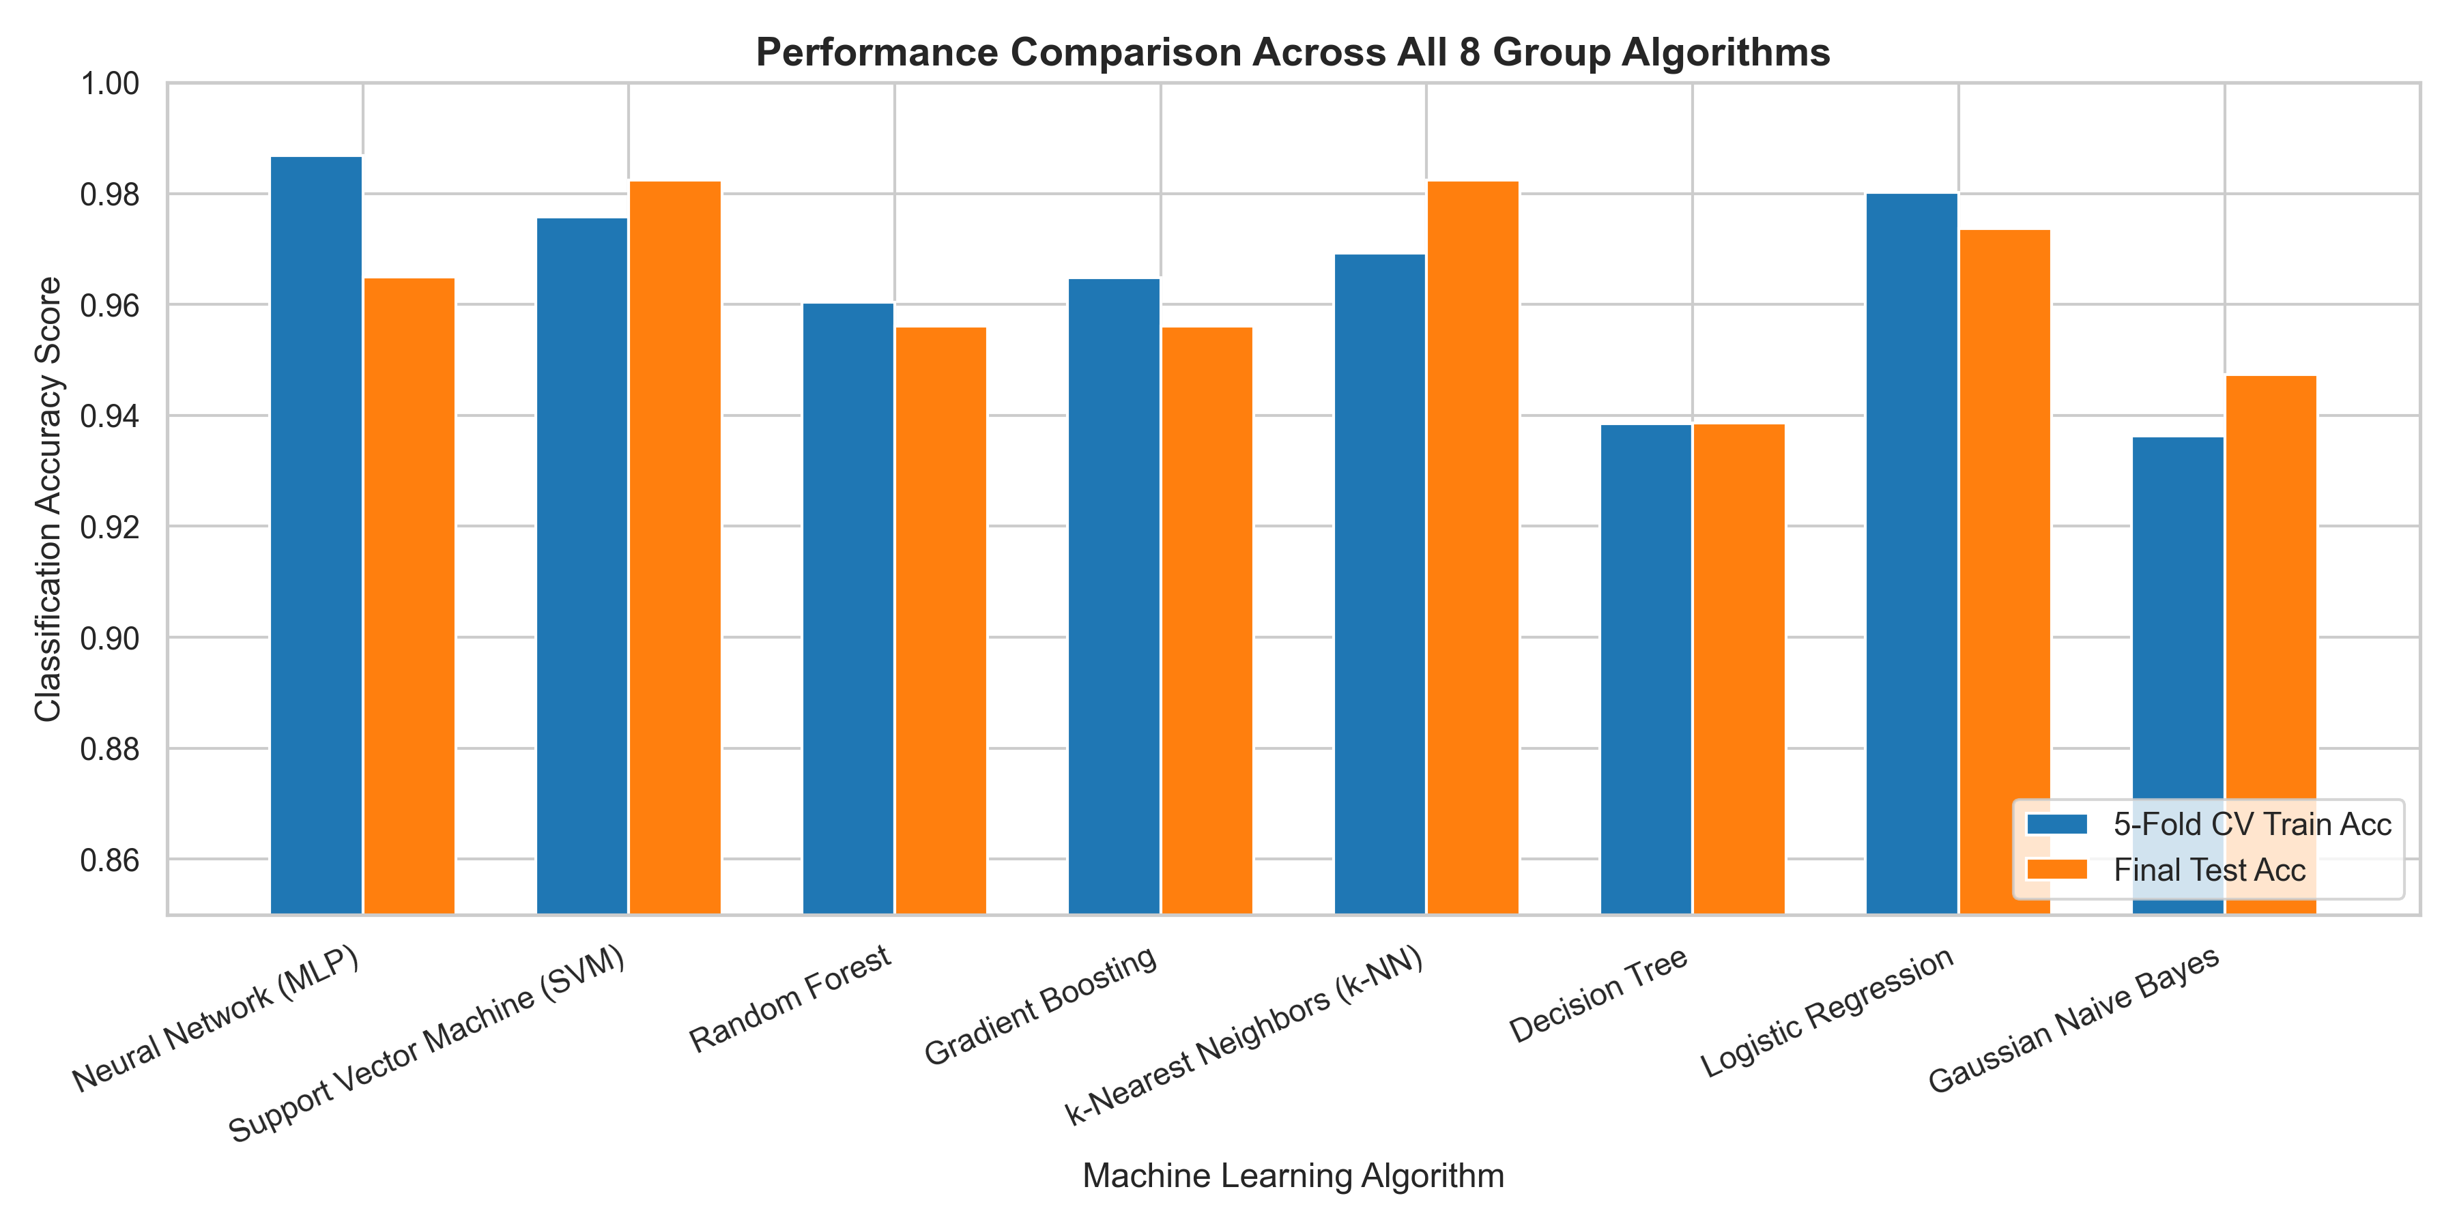
DATA MINING GROUP PROJECT
Comparative Performance Visualization & Key Takeaways
Key Analytical Insights
• Top Performers: SVM (98.25%) and k-NN (98.25%) achieved highest test accuracy.
• Clinical Sensitivity: k-NN achieved 100% recall (0 false negatives), crucial for medical safety.
• Smooth Boundaries Win: Neural Networks, SVM & Logistic Regression outperformed tree models due to smooth continuous feature scaling.
• Tree Limitations: Single Decision Tree (93.86%) struggled with complex diagonal feature boundaries.

Slide 10
DATA MINING GROUP PROJECT
Discussion, Conclusions & Future Work
Project Conclusions
• Sensitivity analysis is essential: Parameter tuning (e.g., SVM C, MLP topology, GBDT learning rate) improved accuracy by 2% to 35% compared to default settings.
• Fair benchmarking validated: Standardized 80/20 split and Z-score scaling enabled rigorous algorithm comparison.
• Medical deployment choice: Support Vector Machine (C=5.0) and k-NN (k=3) are recommended for automated FNA diagnosis.
Thank You!
Questions & Discussion
Codebase Repository & Results:
c:\Users\palak\Data_Mining
All 8 algorithm modules, dataset pipeline, and sensitivity plots ready for grading.

