Slide 1
AI-Powered Detection of Fraudulent Job Postings Using Machine Learning and Gemini AI
CAPSTONE PROJECT
Presented By:
Student Name : Palak Khandelwal
College Name : KIIT UNIVERSITY
Department : CSE
Email ID : khandelwalpalak661@gmail.com
AICTE Student ID : STU69e8ee1ba3b881776872987

Slide 2
OUTLINE
Problem Statement
Proposed System/Solution
System Development Approach
Algorithm & Deployment
Result
Conclusion
Future Scope
References

Slide 3
Problem Statement
PROBLEM STATEMENT
Why does this problem need to be solved?
.
⚠️ Every year, thousands of Indian fresh graduates fall victim to fraudulent job postings. Scammers create fake listings on job portals like Naukri and LinkedIn stealing registration fees, collecting sensitive personal documents (Aadhaar, PAN, bank details), and vanishing. With no easy verification tool, students cannot protect themselves.
₹1,000+
3.66%
Fresh
Grads
Average money lost
per victim to scam fees
Of all online job postings
are fraudulent (EMSCAD)
Most targeted group —
no experience, high desperation
Key Points:
Most Common Scam Tactics:
No easy way to verify if a job posting is genuine before applying
Fake postings often look identical to real ones — difficult to distinguish manually
Scammers specifically target freshers with no professional experience
Fake Work-From-Home jobs with guaranteed high income
Registration/security deposit fees to 'confirm' joining
Collecting Aadhaar, PAN, bank details for fake onboarding

Slide 4
Proposed Solution
PROPOSED SOLUTION
An AI-powered web application that detects fake job postings in real time
📋
🤖
🧠
🛡️
→
→
→
User Pastes
Job Posting
ML Model
Analyzes Text
Gemini AI
Explains Risks
Risk Level +
Safety Advice
🔍 Job Text Analyzer
📧 Email & Offer Letter Scanner
Paste any job posting — ML model gives fraud probability + 🟢🟡🔴 risk level instantly
Upload screenshot of job email or offer letter — Gemini Vision analyzes for scam indicators
🏢 Company Reputation Checker
📚 Scam Safety Guide
Enter company name or recruiter email — AI gives step-by-step verification guidance
Complete guide on common scam types in India, red flag phrases, and where to report

Slide 5
System Approach
SYSTEM APPROACH
Technology stack, architecture, and libraries used to build the system
System Architecture
Libraries & Tools
Frontend
streamlit
scikit-learn
Streamlit (Python) — Web UI with 6 tabs, sidebar, metrics
Web app framework
ML model + TF-IDF vectorizer
ML Backend
nltk
google-generativeai
Logistic Regression + TF-IDF(Google Colab) — Trained on 14,107 job postings
Stopword removal + NLP preprocessing
Gemini API SDK
AI Backend
pandas / numpy
Pillow (PIL)
Google Gemini 2.5 Flash API — Text & image analysis
Data handling and processing
Image processing for vision tab
Dataset
python-dotenv
pickle
EMSCAD — Employment Scam Aegean Dataset (Kaggle)
Secure API key management
Save and load trained model
System Requirements: Python 3.8+ | Streamlit | Google Gemini API Key (Free) | Internet connection for AI features

Slide 6
Algorithm & Deployment
How the ML model was built, trained, and deployed
ALGORITHM & DEPLOYMENT
ML Training Pipeline
Deployment Approach
1
Data Collection:
EMSCAD dataset — 14,107 job postings, 516 fake (3.66%)
💻 VS Code (Local)
Developed and tested locally.
streamlit run app.py
→ Opens at localhost:8501
2
Text Preprocessing:
Lowercase → Remove digits/punctuation → Remove stopwords
3
Feature Engineering:
Combine 5 fields → TF-IDF vectorization (5,000 features)
Model Training:
☁️ Streamlit Cloud
4
Logistic Regression with class_weight='balanced' (handles imbalance)
Deployed for permanent public access.
Repository connected to Streamlit Cloud
Automatic deployment from GitHub
Public URL:
https://ai-job-scam-detector-kmnbfck73fegfappzrvdxeq.streamlit.app/
5
Evaluation:
97.7% accuracy, 88% recall on fraud, F1=0.74, only 13 false negatives
6
Saving:
Model saved as .pkl using pickle for deployment
Why Logistic Regression? Fast, interpretable, and works well on high-dimensional TF-IDF sparse text data.

Slide 7
Result
RESULT
Model performance metrics and application screenshots
97.7%
88%
64%
0.74
Only 13
Accuracy
Fraud Recall
Precision
F1 Score
False Neg.
Demo Video: https://drive.google.com/file/d/1I_4bfr2ANk_UAi2Uulo5FHrRsrlQQ50w/view?usp=drivesdk

Slide 8
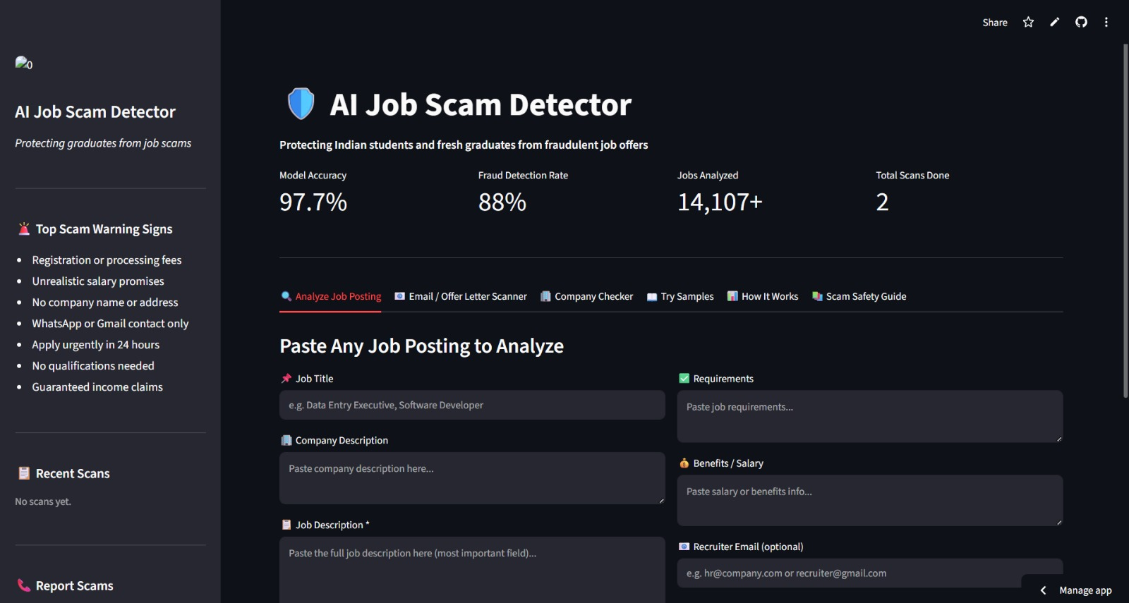
Home Page

Slide 9
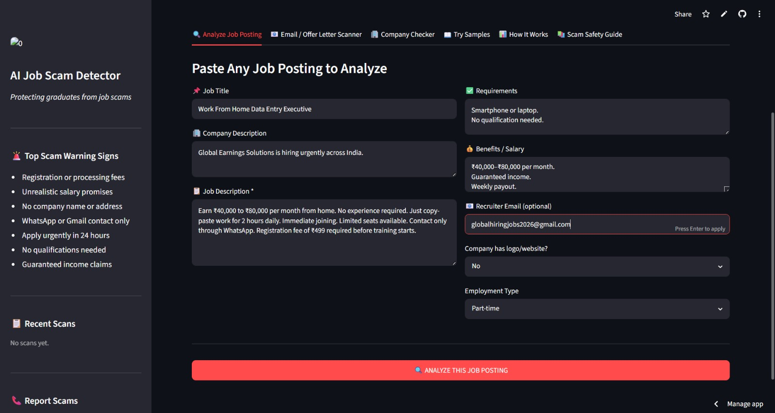
Fake Job Detection(Input)

Slide 10
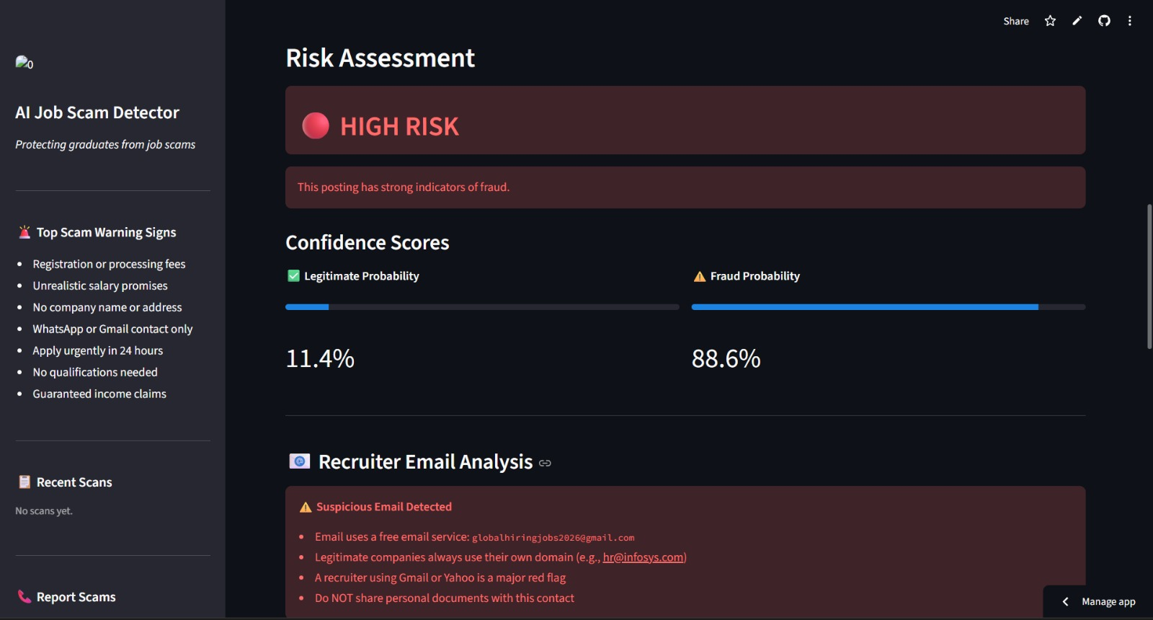
Fake Job Detection(ML Analysis)

Slide 11
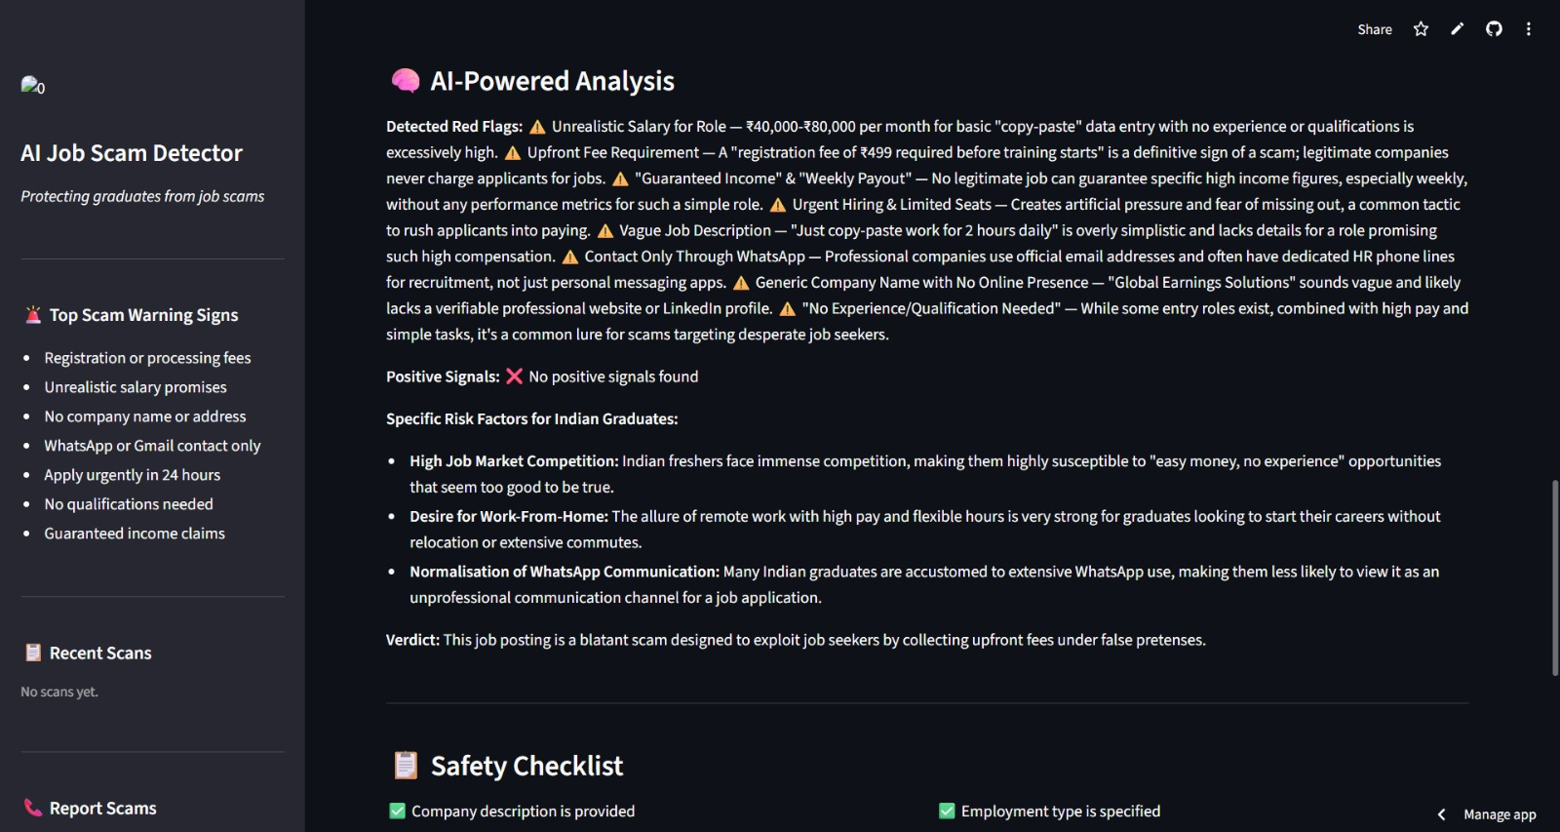
Fake Job Detection(AI Analysis)

Slide 12
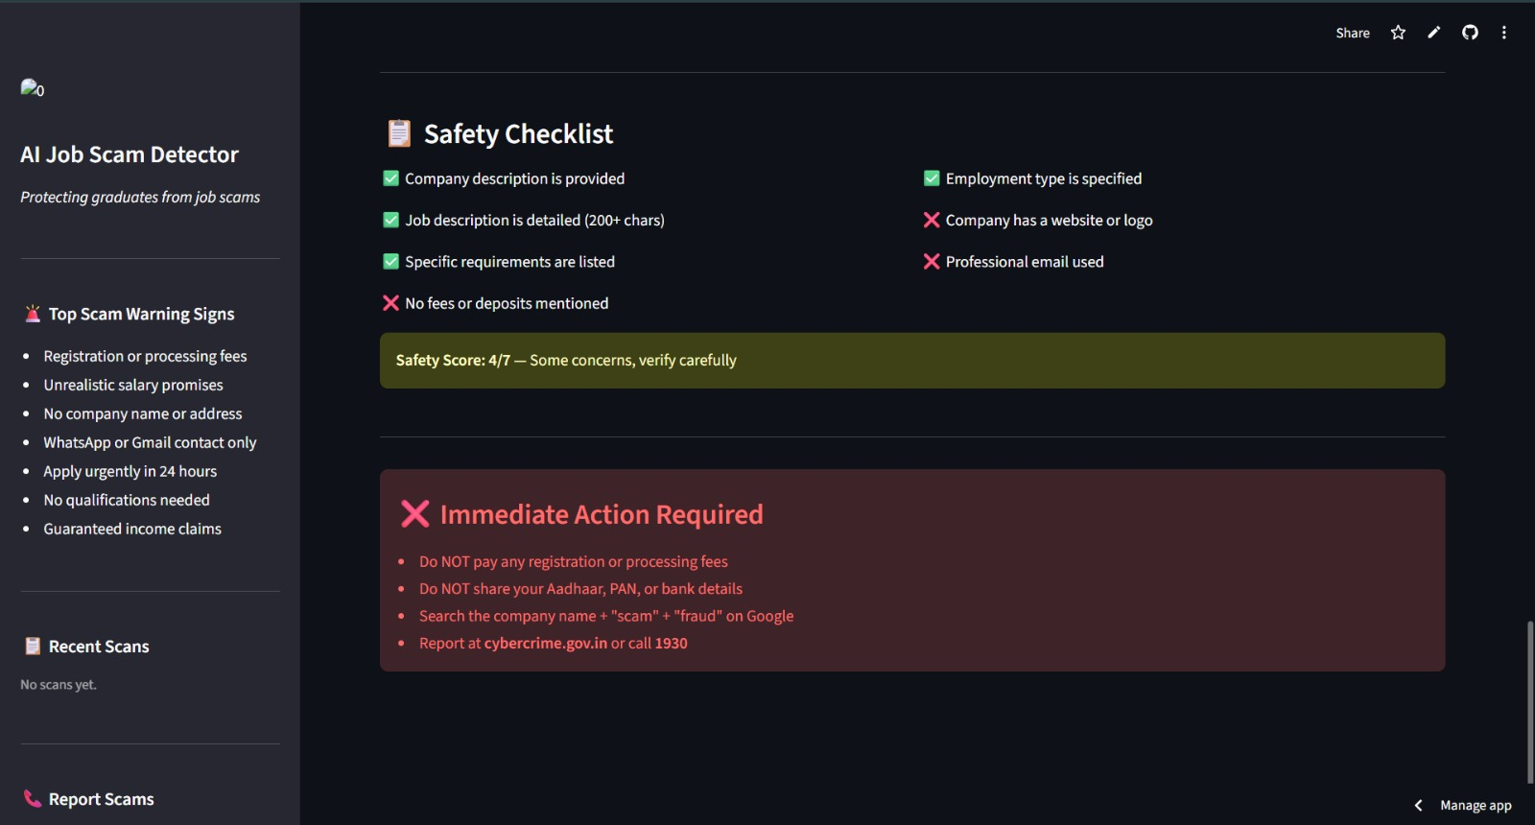

Slide 13
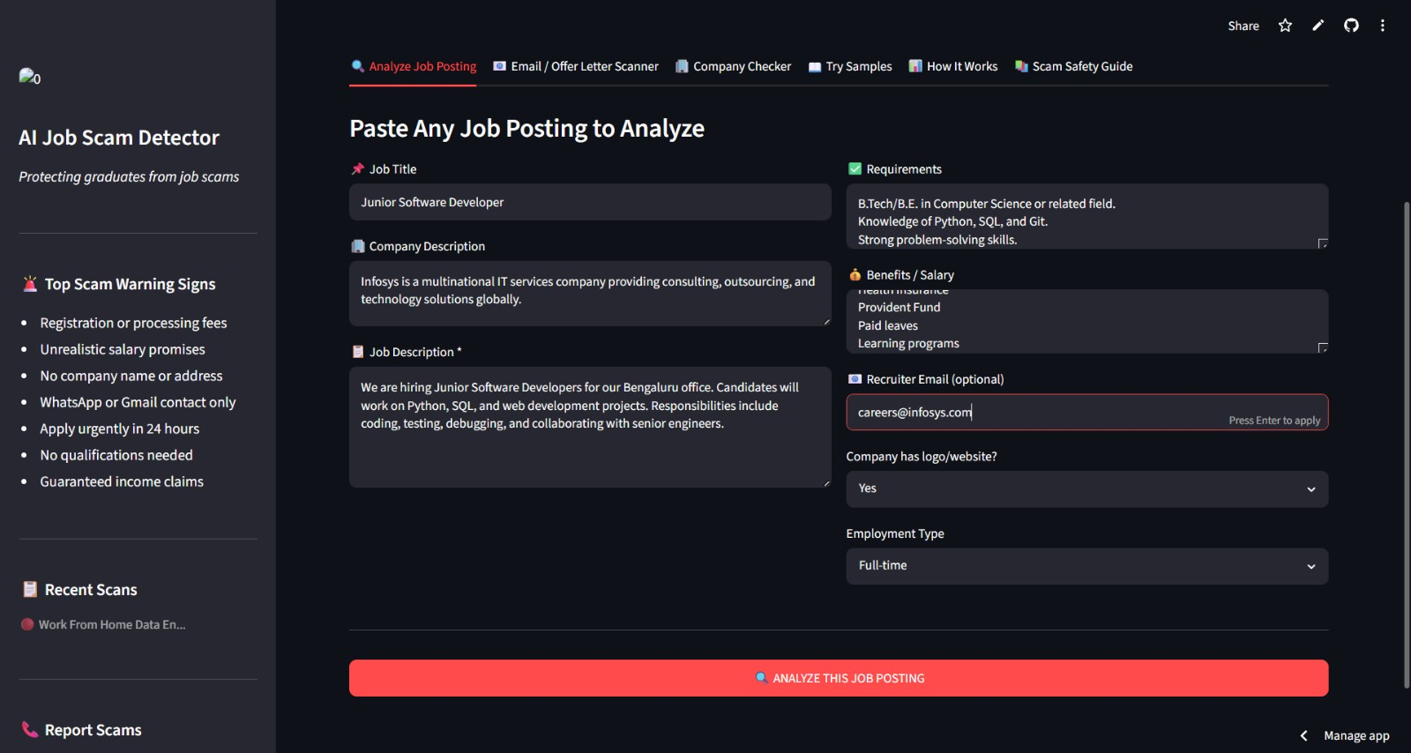
Real Job Detection(Input)

Slide 14
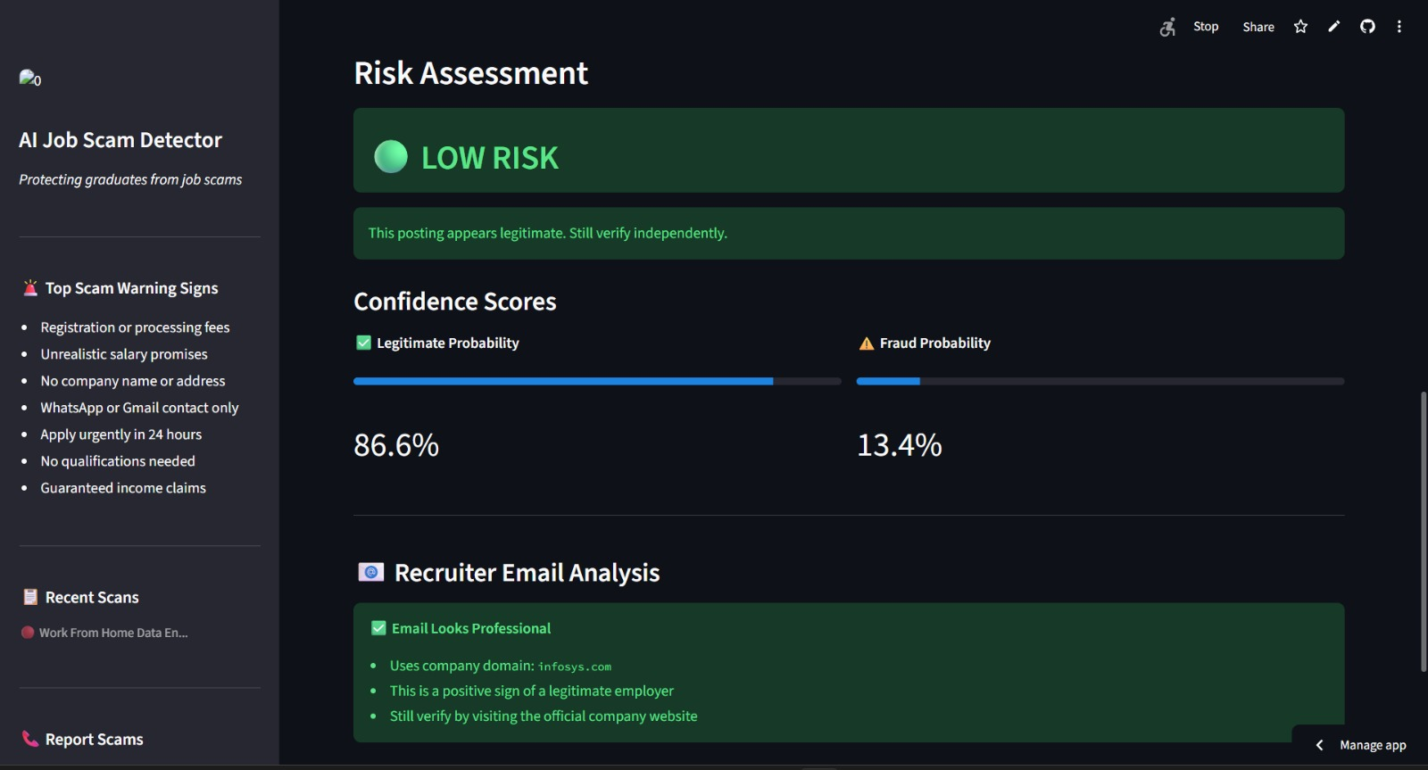
Real Job Detection(ML Analysis)

Slide 15
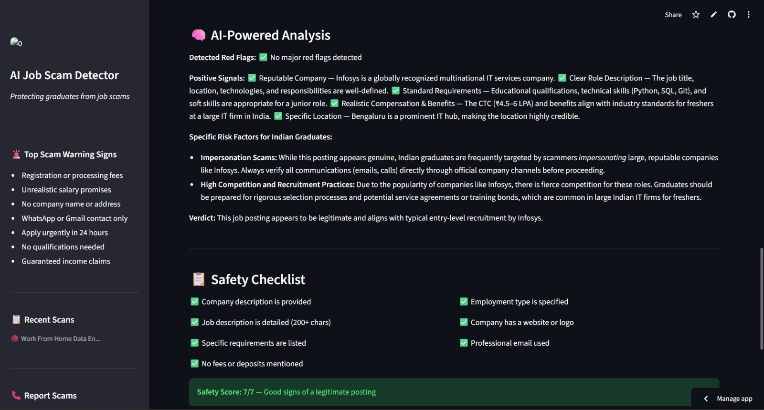
Real Job Detection(AI Analysis)

Slide 16
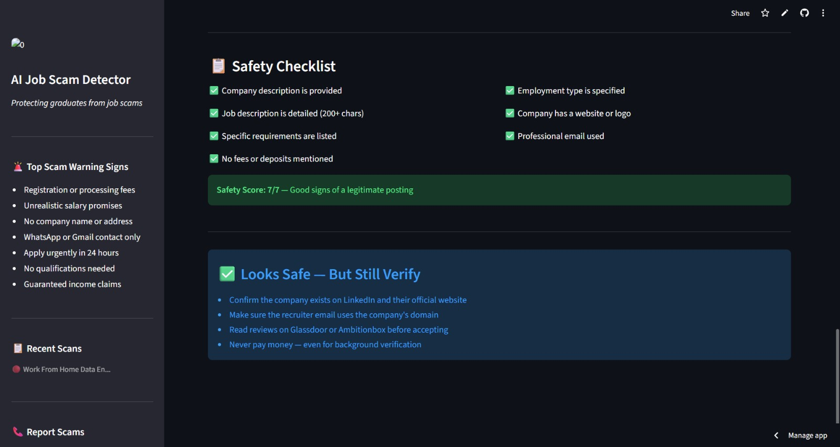

Slide 17
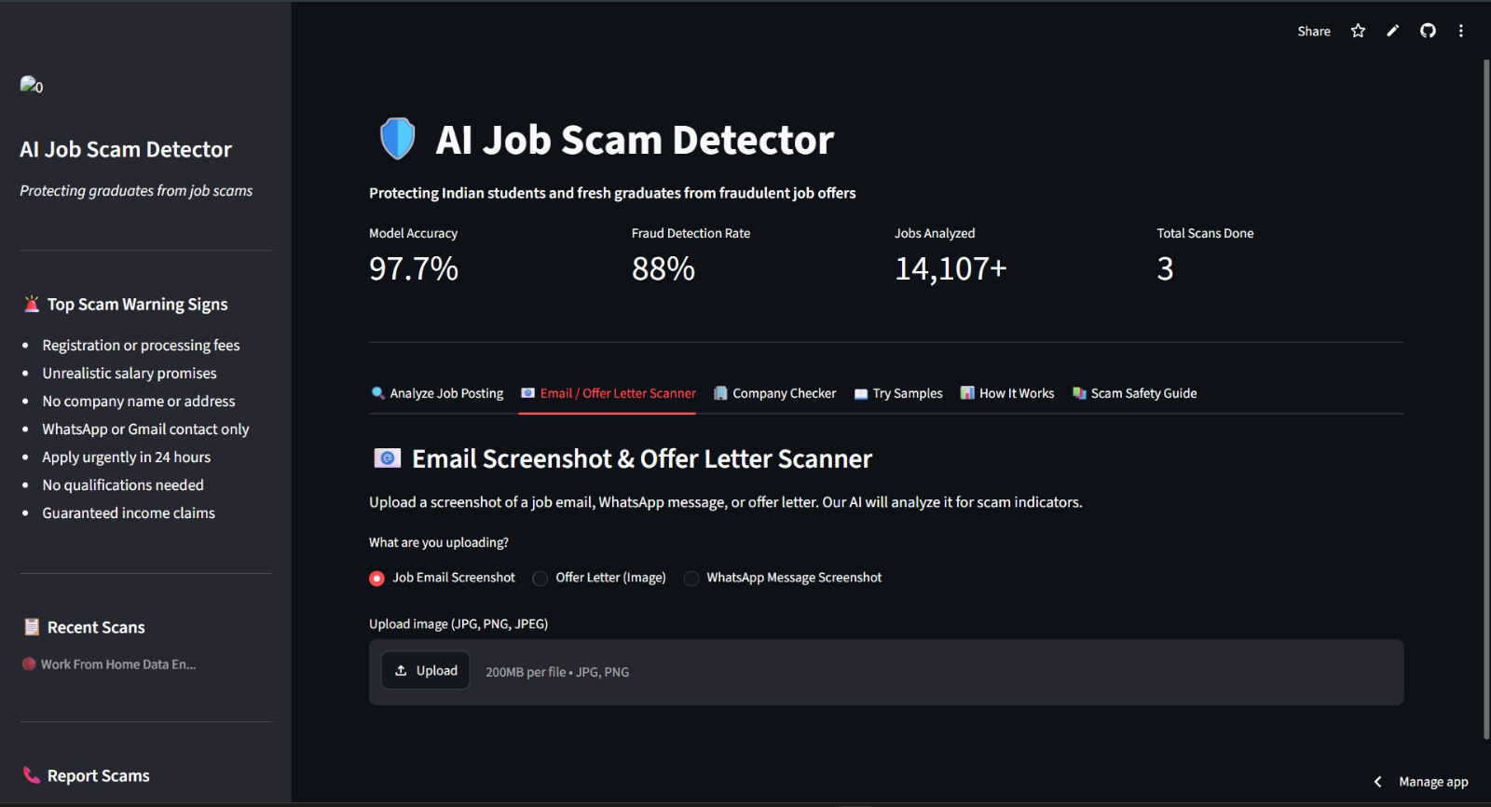
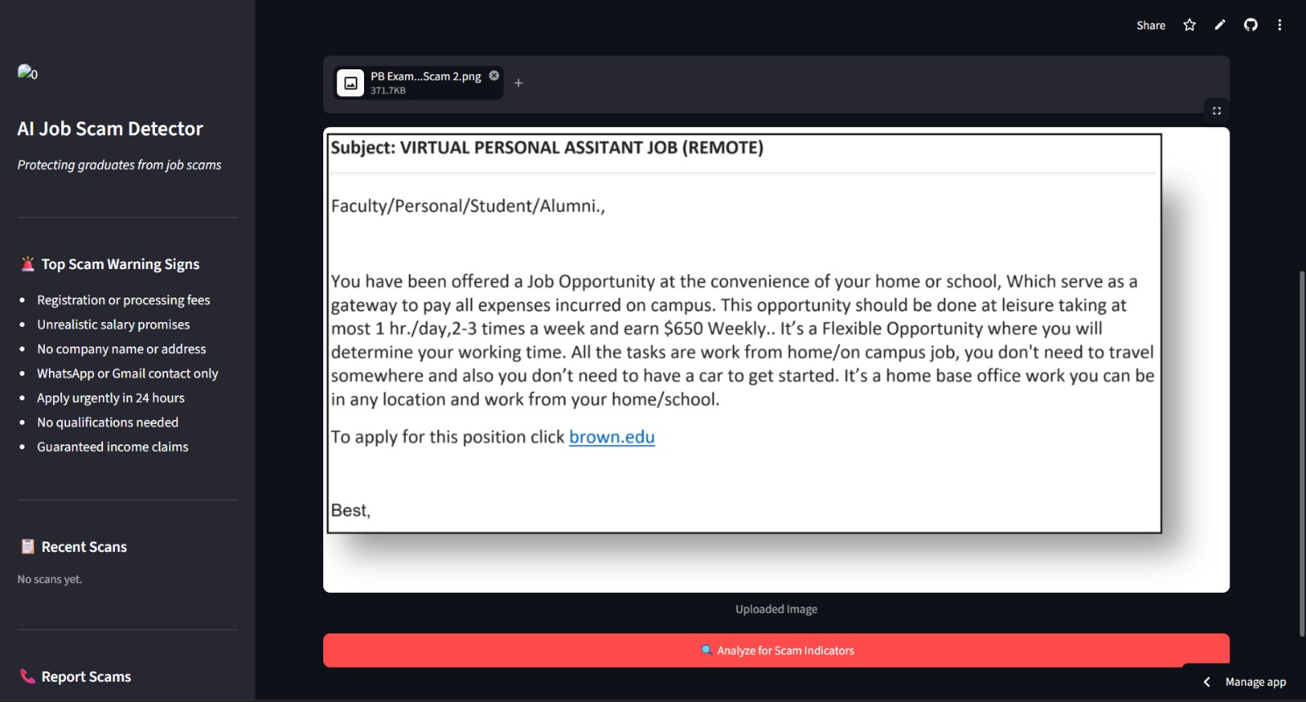
Email Scanner(Input)

Slide 18
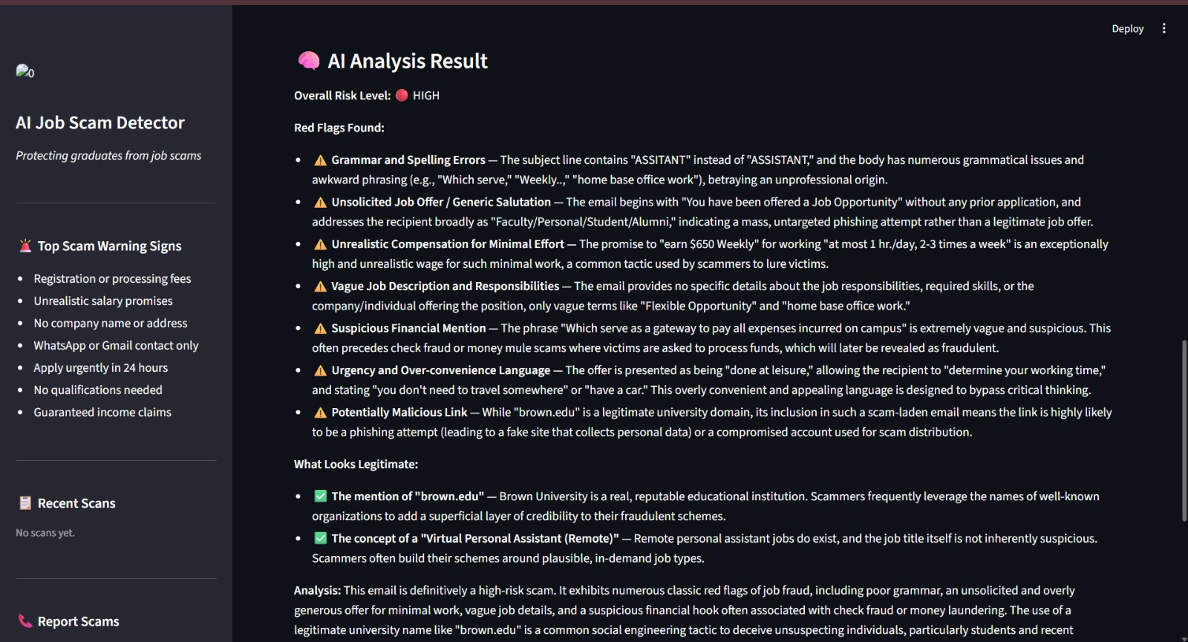
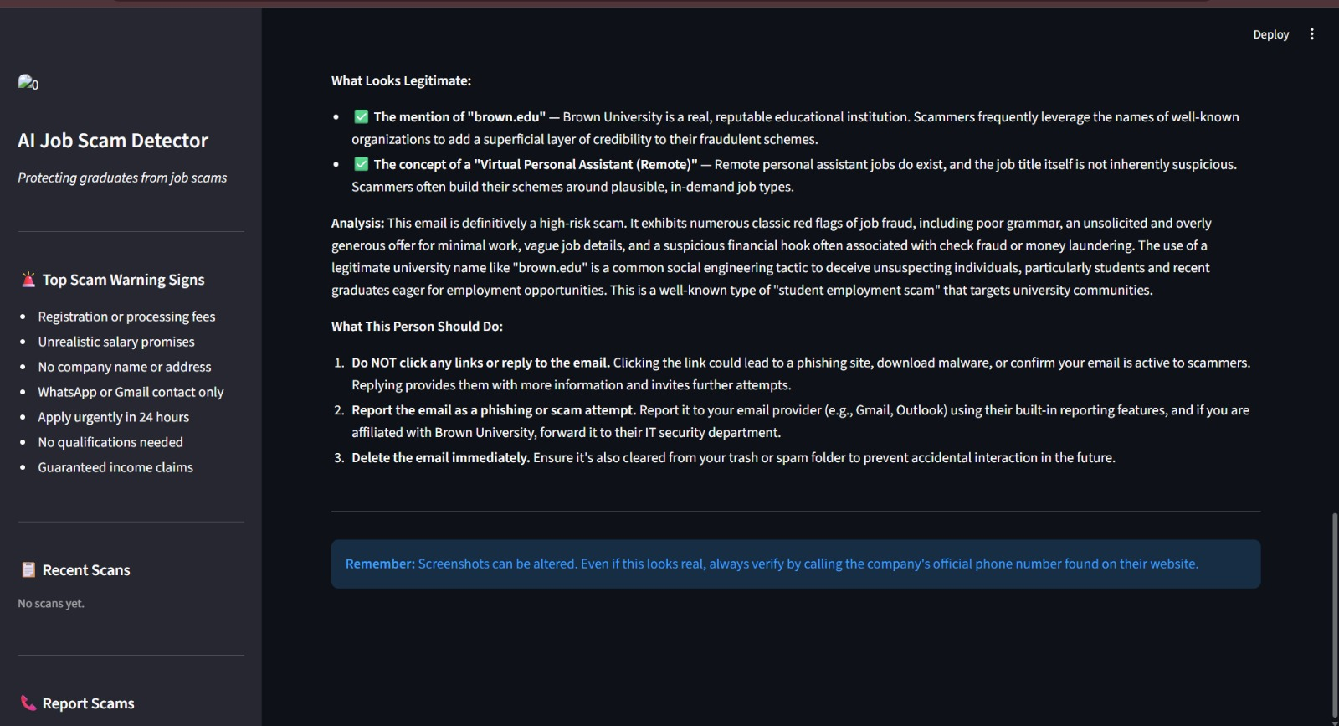
Email Scanner(AI Detection)

Slide 19
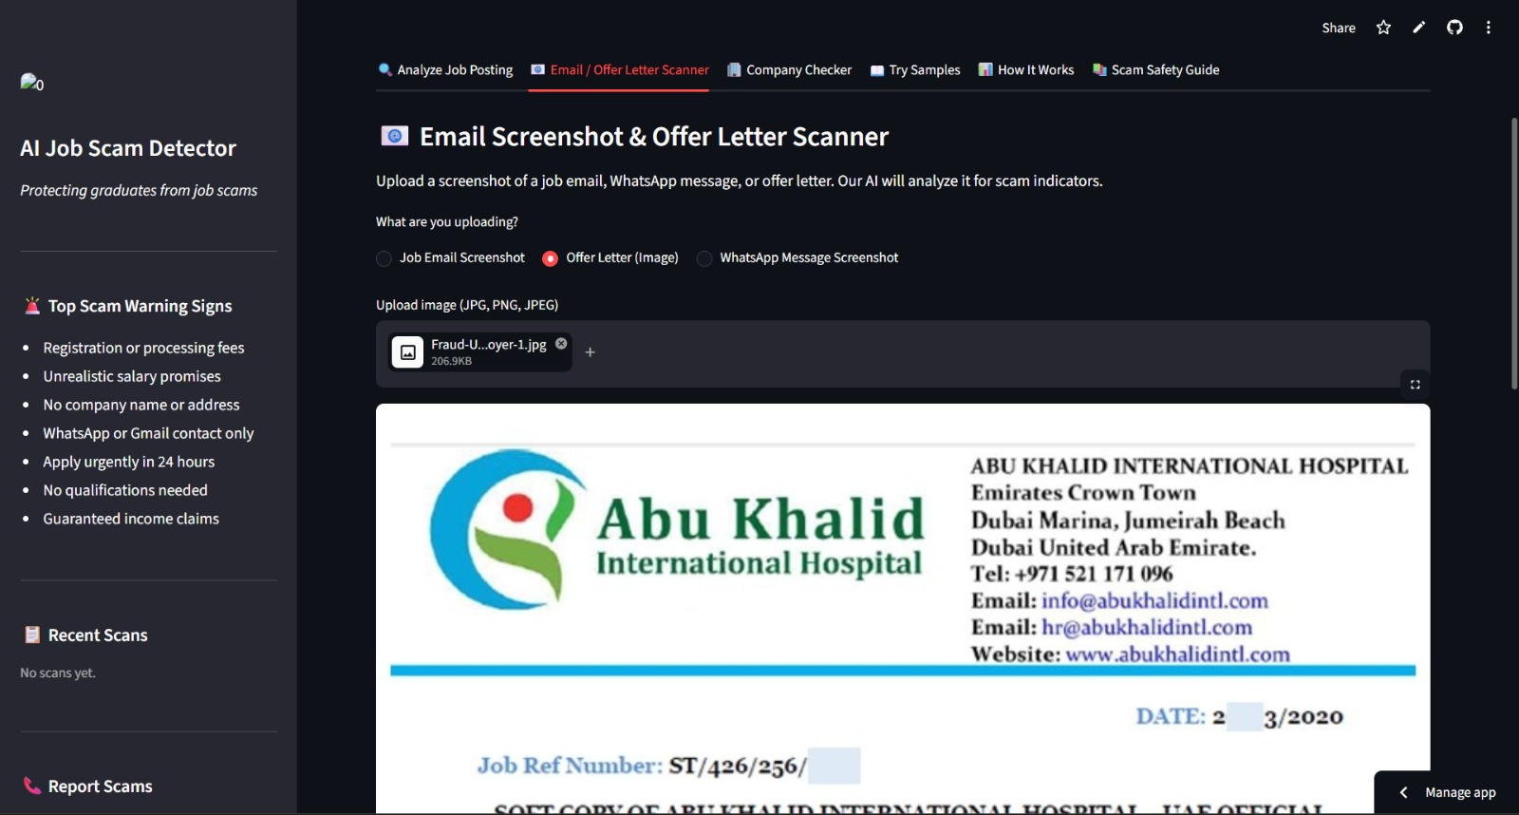
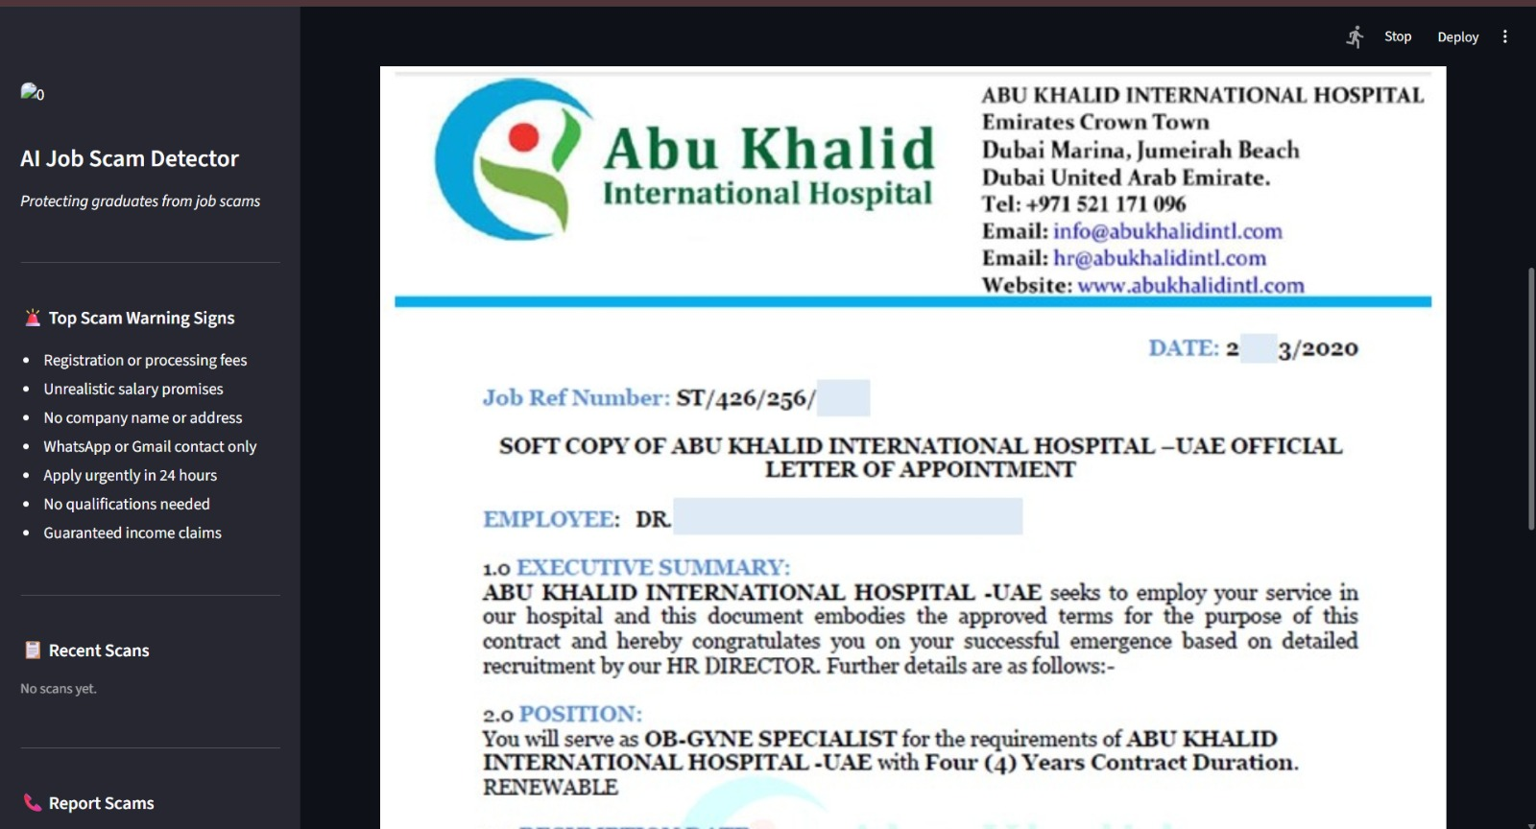
Offer Letter Scanner(Input)

Slide 20
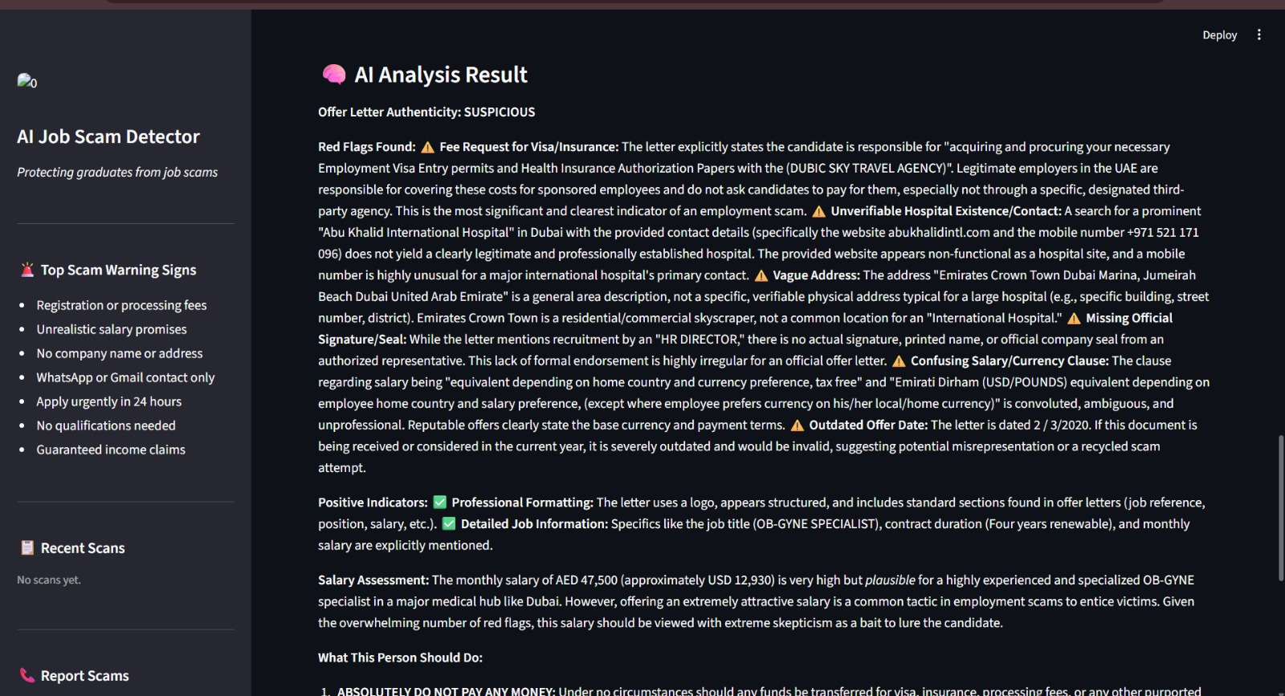
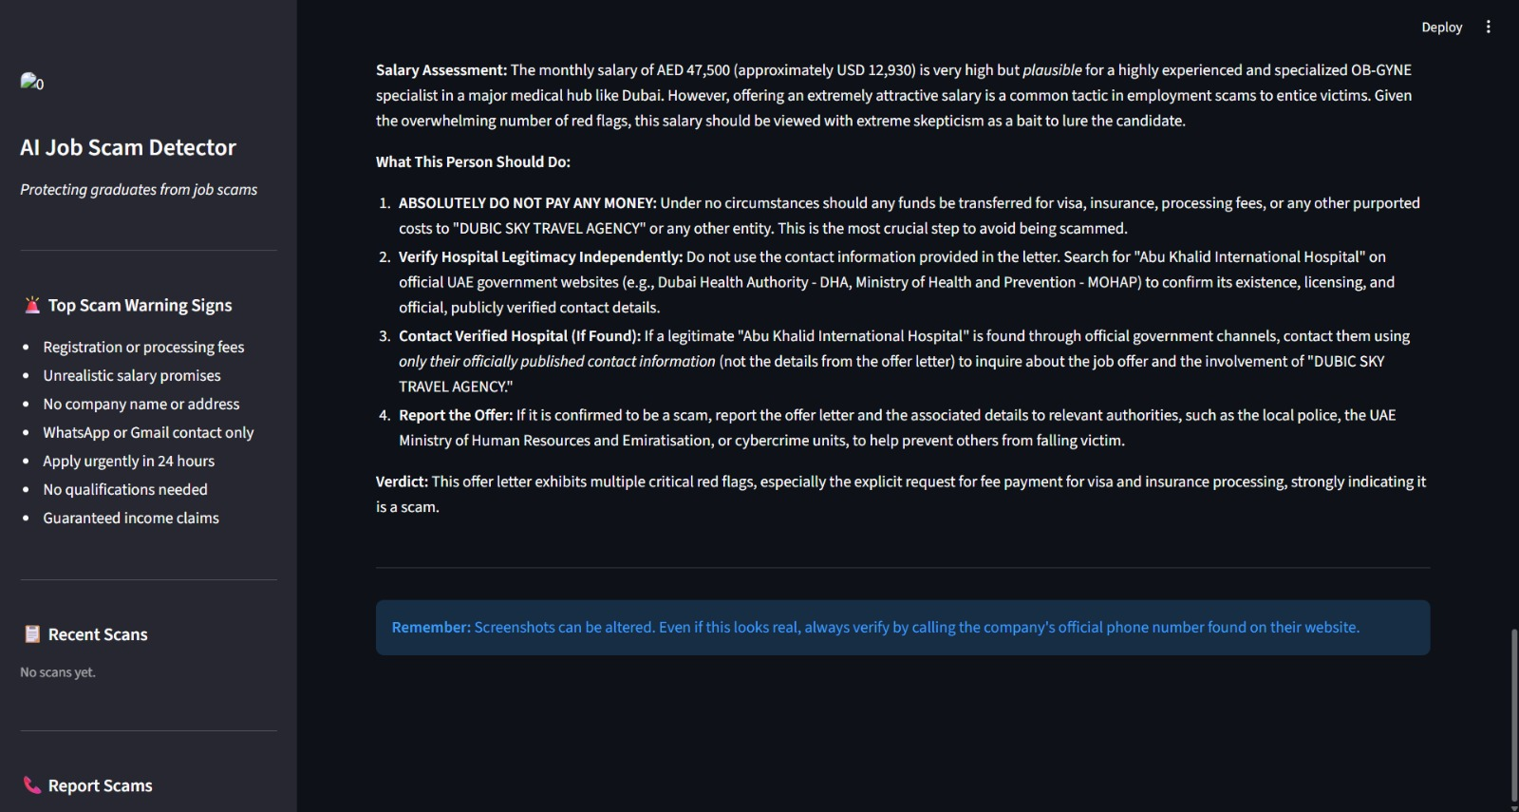
Offer Letter Scanner(AI Detection)

Slide 21
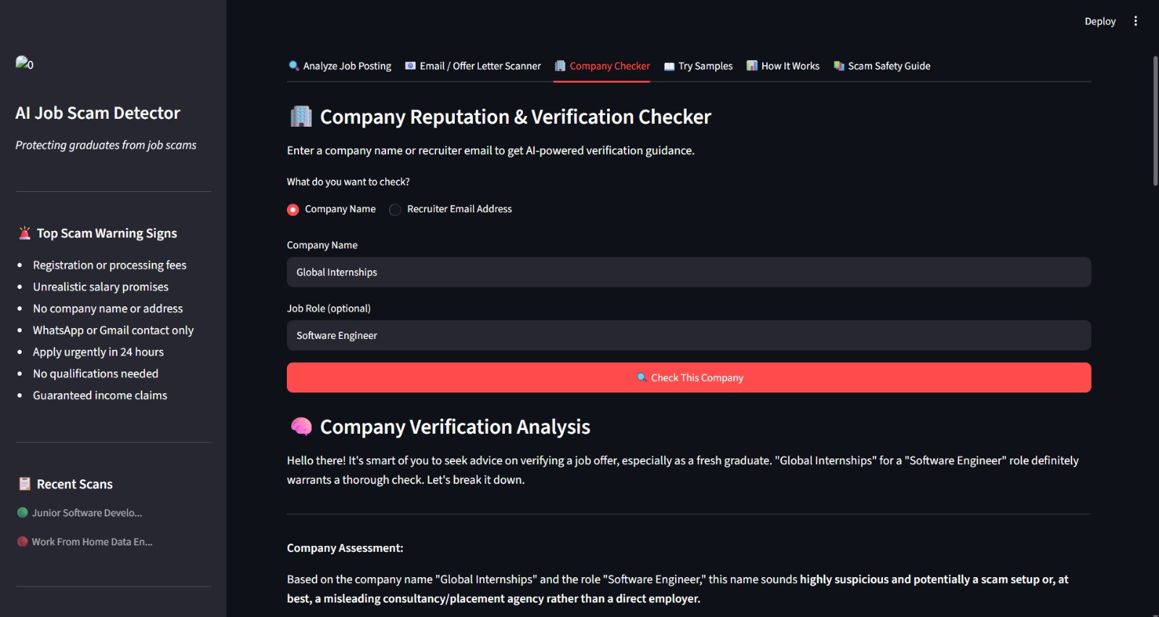
Company Checker

Slide 22
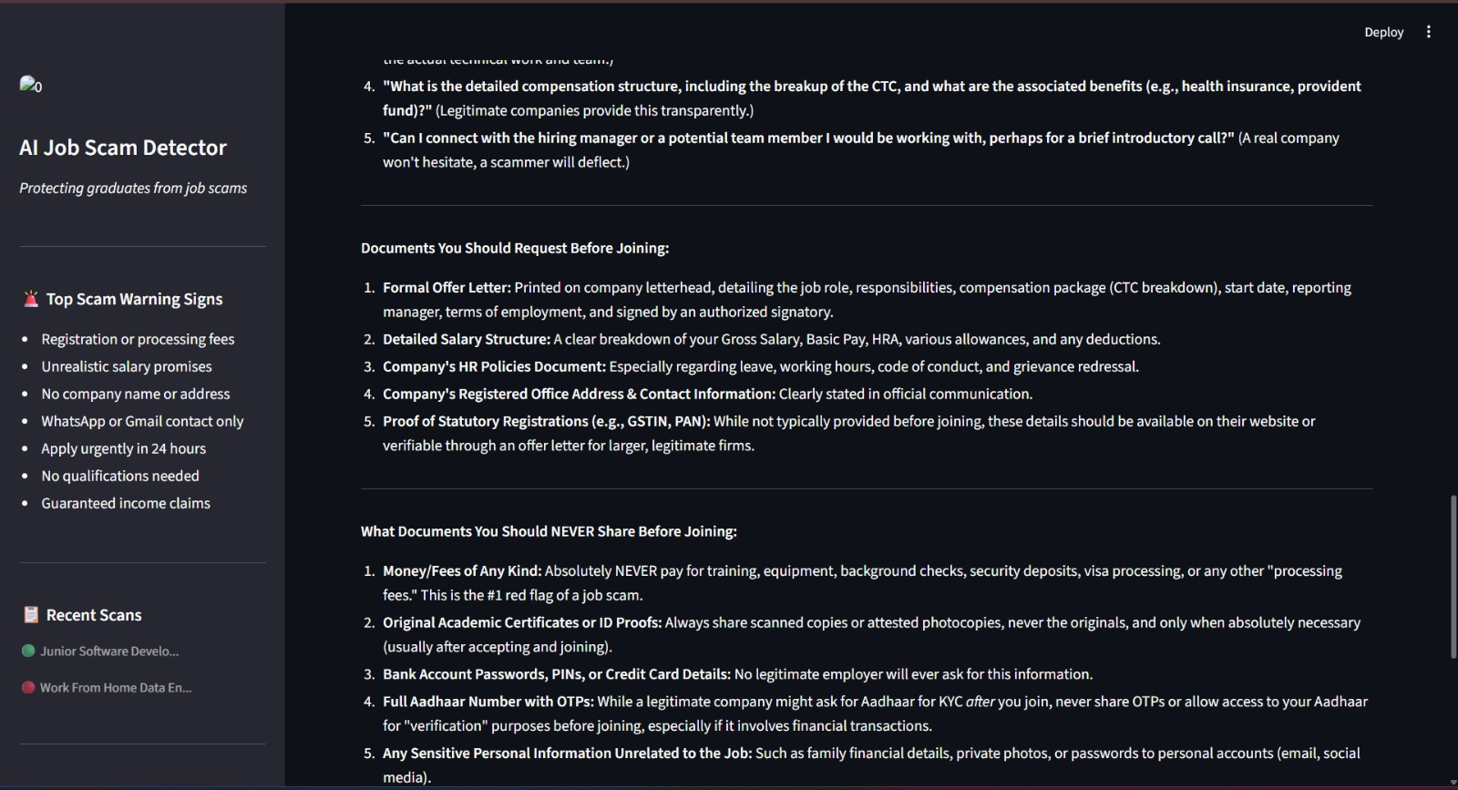

Slide 23
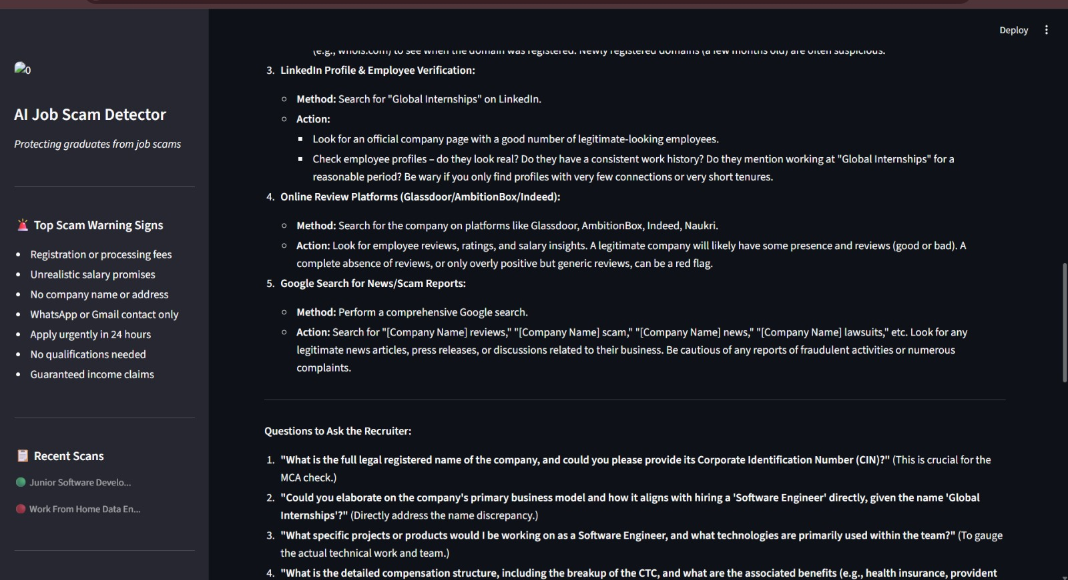

Slide 24
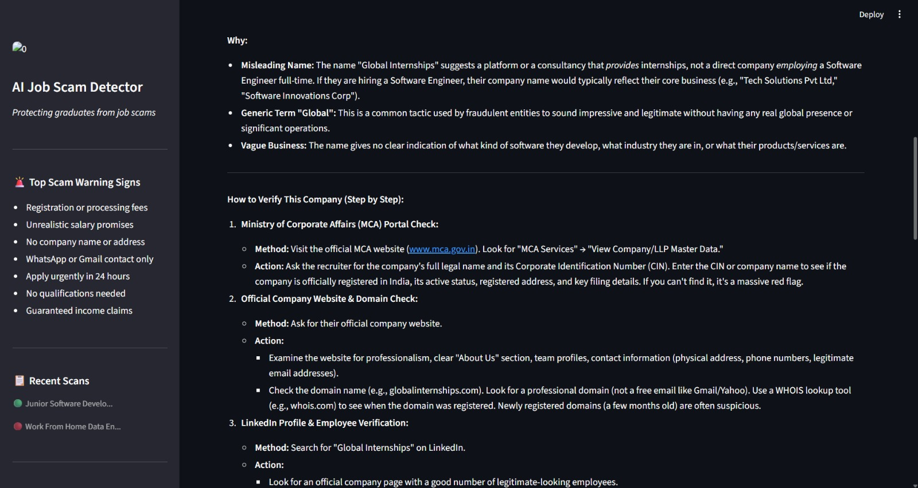
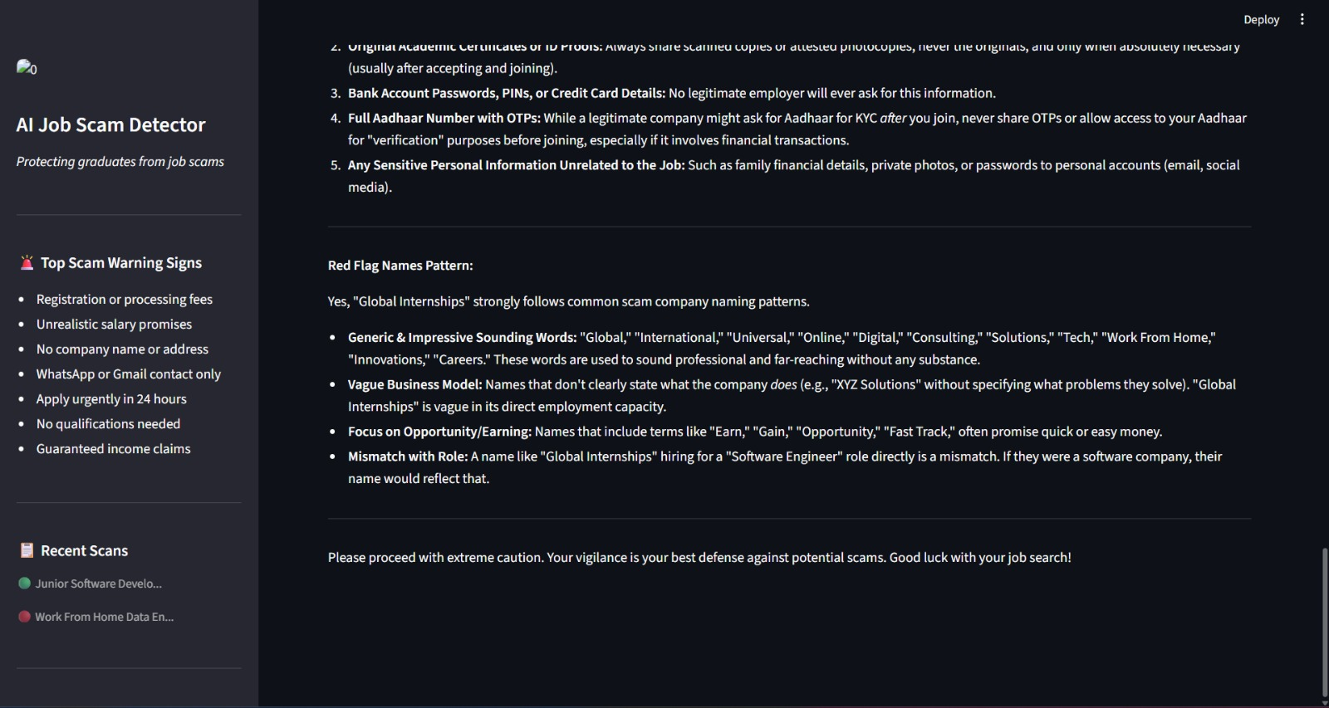

Slide 25
Conclusion
CONCLUSION
Key achievements and social impact of the AI Job Scam Detector
Successfully built and deployed an AI-powered fake job detection system that achieves 97.7% accuracy with 88% recall on fraudulent postings. The system combines the speed of Machine Learning with the intelligence of Google Gemini AI to provide both fast detection and clear, actionable explanations — protecting Indian graduates from financial and personal harm.
🎯 Technical Achievement
🧠 AI Integration
🛡️ Social Impact
✓ Trained on 14,107 real job postings
✓ Gemini 2.5 Flash explains red flags
✓ Protects fresh graduates from financial loss
✓ 88% fraud recall — catches most fake jobs
✓ Analyzes text, images, and email screenshots
✓ Educates users about common scam patterns
✓ Only 13 false negatives per 104 fake jobs
✓ Company reputation and email verification
✓ Provides reporting resources (1930 helpline)
✓ Balanced class weights handle data imbalance
✓ Personalized advice for Indian job market
✓ Addresses a critical real-world problem in India

Slide 26
Future scope
Planned enhancements and upcoming development ideas
🔌 Browser Extension
💬 WhatsApp Chatbot
🌐 Hindi Language Support
Auto-detect scam jobs directly on Naukri, LinkedIn, and Indeed while browsing — no copy-paste needed
Send a job posting to a WhatsApp number and receive instant scam analysis — reaches rural graduates
Support regional languages so students in tier-2/3 cities can use the tool in their native language
High
High
Medium
.
📱 Mobile Application
📊 Real-time Job Portal Monitoring
🎓 College Awareness Integration
Standalone Android/iOS app with camera integration — photograph job ads in newspapers or posters
Crawl job portals automatically, flag suspicious listings, and notify job seekers proactively
API for college placement portals to filter and flag suspicious recruiter registrations
Medium
Low
Low

Slide 27
References
REFERENCES
Datasets, APIs, libraries, and documentation used in this project
01
EMSCAD Dataset
02
Scikit-learn
Employment Scam Aegean Dataset — 17,880 real job postings labelled as real/fake. Used as the training and testing dataset for the ML model.
Machine learning library used for Logistic Regression model training, TF-IDF vectorization, train-test split, and classification report generation.
🔗 https://www.kaggle.com/datasets/shivamb/real-or-fake-fake-jobposting-prediction
🔗 scikit-learn.org/stable/documentation.html
03
Google Gemini API
04
NLTK (Natural Language Toolkit)
Google's Generative AI API (Gemini 2.5 Flash) used for text analysis, red flag extraction, image vision, and personalized safety advice.
Used for text preprocessing — specifically the English stopwords corpus for removing common words before TF-IDF vectorization.
🔗 ai.google.dev/gemini-api/docs
🔗 nltk.org — Bird, Klein, Loper (2009)
05
Streamlit
06
IBM SkillsBuild
Python framework used to build the interactive web application UI with tabs, file upload, metrics, progress bars, and real-time results.
Learning platform providing the AI/ML course content, project guidelines, and internship framework for this capstone project.
🔗 docs.streamlit.io
🔗 https://skills.yourlearning.ibm.com/activity/PLAN-8A48645196FA?ngo-id=0107&utm_campaign=AL-Edunet-ArtificialIntelligence-2025-26

Slide 28
Github link/DEPLOYMENT LINK
🐙 GitHub Repository
https://github.com/palakkhandelwal22/AI-Job-Scam-Detector
🚀 Deployment Link (Streamlit)
https://ai-job-scam-detector-kmnbfck73fegfappzrvdxeq.streamlit.app/

Slide 29
THANK YOU

