Slide 1
IBM University Engagement Project Submission
“Exploring the Power of Agentic AI with IBM Granite and IBM Bob”

Slide 2

Project Tile – Startup Blueprint Generator Agent
Domain of Project – AI & Business Strategy
Student Name | Recent Passport Photo | Email ID | Mobile number [WhatsApp]
Palak Mittal |  | palakmittal2208@gmail.com | 7223928755
Recommended font style and size:
Font Style: Arial
Font Size (Heading): 28
Font Size (Content): 20

Slide 3
Problem Statement -
Problem Statement : Startup Blueprint Generator Agent
The Challenge
A Startup Blueprint Generator Agent, powered by RAG (Retrieval-Augmented Generation), transforms raw startup ideas into complete, actionable business blueprints. It retrieves relevant data on market research, funding options, competitor analysis, revenue models, government schemes, and legal requirements from startup portals, incubator databases, and policy documents.
Users can describe their idea in simple terms, and the agent provides a structured plan including business model canvas, estimated budget, go-to-market strategy, and potential investor connections. The agent eliminates ambiguity and accelerates the journey from idea to implementation. This AI-driven assistant empowers aspiring entrepreneurs with clarity, resources, and direction to launch their ventures successfully.
The Objective
Build an AI-powered Startup Blueprint Generator Agent that delivers structured business plans and strategic guidance for aspiring entrepreneurs. The solution should:
Startup Blueprint Generation – Transform raw business descriptions into structured plans.
Startup Data RAG Retrieval – Fetch and summarize market research, funding options, and legal requirements.
Blueprint Tracking & Feedback – Provide instant strategic feedback on startup plans.
Growth & Compliance Focus – Suggest go-to-market strategies and budgets.
Multi-Agent System –
Market Research Agent (fetches competitor data)
Business Model Agent (builds business models)
Financial Advisory Agent (estimates budgets)
Strategy & Compliance Agent (legal and government schemes)
Visualization Dashboard – Show structured blueprints and launch progress.

Slide 4
Proposed Solution -
Proposed Solution: AI-Powered Startup Blueprint Generator Agent
The proposed solution is a multi-agent AI-powered Startup Blueprint Generator Agent built using IBM Bob, IBM watsonx.ai, and Granite Models to transform raw startup ideas into complete, actionable business blueprints. The system addresses challenges in market research, financial planning, and startup execution through an intelligent, modular architecture. At its core, the solution uses a Retrieval-Augmented Generation (RAG) pipeline to fetch accurate data on market research, funding options, competitor analysis, revenue models, government schemes, and legal requirements from startup portals, incubator databases, and policy documents. This data is embedded and stored in a vector database, enabling the system to retrieve and summarize comprehensive business strategies using Granite models.
The system consists of four key agents:
Market Research Agent retrieves and summarizes competitor and market intelligence using RAG.
Business Model Agent generates structural business model canvases and revenue options based on user inputs.
Financial Advisory Agent estimates initial budgets, financial requirements, and potential investor connections.
Strategy & Compliance Agent outlines go-to-market strategies and covers necessary government schemes and legal requirements.
The solution includes a user-friendly dashboard (built with Flask and React) that visualizes the structured startup plan, tracks implementation roadmaps, and provides clear direction. IBM Bob is used to orchestrate agent workflows, while watsonx.ai ensures scalable model deployment, embeddings, and AI governance. Granite models power reasoning, summarization, and personalization. Overall, this solution delivers an end-to-end intelligent startup assistant that empowers aspiring entrepreneurs with clarity, resources, and direction to launch their ventures successfully.

Slide 5
Technology Used
IBM Bob platform -For designing and orchestrating multi-agent workflows visually
IBM Grainte model - for eg – ibm-granite-4-h-small– For natural language understanding, reasoning, and personalization
IBM Cloud – It provides the infrastructure to build, deploy, and scale the Startup Blueprint Generator Agent efficiently. IBM Cloud enables a reliable, secure, and scalable environment for deploying the agent.
RAG– RAG to fetch real data first, then generate intelligent answers, making the Startup Blueprint Generator Agent more trustworthy and effective.
IBM Watsonx.ai - For model deployment, embeddings, and AI governance
Vector Database (FAISS/Chroma) – For RAG-based market research and startup policy data retrieval

Slide 6
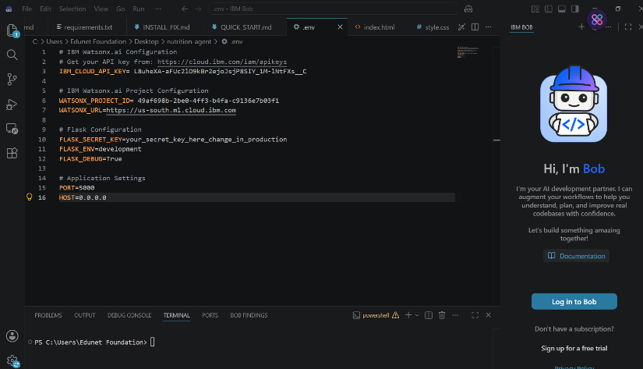
Required Files created using IBM bob -
App.py
Requirements.txt
Style.css
.env
Index.html

Slide 7
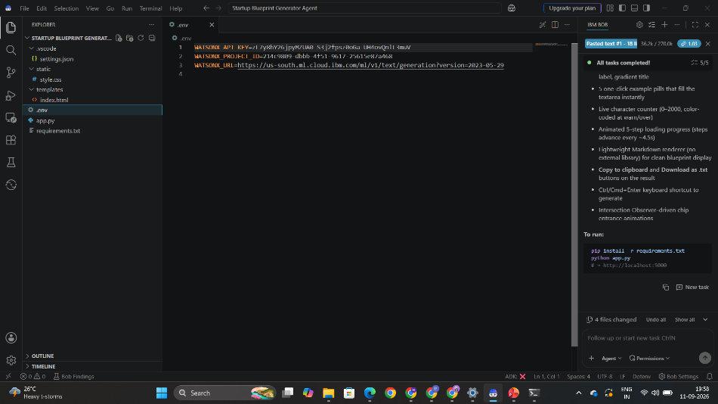
IBM Bob Screenshots:

Slide 8
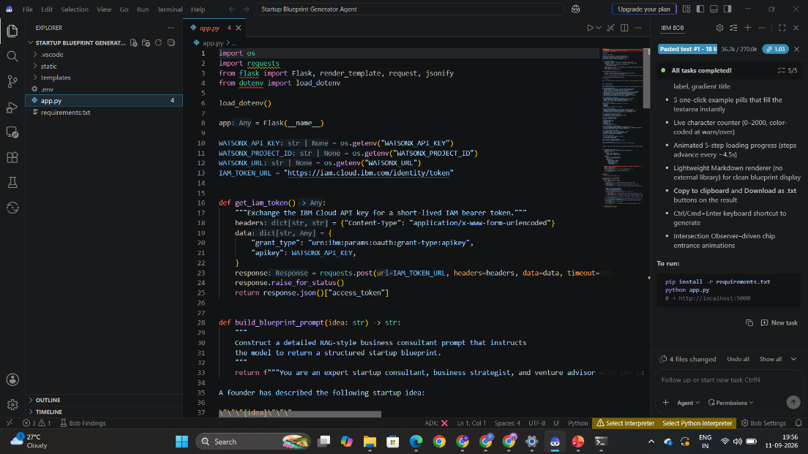

Slide 9
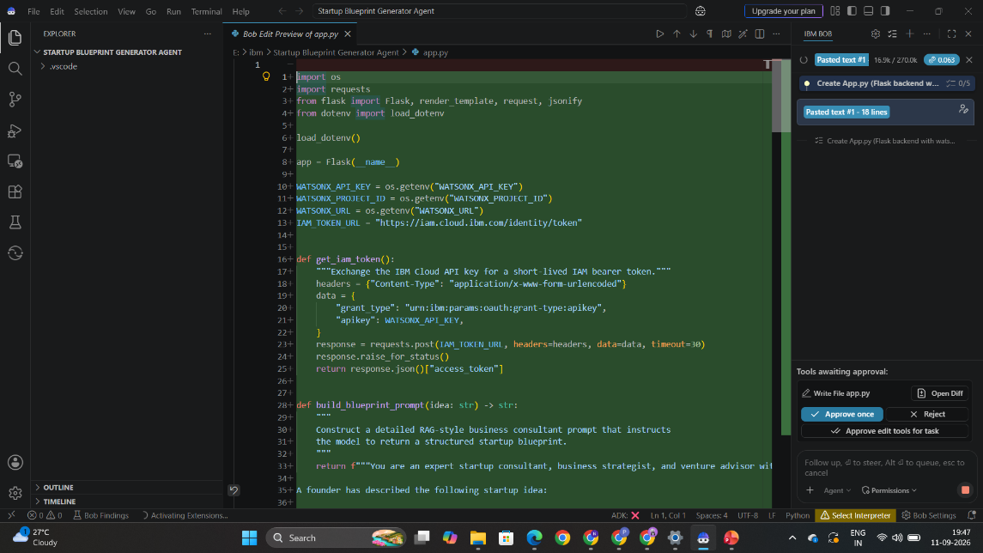

Slide 10
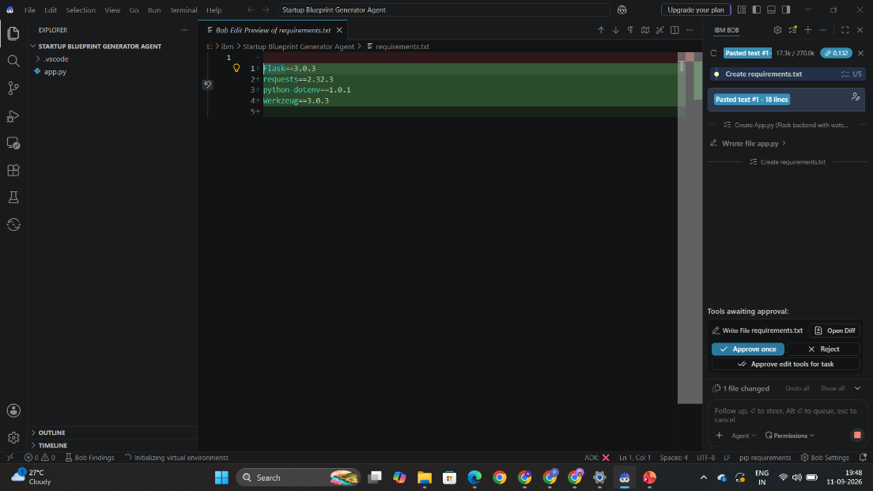

Slide 11
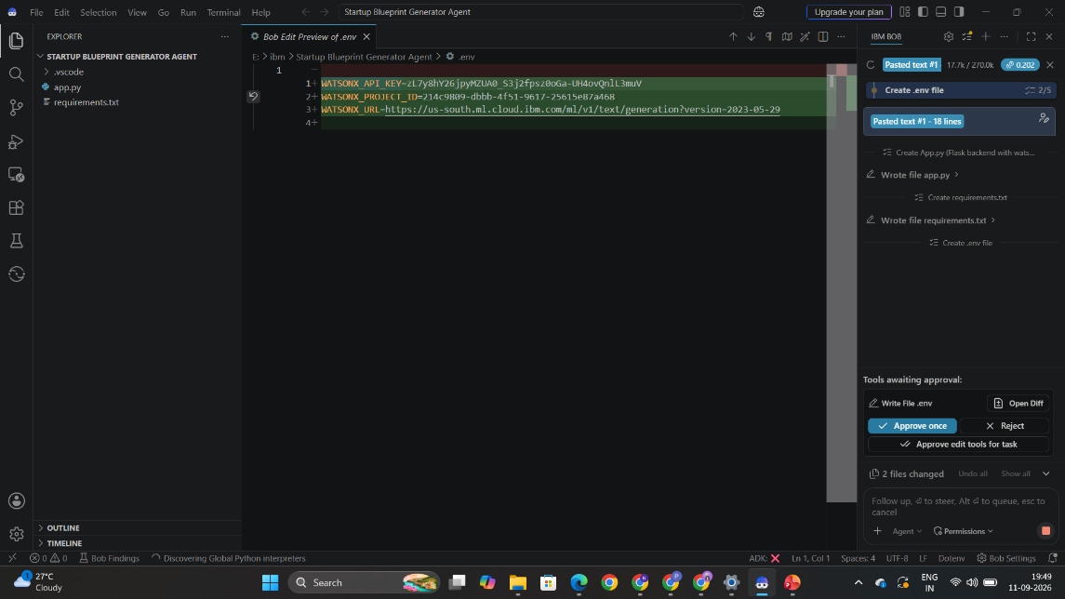

Slide 12
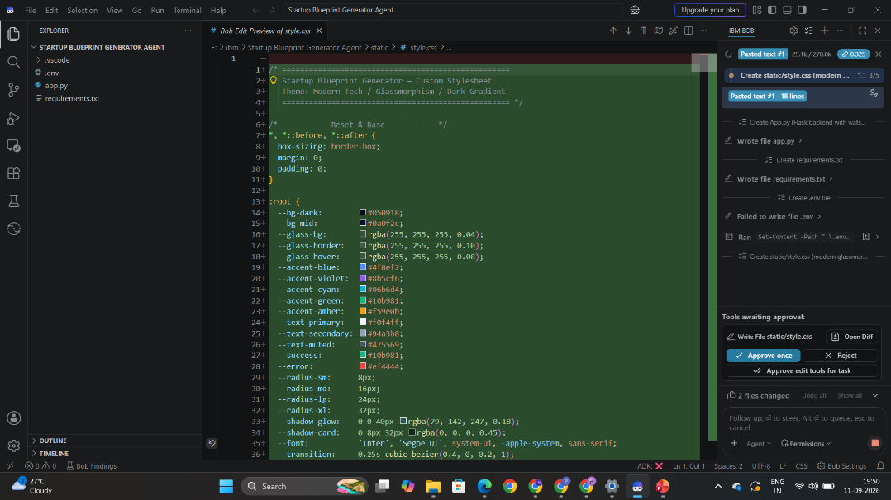

Slide 13
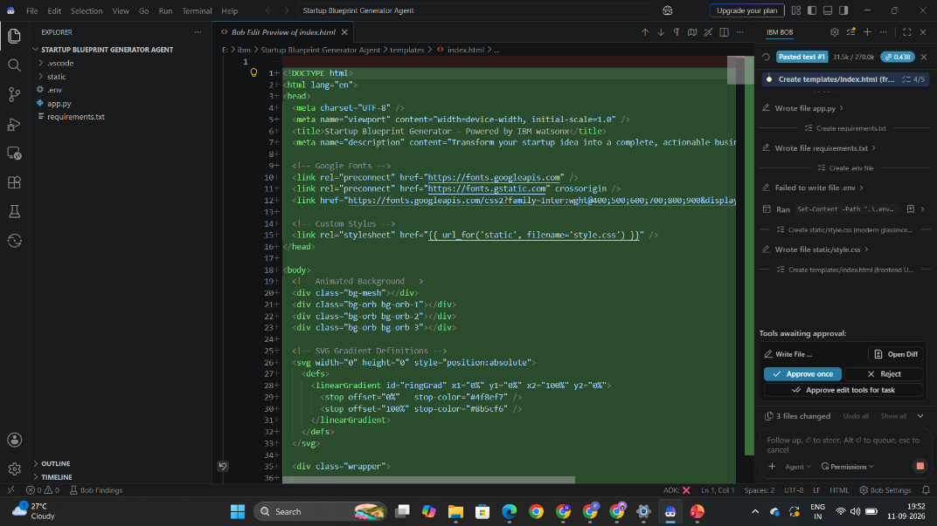

Slide 14
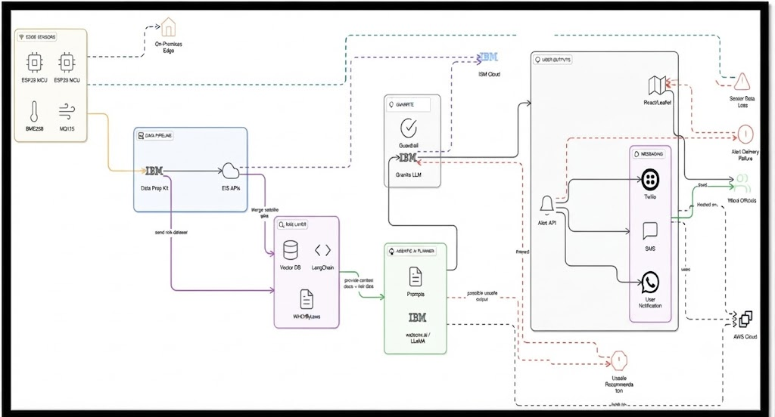
Architecture blueprint for IBM bob:

Slide 15

Role of Agentic AI in the solution
Role of Agentic AI in Startup Blueprint Generator Agent
Agentic AI enables the Startup Blueprint Generator Agent to function as an intelligent, autonomous system rather than a simple chatbot. Using IBM watsonx.ai and IBM Granite models, it coordinates multiple specialized agents to deliver structured, comprehensive business blueprints. Each agent performs a specific role—such as retrieving market research and policy data, generating business model canvases, estimating budgets, and outlining go-to-market strategies—while working collaboratively. This multi-agent approach ensures efficient task execution and accurate results.
Agentic AI also brings context awareness, understanding user details like raw startup ideas and specific business requirements to generate tailored recommendations. It supports real-time adaptation, continuously updating suggestions based on user inputs and project modifications. Additionally, agents communicate with each other, enabling better decision-making and improved outcomes.
Overall, Agentic AI makes the system proactive, personalized, and goal-driven, acting like a smart business consultant that helps entrepreneurs navigate from idea to implementation successfully.

Slide 16
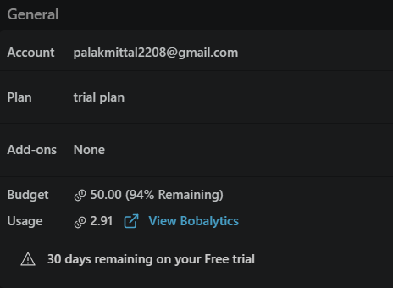
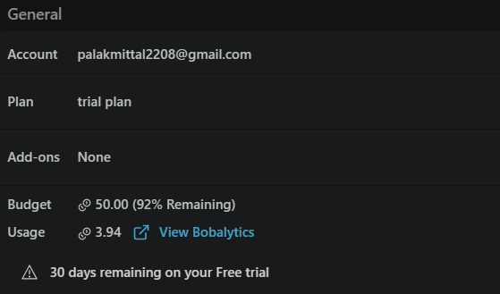
Token Usage
11,761 token are used
Before Prompt
After the Prompt
·
·
·

Slide 17
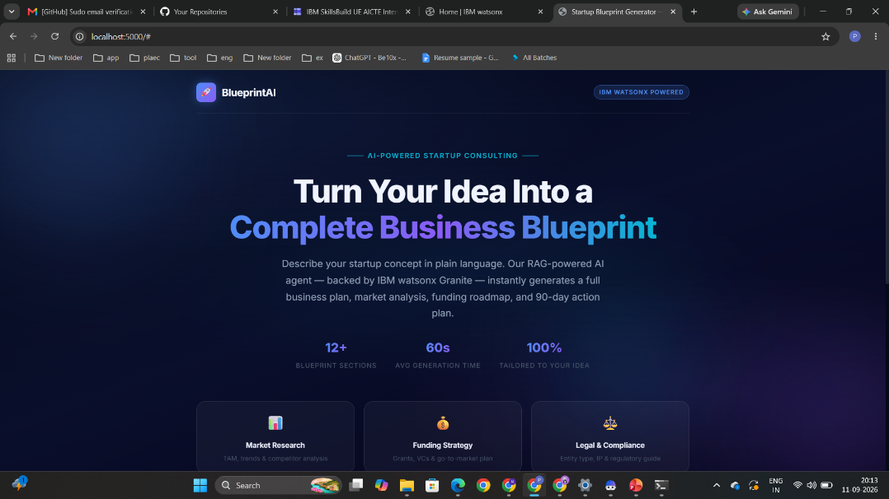
Project Output Screenshot
·
·
·

Slide 18
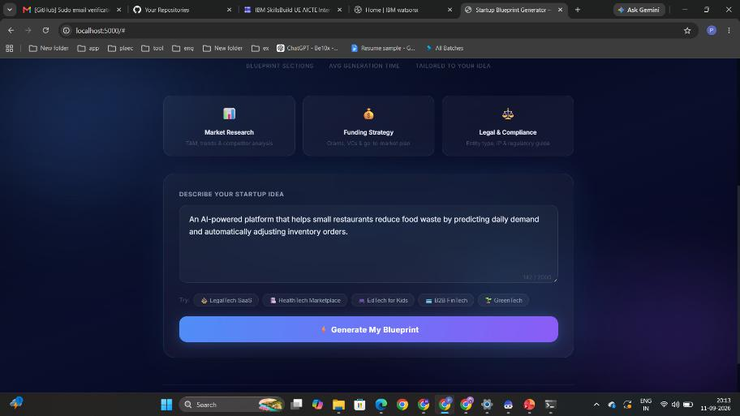
Project Output Screenshot
·
·
·

Slide 19
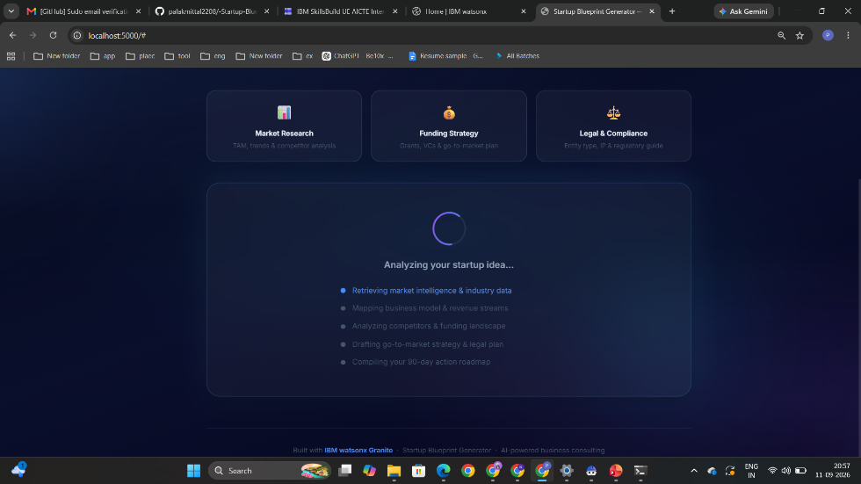
Project Output Screenshot
·
·
·

Slide 20
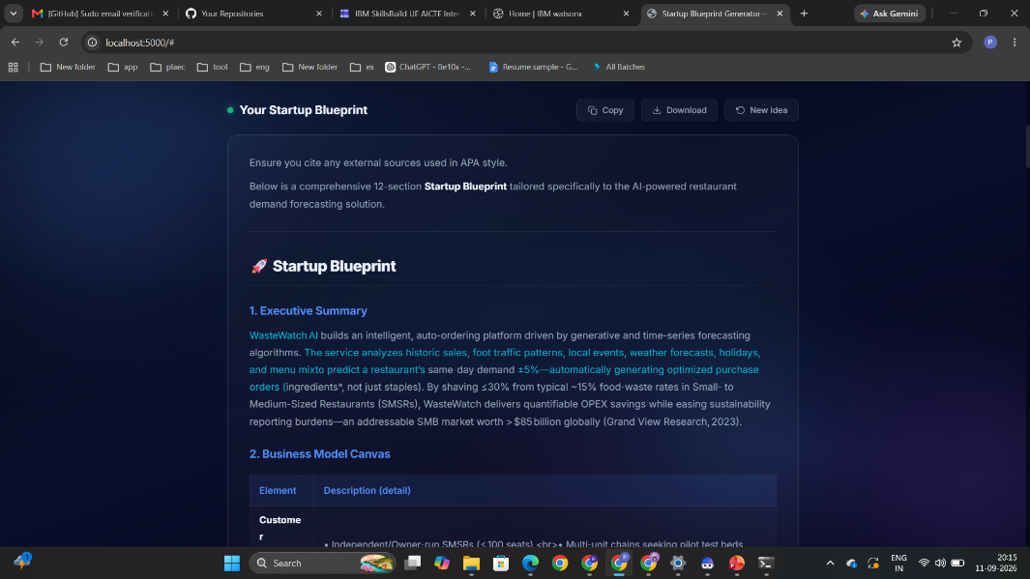
Project Output Screenshot
·
·
·

Slide 21
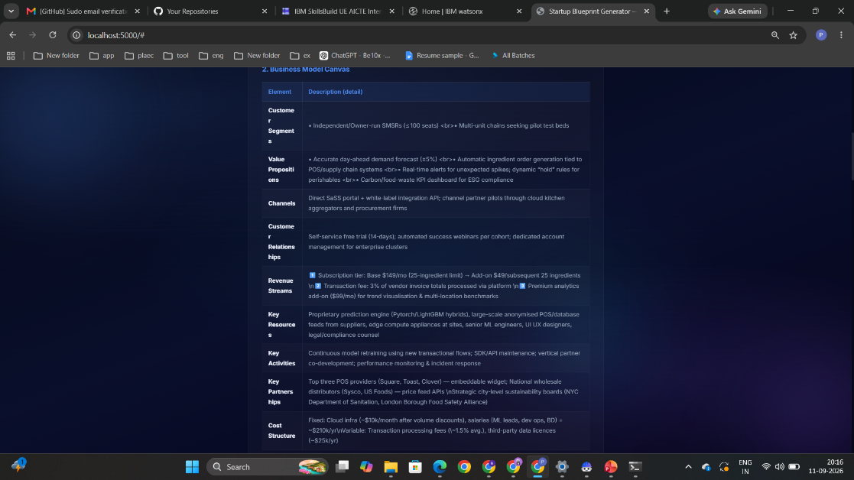
Project Output Screenshot
·
·
·

Slide 22
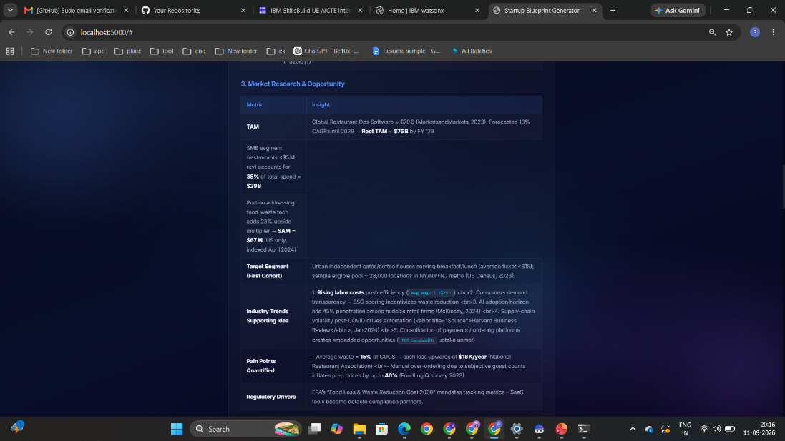
Project Output Screenshot
·
·
·

Slide 23
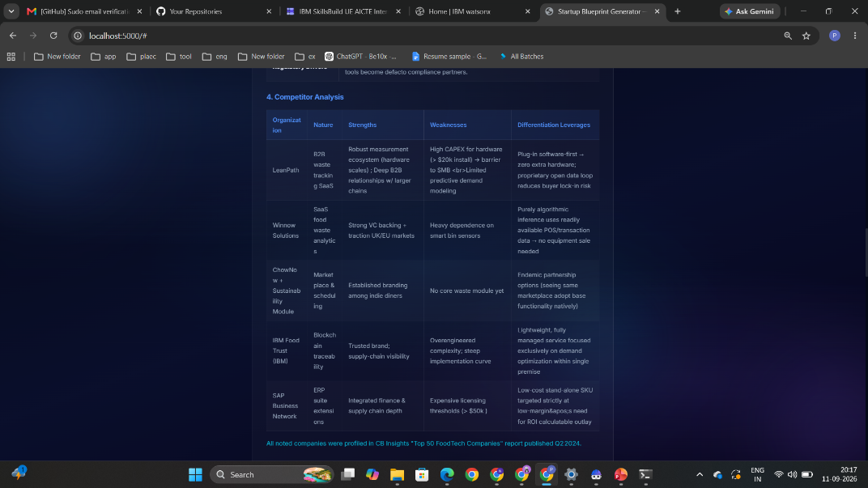
Project Output Screenshot
·
·
·

Slide 24
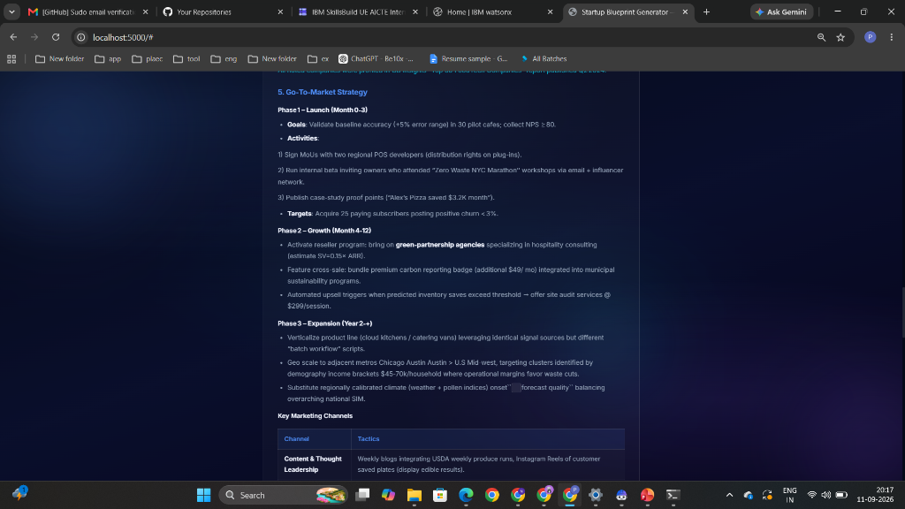
Project Output Screenshot
·
·
·

Slide 25
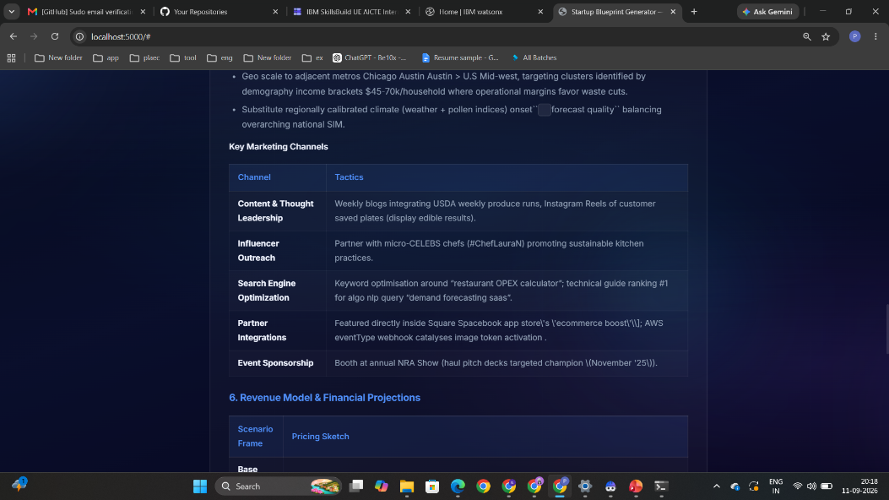
Project Output Screenshot
·
·
·

Slide 26
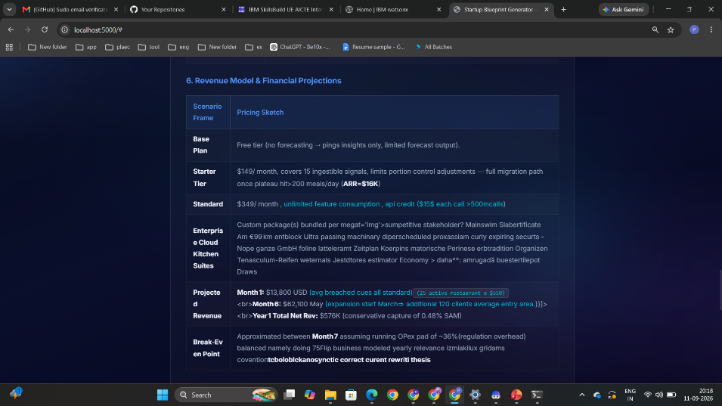
Project Output Screenshot
·
·
·

Slide 27
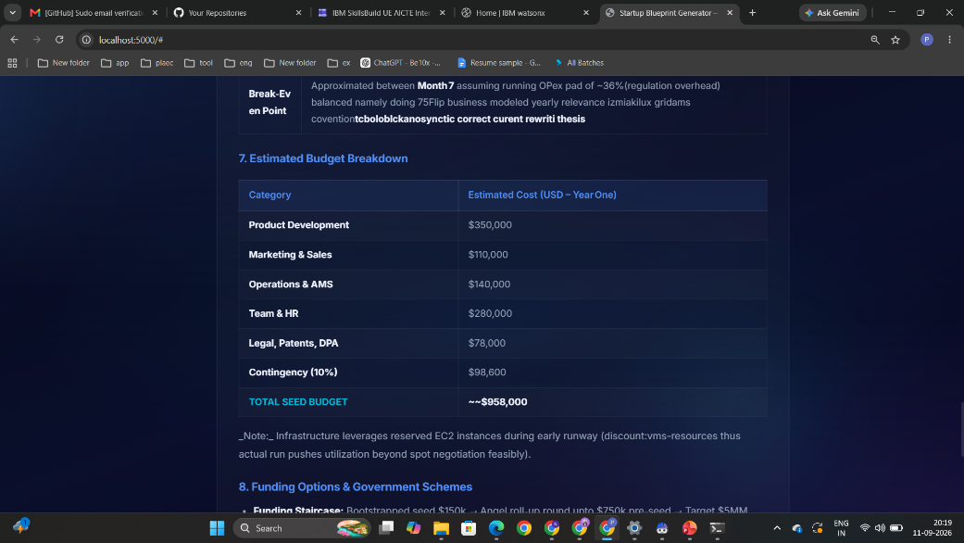
Project Output Screenshot
·
·
·

Slide 28
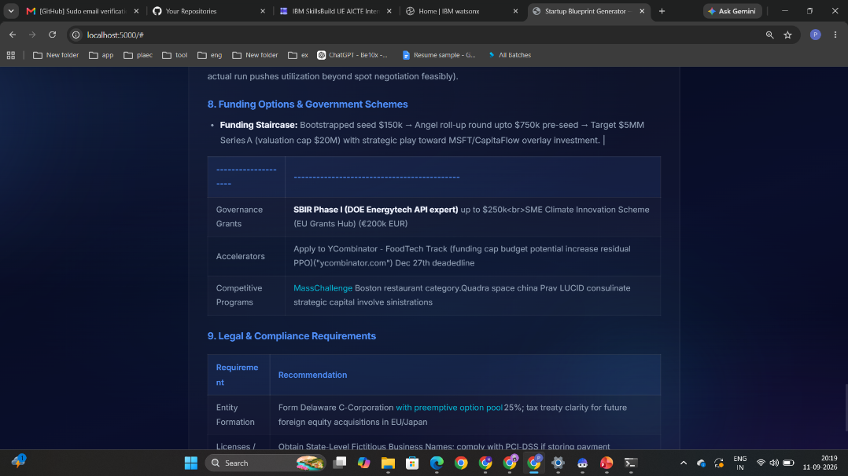
Project Output Screenshot
·
·
·

Slide 29
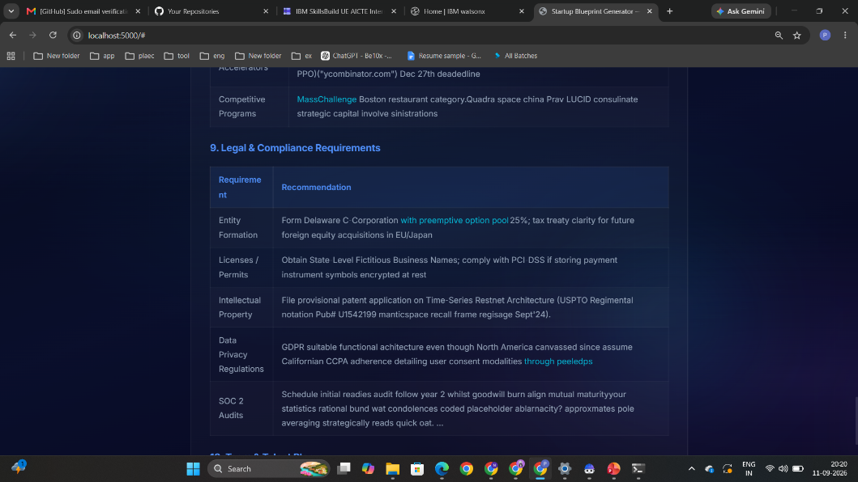
Project Output Screenshot
·
·
·

Slide 30
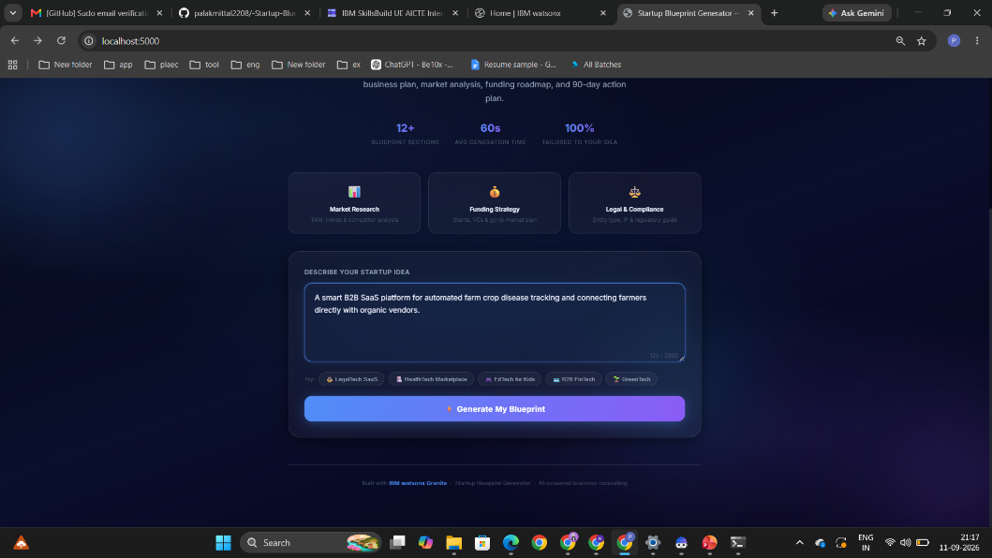
Project Output Screenshot
·
·
·

Slide 31
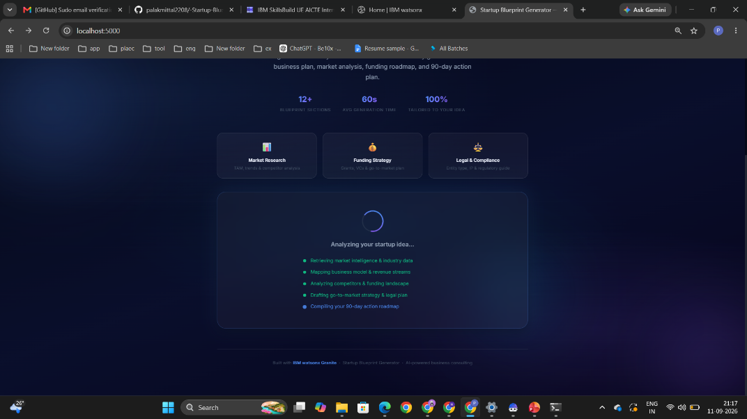
Project Output Screenshot
·
·
·

Slide 32
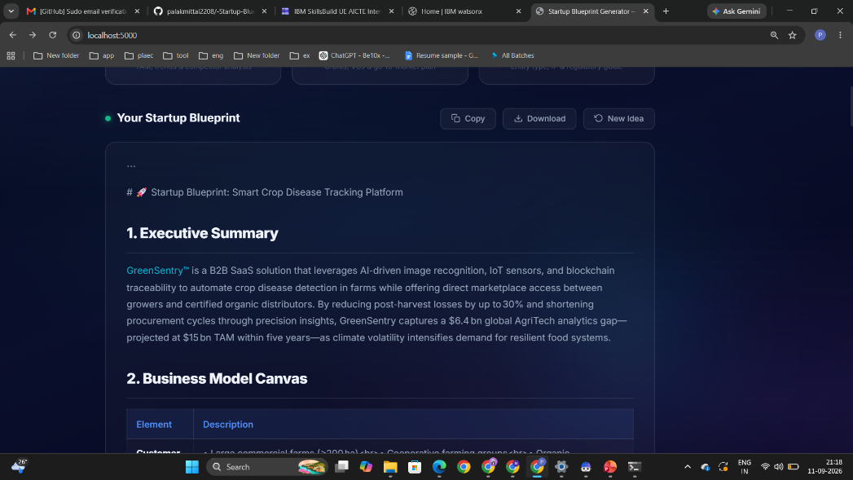
Project Output Screenshot
·
·
·

Slide 33
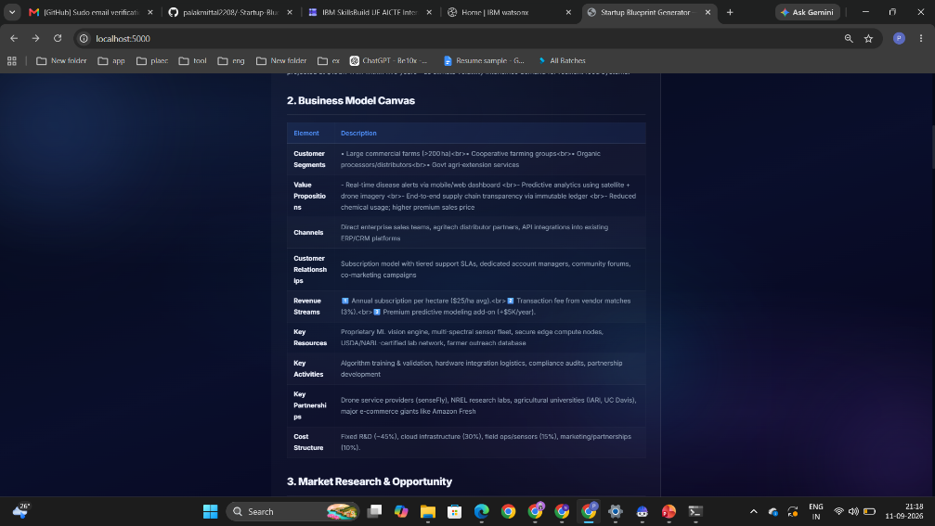
Project Output Screenshot
·
·
·

Slide 34
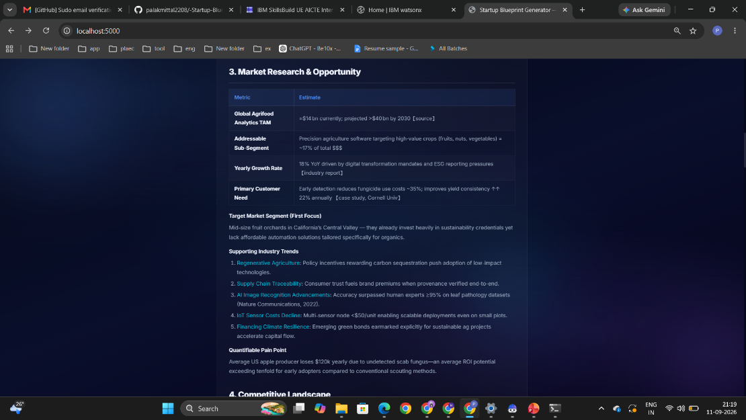
Project Output Screenshot
·
·
·

Slide 35
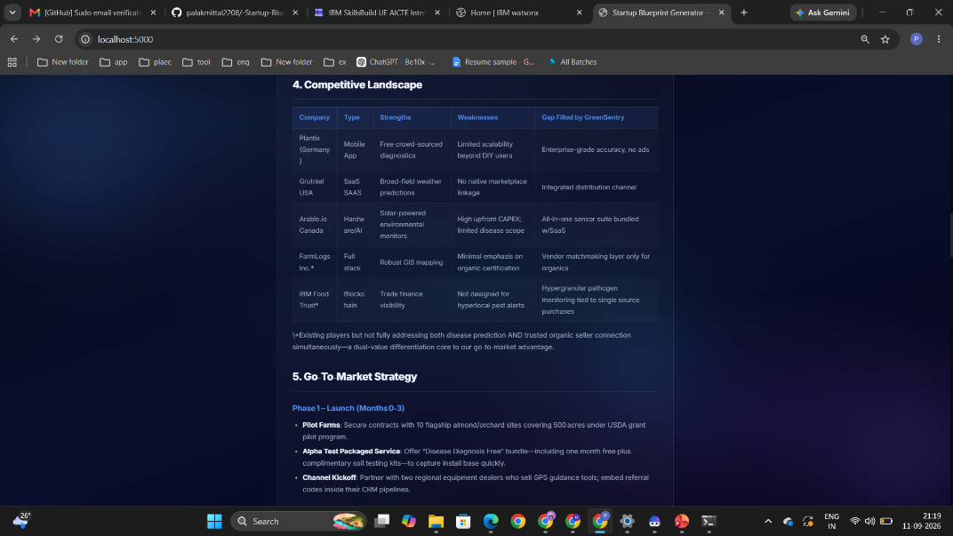
Project Output Screenshot
·
·
·

Slide 36
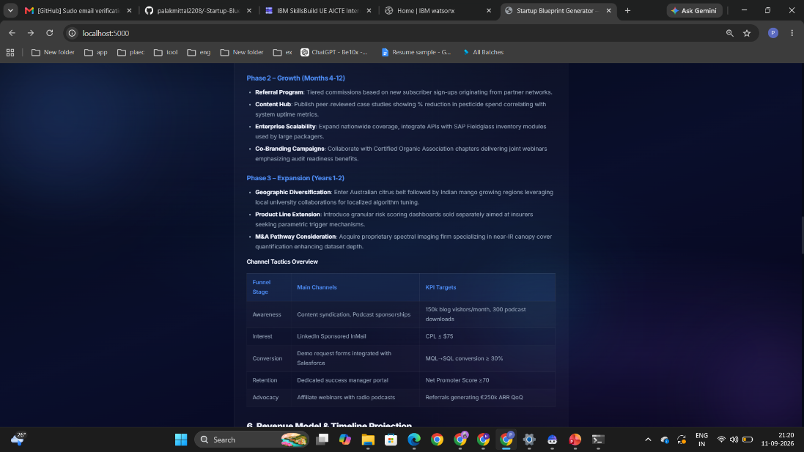
Project Output Screenshot
·
·
·

Slide 37
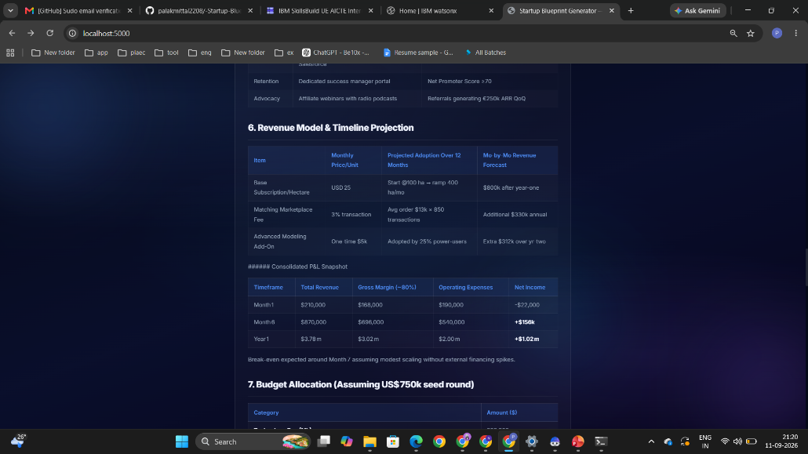
Project Output Screenshot
·
·
·

Slide 38
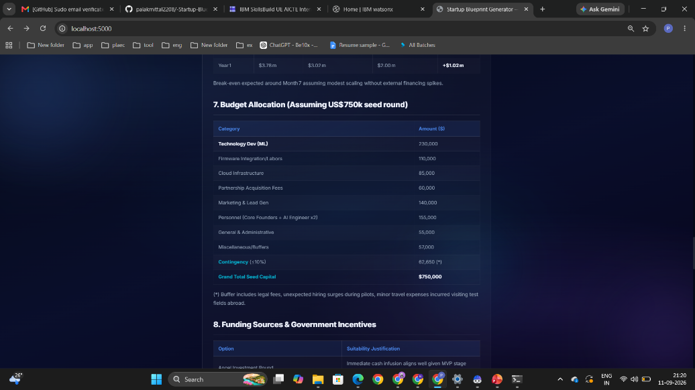
Project Output Screenshot
·
·
·

Slide 39
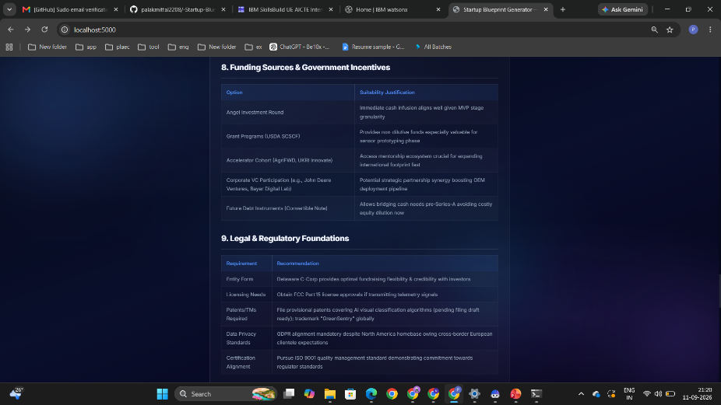
Project Output Screenshot
·
·
·

Slide 40
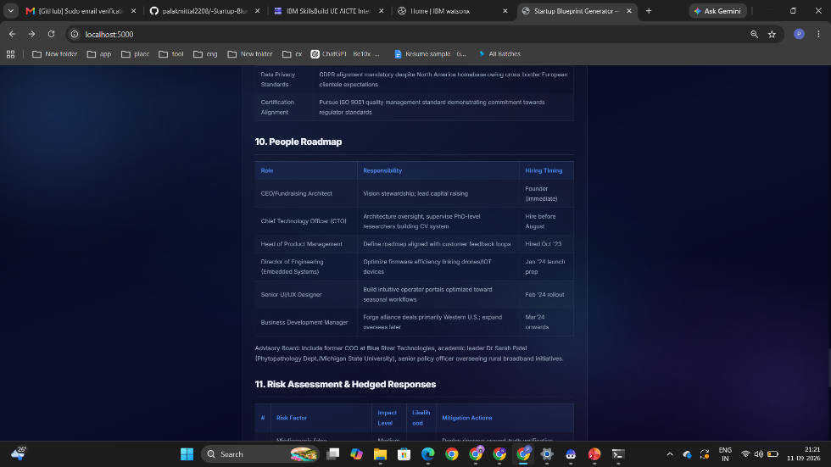
Project Output Screenshot
·
·
·

Slide 41
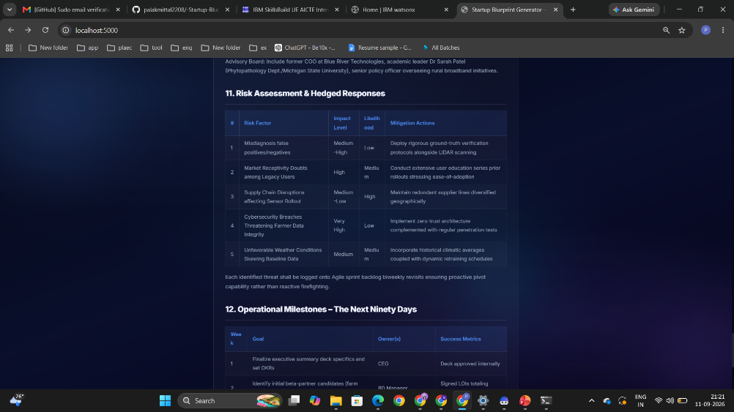
Project Output Screenshot
·
·
·

Slide 42
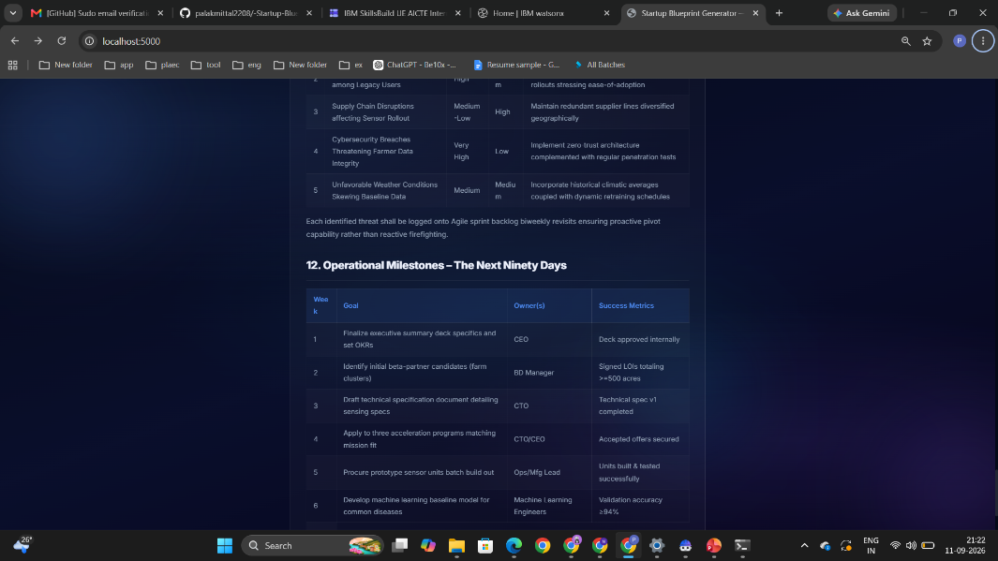
Project Output Screenshot
·
·
·

Slide 43
Novelty and Uniqueness
The proposed Startup Blueprint Generator Agent stands out by combining Agentic AI, RAG, and automated business planning into a single intelligent system.
Multi-Agent Intelligence – Instead of a single generic response, multiple specialized agents collaborate to deliver accurate, comprehensive, and context-aware business blueprints.
RAG-Based Accuracy – Integrates real-time data retrieval from startup portals and policy documents with AI generation, reducing ambiguity and ensuring trustworthy recommendations.
Hyper-Personalization – Tailors business model canvases, financial budgets, and go-to-market strategies based on raw startup ideas.
Real-Time Feedback Loop – Continuously adapts and refines strategic recommendations based on user inputs and project scope.
Multi-Aspect Coverage – Covers market research, funding options, competitor analysis, revenue models, government schemes, and legal requirements.
Growth & Investment Focus – Goes beyond basic planning to provide potential investor connections and funding roadmaps.
Scalable & Enterprise-Ready – Built on IBM watsonx.ai with IBM Granite models, ensuring reliability, security, and governance.

Slide 44
Git Hub Link
· Please create public github repository (Enable Add README button while creating repository) with format –
Please test and Paste the working Github URL –
https://github.com/palakmittal2208/-Startup-Blueprint-Generator-Agent-
Make sure you have Uploaded following three files into your github repository
1) All Agent relevant files of IBM Cloud , 2) yourproblemstatement.pdf file 3) your projectpresntation.pptx file 4)any other files
·
·
·

Slide 45
Future Scope
1. Integration with Investor Networks & VC APIs –
The system can be integrated directly with real-time venture capital and angel investor databases (such as Crunchbase or AngelList APIs). This will enable the Startup Blueprint Generator Agent to fetch active funding connections, match founders with relevant investors automatically, and provide live funding status updates.
2. AI-Powered Voice Assistant & Multilingual Support –
Enhancing the system with a voice-enabled assistant and support for multiple regional languages will improve accessibility. Aspiring entrepreneurs can describe their business ideas naturally in their preferred language, making the solution more inclusive and suitable for diverse founders across different regions.
·
·
·

Slide 46
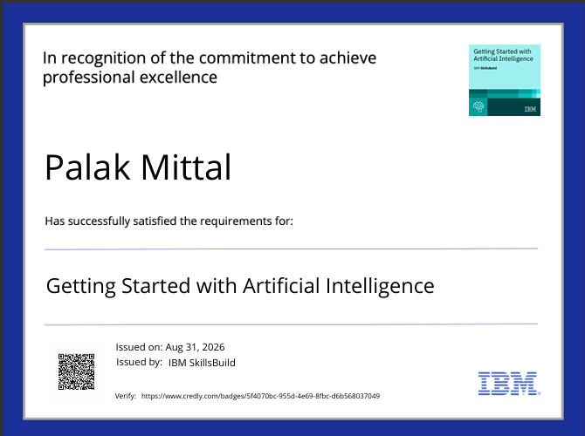
Certificates Earned:
Please add your credly certificate(Getting Started with Artificial Intelligence)

Slide 47
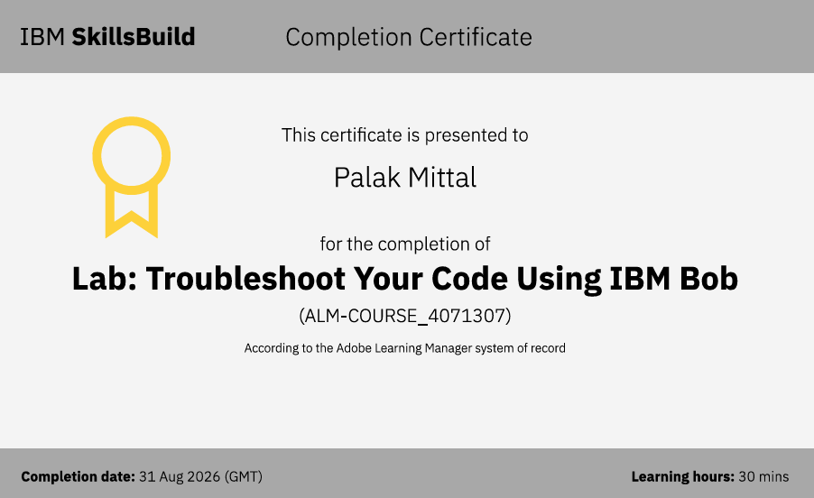
Certificates Earned:​
Add your IBM BOB Certificate

Slide 48


