Slide 1


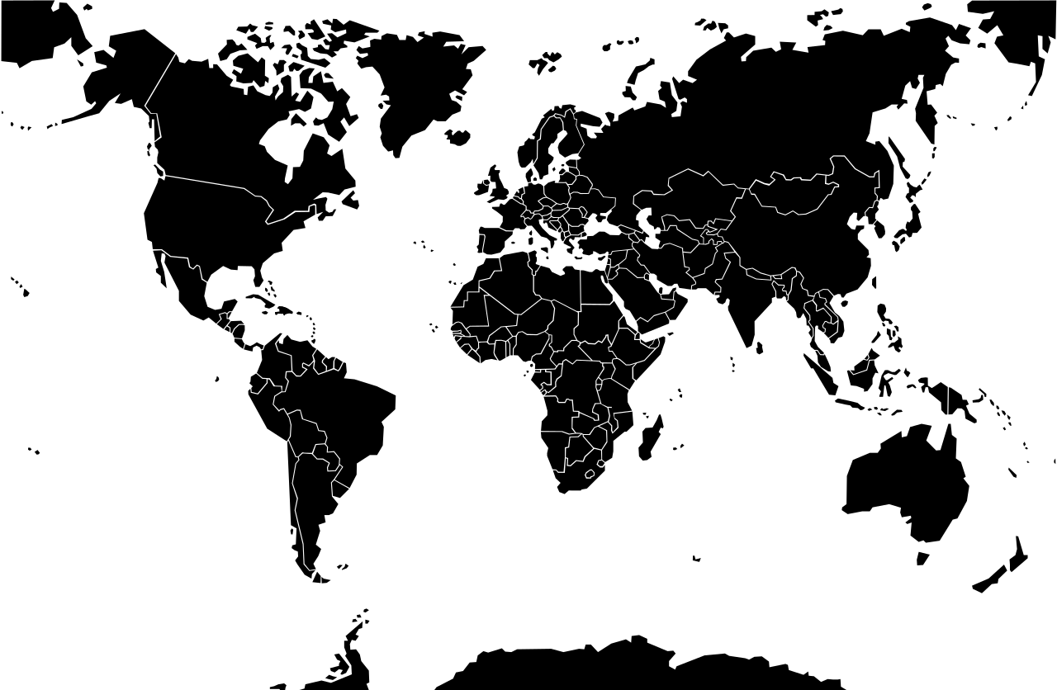
EDUCATIONAL DIALOGUES ON
CULTURAL AND CROSS-CULTURAL AWARENESS
Palak Patel
June 26, 2026
United States 🇺🇸

Slide 2
INTRODUCTION
WHAT IS CULTURE?
• Shared beliefs, values, behaviors, and symbols
• Passed between generations and groups
• Shapes identity and everyday life
🤝
WHY IT MATTERS
• Builds empathy across differences
• Reduces bias and misunderstanding
• Prepares us for a connected world
💬
"Culture is the widening of the mind and of the spirit." — Jawaharlal Nehru
🌐
Educational Dialogues on Cultural Awareness

Slide 3

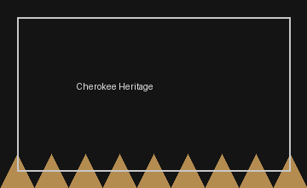
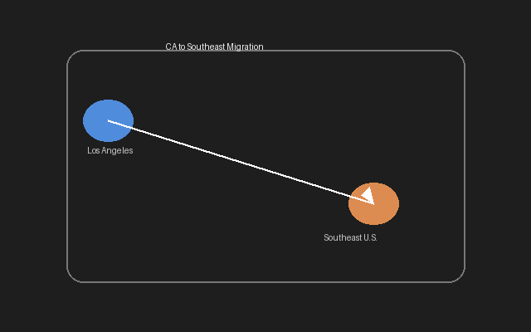

CULTURE
DEFINITION
• Shared values, beliefs, customs, and behaviors
• Shape a group's way of life and identity
EXAMPLE
• Krystal's identity blends German and Cherokee heritage
• She moved from Los Angeles to the Southeastern U.S.
• Multiple cultural influences shape how she sees the world
KEY TAKEAWAY: Culture is learned, shared, and always evolving.
Educational Dialogues on Cultural Awareness

Slide 4
CULTURAL UNIVERSAL
DEFINITION
• A trait or practice found in every known society
• Form varies, but the institution appears everywhere
Family
Language
EXAMPLE
• Family, language, marriage, religion, and music
• Every society creates ways to connect and belong
Music
Marriage & Religion
KEY TAKEAWAY: Humans share core institutions — expression differs.
Educational Dialogues on Cultural Awareness

Slide 5
ETHNOCENTRISM
DEFINITION
• Judging another culture by your own standards
• Often treats your culture as superior or 'normal'
⚖️ My Way vs. Their Way
EXAMPLE
• Calling insect-based diets 'gross'
• Because they differ from your culture's food norms
🍽️ Food Norms
KEY TAKEAWAY: My culture is the center — not the universal standard.
Educational Dialogues on Cultural Awareness

Slide 6
CULTURAL RELATIVISM
DEFINITION
• Evaluate a culture on its own values and context
• Suspend judgment based on outside standards
🔍 Context First
EXAMPLE
• Understanding arranged marriages within their social context
• Asking why practices exist before labeling them
🌍 Local Meaning
KEY TAKEAWAY: Understand a culture by its own standards.
Educational Dialogues on Cultural Awareness

Slide 7
LANGUAGE
DEFINITION
• A system of symbols used to communicate culture
• Shapes thought, identity, and social interaction
Speech
A · B · C
EXAMPLE
• English, Spanish, and American Sign Language
• Cherokee language preservation efforts
Cherokee Syllabary
KEY TAKEAWAY: Language carries culture — and can be lost or revived.
Educational Dialogues on Cultural Awareness

Slide 8
NON-VERBAL COMMUNICATION
DEFINITION
• Communication without words
• Gestures, expressions, tone, eye contact, space
👍 Thumbs Up
😊 Expression
EXAMPLE
• A thumbs-up, nodding, or smiling
• Personal space norms differ across cultures
↔️ Personal Space
KEY TAKEAWAY: Messages travel through body language too.
Educational Dialogues on Cultural Awareness

Slide 9
NORMS
DEFINITION
• Shared rules and expectations that guide behavior
• Help societies run smoothly and predictably
Courtesy
🚶 Queue Culture
EXAMPLE
• Waiting in line
• Saying 'thank you'
✓ Expected Conduct
KEY TAKEAWAY: Norms = rules for everyday behavior.
Educational Dialogues on Cultural Awareness

Slide 10
TYPES OF NORMS
DEFINITION
• Folkways: everyday customs
• Mores: moral expectations · Laws: formal rules · Taboos: strong prohibitions
🤝 Folkway
⚖️ More
📜 Law
🚫 Taboo
EXAMPLE
• Folkway: shaking hands
• More: not cheating · Law: speed limits · Taboo: incest
KEY TAKEAWAY: Not all norms carry the same weight.
Educational Dialogues on Cultural Awareness

Slide 11
CULTURAL VALUES
DEFINITION
• Shared ideas about what is good and desirable
• Guide priorities, goals, and social choices
🇺🇸 Individualism
🌏 Collectivism
EXAMPLE
• Independence in the United States
• Collectivism in many Asian cultures
⭐ Shared Priorities
KEY TAKEAWAY: Values = ideas about what matters most.
Educational Dialogues on Cultural Awareness

Slide 12
SANCTIONS
DEFINITION
• Rewards or punishments that enforce norms
• Can be positive/negative and formal/informal
🏆 Positive
⚠️ Negative
EXAMPLE
• Praise for volunteering (positive informal)
• Fine for speeding (negative formal)
Formal vs Informal
KEY TAKEAWAY: Sanctions reward conformity and discourage violation.
Educational Dialogues on Cultural Awareness

Slide 13
CULTURE WAR
DEFINITION
• Conflict over competing values, beliefs, or social issues
• Groups fight to define what society should accept
⚔️ Competing Values
EXAMPLE
• Debates over abortion, same-sex marriage, school curricula
📢 Public Debate
KEY TAKEAWAY: Deep value clashes can divide communities.
Educational Dialogues on Cultural Awareness

Slide 14
DOMINANT IDEOLOGY
DEFINITION
• Beliefs promoted by the most powerful groups
• Often accepted as 'normal' or common sense
🏛️ Power & Ideas
EXAMPLE
• The 'American Dream': hard work leads to success
📈 Merit Narrative
KEY TAKEAWAY: Power shapes which ideas feel 'natural.'
Educational Dialogues on Cultural Awareness

Slide 15
CULTURAL VARIATION
DEFINITION
• Differences in beliefs, customs, and behaviors
• Appear among societies and within them
🥢 Chopsticks
🍴 Fork
EXAMPLE
• Eating with chopsticks vs. forks
• Regional accents, dress, and traditions
🗺️ Global Differences
KEY TAKEAWAY: Variation is normal — not a defect.
Educational Dialogues on Cultural Awareness

Slide 16
SUBCULTURE
DEFINITION
• Distinct beliefs/behaviors within a larger culture
• Different — but still compatible with mainstream society
🎮 Gamers
🛹 Skaters
EXAMPLE
• Gamers, skateboarders, medical students
☂️ Mainstream Umbrella
KEY TAKEAWAY: Sub = under the umbrella of the larger culture.
Educational Dialogues on Cultural Awareness

Slide 17
COUNTERCULTURE
DEFINITION
• Values and norms that challenge dominant culture
• Actively reject or oppose mainstream ideals
✌️ 1960s Movement
EXAMPLE
• 1960s hippie movement rejecting consumerism
🔄 Reject Mainstream
KEY TAKEAWAY: Counter = against the dominant culture.
Educational Dialogues on Cultural Awareness

Slide 18
CULTURE SHOCK
DEFINITION
• Confusion, anxiety, or disorientation in a new culture
• Common when customs and cues feel unfamiliar
EXAMPLE
• Krystal adjusting from Los Angeles to the Southern U.S.
• New accents, pace, food, and social expectations
✈️ Transition
KEY TAKEAWAY: Adaptation takes time — discomfort is part of learning.
Educational Dialogues on Cultural Awareness

Slide 19
INNOVATION
DEFINITION
• Creation of new ideas, technologies, or practices
• Can reshape how societies live and communicate
📱 Smartphones
💡 New Ideas
EXAMPLE
• Smartphones and social media platforms
🚀 Cultural Change
KEY TAKEAWAY: Innovation = creating something new.
Educational Dialogues on Cultural Awareness

Slide 20

DIFFUSION
DEFINITION
• Spread of cultural traits across societies
• Ideas, foods, and styles travel through contact
EXAMPLE
• Sushi becoming popular worldwide
KEY TAKEAWAY: Diffusion = spreading what already exists.
Educational Dialogues on Cultural Awareness

Slide 21
MATERIAL VS. NON-MATERIAL CULTURE
MATERIAL CULTURE
• Physical objects and technology created by society
• Buildings, clothing, cars, Cherokee stone tools
🪓 Stone Axe
🏠 Buildings
NON-MATERIAL CULTURE
• Intangible beliefs, values, norms, and traditions
• Religion, Pentecostal beliefs, laws, morals
⛪ Beliefs
📖 Traditions
KEY TAKEAWAY: Objects vs. ideas — both carry culture.
Educational Dialogues on Cultural Awareness

Slide 22
CULTURAL LAG
DEFINITION
• Non-material culture adapts slower than material culture
• Laws and ethics trail behind new technology
🤖 AI Ethics
🧬 Gene Editing
EXAMPLE
• AI and gene editing outpacing regulation
• Society debates ethics while tech advances quickly
⏳ The Gap
KEY TAKEAWAY: Society's values and laws lag behind technology.
Educational Dialogues on Cultural Awareness

Slide 23
HIGH-YIELD DISTINCTIONS
Ethnocentrism → My culture is the standard.
Cultural Relativism → Understand by its own standards.
Subculture → Different but compatible.
Counterculture → Challenges mainstream society.
Innovation → Creating something new.
Diffusion → Spreading what exists.
Norms → Rules for behavior.
Values → Ideas about importance.
Sanctions → Rewards and punishments.
Educational Dialogues on Cultural Awareness

Slide 24
SUMMARY
MAJOR CONCEPTS
• Culture shapes identity through shared symbols, norms, and values
• Awareness requires cultural relativism over ethnocentrism
• Subcultures, countercultures, and variation show culture's complexity
• Innovation, diffusion, and cultural lag explain how culture changes
FINAL TAKEAWAYS
• Listen before judging — context matters
• Recognize your own cultural lens
• Cross-cultural awareness builds empathy and respect
Educational Dialogues on Cultural Awareness

Slide 25
REFERENCES
SOURCES
• Course material — Sociology: Culture and Society unit
• Wikimedia Commons — flags, icons, and map imagery (public domain / CC)
• Educational Dialogues on Cultural and Cross-Cultural Awareness
• Prepared by Palak Patel — June 26, 2026

