Slide 1



Instagram Tech
Influencer Account Analysis Using SQL
Presented by: Palak Patel

Slide 2

Objective
Analyze Instagram performance data
Extract insights to improve content strategy
Answer key business questions using SQL and visualise data using Power BI

Slide 3
Data Sources
Table Name | Description
fact_content | Post-level metrics (likes, impressions, reach, etc.)
fact_account | Daily account-level metrics (profile visits, new followers)
dim_date | Date dimension (month, weekday/weekend, etc.)

Slide 4
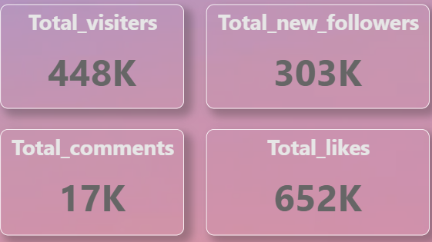
KPI’s

Slide 5
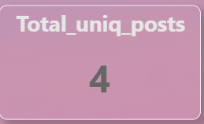
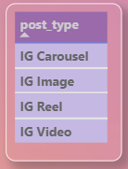
1. How many unique post types are found in the 'fact_content' table?
SQL Query :-
SELECT COUNT(DISTINCT post_type) AS unique_post_types
FROM fact_content;
Power Bi Visual :-
💡 Why It Was Used :-
Count Unique Post Types COUNT(DISTINCT post_type)
To find how many different post formats exist

Slide 6
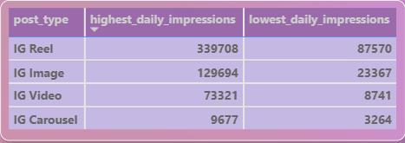
2. What are the highest and lowest recorded impressions for each post type?
SQL Query :-
Power Bi Visual :-
SELECT post_type,
MAX(impressions) AS highest_daily_impression, MIN(impressions) AS lowest_daily_impression
FROM fact_content
GROUP BY post_type;
💡 Why It Was Used :-
Highest/Lowest Impressions
MAX(), MIN(), GROUP BY
To compare best and worst performing post types

Slide 7
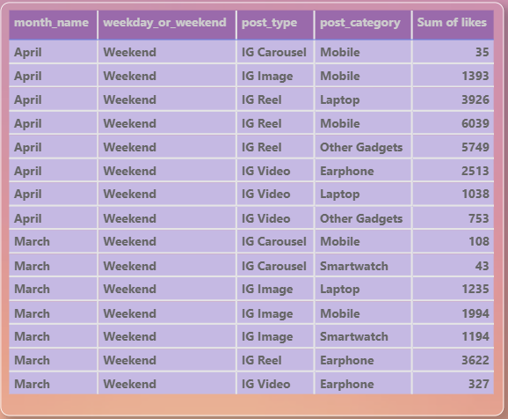
3. Filter all the posts that were published on a weekend in the month of March and April.
SQL Query :-
Power Bi Visual :-
SELECT fc.*
FROM fact_content fc
JOIN dim_dates dd ON fc.date = dd.date
WHERE dd.weekday_or_weekend = 'Weekend’
AND dd.month_name IN ('March', 'April');
💡 Why It Was Used :-
Weekend Posts in March & April
JOIN, WHERE
To filter posts by calendar attributes

Slide 8
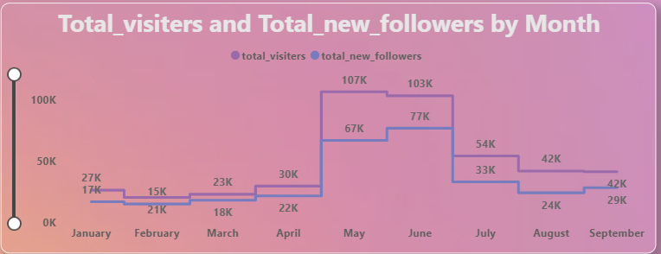
4. Create a report to get the statistics for the account. The final output includes the following fields:
• month_name • total_profile_visits • total_new_followers
SQL Query :-
Power Bi Visual :-
SELECT dd.month_name AS month_name, SUM(fa.profile_visits) AS total_profile_visits, SUM(fa.new_followers) AS total_new_followers
FROM fact_account fa
JOIN dim_dates dd ON fa.date = dd.date GROUP BY dd.month_name
ORDER BY FIELD(dd.month_name, 'January', 'February', 'March', 'April', 'May', 'June', 'July', 'August', 'September', 'October', 'November', 'December');
💡 Why It Was Used :-
Monthly Account Statistics
SUM(), GROUP BY, ORDER BY FIELD()
To track growth and order months chronologically

Slide 9
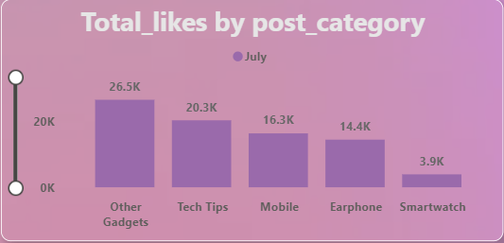
5. Write a CTE that calculates the total number of 'likes’ for each 'post_category' during the month of 'July' and subsequently, arrange the 'post_category' values in descending order according to their total likes.
SQL Query :-
Power Bi Visual :-
WITH july_likes AS
( SELECT fc.post_category AS post_category,
SUM(fc.likes) AS total_likes
FROM fact_content fc
JOIN dim_dates dd ON fc.date = dd.date WHERE dd.month_name = 'July' GROUP BY fc.post_category)
SELECT *FROM july_likes
ORDER BY total_likes DESC;
💡 Why It Was Used :-
July Likes by Category (CTE)
WITH, SUM(), ORDER BY
To isolate July data and rank categories

Slide 10
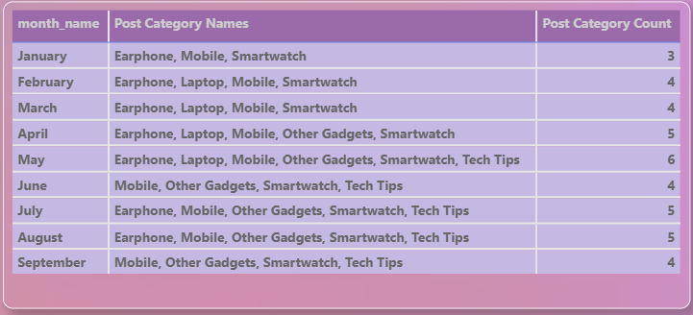
6. Create a report that displays the unique post_category names alongside their respective counts for each month. The output should have three columns:
• month_name • post_category_names • post_category_count
SQL Query :-
Power Bi Visual :-
SELECT dd.month_name AS
month_name, GROUP_CONCAT(DISTINCT fc.post_category
ORDER BY fc.post_category ASC) AS post_category_names, COUNT(DISTINCT fc.post_category) AS post_category_count
FROM fact_content fc
JOIN dim_dates dd ON fc.date = dd.date GROUP BY dd.month_name ORDER BY FIELD(dd.month_name, 'January', 'February', 'March', 'April', 'May', 'June', 'July', 'August', 'September', 'October', 'November', 'December');
💡 Why It Was Used :-
Unique Categories per Month GROUP_CONCAT(DISTINCT), COUNT(DISTINCT)
To measure content diversity and display clearly

Slide 11
Key Findings
Reels dominated with 3.39M impressions.
Stable performance from Jan–Apr, with a strong spike in May–Jun, followed by a gradual decline.
June: 76K new followers from 103K profile visits — highlighting exceptional conversion.
July saw peak in total_likes for the ‘Other Gadgets’ category
Top performers in post_category: Tech Tips, Mobiles, and Other Gadgets.
Content diversity increased in Quarter 2

Slide 12
Recommendations
Prioritize Reels and Other_Gadgets content for maximum engagement
Use insights from May–Jun spikes to plan posting frequency and campaign schedules
Explore underused post_categories

Slide 13

THANK YOU
For Your Attention

