Slide 1
Sri Aurobindo institute of Technology Computer Science and Engineering MAJOR PROJECT - I PYCHESSMATE
Guide Name – Mr. Sunil Parihar
Submitted by - Aditya Ojha

Slide 2
Table of Contents
Introduction
System Development Life Cycle
Analysis and Design
Implementation
Conclusion

Slide 3
1. Introduction PyChessMate: A Python-based Chess Application
Introduction:
PyChessMate is a Python-based chess application developed to provide users with a platform to play chess digitally.
It aims to offer a user-friendly and interactive environment for chess enthusiasts to enjoy the game.
Purpose:
The primary purpose of PyChessMate is to act as a digital platform for playing chess, catering to both casual players and enthusiasts.

Slide 4
2. System Development Life Cycle Model Used
SDLC Model: Agile
Rationale:
Agile methodology was chosen for the development of PyChessMate due to its iterative and flexible nature.
It allows for frequent feedback, adaptability to changes, and incremental development, which is suitable for a project with evolving requirements.

Slide 5
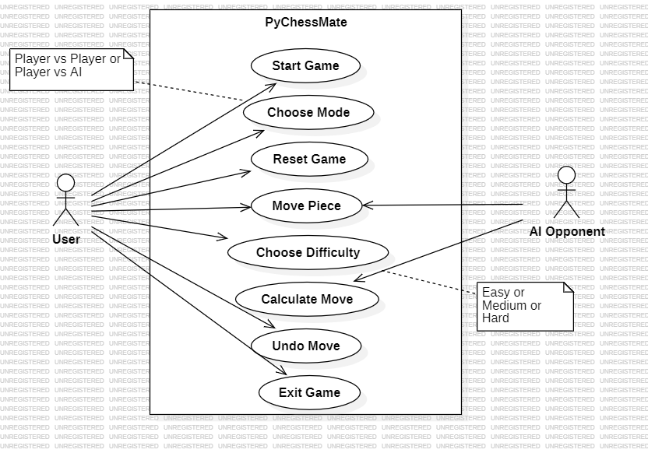
3. Analysis and Design
Use Case Diagram

Slide 6
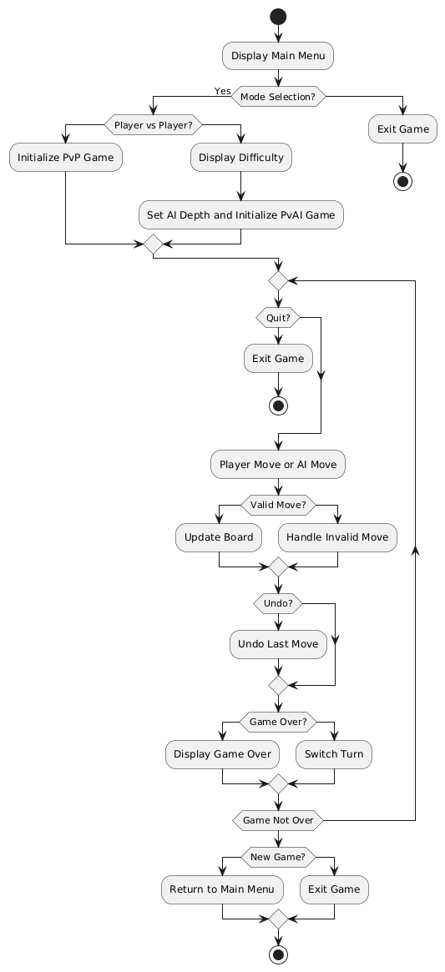
3. Analysis and Design
Activity Diagram

Slide 7
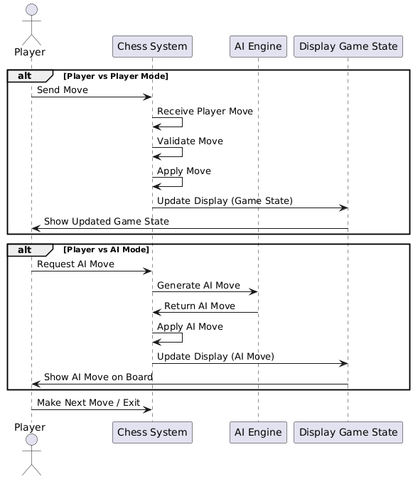
3. Analysis and Design
Sequence Diagram

Slide 8
3. Analysis and Design
Class Diagram

Slide 9
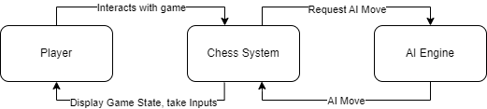
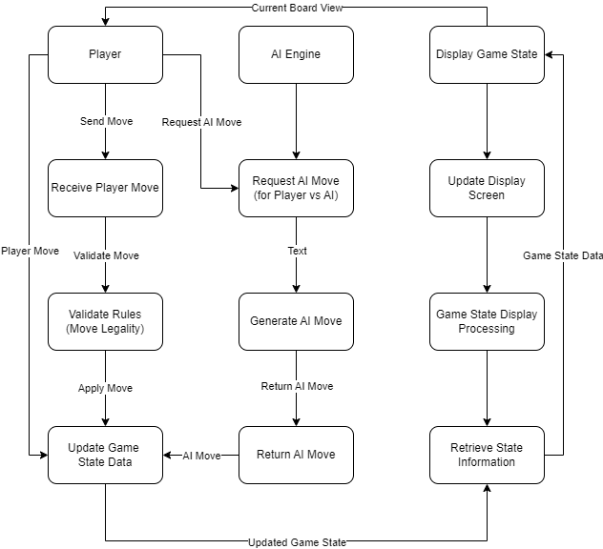
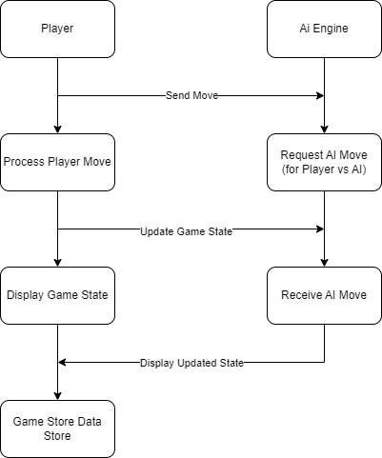
3. Analysis and Design
Data Flow Diagram
Level-0 DFD
Level-1 DFD

Slide 10
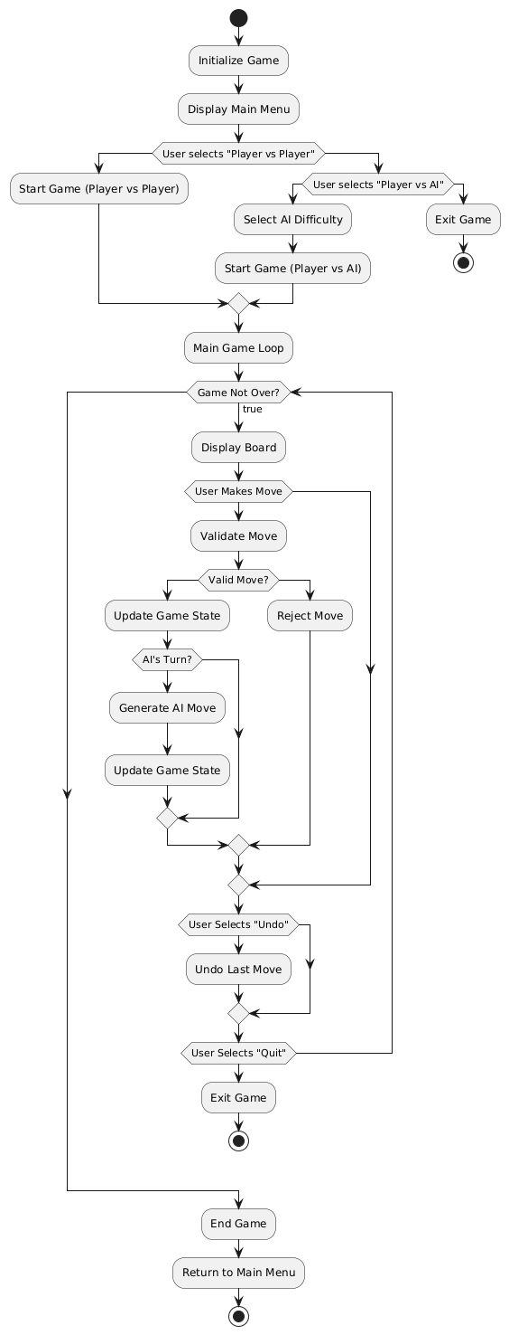
4. Implementation
System Flow Diagram:

Slide 11
4. Implementation
Platform Used
Hardware Platform:
Processor: Intel Core i3
RAM: 4GB
Storage: 100MB available space
Software Platform:
Programming Language: Python
Integrated Development Environment (IDE): Visual Studio Code

Slide 12
4. Implementation
Testing Technique Used:
Unit Testing
User Acceptance Testing

Slide 13
5. Conclusion
Important Features:
Interactive chessboard interface
Player vs. Player mode
Player vs. AI mode
Limitations:
Lack of advanced features such as online multiplayer
Future Work:
Adding online multiplayer functionality
Enhancing user interface with additional features (e.g. statistics)

Slide 14
Thank You

