Slide 1
IT Ticket Analysis and Agent Performance
Presented by:
Palak singh

Slide 2
Problem Statement
This project analyzes 97,498 IT support tickets logged between 2016–2020 across 50 agents. It examines ticket volume trends, category-wise resolution times, and agent performance to identify where operational improvements and training investments will have the greatest impact.

Slide 3
Data Overview
Data Sources
Dataset Size
Deployed data from the Tickets sheet and the IT Agents sheet.
The dataset has exactly 97,498 fully filled rows with zero blank spaces.
Collection Period
Data Categories
Covers a complete 5-year timeline from the year 2016 to 2020.
16 attributes including categories, resolution speed, and agent ages.

Slide 4
Methodology
Data Collection
Data Visualization
Collected IT ticket and agent data from the provided dataset.
Charts, KPI cards and interactive dashboard with slicers.
Tools Used:
Microsoft Excel • PivotTables • PivotCharts • XLOOKUP • CORREL • Dashboard
Data Cleaning
Data Analysis
I cleaned the data and corrected inconsistent entries so that it could be used properly for analysis
Used Microsoft Excel, PivotTables and Excel formulas to analyze ticket volume, category-wise resolution time, satisfaction, agent performance and monthly/quarterly trends.

Slide 5
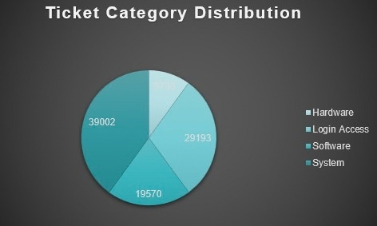
Ticket Categories
Key Insight: System and Login make up about 70% of tickets. Automate Login (0.31 days) and assign specialists to System (6.62 days).
  System (40%): 39,002 tickets, the largest load.
  Login Access (30%): 29,193 tickets, simple lock and password issues.
  Software (20%): 19,570 tickets, setup and configuration.
  Hardware (10%): 9,733 tickets, the slowest at 7.63 days.

Slide 6
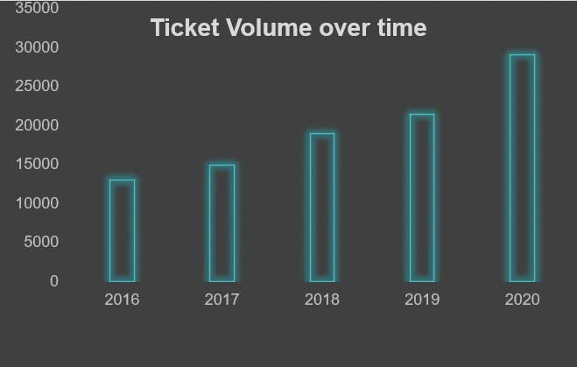
Ticket Volume Over Time
Key Insight: Tickets grew 123% (13,051 → 29,088) with the same 50 agents. Resolution time stayed flat (4.55 → 4.59 days) and satisfaction rose (3.98 → 4.16).
2016: 13,051 | 2017: 14,915 | 2018: 18,954 | 2019: 21,490 | 2020: 29,088

Slide 7
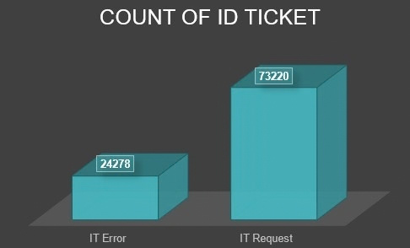
Ticket Breakdown by Issue Type
Key Insight: Most of our work (75%) is just simple requests, so we can easily fix them with automation.
IT Requests (75%): We have 73,220 rows for simple daily help.
IT Errors (25%): We have 24,278 rows for technical system bugs.

Slide 8
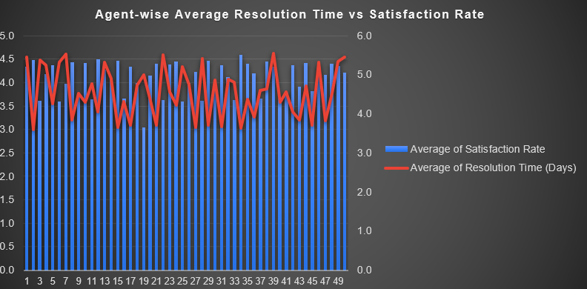
Agent-wise Performance Analysis
Key Insight: Software upgrade is the absolute first step. Team performance is stable, but the ticket assignment pipeline is broken.
  Statistical Link: Resolution time and satisfaction have a moderate negative correlation (r = -0.40, r² = 0.16): slower agents tend to have lower satisfaction. Speed explains only about 16% of satisfaction, and correlation does not prove causation, so we pair faster resolution with training.
  The 30% Process Gap: The main issue isn't agent speed—29,410 tickets (30.2%) are Unassigned, leaving 409 Urgent and 1,434 Major tickets stuck in queue.
  Targeted Training Only: Workload is evenly balanced (~1,950 tickets/agent). Avoid mass training; target only the 6 lowest-performing agents (led by Agent 19 with 3.0 satisfaction).
  Hiring Threshold: Postpone hiring until workload crosses 2,250 tickets/agent or resolution stays above 5 days after software automation.

Slide 9
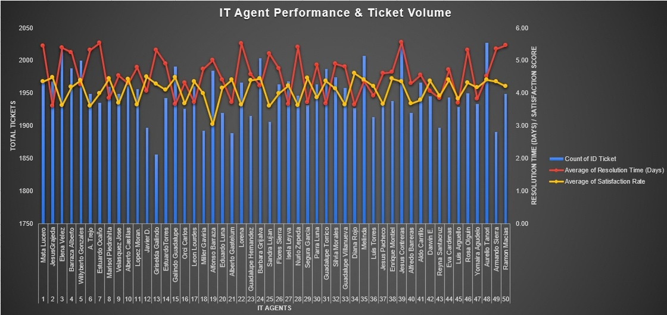
Finding Agents for Support
Key Insight: Four agents (Lorena, Nurio Zepeda, Elena Velez and A. Trejo) are on both the lowest-satisfaction and slowest-resolution lists.
  The team average is 4.55 days (about 4.6) to solve a ticket.
  This chart shows each agent's tickets, resolution time (red line) and satisfaction (yellow line). Peaks in the red line are the slowest agents, and dips in the yellow line are the unhappy customers.
  The four agents above take 5.3 to 5.5 days per ticket, with satisfaction between 3.59 and 3.63.

Slide 10
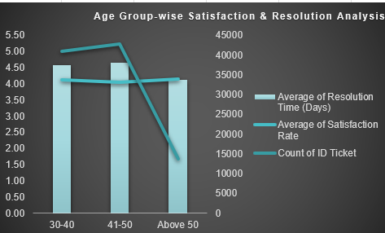
Age Group-wise Analysis
Key insight: The groups handling the most tickets (30-40 and 41-50) are slower than Above 50, which handles far fewer.
Above 50: 13,706 tickets, 4.12 days, satisfaction 4.16
41-50: most tickets (42,840), slowest (4.66 days), satisfaction 4.05
30-40: 40,952 tickets, 4.59 days, satisfaction 4.13

Slide 11
Key Metrics
01
Total Tickets
97,498
04
Highest Ticket Category
System — 39,002
02
Avg. Satisfaction
4.1 / 5
05
Main Issue Type
IT Request — 73,220
03
Avg. Resolution Time
4.6 Days
06
Analysis Period
2016–2020

Slide 12
Recommendations: Supporting Our Team
  The Plan: 30-60day improvement plan for Lorena, Nurio Zepeda, Elena Velez and A. Trejo, paired with top performers like Jesus Grajeda and Diana Rojo.
  Why: They average 5.4 days and 3.61 satisfaction, against the team's 4.55 days and 4.10.
  Target: Reach the team average: -16% resolution time and +0.49 satisfaction.
  Key Insight: Do not fire anyone right away. If there is no improvement after support, take stricter action.

Slide 13
Recommendations: Fixing Slow Ticket Categories
  Where to Focus: System first (39,002 tickets, 6.62 days), then Hardware (9,733 tickets, 7.63 days).
  Target: Bring both to the Software level (5.24 days).
  Overall average 4.55 → about 3.76 days (-17%).
  Calculation: (2.39 × 9,733) + (1.38 × 39,002) ≈ 77,085 days saved.
  Key Insight: Hardware and System tickets take almost a week to fix. Fixing these two gives the biggest speed gain.

Slide 14
Recommendations: Training Over Hiring
  Where to Invest: Train our current team first, then fix only Hardware and System tools.
  Why: 20 of 50 agents are low performers. Tickets grew 123% but resolution time stayed flat (4.55 to 4.56). New tools gave no speed gain (4.55 → 4.56 days).
  Target: Resolution time below 4.5 days, satisfaction above 4.15 (now 4.10).
  Key Insight: Fast work does not always mean good work. Training our own staff is the cheapest way to improve quality.

Slide 15
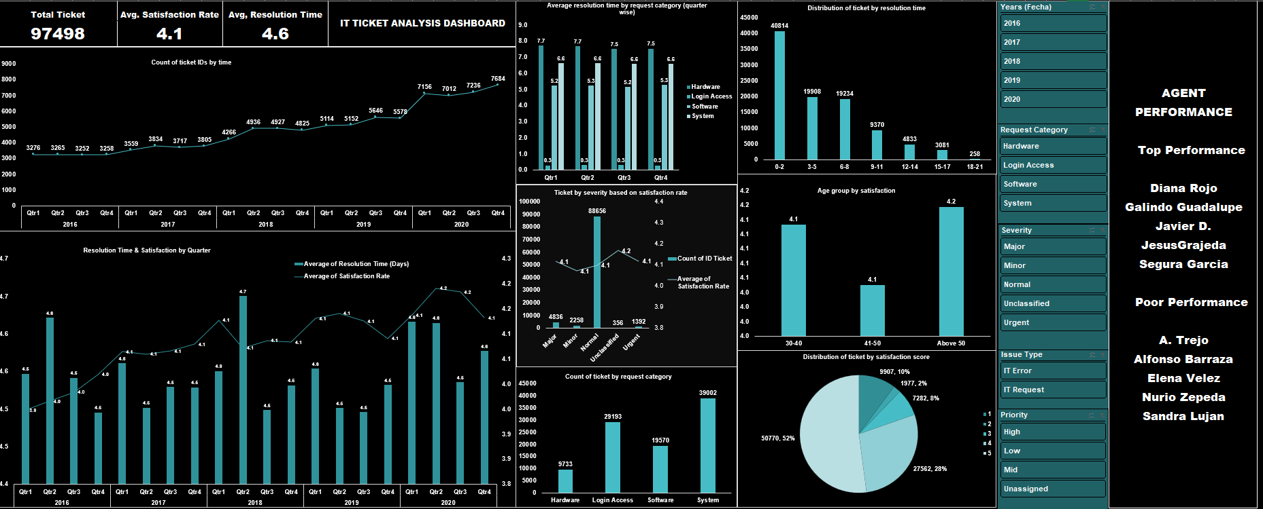
Dashboard

Slide 16
Conclusion
Our IT team successfully managed a massive load of 97,498 tickets over 5 years. The data clearly shows that we do not need to spend extra money on new hiring because most of our 50 agents are already doing a good job. The easy and best way to speed up our helpdesk is simply giving training to our slow agents and focusing more on Hardware and System issues.

Slide 17
References
IT Ticket and IT Agents dataset (2016–2020)
Microsoft Excel — Pivot Tables, XLOOKUP, CORREL, DATEDIF functions
Acknowledgements
I would like to express my sincere gratitude to my mentors and evaluators at Newton School for providing the structured guidelines and datasets for this Spreadsheet project. Their continuous guidance helped me successfully build the analytical framework and dashboard for this IT ticket analysis.

Slide 18
Thank
You

