Slide 1
Project Title
E-commerce Website
Team Name/No
Pro-Testers/6
Team Member and Roll No.
Palak Singla , 2210990994
Prachi , 2210990659
Paras Kapoor , 2210990637

Slide 2
Index
Objective
Introduction
Methodology, Approach & Techniques
Algorithm
Flow Chart
Result
Source Code (screenshots)
Conclusion
Reference

Slide 3
Objective
User-Friendly Interface
Comprehensive Product Offering
Efficient Search and Navigation
Personalized Experiences
Tailored Wishlist Customization
Reliable Shopping Cart Management

Slide 4
Introduction
Our project aims to create the functionality and design of SiLox.in using HTML, CSS, and React js – the fundamental building blocks of modern web development.
HTML for structuring content, CSS for styling elements, and React js for adding interactivitym.
Beyond technical proficiency, this project presents an opportunity to explore the principles of e-commerce design and user experience (UX).

Slide 5
Methodology, Approach & Techniques
Methodology:
Agile Development
Approach:
Component-Based Development
Progressive Enhancement
React Integration
User-Centered Design
Techniques:
HTML (Hypertext Markup Language)
CSS (Cascading Style Sheets)
JavaScript
Responsive Design

Slide 6
Algorithm
Search Algorithms:
Binary Search
Text Search Algorithms
Recommendation Algorithms:
Collaborative Filtering
Content-Based Filtering
Shopping Cart Management Algorithm
Checkout Process Algorithm

Slide 7
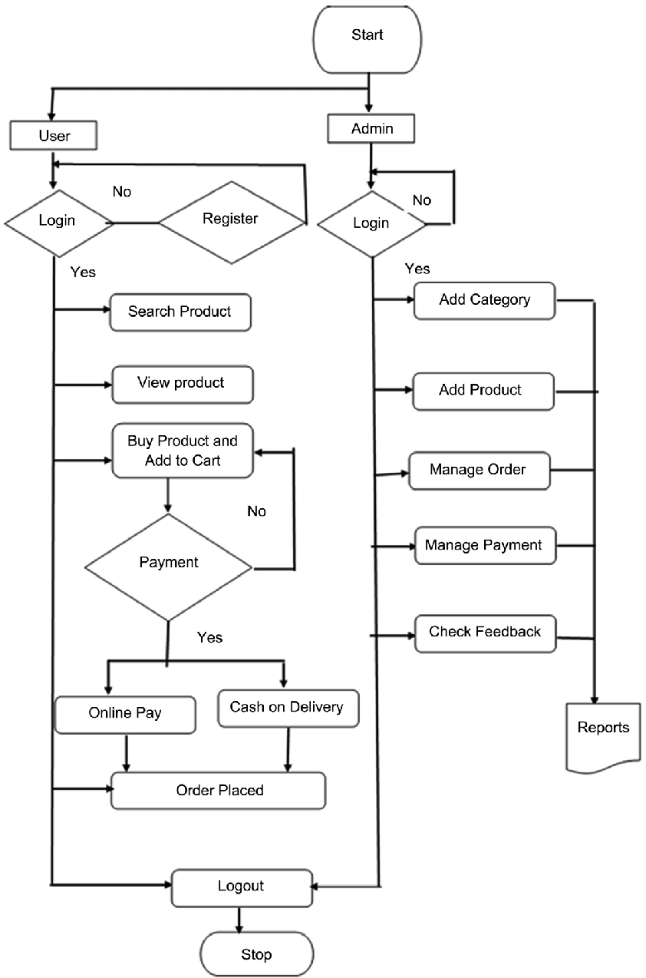
Flow Chart

Slide 8
Result
Users can :
browse products
view details
add items to a shopping cart
search/filter products
complete purchases through a multi-step checkout process

Slide 9

Result

Slide 10
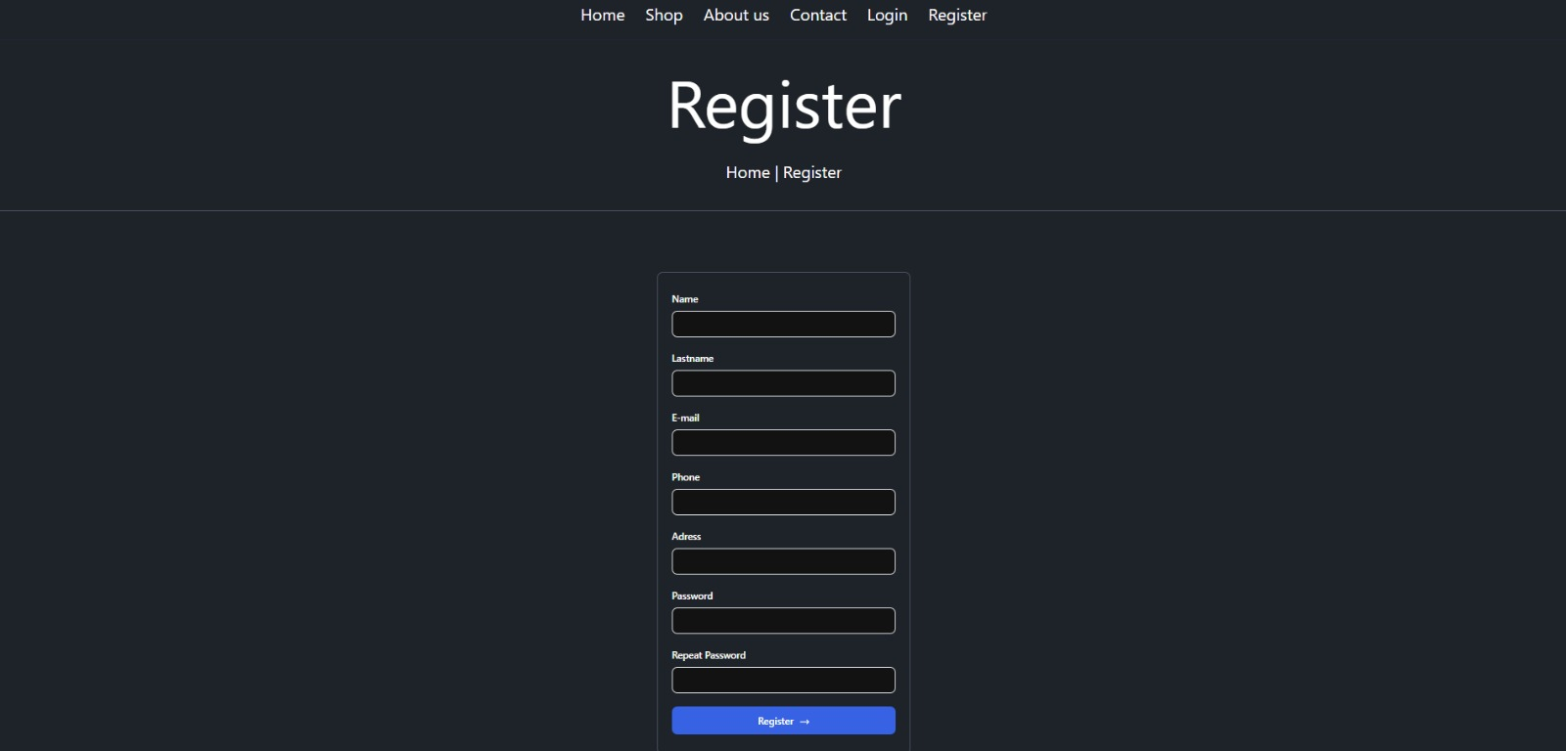
Result

Slide 11
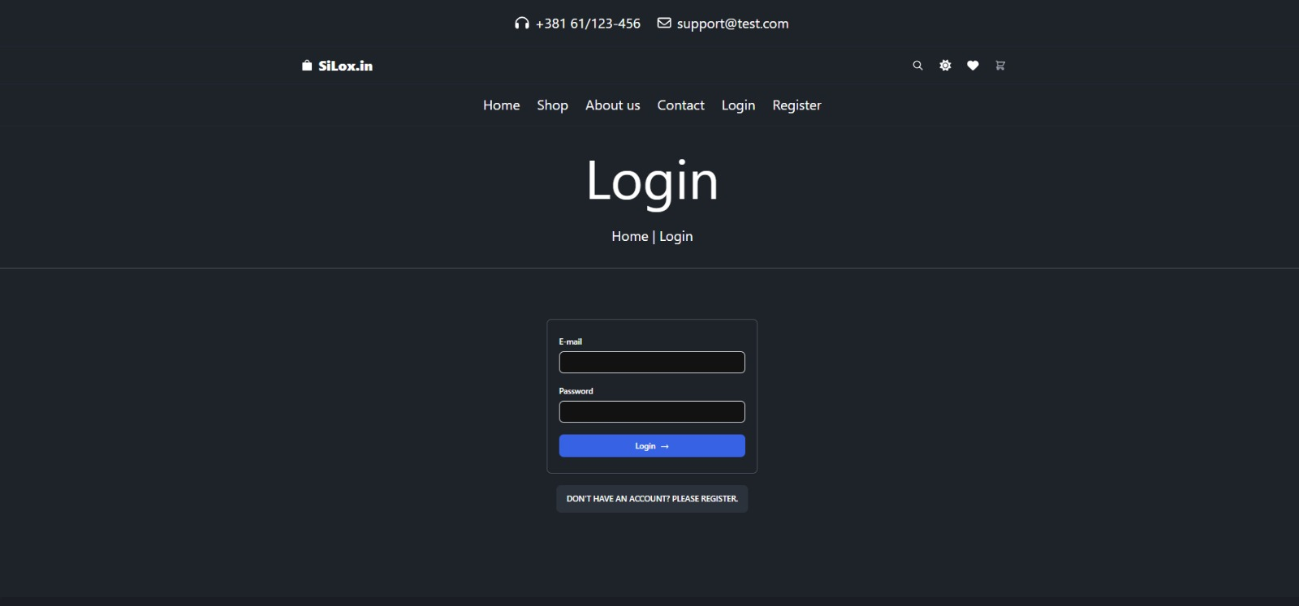
Result

Slide 12
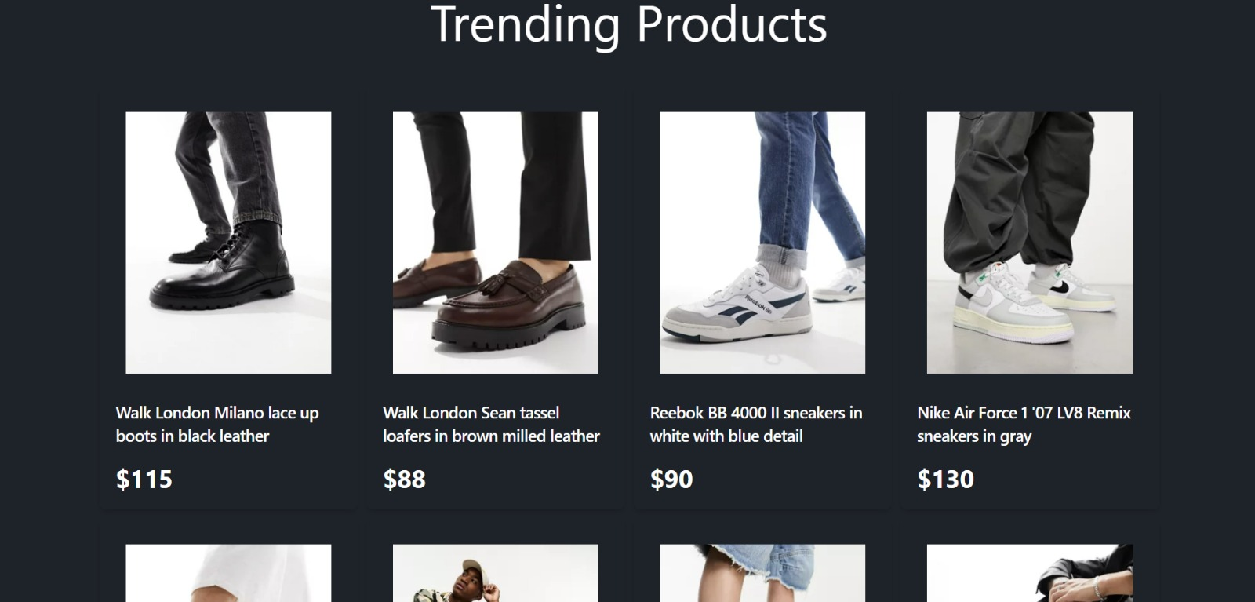
Result

Slide 13
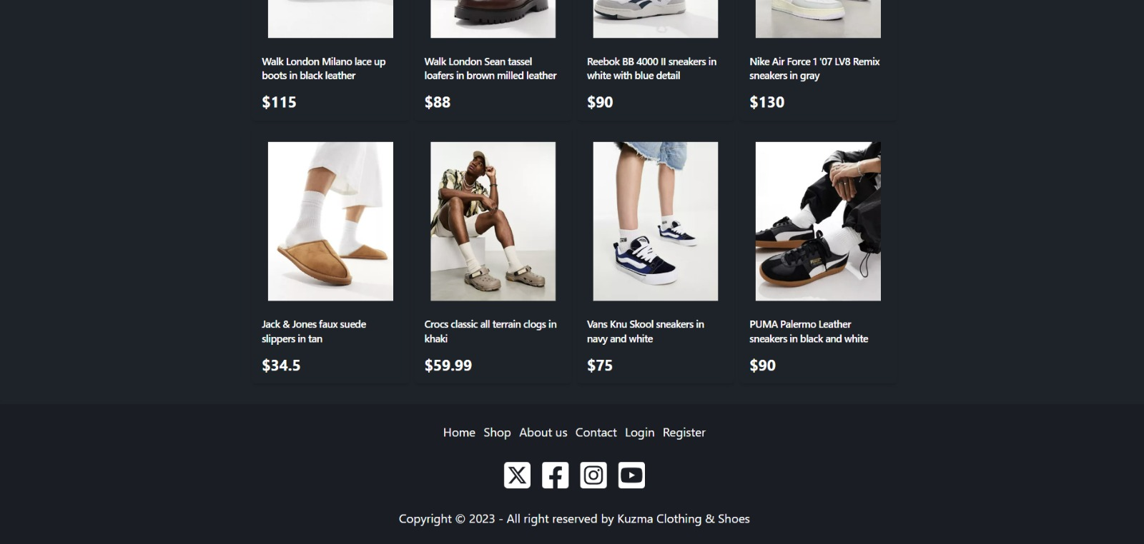
Result

Slide 14
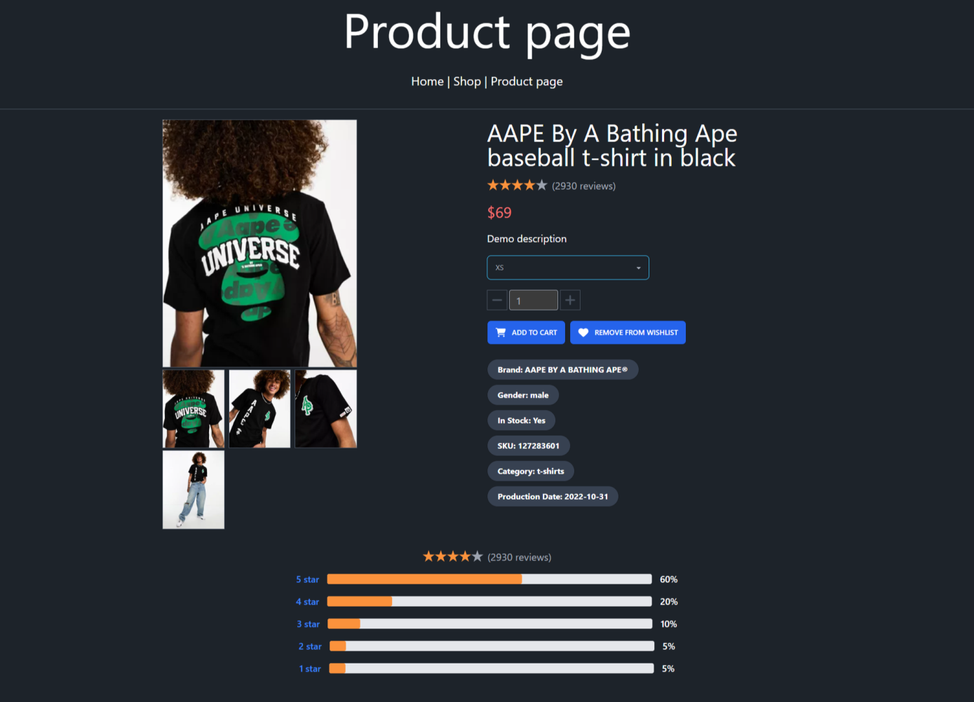
Result

Slide 15
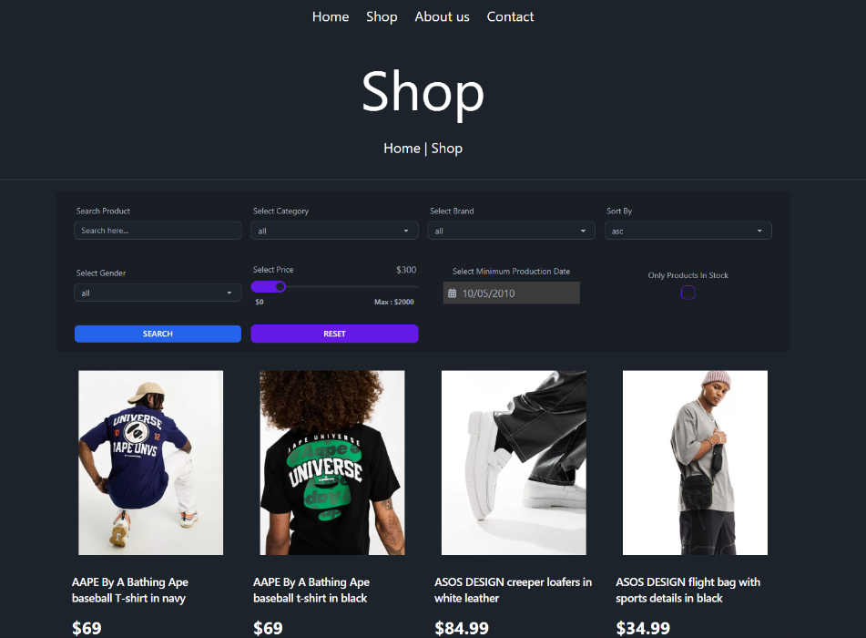
Result

Slide 16
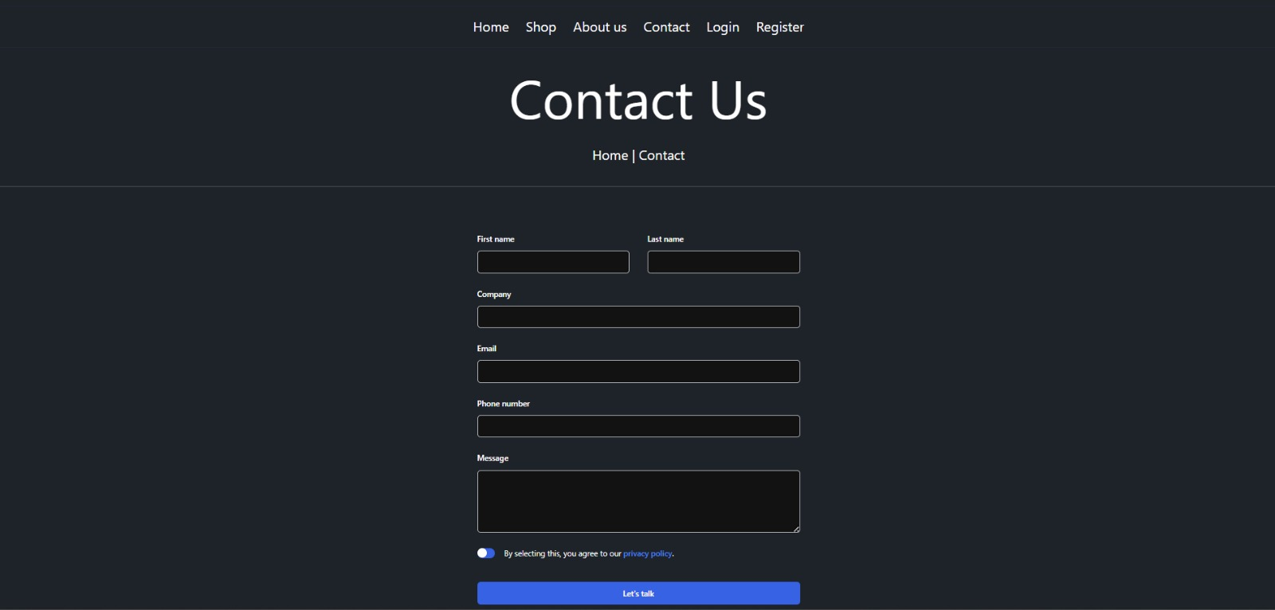
Result

Slide 17
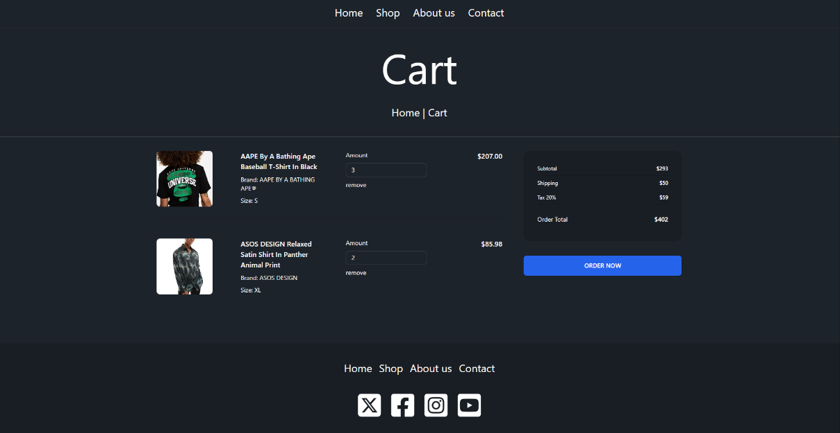
Result

Slide 18
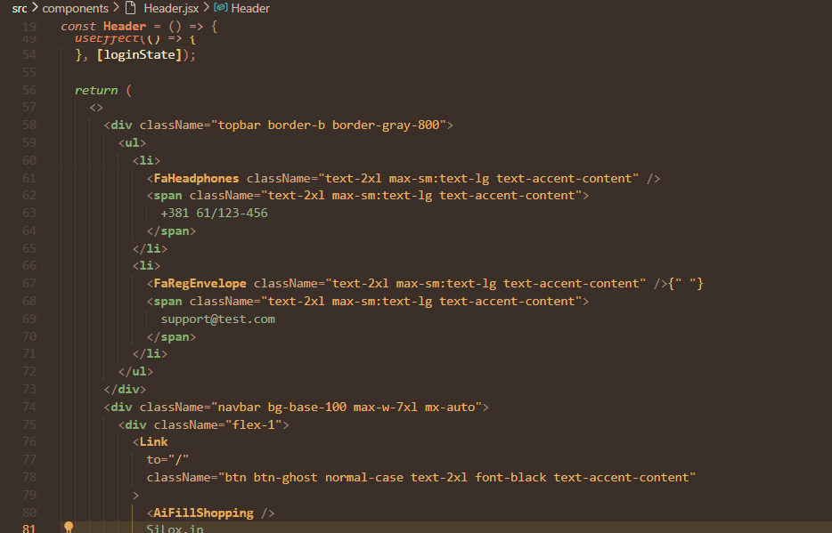
Source Code

Slide 19
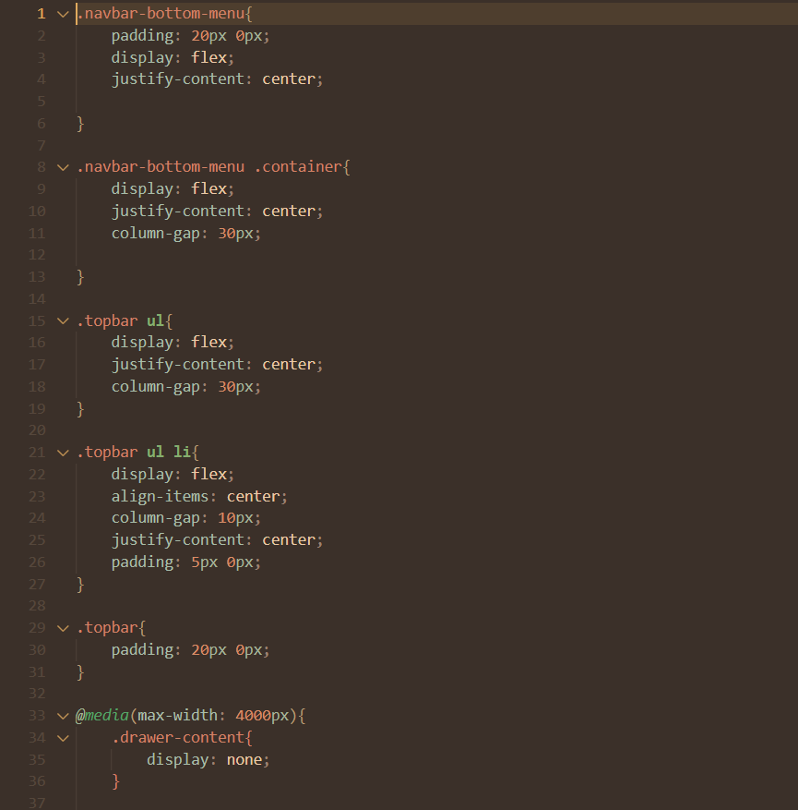
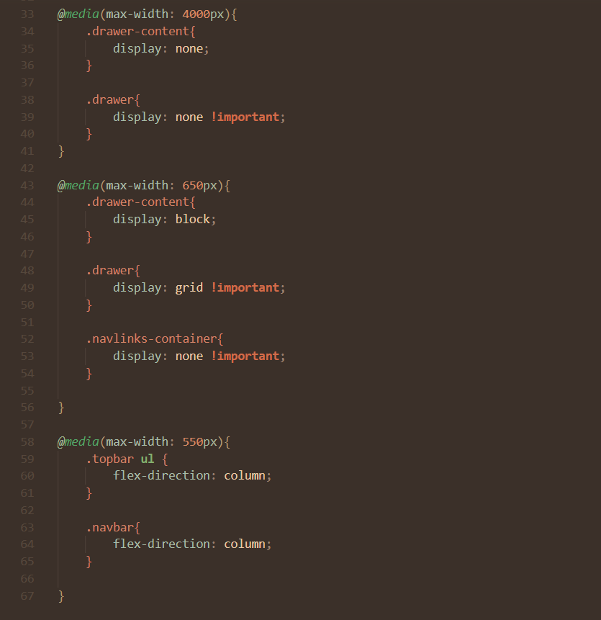
Source Code

Slide 20
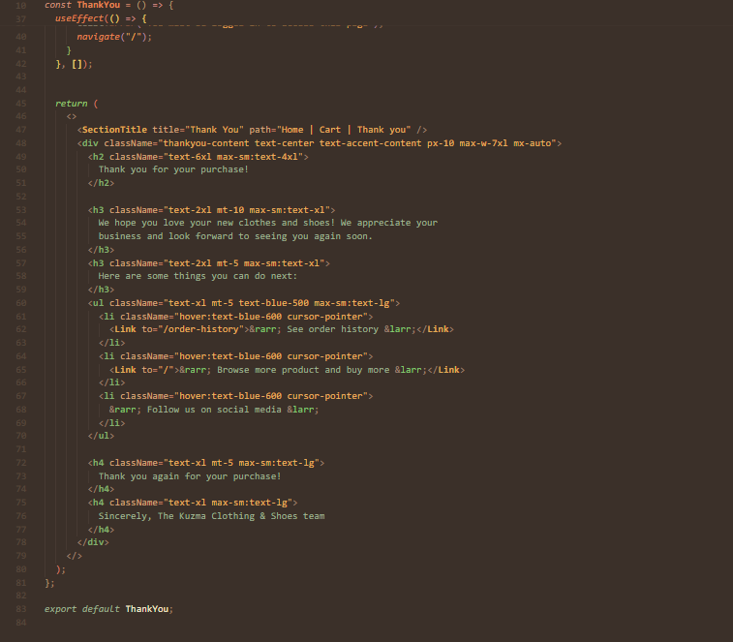
Source Code

Slide 21
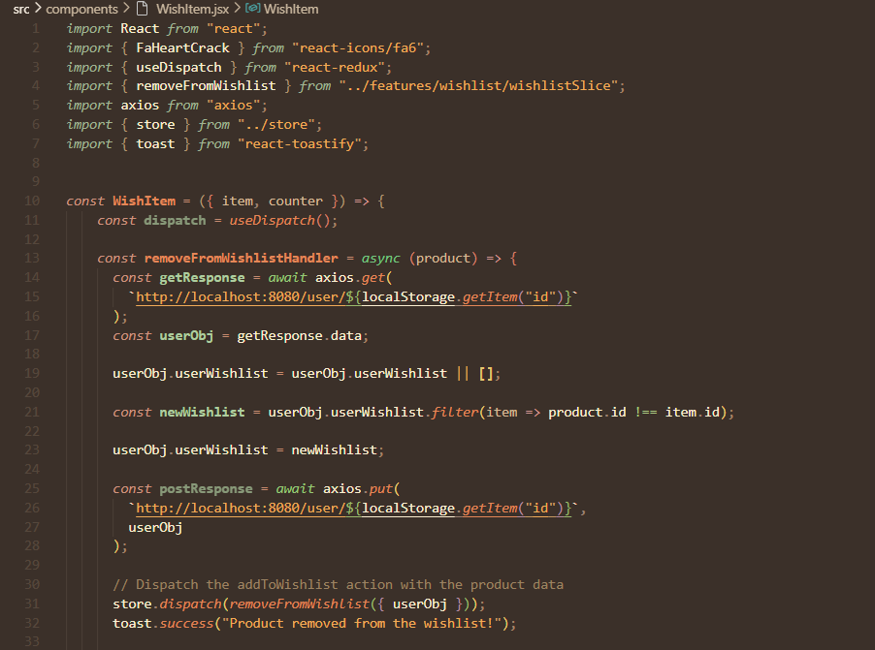
Source Code

Slide 22
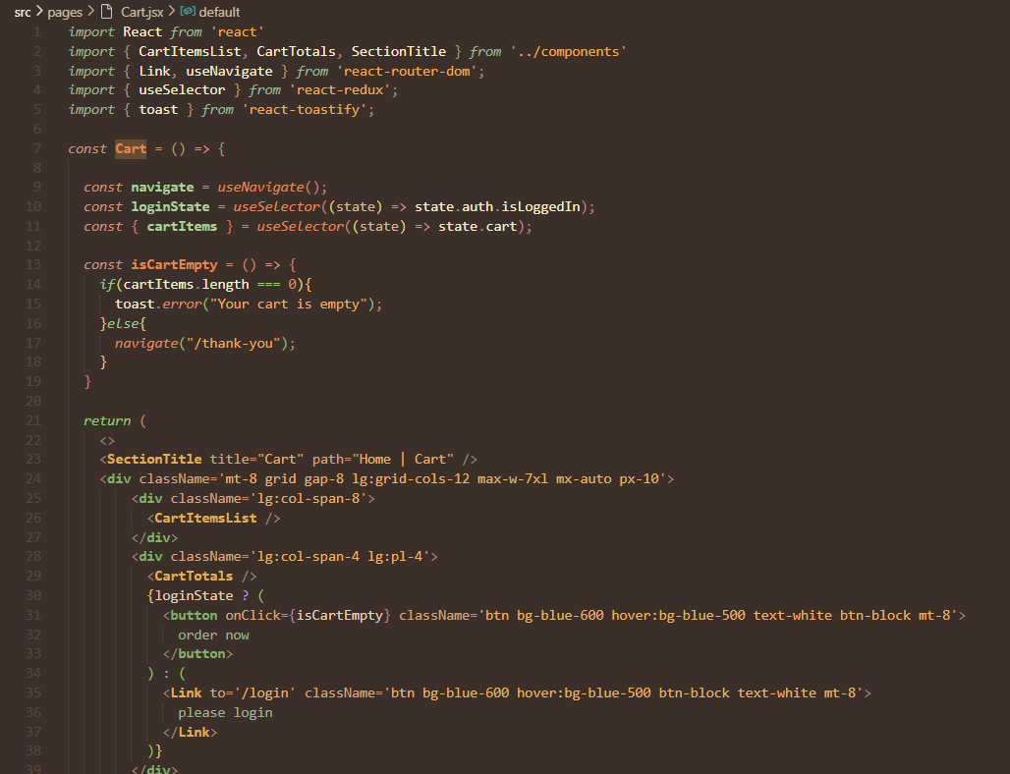
Source Code

Slide 23
Conclusion
In conclusion, Silox.in has achieved its goal of creating a user-friendly e-commerce platform that combines modern web technologies with comprehensive functionality. The platform is well-positioned for future growth and enhancements, offering a scalable solution that can adapt to evolving user needs and market trends. The successful implementation of this project showcases the potential of web technologies in delivering high-quality, user-centric e-commerce experiences.

Slide 24
Reference
[1]
https://www.researchgate.net/figure/Flow-chart-diagram-Online-e-commerce-shopping-web-app_fig1_347169962 , Accessed on May 18, 2024
[2]
https://in.pinterest.com/pin/464011567853893423/ , Accessed on May 18,2024
[3]
https://www.w3schools.com/js/ , Accessed on April 22,2024

Slide 25


