Slide 1
Project Title
Food Commodities Website
Team Member and Roll No.
Palak Singla , 2210990994
Ojasva Raghav , 2210990628
Gunjan , 2210990332
Mukund, 2210990587

Slide 2
Index
Objective
Introduction
Methodology, Approach & Techniques
Algorithm
Flow Chart
Result
Source Code (screenshots)
Conclusion
Future Scope
Reference

Slide 3
Objective
To understand the concept of food commodities and their importance in daily life.
To explore the different types of food commodities, including cereals, pulses, dairy, fruits, and vegetables.
To analyze the supply chain and market trends of food commodities.
To highlight the role of food commodities in global trade and economy.
To discuss food safety, storage, and preservation techniques for maintaining quality.
To examine current challenges and future prospects in food commodity production and distribution.

Slide 4
Introduction
The MERN stack is a powerful and popular technology stack used for building modern web applications. It is composed of four key technologies:
MySQL – It stores the user details(name,e-mail and password).
Express.js – We have used this for users login/signup.
React.js is a front-end JavaScript library used for building dynamic and interactive user interfaces.
Node.js is a runtime environment that allows JavaScript to be executed on the server side.

Slide 5
Methodology, Approach & Techniques
Methodology:
Agile Development
Approach:
Component-Based Development
Progressive Enhancement
React Integration
User-Centered Design
Techniques:
M - Mongo Db
E - Express.js
R - React.js
N - Node.js

Slide 6
Algorithm
User Interface and Input Handling
Request Handling :
1. Receiving the request
2. Routing
3. Middleware Processing
4. Handling the request
5. Sending the response
Authentication:
1. User credentials
2. Token Based Authentication

Slide 7
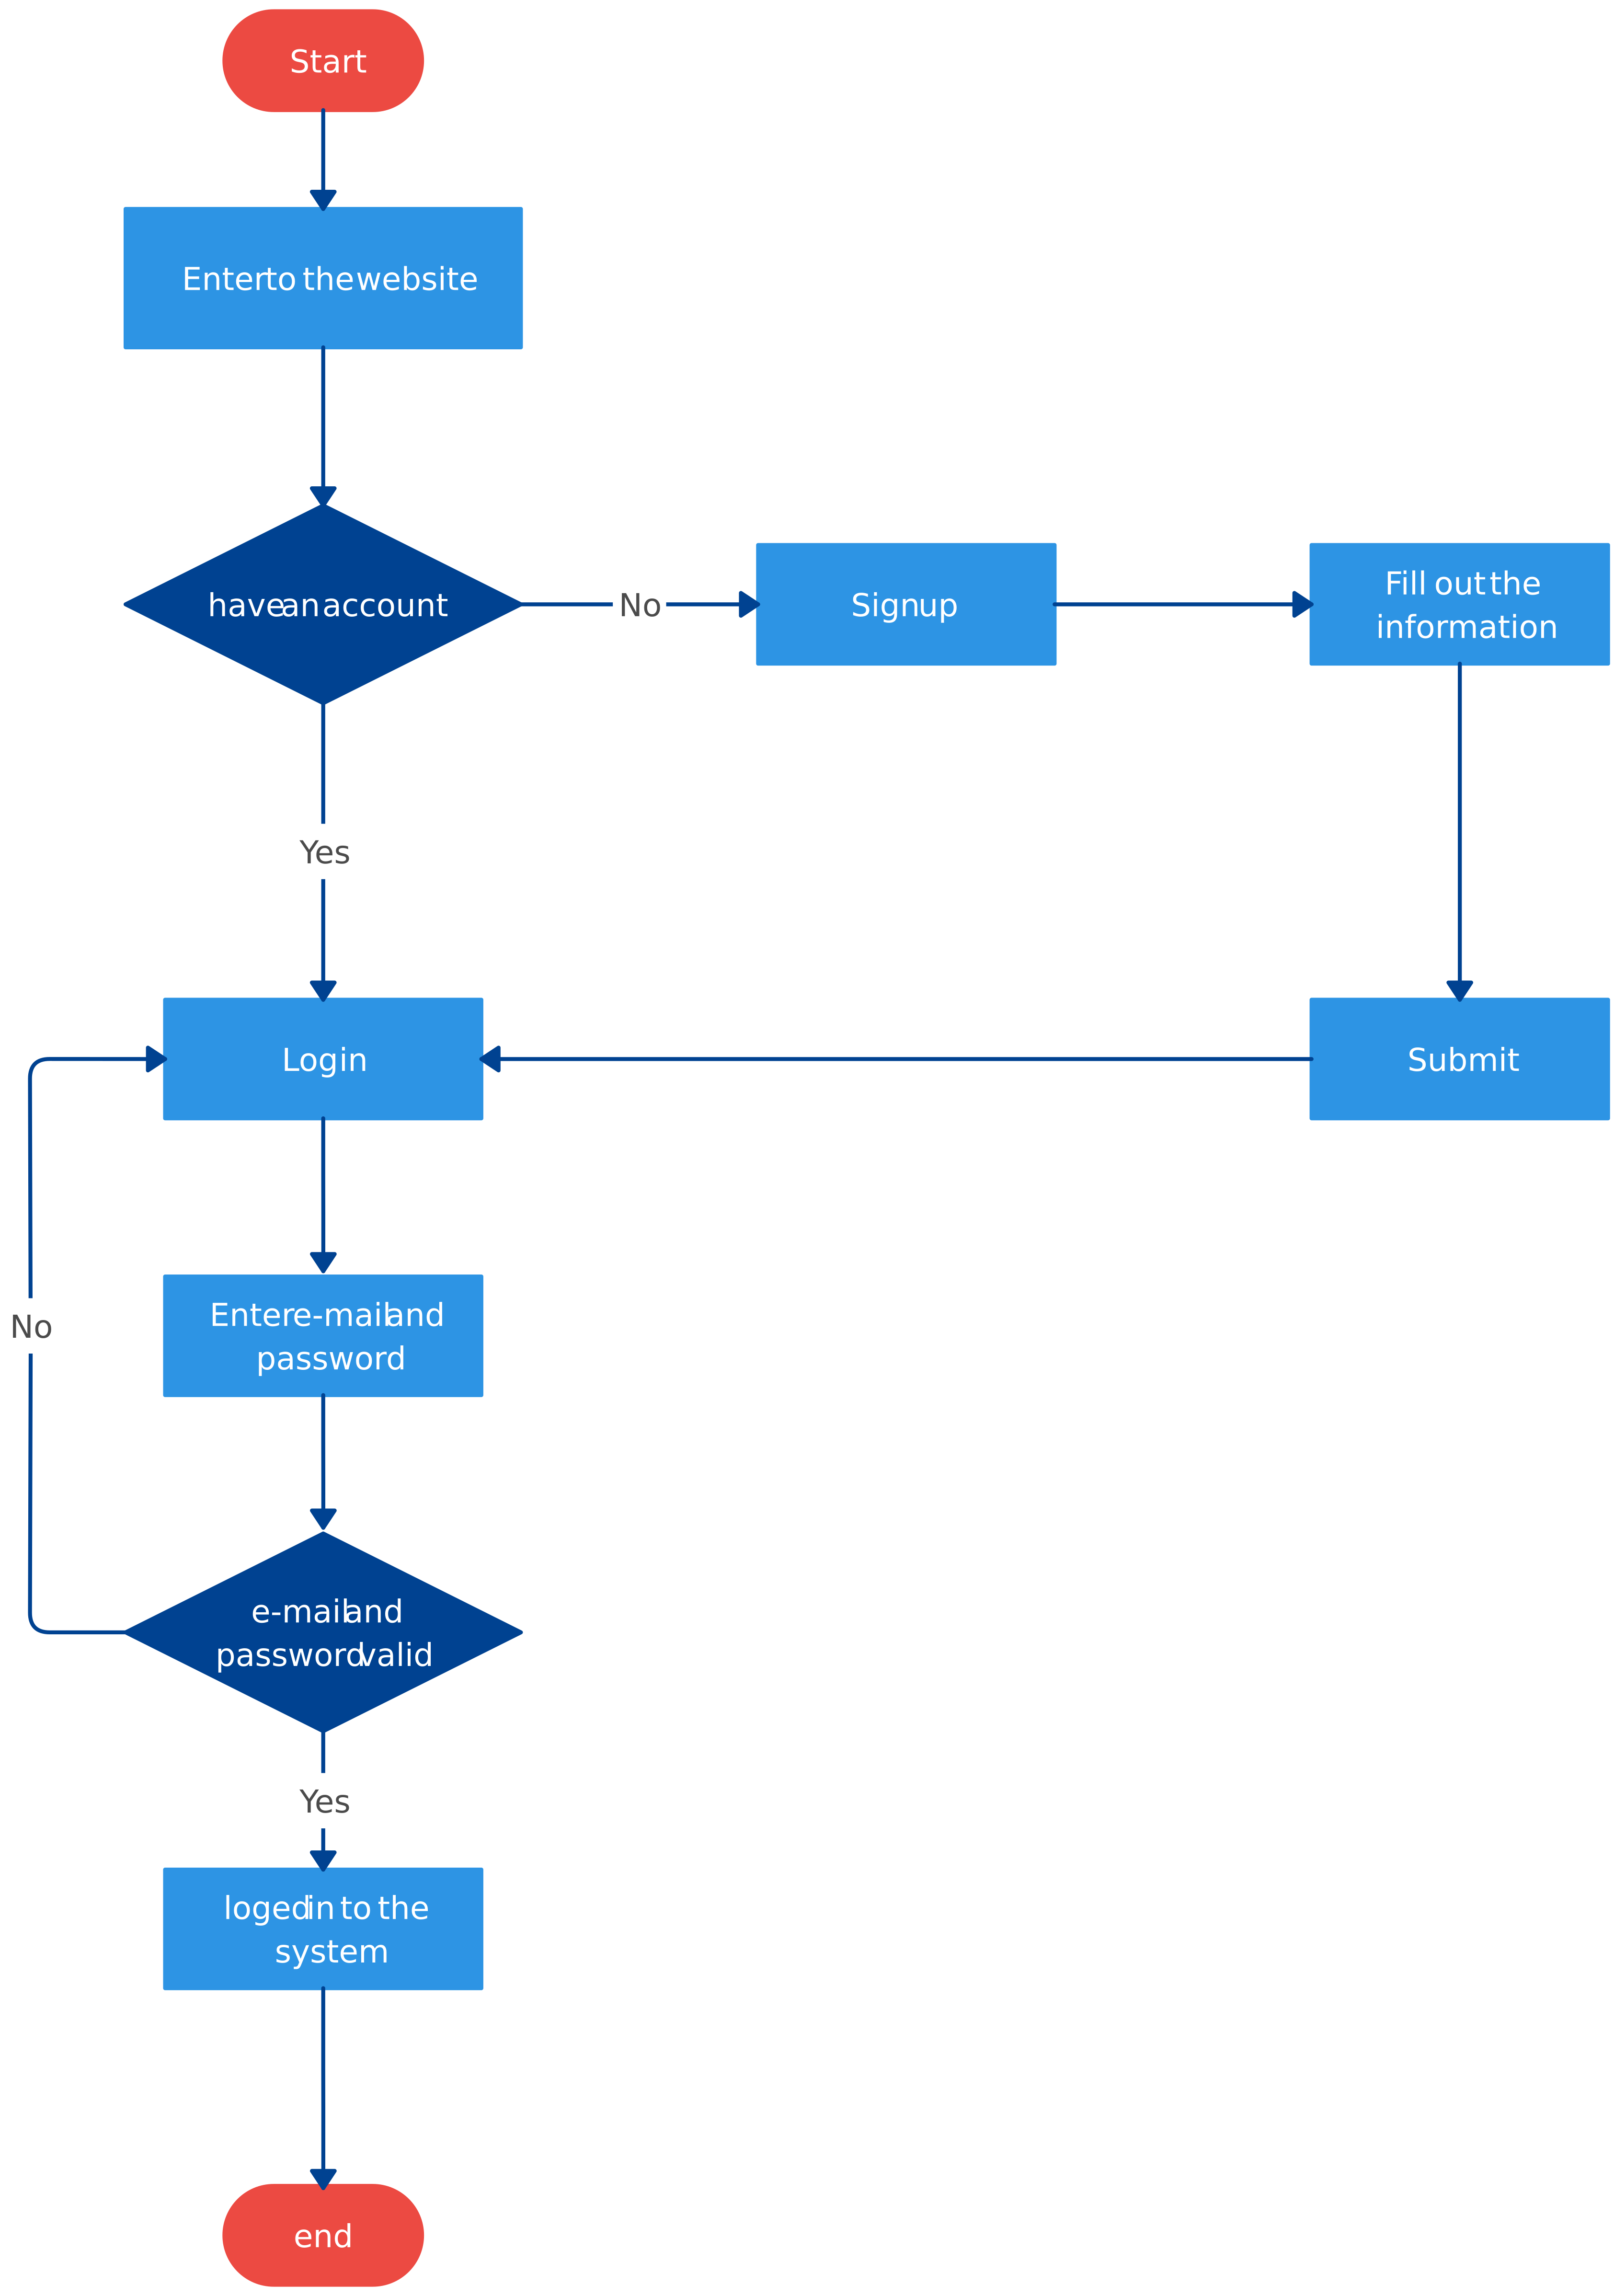
Flow Chart

Slide 8
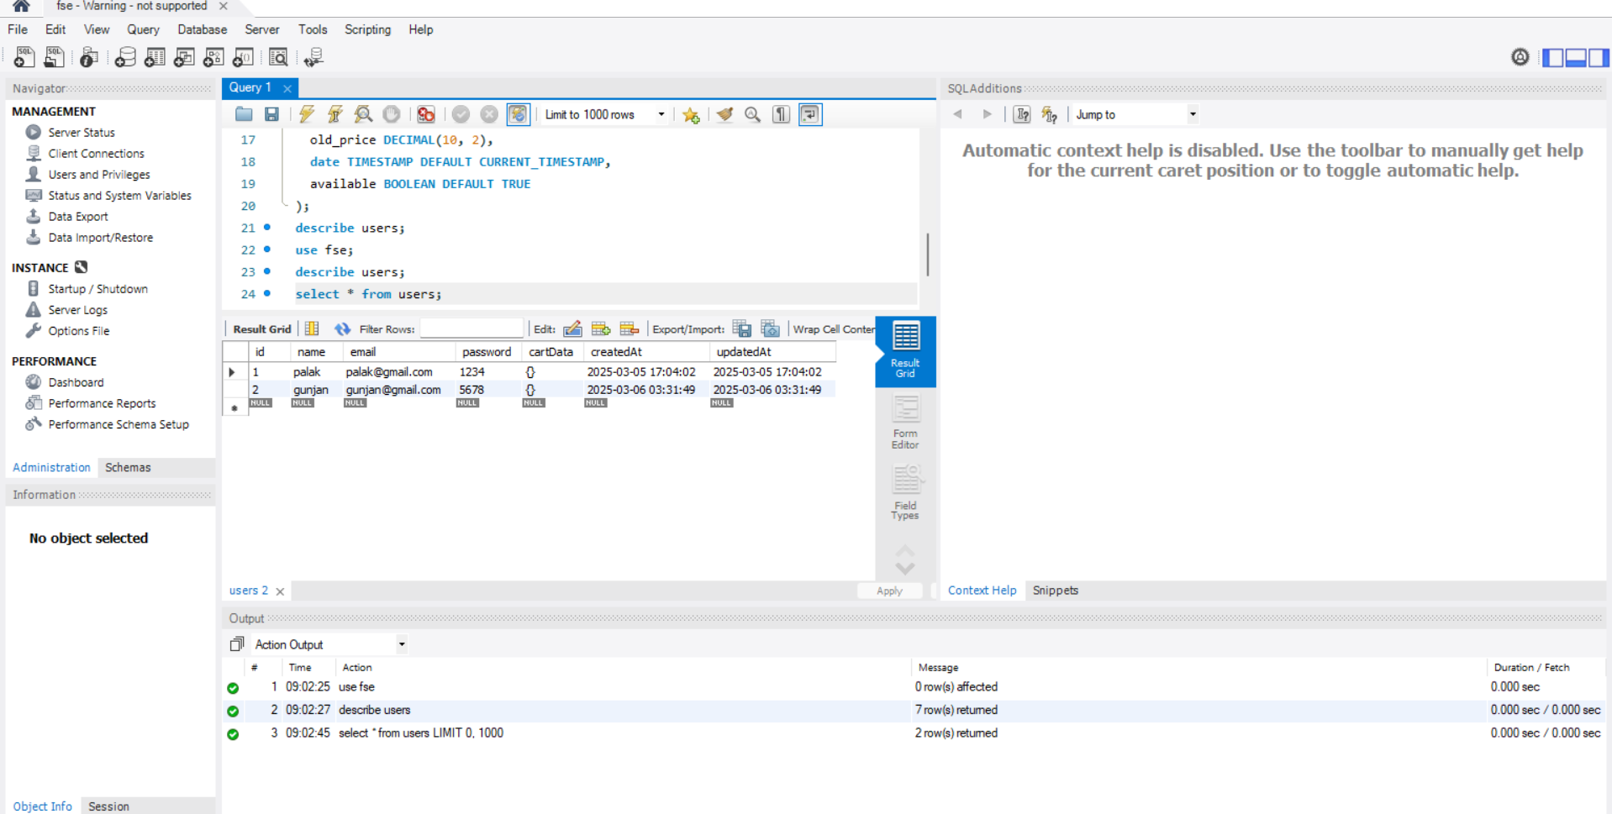
Result
This is the MySQl page where the user data is getting stored and dispalyed.

Slide 9
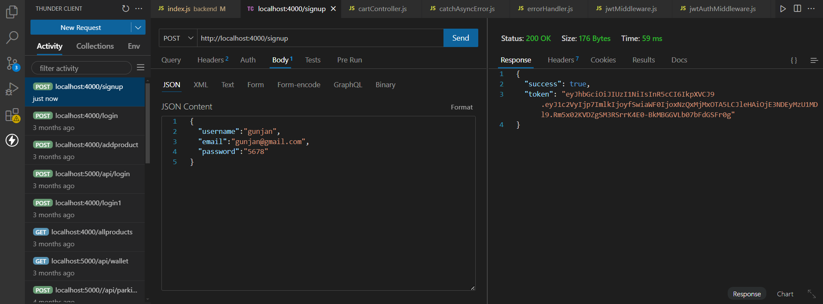
Source Code
This is the Thunderclient where we ass user data.

Slide 10
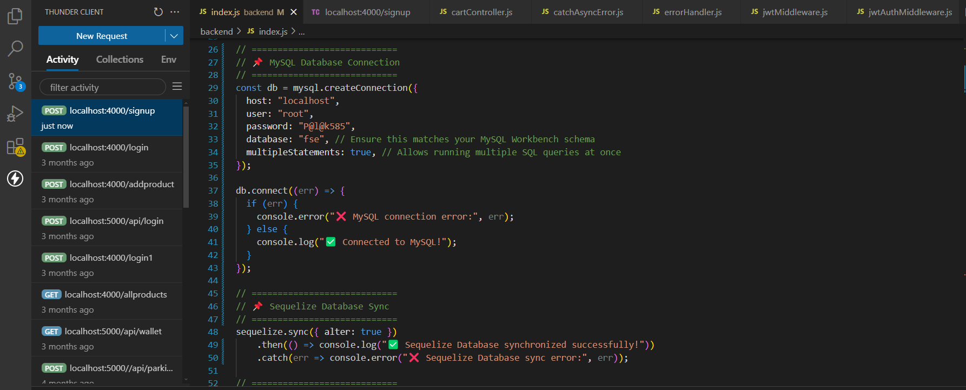
Source Code
Set up of MySQL and Sequelize.

Slide 11
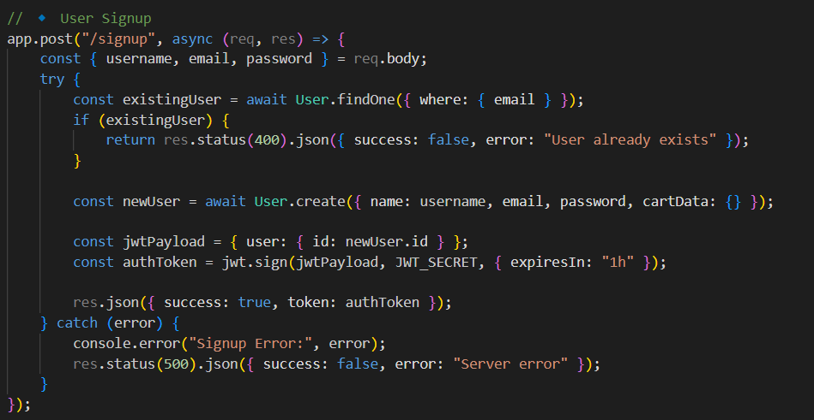
Source Code
Route for user signup.

Slide 12
Conclusion
In conclusion, this website has successfully achieved its objective of implementing a user-friendly authentication system within an e-commerce platform using modern web technologies. By leveraging the MERN stack—MongoDB for database management, Express.js for backend operations, React.js for the frontend, and Node.js as the runtime environment—the project demonstrates a robust and scalable approach to user authentication.

Slide 13
Future Scope
Payment Gateway
Wishlist Customisation
Cart Management

Slide 14
Reference
[1] https://reactjsexample.com/tag/ecommerce/ , Accessed on Jan 25,2025
[2] http://chat.openai.com/chat , Accessed on Jan 18,2025
[3] https://www.mysql.com/docs/manual/crud/ , Accessed on Feb 1,2025

Slide 15


