Slide 1
ISM 6225 Distributed Information Systems
Razor, MVC Site
Based on ADAM FREEMAN, MVC 7th Edition, Chs 1-3

Slide 2
Agenda
Typical web application architecture
First ASP.NET MVC Core application
Application walkthrough
Debugging
First full-cycle application
Using models
Using Tag helpers and Html helpers
Model binding
Data annotations
Validation
Viewbag object

Slide 3
Web development evolution
ASP
HTTP request-response
ASP.Net web forms
Developer friendly
Drag and drop widgets
ASP.NET MVC
Testability
Complete control over HTML
ASP.NET MVC Core
Cross-platform
Light-weight

Slide 4
MVC pattern
Typical business application
User views/ enters data using a form
Submission leads to change in some data store
Updated information reflected in form
…. Repeat
Appropriate semantics for each step
Appearance for forms
Read/ write for data
Thread safety between forms

Slide 5
MVC pattern benefits
Additionally
Independence is preferred
Change in data store should not require change in UI
Change in UI should not require change in DB
Called separation of concerns
Evolved as MVC framework
Standard architecture for web applications

Slide 6
MVC pattern evolution
Recommended architecture to build enterprise applications is to organize functionality in layers
Layer only depends upon lower layers for its functionality
MVC is the reference pattern to connect UI to application and domain layers in enterprise applications (Evans, ’04)
Developed by Trygve Reenskaug as part of Smalltalk language
Published, Dec 10, 1979
https://blog.codinghorror.com/understanding-model-view-controller/
http://heim.ifi.uio.no/~trygver/themes/mvc/mvc-index.html
http://heim.ifi.uio.no/~trygver/1979/mvc-2/1979-12-MVC.pdf
http://heim.ifi.uio.no/~trygver/1979/mvc-1/1979-05-MVC.pdf
User interface layer
Application layer
Domain layer (e.g. code-first models)
Infrastructure layer (e.g. EF dbContext)

Slide 7
ASP.NET implementation of MVC
HTTP
1
2
3
Request
Controller
Model
Database persistence
8
7
5
4
Response
View
Presentation model
6

Slide 8
Typical technology use
TCP/ IP
TCP/ IP
TCP/ IP
web API
Protocol buffers
Json
JavaScript
Entity framework
SQL
HTTP
Request
Controller
Model
Database persistence
C#
C#
Response
View
Presentation model
Razor
LINQ

Slide 9
Common optimizations
Partial requests
Controller
Model
Database persistence
Response
Partial view
Browser integration
Partial view
Partial view
Partial view
Partial views
Json data
Browser processing
(React/ Angular)
Json data
Json data
Json data

Slide 10
Create MVC core application
Attention - start
We will first create two MVC applications using templates provided by Visual Studio
Unfortunately, both are sub-optimal
But have useful information
Will motivate why we use the specific starting point built for this class
Recommendation
Create these first two applications in a temp folder
Can delete them later easily
No need to create repositories
Personal preference

Slide 11
Initial disposable MVC applications
New project → Installed → Visual C# → .NET core → ASP.NET core web application → Web application (Model-View-Controller)
Run the application
New project → Installed → Visual C# → .NET core → ASP.NET core web application → Empty
Run the application
Compare folder structures
Application 1 is quite functional, but rather complex for a first application
Application 2 is very straightforward, but extremely limited in functionality

Slide 12
MVC application starting point
https://github.com/magrawal-USF/MVC_Start.git
Check out
Controllers folder
Models folder
Views folder
wwwroot folder
We will also walk through
Program.cs
Startup.cs

Slide 13
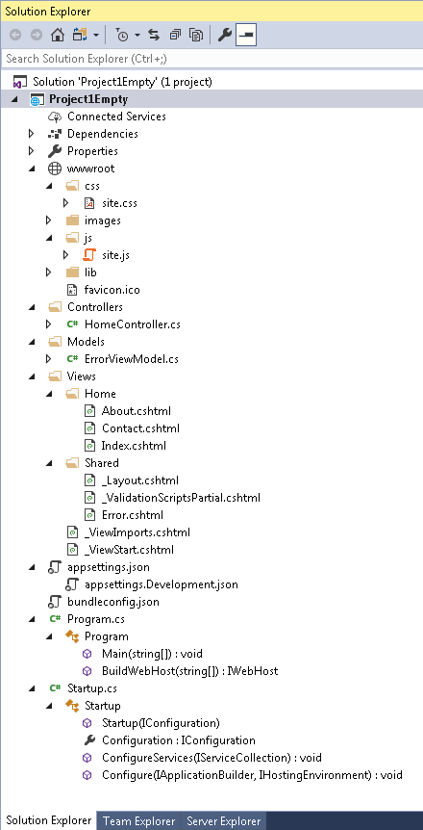
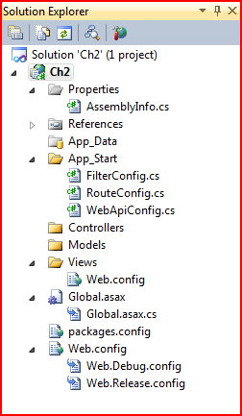
Project structure
Significant changes in early 2018
Gone
App_Start
Content
Web.config
Introduced
appsettings.json
Dependencies
Program.cs
Startup.cs
wwwroot

Slide 14
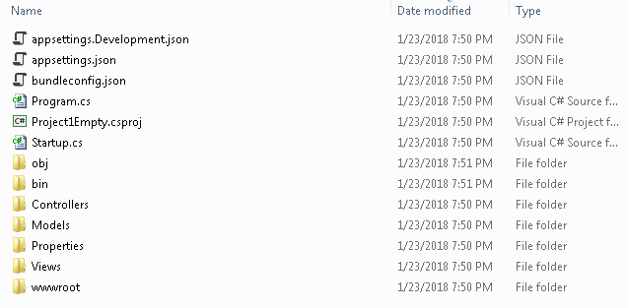
Project structure – contd.
Matches closely to file structure on hard disk

Slide 15
Starting point – changes from empty project
Attention – end
Added folder hierarchy to wwwroot folder
Added Controllers, Models, Views folders
And content in these folders
Added appsettings and bundleconfig files
Updated Startup.cs class

Slide 16
First application – gotchas
Avoid numbers and hyphens in project name
Lead to complexities with naming later
If using network drives
USF does not allow execution from network drives
Therefore, it may help to
Project
Properties
Build
Output Path
<Select a path not on a network drive>
If you picked things like individual user accounts, the application can add a lot of content
Difficult to understand for intro
Delete project and start again

Slide 17
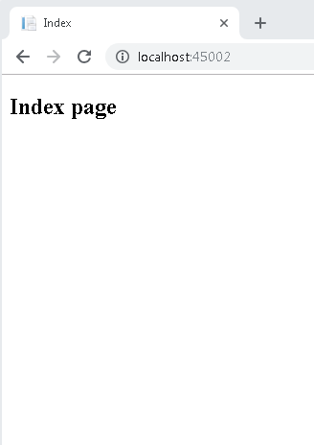
Run application
During development
F5 (most common, very helpful)
Start application in debug mode
Can edit views during debugging
But not controllers
Ctrl+F5
Start application, without debugging
Allows file changes during development
Useful for simple query changes
Build solution
Shift+F8 (very helpful)
Especially after Build -> Clean solution
View in browser

Slide 18
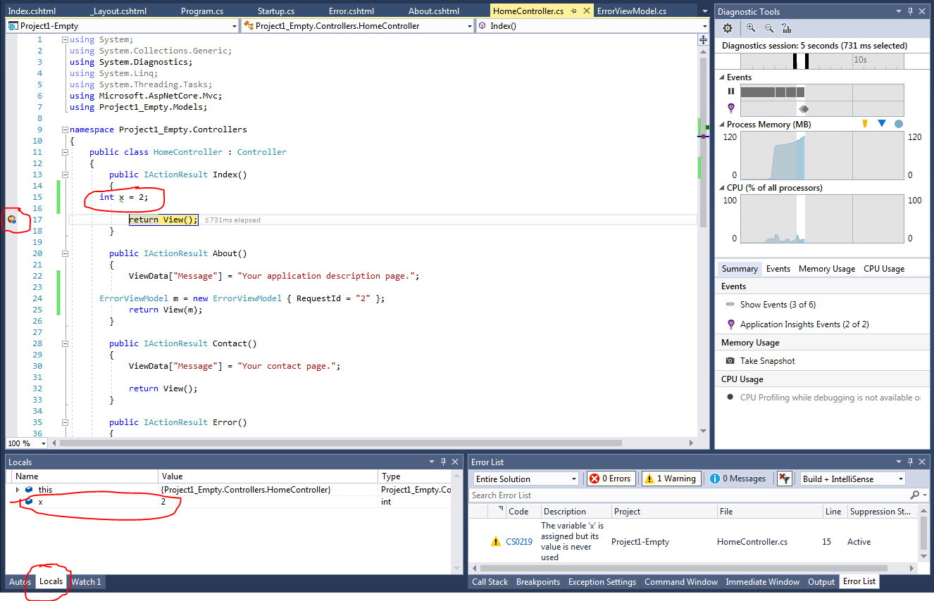
Debugging
Useful procedure
Add breakpoints to stop application flow
View variable contents in Locals window
Useful keyboard shortcuts
F10: step over
Go to the next instruction
F8: step into
Get into the invoked method (if applicable)
F5: continue

Slide 19
Demystification
How does the content appear on the page?
Consider the URL http://localhost:9126 (<sitehome> in later slides)
Application workflow (use breakpoints to observe)
Program -> Main
Startup -> Configure
Sets up routing
app.UseMvc(routes =>
{
routes.MapRoute(
name: "default",
template: "{controller=Home}/{action=Index}/{id?}");
});
Home controller -> Index()
Views/Index.cshtml
Views/Shared/_Layout.cshtml

Slide 20
Application walkthrough
Controllers/Home -> Index method
Returns View();
Return type is IActionResult
https://docs.microsoft.com/en-us/dotnet/api/microsoft.aspnetcore.mvc.iactionresult?view=aspnetcore-2.0
Most commonly used implementation is an ActionResult, parent of
ViewResult : complete views
JsonResult : Json data
PartialViewResult : view components
…
Try changing return type to ViewResult
Why use IActionResult over ViewResult or ActionResult?
https://stackoverflow.com/questions/37998291/advantage-of-using-iactionresult-as-result-type-in-actions
Views/Home/Index.cshtml

Slide 21
Convention over configuration
Overall philosophy for contemporary application development frameworks
Java gave complete control to developers
But ended up requiring considerable developer competence to set things right
Modern frameworks give very high control too
But defaults work as would be expected
Default web pages have always been called index.html/ index.jsp/ index.asp
Home seems a natural location for the default controller

Slide 22
Layouts
Index.cshtml specified entire html
But most of this content is repeated across the entire site
Efficient to have one copy
Easy to update
Layouts help with specifying website boilerplate
E.g. headers, footers, navigation menus etc
Check out <sitehome>/Home/IndexLayout.cshtml

Slide 23
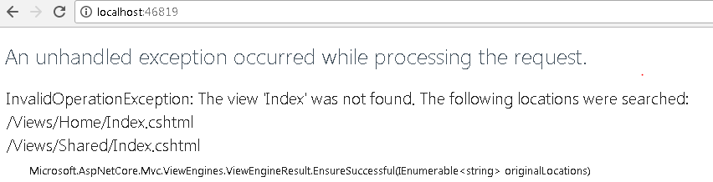
e.g. URLs and associated views
Rename Views/Home/Index.cshtml to something else
Say Index1.html
Select the file in solution explorer and use F2 (universal file renaming shortcut)
Run application
Searched locations are listed:
Views/Home
Views/Shared
Views/Home: Follows Views/<Controller> pattern
Views/Shared: Location for views shared by multiple actions
E.g. layouts, headers, footers

Slide 24
Convention over configuration
Decrease the number of decisions made by the developer
Only specify deviations from convention
Appropriate naming automatically leads to expected behavior
Entity Sale automatically maps to Sales table
Popularized by Ruby on Rails
Used extensively in .NET MVC

Slide 25
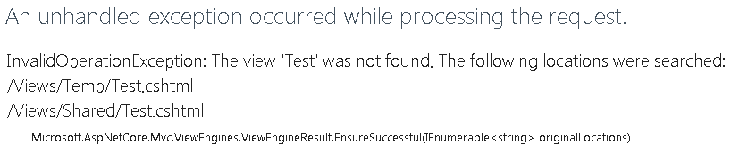
Simple operation
Add a controller, action method and associated view
And view in browser
In solution explorer, right-click Controllers
Add MVC Controller – Empty
Give a suitable name, say TempController
Add an action method, or rename the Index method, to say Test()
Add a break point in the method to detect method call
Run the application, and navigate to the action method
E.g. http://localhost:46819/Temp/Test
Control reaches breakpoint, error on continuation:

Slide 26
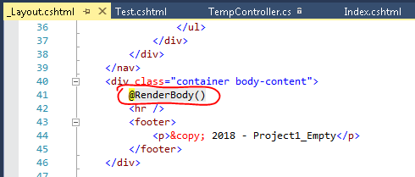
Fix missing view
Error message is helpful
Specifies expected location of missing view
Add view, preferably by using IDE features
Right-click anywhere in the action method, select Add View
Accept defaults
Observe view in Views/<Controller> folder
Run the project
Observe header (where did it come from?)
Read _ViewStart.cshtml and Views/Shared/_Layout.cshtml
Views can be edited in debug mode

Slide 27
Progress so far
Created a web application
Seen routing
Added controller
Added view
Made it all work together
Can create a web site with any number of static web pages

Slide 28
Simple interactive application
All common application development activities are similarly straightforward
Lot of pre-configured support in all frameworks including MVC
Let’s add interactivity to the application
Demonstrates
Model class
Passing model to view
Model use in view for user input
Model binding in controller
Input validation
Recommendation: Create a new application (MVC template is fine)
Adds practice

Slide 29
What we will do
Attention – start
Create a simple class
Initialize it in the controller
Pass it to the view
Render it in the view
Attention - end

Slide 30
Add a Model class
In Models folder
Right-click -> Add class -> ASP.NET Core -> Code -> Class
Unusually long path?
Name it say, GuestContact.cs
namespace MVC_Start.Models
{
public class GuestContact
{
public string Name { get; set; }
public string Email { get; set; }
public string Phone { get; set; }
}
}
Can be used everywhere in the project like any object
With Entity Framework, can also be easily persisted into the database

Slide 31
Use the model class - controller
Initialize an instance of the model class in an action method, e.g. Home -> Contact
To deal with compilation errors, right-click the Class and add the using … option
public IActionResult Contact()
{
GuestContact contact = new GuestContact();
contact.Name = "Manish Agrawal";
contact.Email = "magrawal@usf.edu";
contact.Phone = "813-974-6716";
/* alternate syntax to initialize object
GuestContact contact2 = new GuestContact
{
Name = "Manish Agrawal",
Email = "magrawal@usf.edu",
Phone = "813-974-6716"
};
*/
ViewData["Message"] = "Your contact page.";
return View(contact);
}

Slide 32
Use the model class – view
The class is easily passed to the view from the controller
But how do you use it in the view?
Use the @model directive
Defines a strongly typed view
Introduced in MVC 3
https://weblogs.asp.net/scottgu/asp-net-mvc-3-new-model-directive-support-in-razor
Model properties can be accessed on the page using the @Model.<property> accessors
The IDE makes it easy to add these directives
In Add View dialog, select Details and select GuestContact class
But for now, let us just add things manually
Select defaults in the Add View dialog

Slide 33
Use the model class – view
Views mix html and active code
@ and @{} directives let you include active code in page
Access model properties
Access Html helpers
Use regular C# code

Slide 34
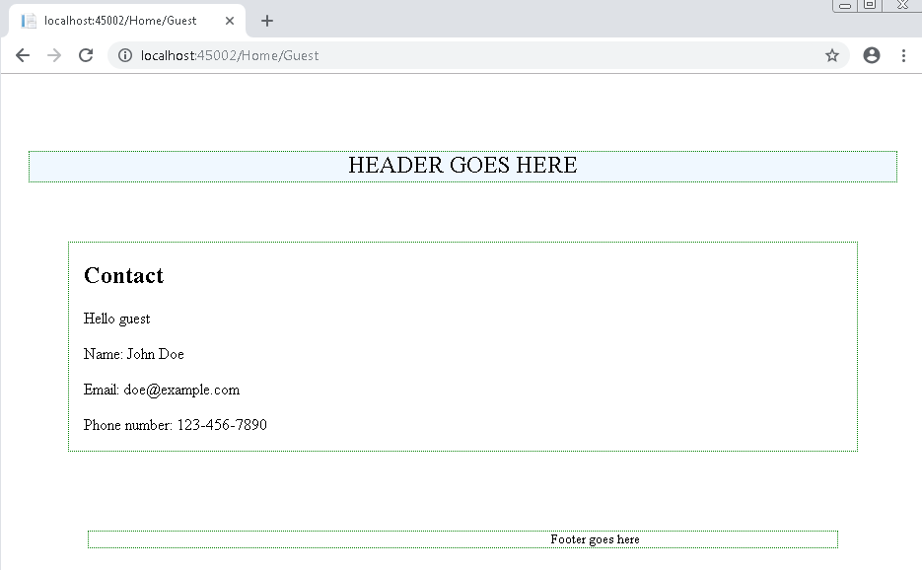
Contact.cshtml – with Model
@model GuestContact
@{
ViewData["Title"] = "Contact";
}
<h2>@ViewData["Title"]</h2>
<h3>@ViewData["Message"]</h3>
<p>Hello guest</p>
<p>Name: @Model.Name</p>
<p>Email: @Model.Email</p>
<p>Phone number: @Model.Phone</p>

Slide 35
Model use in view for user input
Progress so far in simple application
Model class
Model passing to view
Next step
Use model in view for user input
Model binding in controller
Recall – MVC is a specialized framework for web applications
Has easy-to-use constructs to handle all web interactions
Getting progressively easier
minification, bundling, SASS etc
Alert: Instructor is more familiar with former Html helper syntax

Slide 36
Update view for user input
In html, user input is collected by forms
Update Contact.cshtml as follows by making 3 changes:
Wrap fields in form
Specify submission target
Replace field display with text boxes
Using tag helpers
Include a button to submit the form
<form asp-controller="Home" asp-action="Contact" method="post">
<p>Name: <input asp-for="Name" /></p>
<p>Email: <input asp-for="Email" /></p>
<p>Phone number: <input asp-for="Phone" /></p>
<button type="submit">Submit</button>
</form>
1
2
3

Slide 37
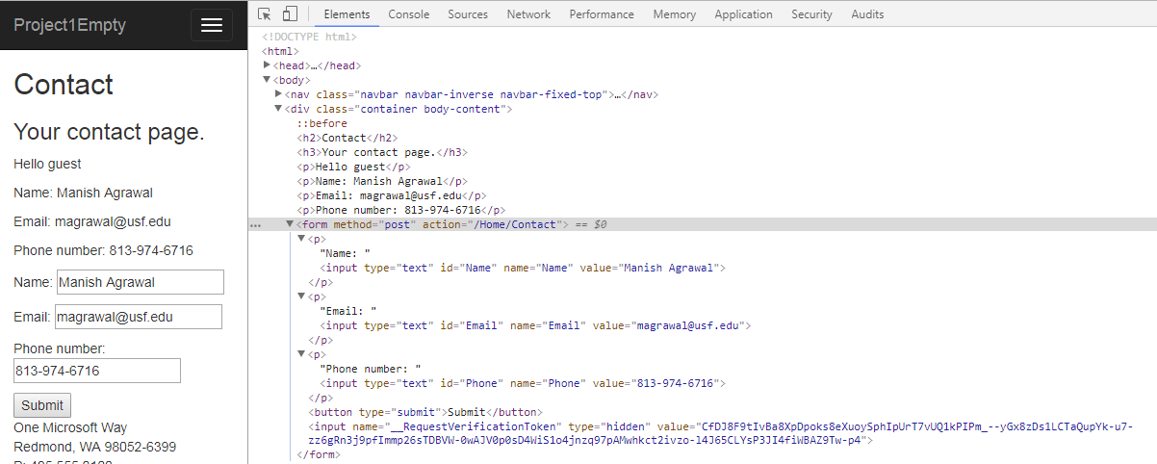
Generated view
<form asp-controller="Home" asp-action="Contact" method="post">
<p>Name: <input asp-for="Name" /></p>
<p>Email: <input asp-for="Email" /></p>
<p>Phone number: <input asp-for="Phone" /></p>
<button type="submit">Submit</button>
</form>

Slide 38
Razor view language
Language support to script dynamic content into views
Most commonly from view model
Has access to routing configuration
Has helpers for relevant tasks
E.g. Html/ Url: used to generate URL links
<div>@Html.ActionLink("Contact us", "Contact", "Home")</div>
<div><a href="@Url.Action("Contact", "Home")">Contact us</a></div>
However, diminished role in Core 2
Replaced with tag helpers
E.g. https://davepaquette.com/archive/2016/01/02/goodbye-child-actions-hello-view-components.aspx
Can include any C# code in @{}
Used in examples

Slide 39
Model binding in controller
Form attributes generate html that will send the form to the specified end point
In this case, the contact() method in the home controller
Add the receiver target method
Observe the method argument
Model binding passes a strongly typed object to the controller
Populated with user input
Also observe the HttpPost decorator
Disambiguates with the pre-existing Contact() method, which is called on GET requests
Insert a breakpoint, run the application, submit the form
View the contents of the contact object
[HttpPost]
public IActionResult Contact(GuestContact contact)
{
return View(contact);
}

Slide 40
Model binding in controller - 2
Views can also be specified by name, using an overload method of the Controller.View method
return View("Guest", Contact);

Slide 41
Application interactivity
Progress so far
Model class
Model passing to view
Model use in view for user input
Model binding in controller
You have all the basic elements to build web applications
CSS, JavaScript, Routes, Controllers, Actions, Views, Model binding
We will soon refine with Entity Framework for persistence, Identity for authentication etc

Slide 42
Exercise
Add all components needed to process one web request cycle for form input
One controller
One view, with the form
One model to populate the form
get and post action methods to present the form and collect inputs

Slide 43
Loose ends 1 – html helpers
Html helpers
Razor initially used Html helpers to generate HTML tags
Still available, though tag helpers are probably much easier to use
And create cleaner view code
Compare html generated by the two methods
Tag-helpers approach | Html helpers approach
<form asp-controller="Home" asp-action="Contact" method="post"> <p>Name: <input asp-for="Name" /></p> <p>Email: <input asp-for="Email" /></p> <p>Phone number: <input asp-for="Phone" /></p> <button type="submit">Submit</button> </form> | @using (Html.BeginForm("Contact", "Home", FormMethod.Post)) { <p>@Html.TextBoxFor(m => m.Name)</p> <p>@Html.TextBoxFor(m => m.Email)</p> <p>@Html.TextBoxFor(m => m.Phone)</p> <input type="submit" value="Sign In"> }

Slide 44
Loose ends 2 - validation
Validation
Good practice to run sanity checks on end user inputs
Simple checks on the browser before submission, more exhaustive checks on the server upon submission
MVC uses jQuery for validation
Scaffolding already present in Views/Shared/_ValidationScriptsPartial.cshtml
https://stackoverflow.com/questions/32645632/do-i-need-to-add-javascript-source-of-validationscriptspartial-cshtml-to-layou
<environment include="Development">
<script src="~/lib/jquery-validation/dist/jquery.validate.js"></script>
<script src="~/lib/jquery-validation-unobtrusive/jquery.validate.unobtrusive.js"></script>
</environment>
<environment exclude="Development">
<script src="https://ajax.aspnetcdn.com/ajax/jquery.validate/1.14.0/jquery.validate.min.js"
asp-fallback-src="~/lib/jquery-validation/dist/jquery.validate.min.js"
asp-fallback-test="window.jQuery && window.jQuery.validator"
crossorigin="anonymous"
integrity="sha384-Fnqn3nxp3506LP/7Y3j/25BlWeA3PXTyT1l78LjECcPaKCV12TsZP7yyMxOe/G/k">
</script>
<script src="https://ajax.aspnetcdn.com/ajax/jquery.validation.unobtrusive/3.2.6/jquery.validate.unobtrusive.min.js"
asp-fallback-src="~/lib/jquery-validation-unobtrusive/jquery.validate.unobtrusive.min.js"
asp-fallback-test="window.jQuery && window.jQuery.validator && window.jQuery.validator.unobtrusive"
crossorigin="anonymous"
integrity="sha384-JrXK+k53HACyavUKOsL+NkmSesD2P+73eDMrbTtTk0h4RmOF8hF8apPlkp26JlyH">
</script>
</environment>

Slide 45
Using client side validation
Straightforward to use with data annotations
Add required annotations to the view model
Create new model class, say GuestValidated
Use model in controller actions
Include validation scripts in page
Create space on page to display validation errors

Slide 46
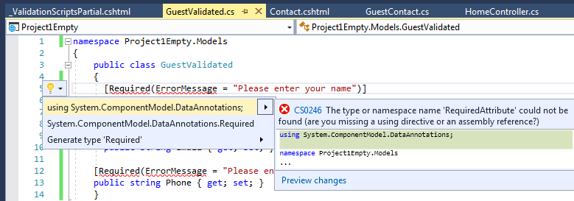
Create model class for validation
public class GuestValidated
{
[Required(ErrorMessage = "Please enter your name")]
public string Name { get; set; }
[Required(ErrorMessage = "Please enter your email address")]
[RegularExpression(".+\\@.+\\..+", ErrorMessage = "Please enter a valid email address")]
public string Email { get; set; }
[Required(ErrorMessage = "Please enter your phone number")]
public string Phone { get; set; }
}
Remove errors by including relevant libraries
Ctrl+. on error and select recommendation
Adds using System.ComponentModel.DataAnnotations;

Slide 47
Update controller actions
public IActionResult Contact()
{
GuestValidated contact2 = new GuestValidated
{
Name = "Manish Agrawal",
Email = "magrawal@usf.edu",
Phone = "813-974-6716"
};
return View(contact2);
}
[HttpPost]
public IActionResult Contact(GuestValidated contact)
{
return View(contact);
}

Slide 48
Update view
@*@model GuestContact*@
@model GuestValidated
<form asp-controller="Home" asp-action="Contact" method="post">
<div asp-validation-summary="All"></div>
<p>Name: <input asp-for="Name" /></p>
<p>Email: <input asp-for="Email" /></p>
<p>Phone number: <input asp-for="Phone" /></p>
<button type="submit">Submit</button>
</form>
...
<address>
<strong>Support:</strong> <a href="mailto:Support@example.com">Support@example.com</a><br />
</address>
@section Scripts {
@{await Html.RenderPartialAsync("_ValidationScriptsPartial"); }
}

Slide 49
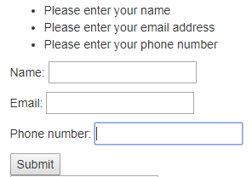
Verify validation
Run the application
Delete all text box contents
Submit the form

Slide 50
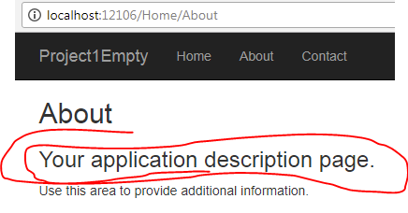
Loose ends 3 – ViewBag object
Arbitrary data type passed from controller action to view
Used liberally in example
HomeController -> About: ViewData["Message"] = "Your application description page.";
Views/Home/About.cshtml: <h3>@ViewData["Message"]</h3>
Opinion
Very useful in examples
Also very useful in collecting error messages during server side processing
Does not require cluttering models with error messages
But otherwise, can easily lead to sloppy coding
Put all data in models

Slide 51
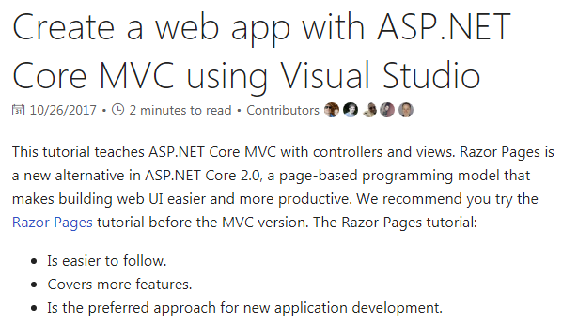
Next steps 1 – MVC tutorial
Do the MVC web app tutorial pointed to on the default application page
https://docs.microsoft.com/en-us/aspnet/core/tutorials/first-mvc-app/
Simpler, faster and less detailed example than Sports Store
But will be a great refresher

Slide 52
Next steps 2 – Sports Store
Highly recommended for anyone interested in technology careers
Start the Sports Store tutorial in the book
Soup to nuts example
Covers building a web application from scratch
Including a heavy focus on testability
We will do Entity Framework for the database connections next week

Slide 53
Summary
Typical web application architecture
First ASP.NET MVC Core application
Application walkthrough
First full-cycle application
Using models
Using Tag helpers and Html helpers
Model binding
Data annotations
Validation
Viewbag object

Slide 54
References
Eric Evans, Domain driven design, Addison-Wesley, 2004
ASP.NET Core changelog: https://stackify.com/asp-net-core-features/

