Slide 1
Project on Analytics
Project Assignment 1
Part-1

Slide 2
Task1:
How much is spent for each category (Pivot Table).
Visually represent the amount spent against each category is what percentage of the total expense amount (Pivot Chart).
Row Labels | Sum of Expense (INR)
Grocery | 4690
Shopping | 3500
Ticket and Bills | 2570
Entertainment | 1000
Food | 850
Miscellaneous | 500
Doctor and Medicine | 450
Grand Total | 13560
(Pivot Table)
(Pivot Chart)

Slide 3
Task2:
How much is spent on different items of each category (Pivot Table).
Row Labels | Sum of Expense (INR)
Doctor and Medicine | 450
Mother's Medicine | 450
Entertainment | 1000
Movie | 1000
Food | 850
Chips and Fries | 250
Online Food Order | 600
Grocery | 4690
Beverages | 250
Bread and bakery | 500
Foodgrains and cereals | 1050
Fruit | 650
Oil and spices | 550
Vegetables | 1690
Miscellaneous | 500
Sister's birthday gift | 500
Shopping | 3500
Shoes | 1000
Tshirt and Jeans | 2500
Ticket and Bills | 2570
Electricity bill | 370
Gas | 850
House help | 1000
Railway monthly ticket | 350
Grand Total | 13560
(Pivot Table)

Slide 4
Visually represent the amount spent on different items of Entertainment and Tickets and bills category (Pivot Chart).
Row Labels | Sum of Expense (INR)
Entertainment | 1000
Movie | 1000
Ticket and Bills | 2570
Electricity bill | 370
Gas | 850
House help | 1000
Railway monthly ticket | 350
Grand Total | 3570
(Pivot Table)
(Pivot Chart)

Slide 5
Task3:
How many times money has been spent against different items of each category (Pivot Table).
Row Labels | Count of Expense (INR)
Doctor and Medicine | 1
Mother's Medicine | 1
Entertainment | 4
Movie | 4
Food | 6
Chips and Fries | 2
Online Food Order | 4
Grocery | 15
Beverages | 1
Bread and bakery | 3
Foodgrains and cereals | 1
Fruit | 4
Oil and spices | 1
Vegetables | 5
Miscellaneous | 1
Sister's birthday gift | 1
Shopping | 2
Shoes | 1
Tshirt and Jeans | 1
Ticket and Bills | 4
Electricity bill | 1
Gas | 1
House help | 1
Railway monthly ticket | 1
Grand Total | 33
(Pivot Table)

Slide 6
Filter the data to display the data for Grocery items and Shopping items.
Row Labels | Count of Expense (INR)
Grocery | 15
Beverages | 1
Bread and bakery | 3
Foodgrains and cereals | 1
Fruit | 4
Oil and spices | 1
Vegetables | 5
Shopping | 2
Shoes | 1
Tshirt and Jeans | 1
Grand Total | 17
(Pivot Table)

Slide 7
Task4:
What amount is spent on each item of the categories with highest and 2nd highest expense amount (Pivot Table)
Row Labels | Max of Expense (INR)
Shopping | 2500
Tshirt and Jeans | 2500
Shoes | 1000
Grocery | 1050
Foodgrains and cereals | 1050
Oil and spices | 550
Vegetables | 470
Beverages | 250
Bread and bakery | 200
Fruit | 200
Ticket and Bills | 1000
House help | 1000
Gas | 850
Electricity bill | 370
Railway monthly ticket | 350
Miscellaneous | 500
Sister's birthday gift | 500
Doctor and Medicine | 450
Mother's Medicine | 450
Entertainment | 250
Movie | 250
Food | 200
Online Food Order | 200
Chips and Fries | 150
Grand Total | 2500
(Pivot Table)

Slide 8
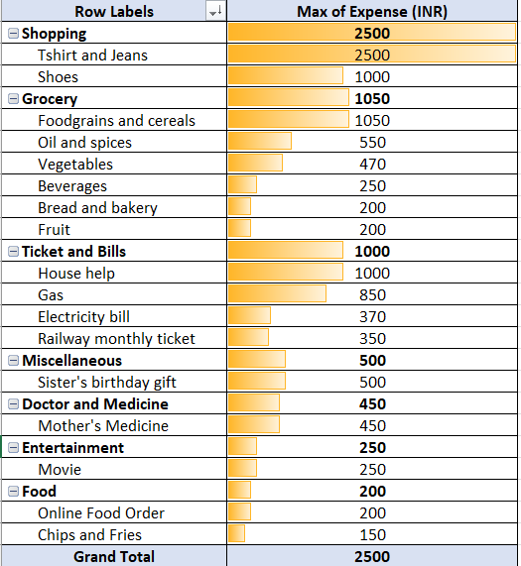
Visually represent the data with data bars (Conditional formatting).
(Pivot Table with Conditional Formatting)

Slide 9
Q.1) The category with the highest expense amount.
Grocery category have the highest expense amount which is 4690INR with 35% of Total Expense.
Q.2) Total expense amount against entertainment and shopping.
Total Expense for entertainment is 1000INR and Shopping is 3500INR.
Q.3) Number of times Nitin has ordered food online and the amount spent for it.
Nitin has ordered food online 4 times and the Total amount spent for it is 600INR.
Q.4) Number of times Nitin has watched a movie.
Nitin has watched a movie 4 times and the Total amount spent for it is 1000INR.
Q.5)The less essential category that Nitin may remove to increase his savings.
Nitin may remove Entertianment Category and needs to Optimize or Limit spending on Grocery and shopping to increase his savings.

Slide 10
Project Assignment 1
Part-2

Slide 11
Task1:
Month-wise trend of expenses (Pivot table and chart).
Row Labels | Sum of Expense (INR)
January | 13900
February | 15620
March | 13140
April | 14800
May | 13370
June | 13560
Grand Total | 84390
(Pivot Table)
(Pivot Chart)
Find out the month Nitin spent the most.
Febuary

Slide 12
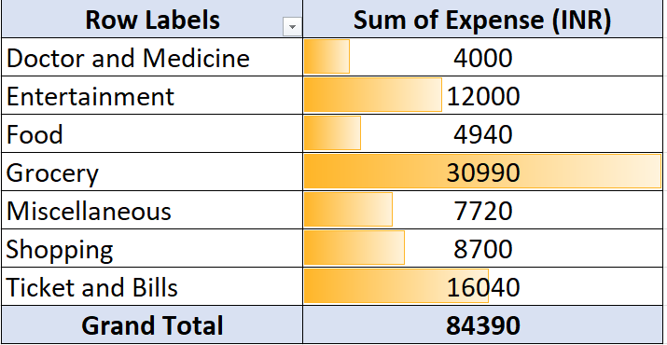
Task2:
Category wise expenses (Pivot table).
Visually represent it with data bars to display categories with the highest and lowest expense amount.
(Pivot Table with Conditional Formatting)
(Pivot Chart)

Slide 13
Task3:
Month-wise expense of each category (Pivot table).
Row Labels | Sum of Expense (INR)
January | 13900
Grocery | 4500
Ticket and Bills | 2650
Shopping | 2000
Food | 1900
Doctor and Medicine | 1750
Miscellaneous | 850
Entertainment | 250
February | 15620
Entertainment | 7500
Grocery | 4300
Ticket and Bills | 2650
Miscellaneous | 720
Doctor and Medicine | 450
March | 13140
Grocery | 6090
Ticket and Bills | 2750
Shopping | 1700
Miscellaneous | 850
Food | 800
Entertainment | 500
Doctor and Medicine | 450
April | 14800
Grocery | 5460
Miscellaneous | 3500
Ticket and Bills | 2750
Food | 1390
Entertainment | 1250
Doctor and Medicine | 450
May | 13370
Grocery | 5950
Ticket and Bills | 2670
Shopping | 1500
Entertainment | 1500
Miscellaneous | 1300
Doctor and Medicine | 450
June | 13560
Grocery | 4690
Shopping | 3500
Ticket and Bills | 2570
Entertainment | 1000
Food | 850
Miscellaneous | 500
Doctor and Medicine | 450
Grand Total | 84390
Find out 2 categories with higher expenses for each of the
6 months.
January: I) Grocery II) Ticket and Bills
February: I) Entertianment II) Grocery
March: I) Grocery II) Ticket and Bills
April: I) Grocery II) Miscellaneous
May: I) Grocery II) Ticket and Bills
June: I) Grocery II)Shopping
(Pivot Table)

Slide 14
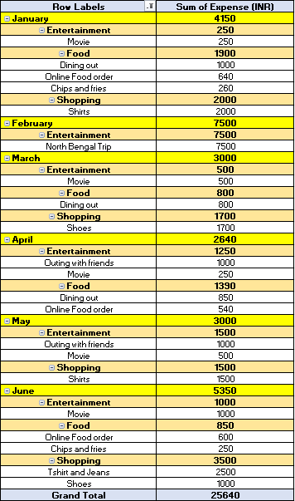
Task4:
How much is spent in each month against different items
of Entertainment, Food and Shopping categories (Pivot table).
(Pivot Table)
Find out which months have the highest amount spent
for movies and dining out.
June month have the highest amount spent for movies
which is 1000INR and January month have the highest
amount spent for dining out which is also 1000INR.

Slide 15
Recommend how can Nitin increase his savings.
1) Review and reduce expenses on less essentials:
Nitin should review his less essential expenses such as entertainment, shopping and miscellaneous.
He have to limit his expenses on such.
2) Limit food expense:
He have to reduce his food expenses.
He can plan meals avoiding eating out and look for cost effective alternative.
3) Control grocery expense:
Grocery are Essential but he had to optimise it.
Making shopping list and stick to it will avoid more impulse purchase Avoid food wastage by planning meals and storing food properly.

