Slide 1
Underwater Image Enhancement (DA-2)
-Madhukiran Reddy 21BCE1723
-Palaniappa K 21BCE1712
-Nirudeeswar 21BCE5484

Slide 2
Abstract
Underwater images often suffer from low visibility due to light absorption, scattering, and distortion. This project aims to enhance underwater images by restoring natural colors, improving contrast, and reducing noise using advanced digital image processing techniques.
The methods used include white balance correction, Contrast Limited Adaptive Histogram Equalization (CLAHE), and denoising with OpenCV. These enhancements have applications in marine research, underwater navigation, and photography.

Slide 3
Introduction
Challenges:
Color distortion caused by light absorption underwater.
Loss of sharpness due to scattering.
Reduced contrast in deep-water images.
Objective:
To create a robust technique that enhances underwater image quality.
Applications:
Marine exploration, underwater robotics, and oceanography.

Slide 4
Methodology
Image Acquisition:
Collect underwater photos for processing.
Preprocessing:
White balance adjustment for color correction.
Enhancement Techniques:
Apply CLAHE for improved contrast.
Reduce noise with fast non-local means denoising.
Postprocessing:
Save and analyze the enhanced image output.
Tools: Python, OpenCV, and additional libraries.

Slide 5
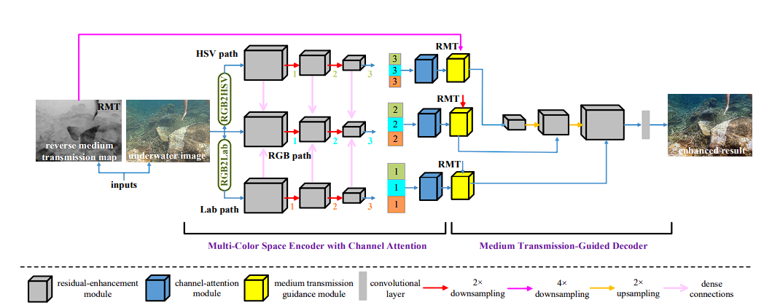
System Architecture

Slide 6

Demonstration

Slide 7
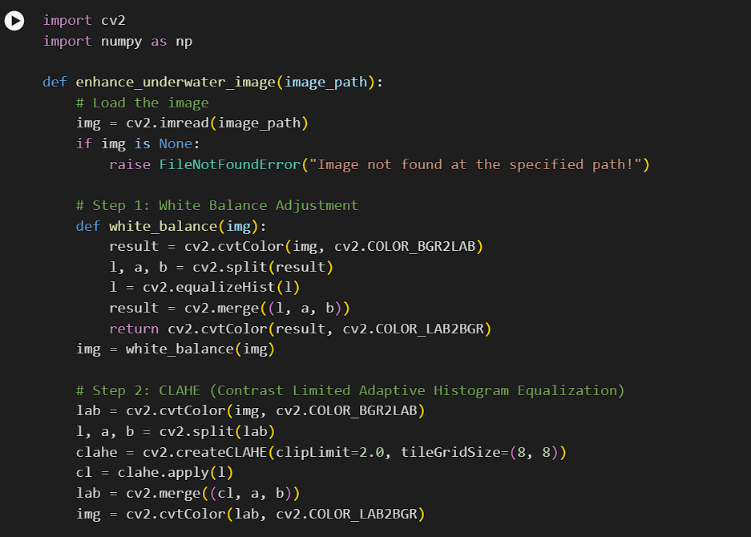
Demonstration

Slide 8
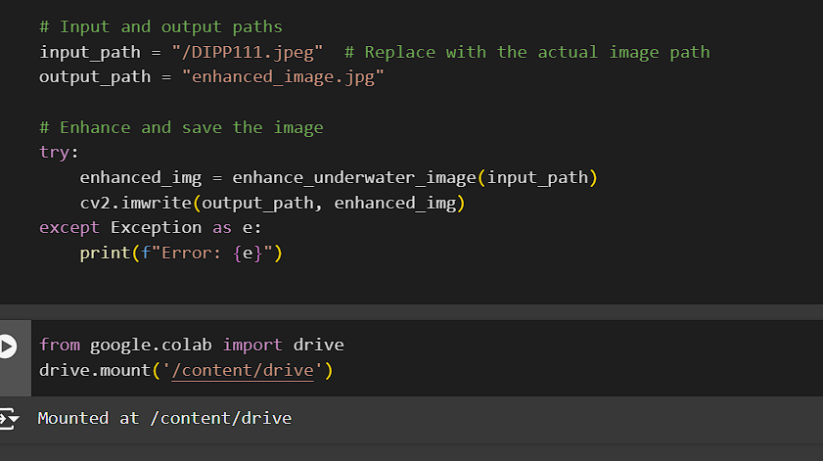
Demonstration

Slide 9
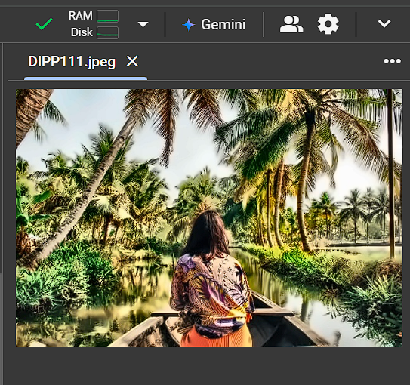

Demonstration

Slide 10
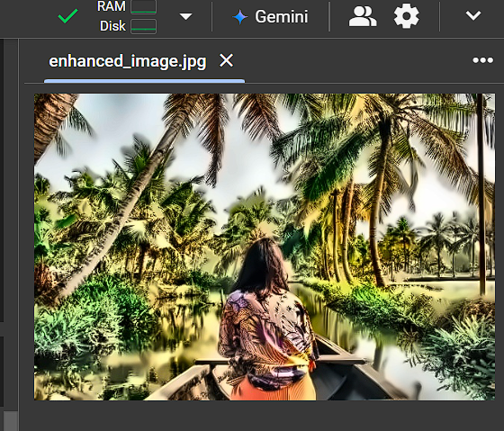

Demonstration

Slide 11
Conclusion
This project demonstrated a simplified approach to enhancing underwater images using basic digital image processing techniques such as white balance correction, histogram equalization, and noise reduction. By addressing the key challenges of underwater photography—color distortion, low contrast, and noise—this method successfully restores natural colors and improves image clarity.
The simplicity of this approach ensures it can be easily adapted for real-time applications in marine research, underwater robotics, and photography. Future developments could include integrating advanced deep learning techniques for more precise and adaptive image enhancement.

