Slide 1
CAPSTONE PROJECT
ONLINE MEDICAL CONSULTANT SYSTEM
GROUP 2

Slide 2
About us
SUPERVISOR:
NGUYỄN HUY HÙNG
TEAM LEADER:
TRẦN NGUYÊN TIẾN SỨ
TEAM MEMBER:
TRẦN CAO DANH
TRƯƠNG HẢI ĐĂNG (DROP OUT)
BÙI NGUYÊN TÍN (DROP OUT)

Slide 3
Scenario Problem
Propose our solution
Technologies
System Process Model
Work flows
Demo
Disadvantages
Future Plan

Slide 4
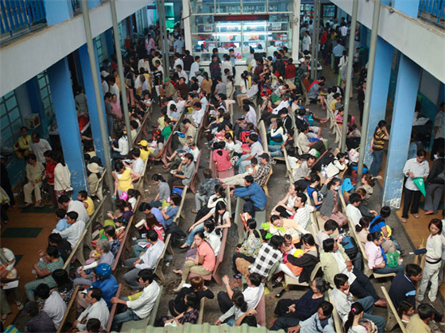
Scenario Problem
Nowadays, Vietnam hospitals usually are overwhelmed with patients.

Slide 5



Scenario Problem

Slide 6


Scenario Problem
Existing solutions in Viet Nam:

Slide 7
Scenario Problem
Disadvantage of current system:
Lack of interaction between patients and doctors
Hardly can provide high quality consulting service due to missing reliable resources (medical profile, allergy, immunization,…)
Patient cannot able to manage their own profile information, medical heath record

Slide 8

Propose our solution
We see that there are many cases that patients don’t need to go to the hospital quite often because those can easily conduct via internet.

Slide 9
Propose our solution
Advantages:
Interaction between patients and doctors.
Provide build medical profile online.
Patient can manage their own profile information, medical heath record.
Patient can see comment/rating doctor.

Slide 10

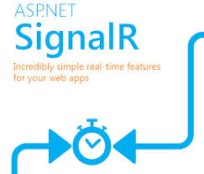



Technologies

Slide 11
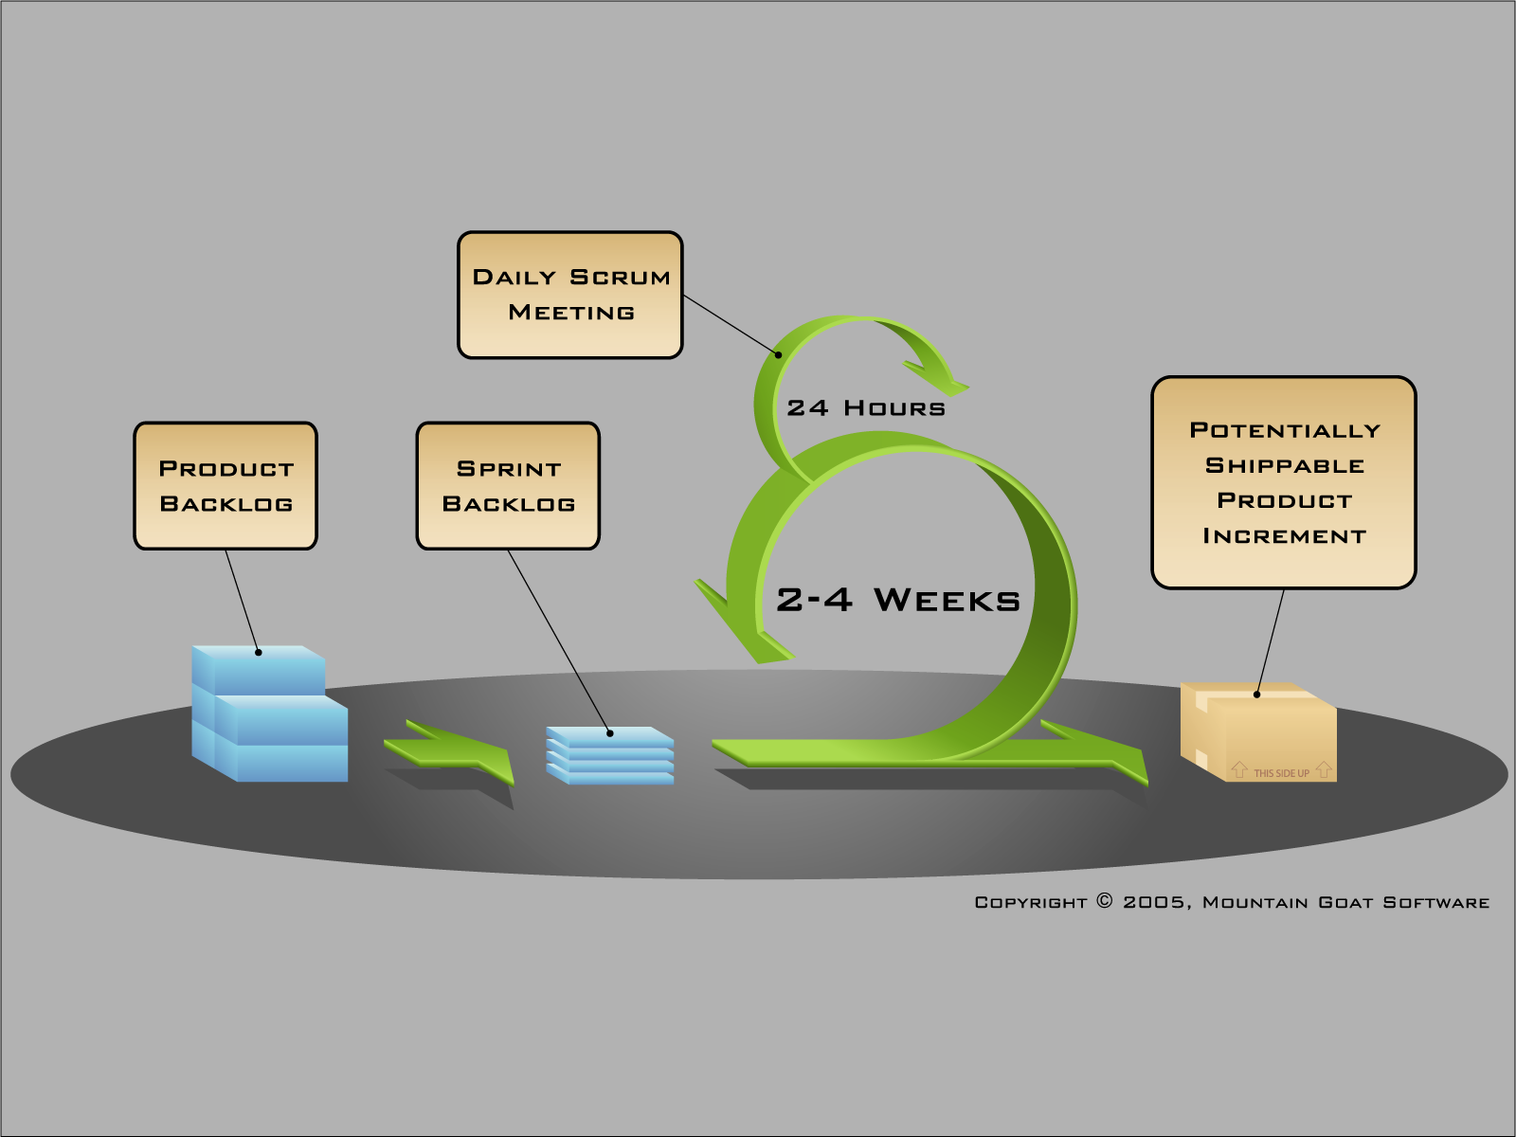
System Process Model

Slide 12

Work flows
Manage User
Manage Doctor
Search
Manage
Medical Profile
Create
Manage Medical Profile Template
Activate/Deactivate
Manage Medical Profile
Delete
Manage Film Types
Update
Manage Specialty Fields
Manage Comment

Slide 13

Work flows
Chat
Consult Online
Request webcam
Create
Update
Manage Patient
Create Medical Profile
Search
Medical Profile
View
Update
Comment - Rating
Comment

Slide 14

Work flows
Chat
Consult Online
Show webcam
View history
Medical Profile
View
Comment - Rating
Doctor
View
Personal Health Record
Edit

Slide 15
Demo

Slide 16
Disadvantages
The system is intended for using in one hospital.
This system not suitable for some patients.
This system doesn’t support yet:
Exporting medical profile.
Managing prescription.
Managing process of a hospital.
Custom layout for medical.
This system not intend to replace the current medical treatment processes in hospital.

Slide 17
Future Plan
The system is intended for using in link that hospital.
This system will support:
Exporting medical profile.
Managing prescription.
Managing process of a hospital.
Custom layout for medical.

Slide 18
Q & A

