Slide 1
ONLINE MEDICAL CONSULTANT SYSTEM
GROUP 2

Slide 2
About us
Supervisor:
NGUYỄN HUY HÙNG
Team Member
TRẦN NGUYÊN TIẾN SỨ
TRẦN CAO DANH

Slide 3
Agenda
Scenario Problem
Propose our solution
Technologies
System Process Model
Main features
Demo
Disadvantages
Future Plan

Slide 4
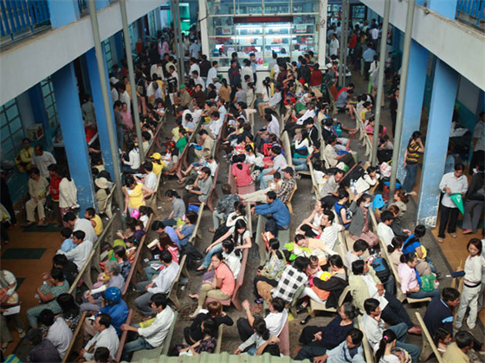
Scenario Problem
Nowadays, Vietnam hospitals usually are overwhelmed with patients^{[1]}.
Tinmoitruong (2012).
Bệnh viện quá tải… dân khổ.
http://kinhtemoitruong.vn/news/Moi-truong-suc-khoe/Benh-vien-qua-tai-dan-kho-389/.

Slide 5

Scenario Problem
Go to hospital not always a good choice due to
Travelling cost
Wasting time
Unsafeness^{[2]}
http://bestfinancenetwork.com/

Slide 6

Scenario Problem
Go to hospital not always a good choice due to
Travelling cost
Wasting time
Unsafeness^{[2]}
http://www.entrepreneur.com/
article/224090

Slide 7

Scenario Problem
Go to hospital not always a good choice due to
Travelling cost
Wasting time
Unsafeness^{[2]}
http://www.safetysign.com/products/
p6169/unsafe-area-do-not-enter-sign

Slide 8


Scenario Problem
Existing solutions in Viet Nam:

Slide 9
Scenario Problem
Disadvantage of current system:
Lack of interaction between patients and doctors
Hardly can provide high quality consulting service
Patient cannot able to manage their own profile information, medical heath record

Slide 10

Propose our solution
We see that there are many cases that patients don’t need to go to the hospital quite often because those can easily conduct via internet.
http://www.crshealthcareitgroup.com/

Slide 11
Propose our solution
Advantages:
Interaction between patients and doctors.
Provide way to build medical profile online.
Patient can manage their own profile information, medical heath record.
Patient can comment/rating for doctor.

Slide 12


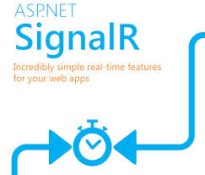




Technologies

Slide 13
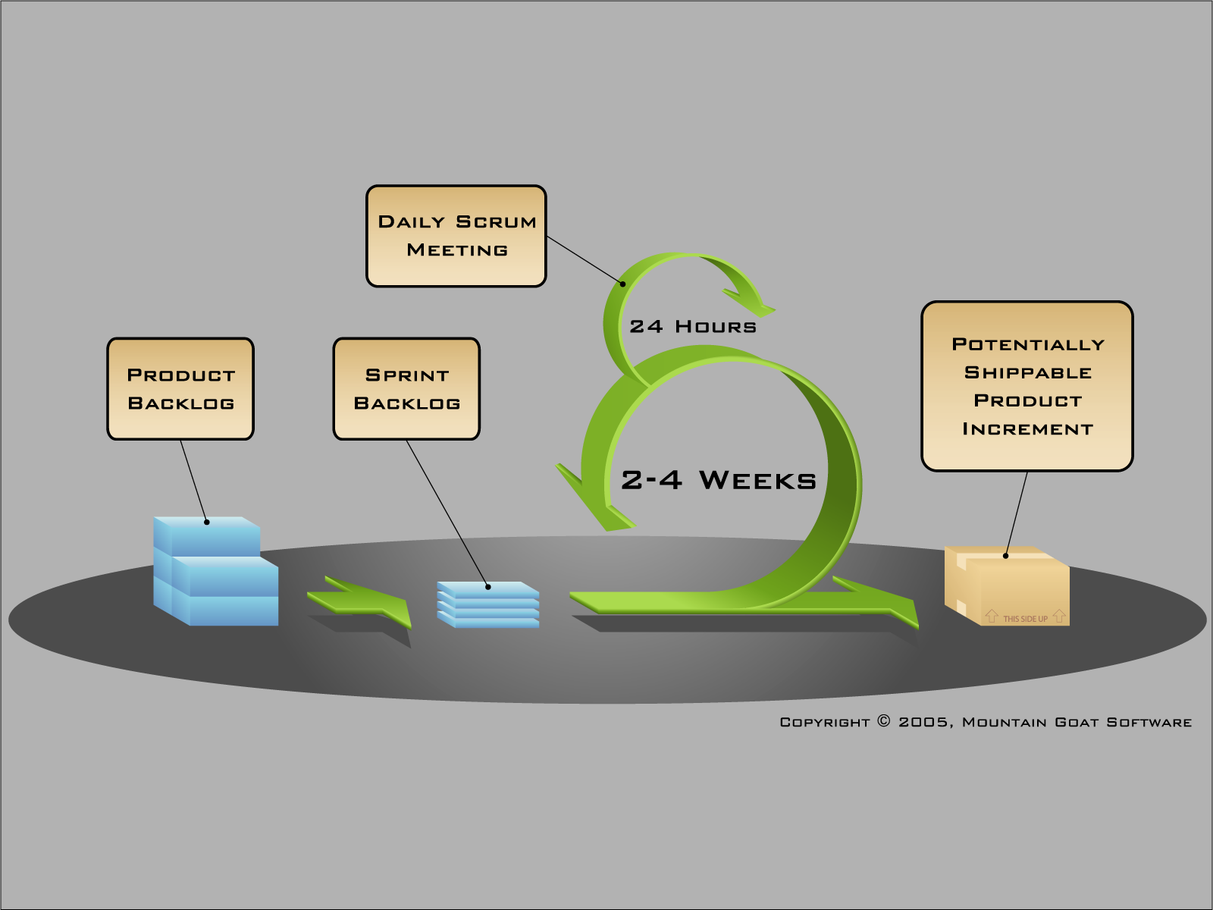
System Process Model
http://www.mountaingoatsoftware.com/agile/scrum/overview (Scrum Overview for Agile Software Development)

Slide 14

Main features
Manage Medical Profile Template
Manage User
Manage Doctor
Manage
Medical Profile
Manage Film Types
Manage Specialty Fields
Manage Comment

Slide 15

Main features
Chat
Consult Online
Request webcam
Manage Patient
Manage Medical Profile
Doctor
View Comment /Rating

Slide 16

Main features
Chat
Consult Online
Show webcam
View history
Medical Profile
View
Comment - Rating
Doctor
Patient
Manage Personal Health Record

Slide 17
Demo

Slide 18
1. Create Medical Profile^{[3]}
Admin defines medical profile template
Doctor creates medical profile for patient
Patient views medical profile

Slide 19
2. Consult With Doctor
Patient requests chatting with doctor
Doctor replies with patient
Doctor update medical profile
Patient rates/ comments on doctor

Slide 20
Disadvantages
The system is intended for using in one hospital or clinic. This system doesn’t support yet:
Exporting medical profile.
Managing prescription.
Managing process of a hospital.
Custom layout for medical.
Tracking changes in a medical profile
This system not intend to replace the current medical treatment processes in hospital.

Slide 21
Future Plan
The system is intended for many hospitals to share their medical profile.
This system will support:
Exporting medical profile.
Managing prescription.
Managing process of a hospital.
Custom layout for medical.
Tracking changes in a medical profile

Slide 22
Q & A

Slide 23
Reference
[1]http://kinhtemoitruong.vn/news/Moi-truong-suc-khoe/Benh-vien-qua-tai-dan-kho-389/
[2]http://www.nhandan.com.vn/suckhoe/tieu-diem/item/22586202-bat-an-nhu-vao%E2%80%A6-benh-vien.html
[3]Reference Appendix: Medical Template Demo

