Slide 1

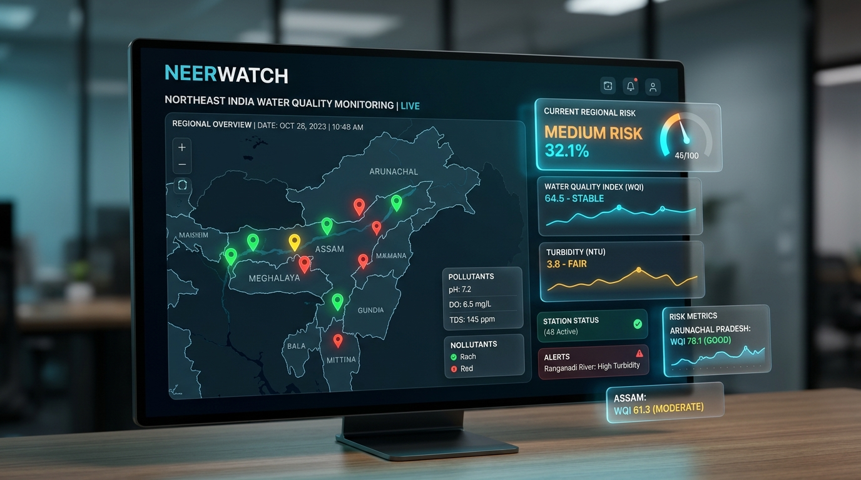
HACKATHON // UNSTOP INNOVATION TRACK
NeerWatch 🌊
AI-Powered Northeast India Water Quality & Epidemic Risk Monitoring Platform
Predicting Contamination. Preventing Outbreaks. Empowering Communities with an Apple-Grade Liquid Glass Interface.
STATUS: WORKING PROTOTYPE | XGBOOST + SHAP | NODE.JS NATIVE
Live Prototype: http://localhost:8000 • Branch: main • Northeast India Catchment Focus

Slide 2
01 // PROBLEM STATEMENT
The Crisis in Northeast India's Water Catchments
Topographical Isolation
• 8 remote states where mountainous terrain collapses during monsoon floods.
• Road & bridge cut-offs sever access to standard testing laboratories.
• Over 40 million citizens vulnerable to sudden catchment contamination.
The 2-Week Surveillance Lag
• Water contamination strikes in hours during flash floods.
• Epidemic reporting relies on hospital bed admissions 14-21 days later.
• By the time an outbreak is declared, thousands are already infected.
• Acute Diarrheal Diseases, Cholera, and Hepatitis spread unchecked.
Resource Scarcity & Black-Box AI
• District health teams have severely limited mobile testing kits.
• Traditional models act as black boxes with no explainable rationale.
• Medical officers cannot issue public boil-water advisories without clear chemical evidence.

Slide 3
02 // VALUE PROPOSITION
NeerWatch: From Reactive Response to Proactive Surveillance
Continuous Regional Telemetry
• Aggregates 44 geo-tagged monitoring stations across 8 Northeast states.
• Tracks key chemical indicators: pH, Turbidity, DO, BOD, and Coliform.
Explainable Machine Learning
• XGBoost risk model calculates exceedance probability in real-time.
• SHAP tree attribution reveals the exact physical & chemical drivers.
Autonomous Priority Dispatch
• Automated ranking flags urgent stations needing physical verification.
• Directs limited testing kits to the top 10% highest-threat clusters.
Apple-Grade Liquid Glass UI
• VisionOS frosted glass aesthetics with zero browser lag (60/120fps).
• Interactive Leaflet maps, live inspection drawers, and CSV analyzers.

Slide 4
03 // TECHNICAL ARCHITECTURE
Multi-Tier System Architecture & Workflow
1. Ingestion Layer
• Station Catalogs (44 locations)
• Historical Records (history_v2.json)
• Verified Field Logs (verification.json)
• Ad-hoc Regional Lab CSVs
• Precipitation & flood indices
2. AI/ML Engine
• Gradient-Boosted Decision Trees (XGBoost v2)
• Contamination Exceedance Risk [0.0 - 1.0]
• Verification Urgency Score (Rank 1-44)
• SHAP Local Feature Explainability
3. Backend Microservice
• Native Node.js HTTP Server (server.mjs)
• Zero external npm runtime dependencies
• Instant startup, <50MB RAM footprint
• RESTful Endpoints: /api/v1/locations, /risk, /verify
4. Liquid Glass UI
• Hardware-accelerated CSS Custom Properties
• Leaflet.js Geospatial Cartography
• Live Detail & Verification Drawer
• 60fps compositor isolation (zero GPU lag)

Slide 5
04 // AI & AGENTIC INNOVATION
Agentic Verification Loop & SHAP Explainability
Why Explainable AI (SHAP)?
• Medical officers will not dispatch emergency teams based on a black-box percentage.
• SHAP calculates exact cooperative game-theory contributions for every sample:
• • Coliform Spike: +0.42 risk escalation
• • Turbidity Exceedance: +0.31 risk escalation
• • High Dissolved Oxygen: -0.18 protective buffer
• Enables targeted remediation: chlorination vs. mechanical filtration vs. flood rerouting.
The Autonomous Agentic Loop
• Step 1: Telemetry stream evaluated by XGBoost Inference Engine.
• Step 2: Anomaly detected (Outbreak Precursor flagged as HIGH/CRITICAL).
• Step 3: Verification Agent surfaces ranked priority alert to district health officer.
• Step 4: Field worker collects physical sample and conducts rapid test kit.
• Step 5: Verified findings submitted directly in browser verification drawer.
• Step 6: Ground truth logged into verification.json for continuous model calibration.

Slide 6
05 // LIVE PRODUCT SHOWCASE
Working Prototype: Apple Liquid Glass Experience
Interface Highlights
• VisionOS / Apple-Inspired Glassmorphism:
• • Refined backdrop-filter blur(14px) optics.
• • Clean SF Pro typography & high-contrast badges.
• Interactive Northeast Cartography:
• • 44 color-coded risk markers with state filters.
• • Auto-centering Leaflet viewport with click drill-down.
• Drill-Down Verification Drawer:
• • Real-time parameter gauges and disease curves.
• • Integrated field sample submission form.
• Zero-Lag Performance Tuning:
• • Compositor-only transforms for smooth 60fps scrolling.

Slide 7
06 // TECH STACK & ENGINEERING
Built for Speed, Reliability & Zero Bloat
Frontend Excellence
• Vanilla HTML5 / Modern ES6+
• Vanilla CSS3 Design System
• Leaflet.js 1.9.4 Cartography
• GPU-Composited Animations
• Zero external framework bloat
• Responsive desktop & mobile view
Backend Microservice
• Node.js Native HTTP Standard Library
• ZERO npm runtime dependencies
• Blazing fast startup (<100ms)
• Memory footprint < 50MB RAM
• Clean RESTful API Architecture
• JSON/GeoJSON/CSV ingestion
AI & Version Control
• Python, XGBoost v2, SHAP
• Scikit-Learn feature transformers
• Git Repository on branch main
• Comprehensive README & docs/
• Portable zip distribution package
• Ready for immediate cloud deployment

Slide 8
07 // SOCIETAL IMPACT
Measurable Societal & Public Health Impact
40% - 60% Faster Intervention
• Detects contamination precursors weeks before clinical cases peak.
• Prevents pediatric waterborne morbidity (Diarrhea, Cholera, Typhoid).
Optimized Resource Allocation
• Directs limited testing kits to highest-yield contamination zones.
• Reduces wasteful blanket testing in low-risk remote catchments.
Jal Jeevan Mission (JJM) Alignment
• Direct digital compliance with Har Ghar Jal water quality surveillance.
• Empowers District Water & Sanitation Missions (DWSM).
UN Sustainable Development Goals
• SDG 3: Good Health and Well-Being for remote rural populations.
• SDG 6: Clean Water and Sanitation through proactive intelligence.
• SDG 11: Sustainable and Resilient Himalayan River Communities.

Slide 9
08 // SCALABILITY & ROADMAP
Roadmap: From Working Prototype to Pan-India Network
Phase 1: Current
• 44 Northeast Stations
• XGBoost Priority Scoring
• SHAP Explanations
• Apple Liquid Glass UI
• Field Verification Form
Phase 2: IoT Mesh
• Solar-powered ESP32 buoys
• LoRaWAN long-range telemetry
• Sub-hourly sampling feeds
• Automated sensor calibration
Phase 3: Alerts
• Automated WhatsApp push
• SMS to Gram Panchayats
• Multilingual voice alerts
• ASHA worker mobile app
Phase 4: Satellite
• ISRO precipitation radar
• Sentinel-2 turbidity mapping
• Basin-wide flood modeling
• Pan-India scale (28 states)

Slide 10
09 // CONCLUSION & Q&A
NeerWatch: Clean Water, Healthier Communities
Submission Summary
• • Working Prototype Live: http://localhost:8000
• • Git Repository: Branch main with clean commit history
• • Zero Backend Dependencies: Starts instantly with node backend/server.mjs
• • Complete Submission Package: Dossier, Pitch Deck, Video Script & Zip
• • Measurable Impact: Preventing epidemics before they start.
Ready for Judges' Evaluation
• Thank you to the Unstop jury and organizers!
•
• Key Differentiators:
• 1. Grounded in Northeast India's unique flood hydrology.
• 2. Mathematical trust via SHAP game-theoretic explainability.
• 3. Autonomous agentic verification loop connecting AI to field action.
• 4. Modern Apple-grade UI tuned for buttery-smooth interaction.
•
• We welcome your questions!

