Slide 1

Presented By: Team Members: 1.K.Pranitha - 24251A05E6 2.M.Sneha-24251A05F1 3.P.Vaishnavi-24251A05F6
G. NARAYANAMMA INSTITUTE OF TECHNOLOGY & SCIENCE
AUTONOMOUS (For Women)
Shaikpet, Hyderabad ,Telangana
DEPARTMENT OF COMPUTER SCIENCE AND ENGINEERING
IoT-Based Non-Destructive Invasive Species Suppression System
Batch No:C8
Guide:
Dr. Jayashree S.Patil
Associate Professor

Slide 2
Table of Contents
Introduction
Literature Survey
Existing system
Problem Statement
Proposed system
Objectives
Methodology
Technologies
Results

Slide 3
Introduction
Freshwater bodies such as lakes, ponds, and reservoirs play a vital role in drinking water supply, agriculture, biodiversity, and climate balance.
Rapid urbanization, industrial discharge, and nutrient runoff have caused serious degradation of aquatic ecosystems.
One of the major consequences of this degradation is increased turbidity, reduced light penetration, and uncontrolled algal growth.
These changes disturb dissolved oxygen levels and negatively impact native aquatic species.
Existing monitoring methods are mostly manual, periodic, and unsustainable in nature.
Actions are usually taken only after visible damage occurs, which leads to irreversible ecosystem loss.
Many current solutions rely on chemical or mechanical removal techniques that can harm native species.
Hence, there is a strong need for a real‑time, continuous, and non‑destructive monitoring system.
The proposed project introduces an IoT‑based monitoring system using ESP32 and environmental sensors.
The system focuses on early detection of ecosystem imbalance and supports sustainable, eco‑friendly intervention methods.

Slide 4
Literature Survey (List the reference papers in year-wise order, starting with the most recent year first, followed by earlier years.)
S.No | Tittle of the Journal with Published Year | Author’s | Method | Outcomes | Limitations
1 | AI‑Enabled IoT Framework for Real‑Time Water Quality Monitoring | Lokman et al. | Multi‑sensor IoT system with AI‑based anomaly detection. | Enabled early contamination detection and intelligent monitoring. | Requires higher computational resources and cloud connectivity.
2 | Multi‑Sensor IoT Architecture for Environmental Monitoring | Wang et al. | Sensor fusion using ESP‑based microcontrollers. | Improved real‑time environmental parameter monitoring. | Limited validation for large ecosystems.
3 | Machine Learning for Algal Bloom Prediction Using Water Quality Sensors | Xia et al. | ML models trained on turbidity and environmental data. | Early prediction of harmful algal bloom conditions. | Requires historical dataset for accurate prediction.
4 | Low‑Cost IoT Water Quality Monitoring System Using ESP32 | Rahman et al. | ESP32 integrated with turbidity, temperature, and pH sensors. | Demonstrated affordable real‑time monitoring prototype. | Small‑scale implementation only
5 | IoT‑Based Smart Water Quality Monitoring System | Sharma et al. | Multi‑sensor monitoring using Arduino/ESP systems. | Continuous remote monitoring of water parameters. | No predictive or automated control mechanism

Slide 5
Existing system
The existing water quality monitoring systems rely mainly on manual sampling or laboratory testing. These methods are time‑consuming, expensive, and provide delayed results. In some cases, chemical treatments are used to control algae or pollution, which can unintentionally harm native aquatic organisms.
Technologies Used:
Manual sensors
Periodic lab analysis
Chemical‑based intervention
Limitations:
No real‑time monitoring
Late detection of ecological imbalance
Destructive impact on native species
High operational cost

Slide 6
Problem statement
Freshwater ecosystems are increasingly threatened due to the absence of continuous, real‑time monitoring systems, resulting in late detection of water quality degradation. Existing solutions are mostly reactive and often involve destructive interventions that harm native species. Therefore, there is a need for a sustainable, real‑time, and non‑destructive monitoring system to identify early signs of ecosystem imbalance and support eco‑friendly corrective actions.

Slide 7
Proposed system
The proposed system is an IoT‑Based Intelligent System for Real‑Time Aquatic Ecosystem Monitoring that uses multiple sensors connected to an ESP32 microcontroller to continuously monitor turbidity, light penetration, temperature, and air quality around the water body.
The system focuses on early detection and prevention rather than damage control. Instead of chemical treatment, it supports non‑destructive corrective actions such as controlled aeration and environmental alerts, ensuring that native species remain unaffected.
Key Features:
Real‑time monitoring
Early ecosystem degradation detection
Non‑destructive intervention support
Low‑cost and scalable design

Slide 8
Objectives
To design and develop a low‑cost IoT‑based aquatic monitoring system for early detection of algae bloom conditions.
To monitor key environmental parameters such as turbidity, temperature, light intensity, and air quality using sensors.
To analyze sensor data using ESP32 and classify algae bloom risk levels (Low, Medium, High).
To implement automated preventive control using actuators like water pumps and cooling fan.
To demonstrate a non‑chemical, sustainable, and beginner‑friendly solution for aquatic ecosystem protection.

Slide 9
Implementation
Low-Cost IoT-Based Aquatic Monitoring System
This project focuses on designing and developing a low-cost IoT-based aquatic monitoring system for the early detection of algae bloom conditions in ponds, lakes, and small water bodies. Algae blooms can cause serious damage to aquatic ecosystems by reducing dissolved oxygen, blocking sunlight, and harming fish and other organisms. Traditional monitoring systems are often expensive and require frequent manual checking. To solve this problem, this project uses affordable sensors, the ESP32 microcontroller, and simple automation techniques to provide continuous monitoring. The system is cost-effective, reliable, and suitable for educational as well as real-world small-scale applications.

Slide 10
Monitoring Environmental Parameters
The system continuously monitors important environmental factors that directly influence algae growth and water quality. Turbidity sensors measure the cloudiness of water caused by suspended particles, which can indicate pollution or bloom formation. Temperature sensors detect changes in water temperature, as warmer water supports faster algae growth. Light intensity sensors measure sunlight exposure, which is essential for algae photosynthesis. Air quality monitoring helps understand the surrounding environmental conditions that may affect the aquatic system. By collecting real-time data from all these sensors, the system provides accurate and timely information for better decision-making.

Slide 11
Sensor Data Analysis Using ESP32
The ESP32 microcontroller acts as the main processing unit of the system. It receives data from all connected sensors, processes the readings, and compares them with predefined threshold values to identify possible algae bloom conditions. Based on this analysis, the system classifies the algae bloom risk into three categories: Low Risk, Medium Risk, and High Risk. This classification makes it easier for users to understand the water condition quickly without technical knowledge. The ESP32 can also display the results on a monitoring platform and support remote observation through IoT connectivity.

Slide 12
Automated Preventive Control
To reduce the chances of harmful algae bloom formation, the system includes automated preventive control using actuators such as a water pump and a cooling fan. When sensor values indicate unsafe conditions, the water pump automatically improves water circulation, helping to reduce stagnant water where algae grow easily. The cooling fan helps lower the temperature when excessive heat is detected, preventing rapid algae growth. This automation improves system efficiency, reduces human effort, and ensures a faster response to environmental changes. It also helps maintain a healthier aquatic environment continuously.

Slide 13
Sustainable and Beginner-Friendly Solution
This project provides a non-chemical, eco-friendly, and sustainable method for protecting aquatic ecosystems. Instead of using chemical treatments that may harm fish, plants, and water quality, the system focuses on prevention through smart monitoring and automatic control. The design is simple, beginner-friendly, and easy to implement using commonly available components such as ESP32, sensors, relays, and basic actuators. It is highly suitable for students, researchers, aquarium owners, and small pond managers. This project also helps promote practical learning in IoT, embedded systems, and environmental protection while supporting long-term sustainability.

Slide 14
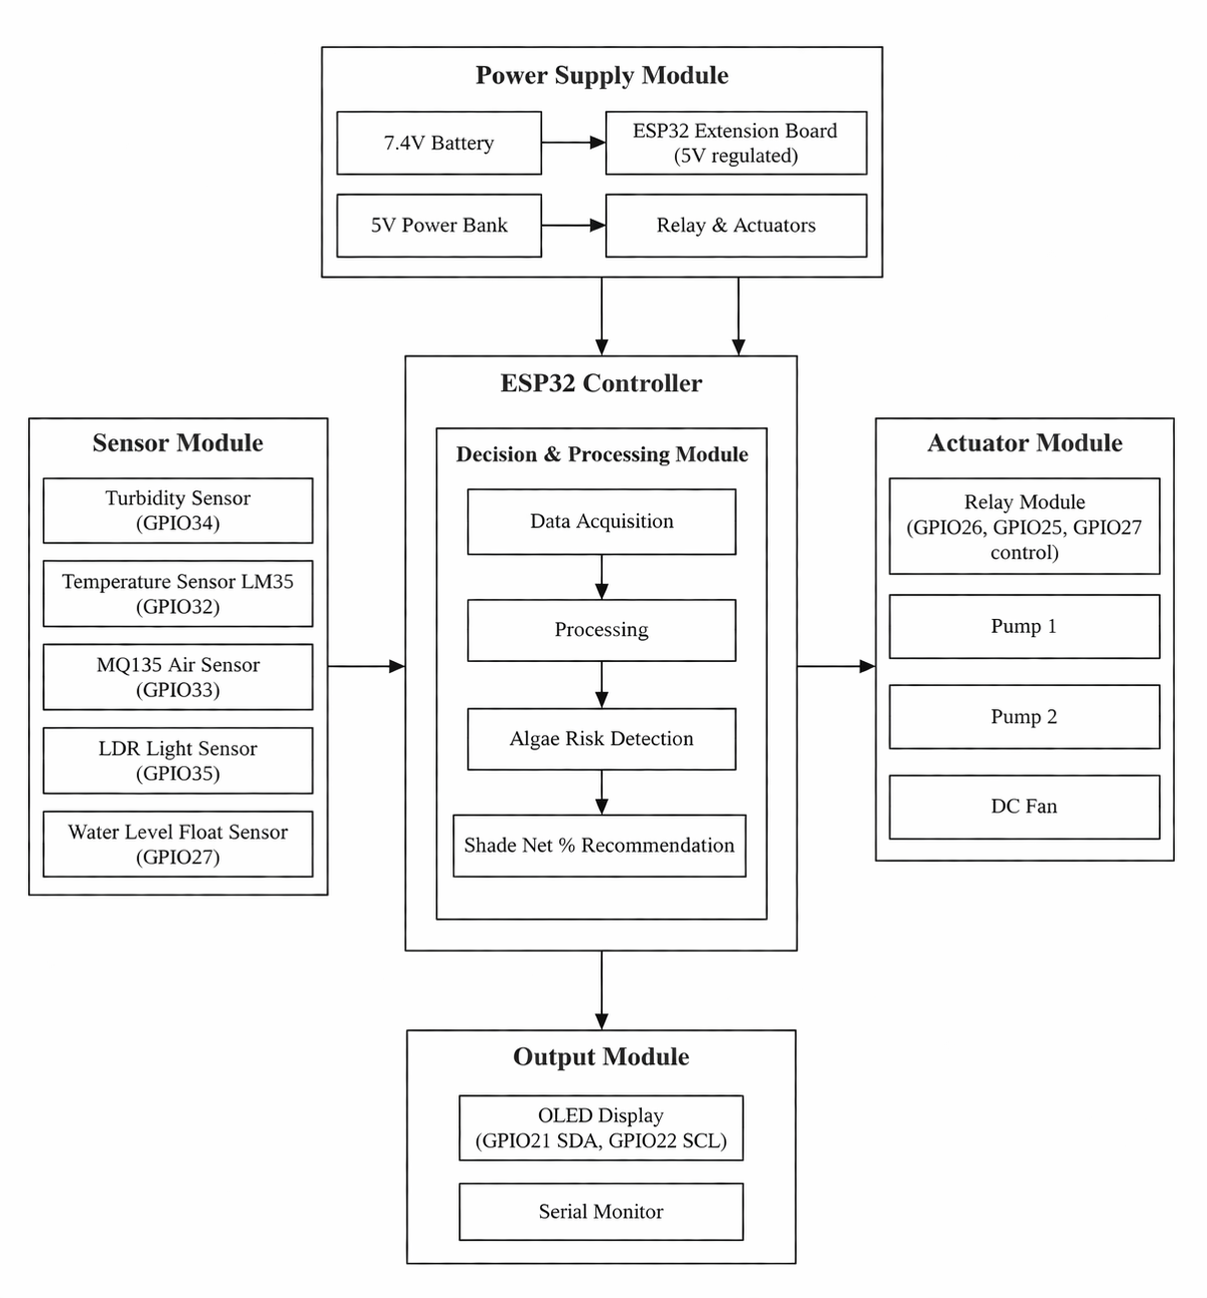

Slide 15
Methodology
System Flow:
Sensor Data Collection → Signal Conditioning → ESP32 Processing → Serial Monitor / Output Display → Ecosystem Health Evaluation
→ Actuator Activation (Relay / Pump / Aerator)
Modules:
Sensor Module (Turbidity, LDR, Temperature, Gas, Float)
Processing Module (ESP32)
Monitoring Module (Arduino Serial Monitor)
Decision Support Module (Alert / Control Logic)

Slide 16
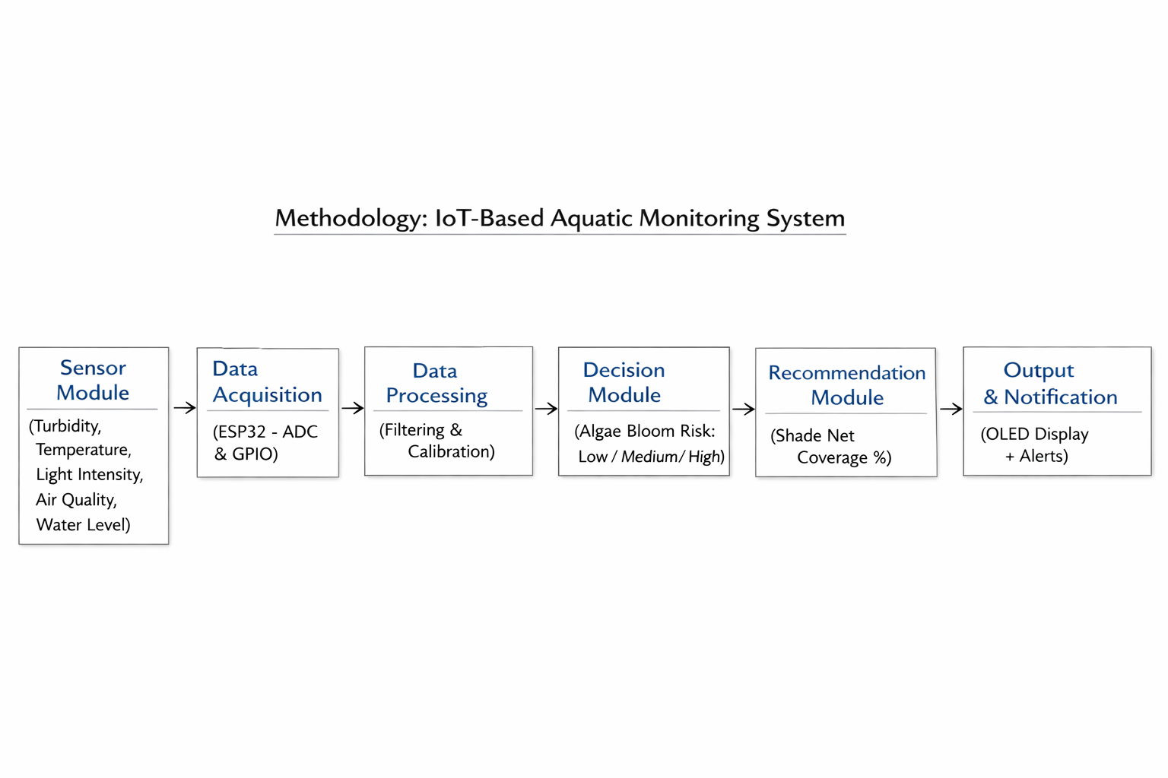
Methodology Diagram

Slide 17
Technologies
Hardware:
ESP32 Microcontroller
Turbidity Sensor
Light Sensor (LDR)
Gas Sensor (MQ-135)
Float Sensor
Temperature Sensor (DHT)
Relay Module
DC Water Pumps
DC Fan
Software:
Arduino IDE
Embedded C / C++
Serial Communication

Slide 18
Results
Real‑time sensor readings were successfully displayed on the Arduino Serial Monitor.
Turbidity and light intensity variations were clearly observed.
ESP32 showed stable and continuous data acquisition.
Observations:
Early changes in water clarity can be detected effectively.
The system supports continuous, real‑time monitoring.
Monitoring method is non‑destructive and safe for native species.
Actuator integration is planned as a future enhancement.

Slide 19
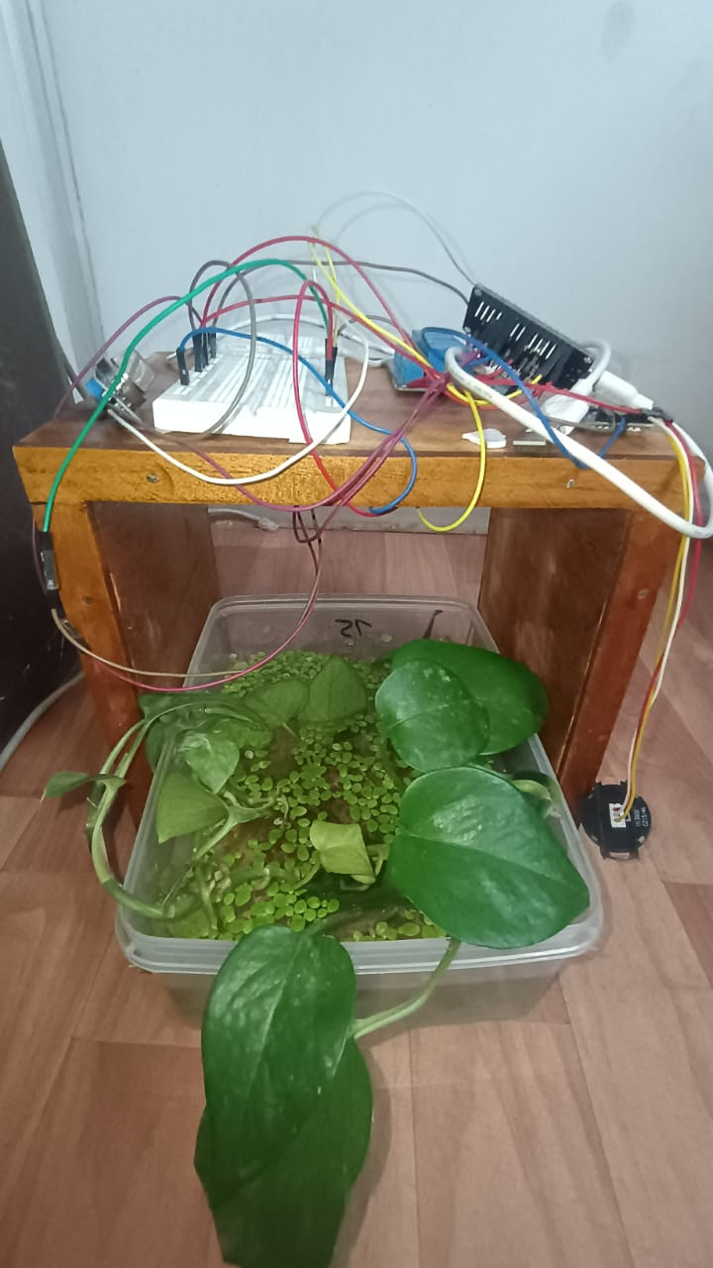
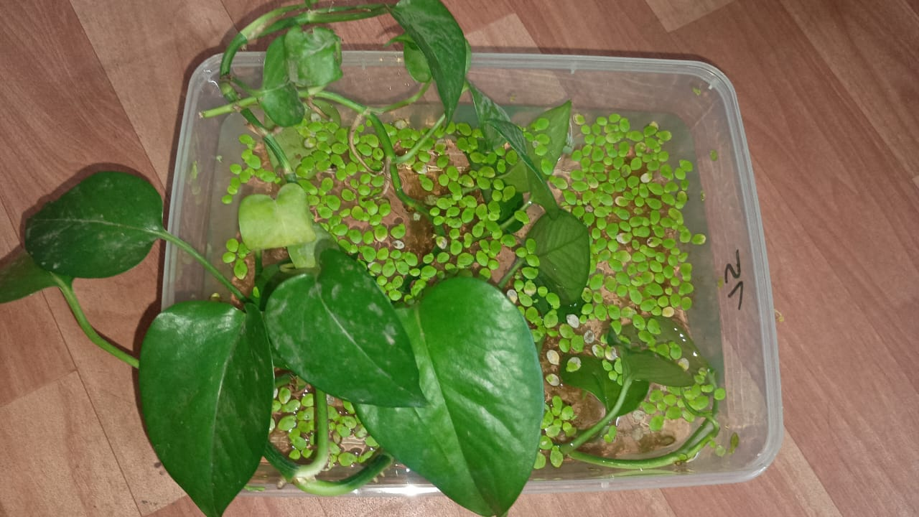
Fig 1: Demonstration of the Aquatic System with Money plant as Native species and DuckWeed as Invasive species
Fig 2: Non-Destructive Invasive species Suppression system by monitoring the environmental parameters through sensors and micro controller

Slide 20


Output 1- Low risk
Output 2-Medium risk

Slide 21

Functioning of the Actuators

Slide 22
References
Lokman et al., AI‑IoT Based Water Quality Monitoring, 2025.
Xia et al., Machine Learning for Algal Bloom Prediction, 2024.
Wang et al., Multi‑Sensor IoT Environmental Monitoring System, 2025.

Slide 23
Thank you

