Slide 1



Exploring German Car Listings
Welcome, Are you all curious about the German car market? My presentation explores the diversity of car models across different car makes, popular car models, price ranges, and correlations between car features. Discover valuable insights that can assist in making informed decisions.
by Palash Bhagwatkar

Slide 2
The Number of Unique Models per Make
Each car make offers various car models. Our bar chart provides an overview of the number of unique models per car make. By comparing the diversity of car models across different car makes, you can easily identify which brands provide a wider range of vehicle choices.
Volkswagen
Mercedes-Benz
BMW
54 unique models
124 unique models
73 unique models

Slide 3
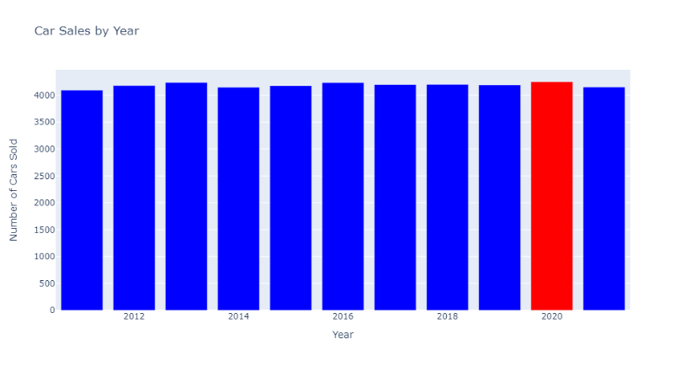
Best Year For Car's Sales
The bar chart visualizes the number of cars sold in each year, allowing us to easily identify trends and patterns in car sales over different years. It clearly presents the year on the x-axis and the corresponding number of cars sold on the y-axis, making it user-friendly for audiences to comprehend.

Slide 4
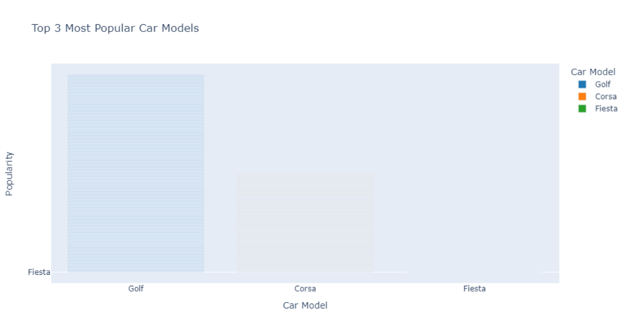
Popular Car Models in Germany
Are you curious about the most popular car models in Germany? Our bar chart shows the top 3 most popular car models in the dataset. By recognizing the most sought-after car models, you can gain insights into which vehicles are currently in demand.

Slide 5
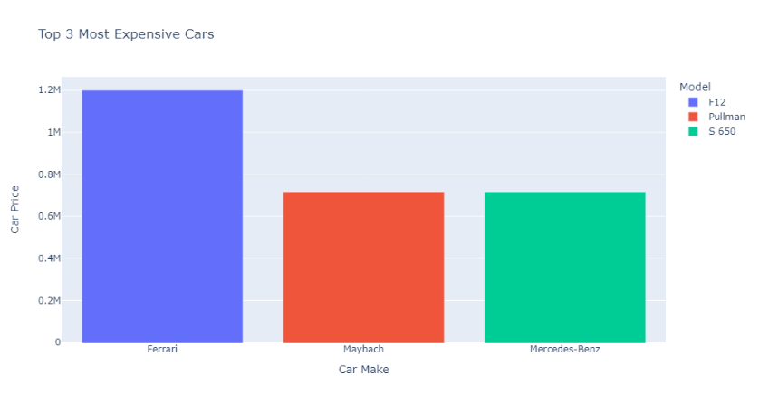
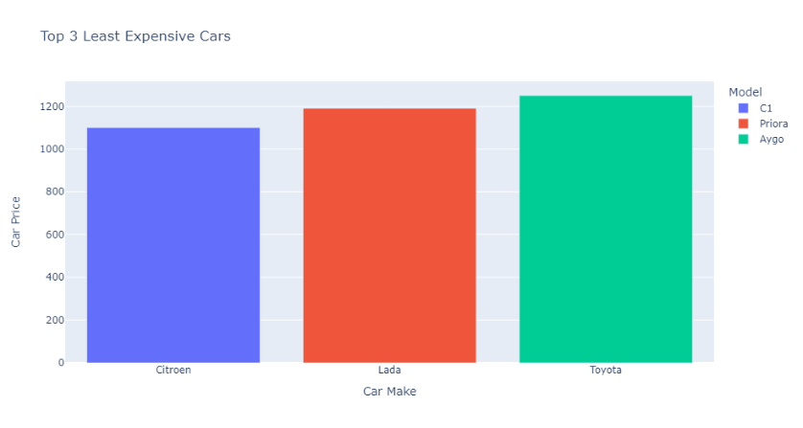
Most Expensive and Least Expensive Cars
Our horizontal bar chart illustrates the most expensive and least expensive cars in the dataset. By understanding the range of car prices, you can identify which make and model fits your budget best.
Most Expensive
Least Expensive
Ferrari F12: €1199900
Citroen C1: €1100
Maybach Pullman: €717078
Lada Priora: €1190
Mercedes-Benz S 650: €717078
Toyota Aygo: €1250

Slide 6
Yearly Percentage Change in Average Car Price and Mileage
Our line chart showcases the yearly percentage change in the average car price and mileage. By comparing these trends, you can see how car prices and mileage have evolved over the years.
2013 - 2016
Between 2013 and 2016, car prices began to increase gradually, while mileage decreased more sharply.
1
2
3
2010 - 2013
2016 - 2020
In the early 2010s, car prices remained stable while mileage decreased at a steady rate.
From 2016 onwards, car prices continued to rise, while mileage decreased at a slower rate.

Slide 7
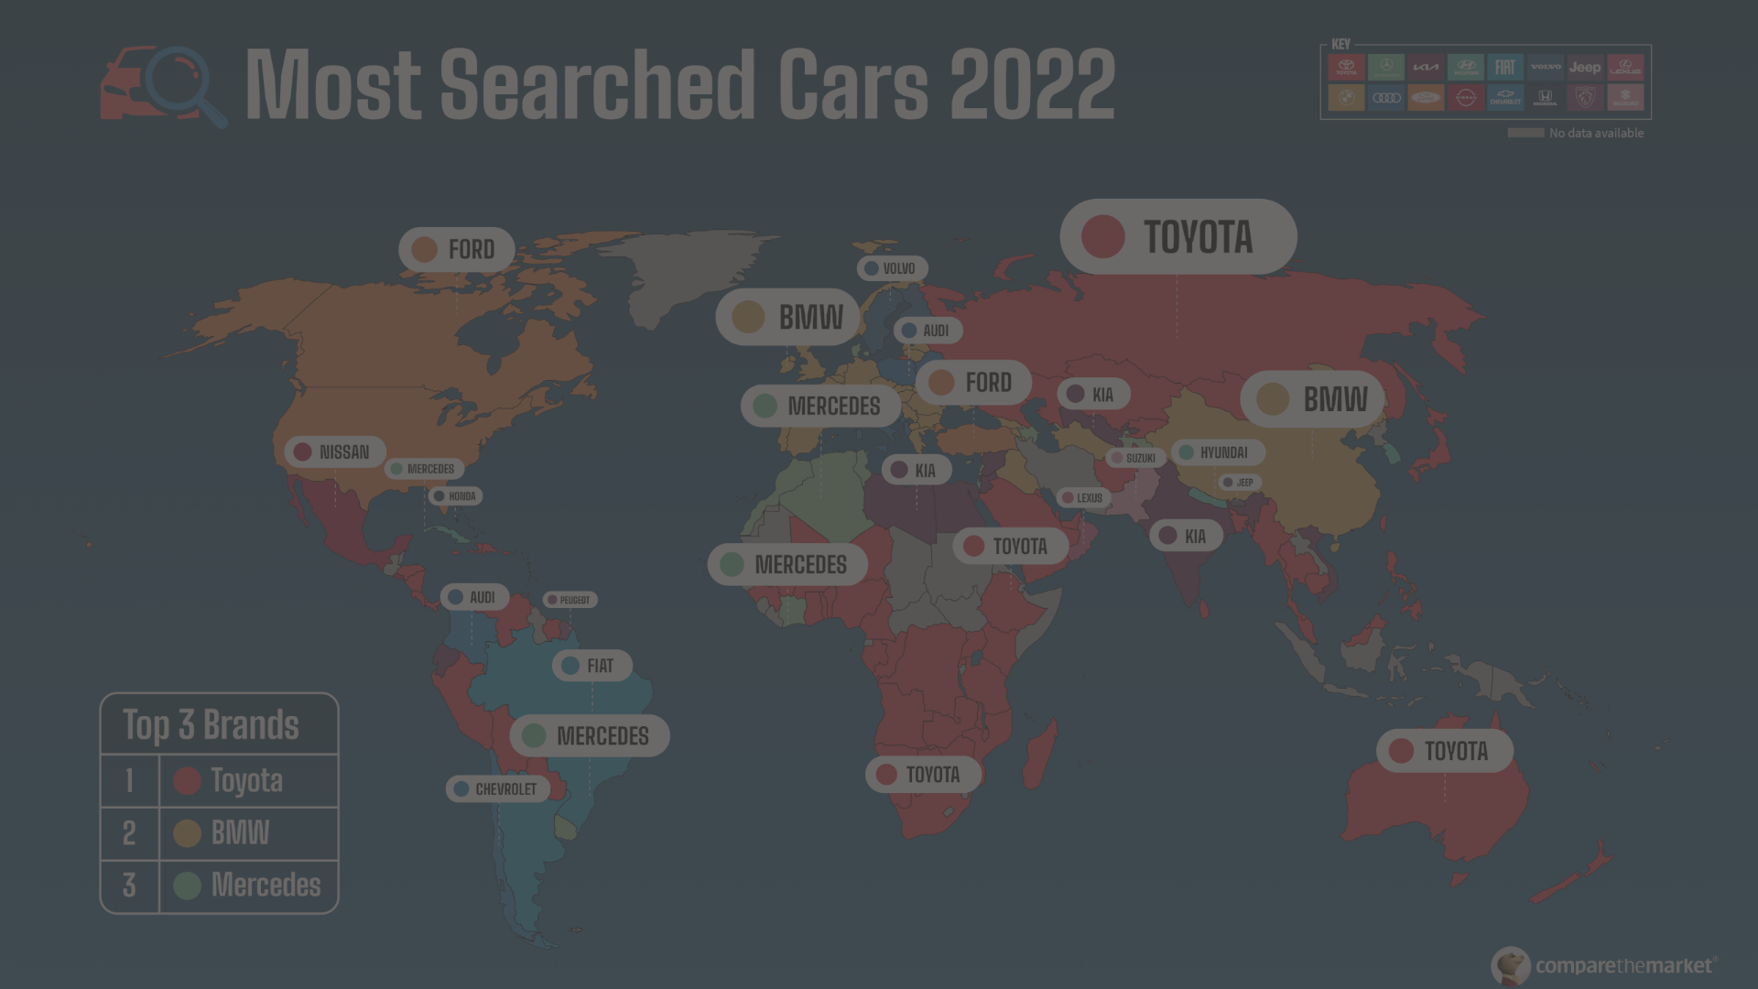
Most Popular Car Makes
This bar chart showcases the top 10 most popular car makes in the dataset. By analyzing the number of listings for each car make, you can identify which brands are the most dominant in the marketplace.
1
Volkswagen
2
Audi
3
BMW
35% of listings
12% of listings
10% of listings

Slide 8
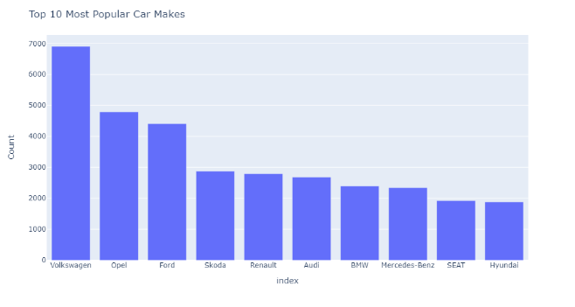
Top 10 Most popular Car Makes
This slide features a bar chart showcasing the top 10 most popular car makes in the dataset.
The height of each bar corresponds to the number of listings for each car make.
The chart enables viewers to see the dominant car makes in the dataset.

Slide 9
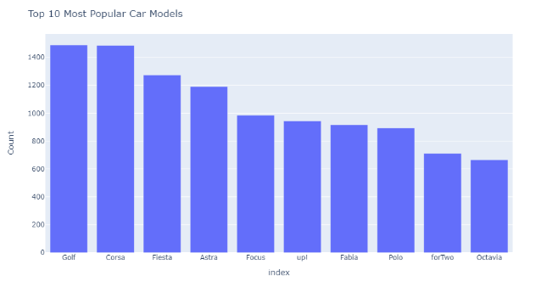
Top 10 Most Popular car Models
This slide features a bar chart showcasing the top 10 most popular car models in the dataset.
The height of each bar corresponds to the number of listings for each car model.
The chart enables viewers to see the dominant car models in the dataset.

Slide 10
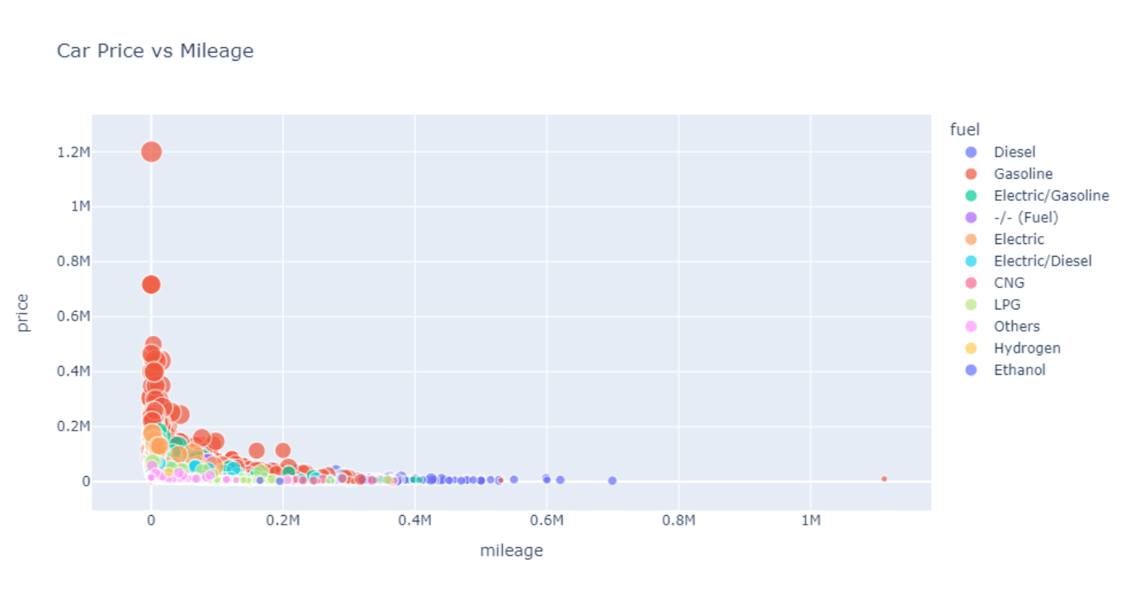
Car Price vs. Mileage
The scatter plot below depicts the relationship between car prices and mileage for each car listing in the dataset. By analyzing this data, it's possible to identify patterns between a car's price and its mileage.

Slide 11
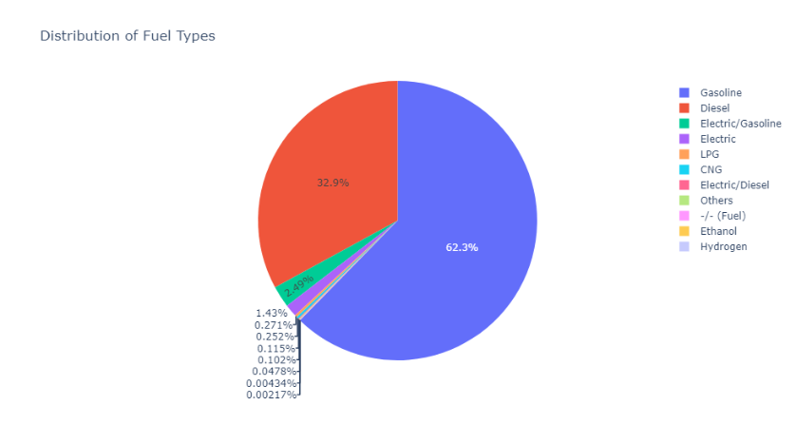
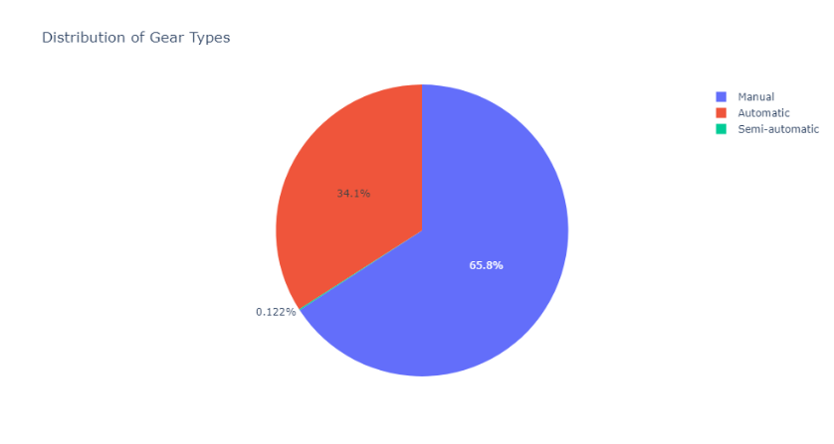
Distribution of Fuel Types and Gear Types
Our pie charts illustrate the distribution of different fuel and gear types among the car listings. Understanding this data can help you identify the most common fuel and gear types, which can be helpful in making informed decisions.
Distribution of Fuel Types
Distribution of Gear Types
Gasoline: 62.3%
Manual: 65.8%
Diesel: 32.9%
Automatic:34.1%
Others: 4.8%
Semi-automatic:0.122%

Slide 12
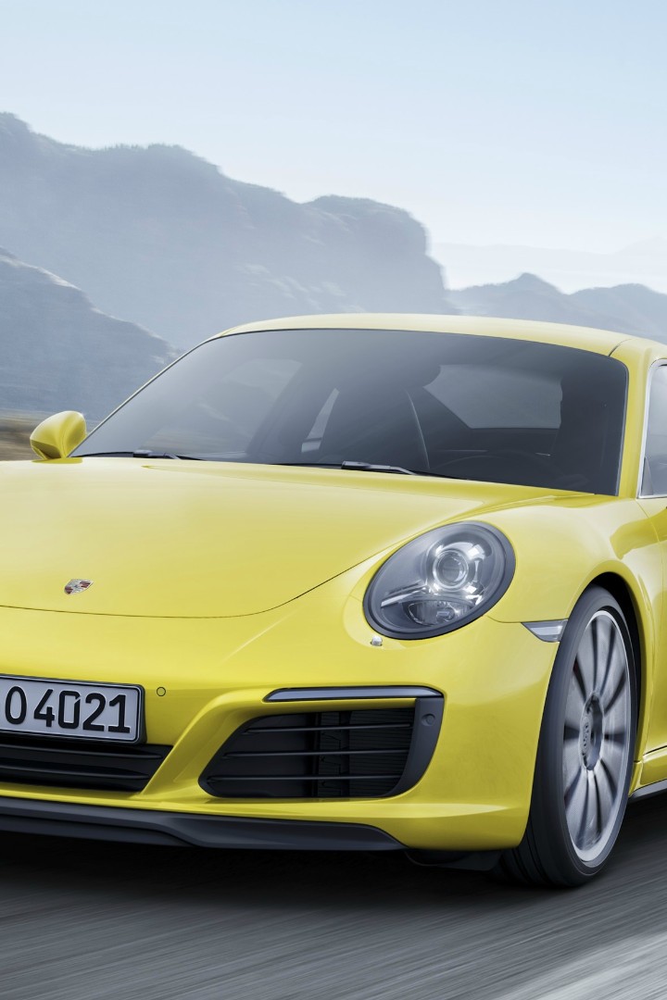
Conclusion
This presentation provides valuable insights into various aspects of German car listings and sales. The findings reveal the most popular car makes and models, price ranges, and correlations between car features. By leveraging this information, you can make more informed decisions that align with your preferences and budget.

