Slide 1
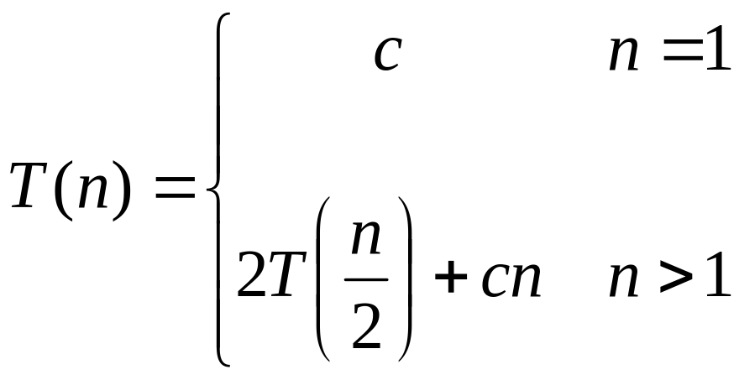
Recurrences
The expression:
is a recurrence.
  Recurrence: an equation that describes a function in terms of its value on smaller functions

Slide 2
Master Method/Theorem
Theorem 4.1 (page 73)
  for T(n) = aT(n/b)+f(n), n/b may be ⎡n/b⎤ or ⎣n/b⎦.
  where a ≥ 1, b>1 are positive integers, f(n) be a non-negative function.
  If f(n)=O(n^{log}b^{a-ε}) for some ε>0, then T(n)= Θ(n^{log}bª).
  If f(n)= Θ(n^{log}bª), then T(n)= Θ(n^{log}bª lg n).
  If f(n)=Ω(n^{log}b^{a+ε}) for some ε>0, and if af(n/b) ≤cf(n) for some c<1 and all sufficiently large n, then T(n)= Θ(f(n)).

Slide 3
Implications of Master Theorem
Comparison between f(n) and n^{log}bª (<,=,>)
Must be asymptotically smaller (or larger) by a polynomial, i.e., n^{ε} for some ε>0.
In case 3, the “regularity” must be satisfied, i.e., af(n/b) ≤cf(n) for some c<1 .
There are gaps
  between 1 and 2: f(n) is smaller than n^{log}bª, but not polynomially smaller.
  between 2 and 3: f(n) is larger than n^{log}bª, but not polynomially larger.
  in case 3, if the “regularity” fails to hold.

Slide 4
Application of Master Theorem
T(n) = 9T(n/3)+n;
  a=9,b=3, f(n) =n
  n^{log}bª = n^{log}3⁹ = Θ (n²)
  f(n)=O(n^{log}3^{9-ε}) for ε=1
  By case 1, T(n) =Θ (n²).
T(n) = T(2n/3)+1
  a=1,b=3/2, f(n) =1
  n^{log}bª = n^{log}3/2¹ = Θ (n⁰) = Θ (1)
  By case 2, T(n)= Θ(lg n).

Slide 5
Application of Master Theorem
T(n) = 3T(n/4)+nlg n;
  a=3,b=4, f(n) =nlg n
  n^{log}bª = n^{log}4³ = Θ (n^{0.793})
  f(n)= Ω(n^{log}4^{3+ε}) for ε≈0.2
  Moreover, for large n, the “regularity” holds for c=3/4.
    af(n/b) =3(n/4)lg (n/4) ≤ (3/4)nlg n = cf(n)
  By case 3, T(n) =Θ (f(n))=Θ (nlg n).

Slide 6
Exception to Master Theorem
T(n) = 2T(n/2)+nlg n;
  a=2,b=2, f(n) =nlg n
  n^{log}bª = n^{log}2² = Θ (n)
  f(n) is asymptotically larger than n^{log}bª , but not polynomially larger because
  f(n)/n^{log}bª = lg n, which is asymptotically less than n^{ε} for any ε>0.
  Therefore,this is a gap between 2 and 3.

Slide 7
Where Are the Gaps
f(n), case 3, at least polynomially larger
n^{ε}
Gap between case 3 and 2
c₁
n^{logba}
f(n), case 2: within constant distances
c₂
n^{ε}
Gap between case 1 and 2
f(n), case 1, at least polynomially smaller
Note: 1. for case 3, the regularity also must hold.
2. if f(n) is lg n smaller, then fall in gap in 1 and 2
3. if f(n) is lg n larger, then fall in gap in 3 and 2
4. if f(n)=Θ(n^{logba}lg^{k}n), then T(n)=Θ(n^{logba}lg^{k+1}n). (as exercise)

