Slide 1

CRIMINAL RECORD MANAGEMENT SYSTEM
LOGIN
username
*****
Submit

Slide 2
Welcome User,
Log out
Add new record
All records

Slide 3

Family Details
Personal Details
Other Details
Case Details
Scanned Details
Submit

Slide 4
Family Details
Name
Uma Shankar Shaw
Father’s Name
Lt. Pannalal Shaw
Mother’s Name
Chameli Shaw
Brother’s Name
Bhannu Shaw,Tarak Shaw,Gouri Shaw
Sister’s Name
Munni Gupta,Asha Shaw
Personal Details
Wife/Husband’s Name
Mita Shaw
Children’s Name
na

Slide 5
Family Details
Personal Details
Height
5’2’’
Weight
56kg
Complexion
Dark
Moustache
Yes
Built
Thin
Wound Mark
na
Age
60yr
Identification Mark
na
Operation Area
Baguiati(Talbagaan)
Associates name’s
Asit Raju
Other Details

Slide 6
Family Details
Personal Details
Other Details
Present Address
A/4 Taltala PO-Jyangra
PS-Baguati Dist- 24 Pgs
Education
Class 3 passed
Permanent Address
Do
Language
Bengali
Religion
Hindu
Others
Case Details
Class of criminal

Slide 7
Family Details
Personal Details
Other Details
Case Details
I.O. Name
SI Robin Haldar
Case Ref No
9/18 U/S-353/186/325 IPC
Crime nature
Others
Arrest Date
07.01.2018
Scanned Details
Forwarding date
08.01.2018
Court Name
Barasat Court

Slide 8

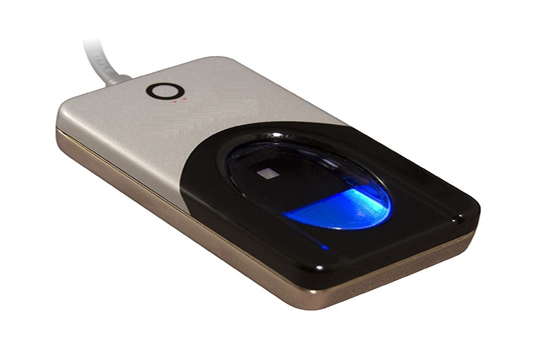

Scanned Details
Take picture
Take figure print
Take voice
Submit

Slide 9
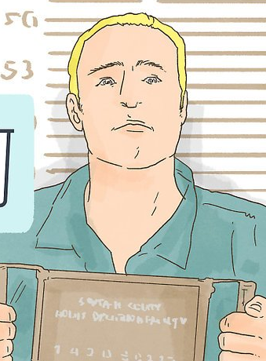
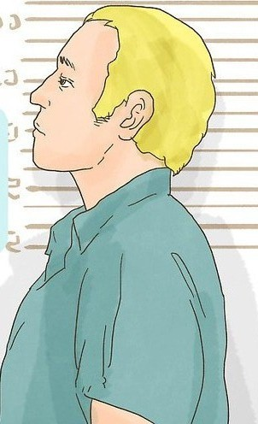
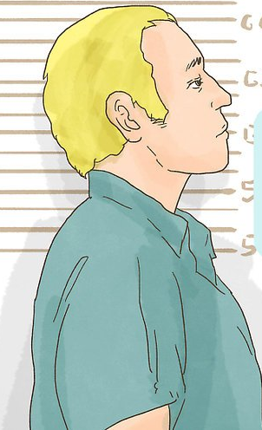
Scanned Details
Front Face
Left Face
Right Face
Submit

Slide 10
Scanned Details
Take picture
Take figure print
Take voice
Submit

Slide 11

Scanned Details
Submit

Slide 12
Scanned Details
Take picture
Take figure print
Take voice
Submit

Slide 13

Scanned Details
Record saved successfully.
Submit

Slide 14
Welcome User,
Log out
Add new record
All records
SL NO | DATE | NAME | CASE REF | ARREST DATE | CRIME NATURE | DETAILS
1 | 30.01.2017 | Uma Shankar Shaw | 9/18 U/S-353/186/325 IPC | 07.01.2018 | Others
Details

Slide 15
Family Details
Details of Uma Shankar Shaw
Personal Details
Other Details
Case Details
Scanned Details

Slide 16
THANK YOU.

