Slide 1
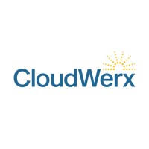
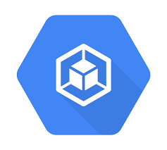

CI/CD Pipeline for Application Deployment
Google Cloud Platform, Cloud Build, Cloud Deploy, and GKE

Slide 2
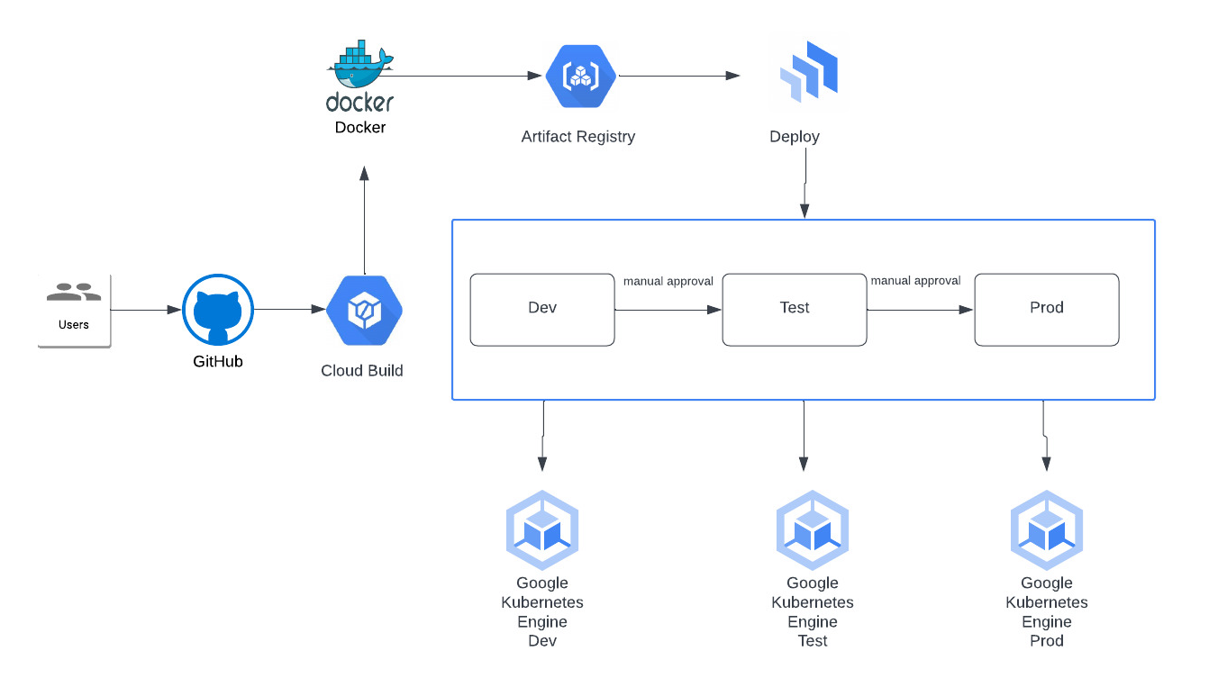

Slide 3
Pipeline Overview
This CI/CD pipeline automates the application deployment process from source code push to deployment in Kubernetes clusters across Dev, Test, and Prod.
Key Components:
Git for source code management
Cloud Build for build automation
Artifact Registry for image storage
Cloud Deploy for orchestrating deployments
Google Kubernetes Engine (GKE) for running applications

Slide 4
Step 1: Code Push and Build Trigger
The user pushes the application code to Git.
This triggers a Cloud Build pipeline which starts the build process.

Slide 5
Step 2: Docker Image Creation and Storage
Cloud Build creates a Docker image from the application code.
The Docker image is pushed to Artifact Registry for versioned storage.

Slide 6
Step 3: Deployment to GKE with Cloud Deploy
Cloud Deploy uses deployment configuration files to deploy the Docker image to the development GKE cluster.
Manual approval moves the deployment to the Test and Production GKE clusters.

Slide 7
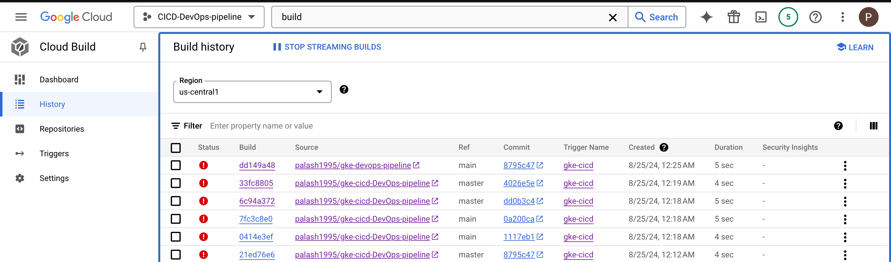

Slide 8
