Slide 1
Lending Club CASE STUDY
PALASH BARANWAL

Slide 2
CONTENTS
BUSINESS UNDERSTANDING
OBJECTIVE
DATA CLEANING
UNIVARIATE ANALYSIS
SEGMENTED UNIVARIATE ANALYSIS
BIVARIATE ANALYSIS
RECOMMENDATIONS

Slide 3
BUSINESS UNDERSTANDING
A Consumer finance company which specialises in lending various types of loans to urban customers. When the company receives a loan application, the company has to make a decision for loan approval based on the applicant’s profile. Two types of risks are associated with the bank’s decision:
If the applicant is likely to repay the loan, then not approving the loan results in a loss of business to the company
If the applicant is not likely to repay the loan, i.e. he/she is likely to default, then approving the loan may lead to a financial loss for the company

Slide 4
OBJECTIVE
We will use EDA to understand how consumer attributes and loan attributes influence the tendency of default.
We will also identify the driving factors (or driver variables) behind loan default, i.e. the variables which are strong indicators of default. The company can utilise this knowledge for its portfolio and risk assessment.

Slide 5
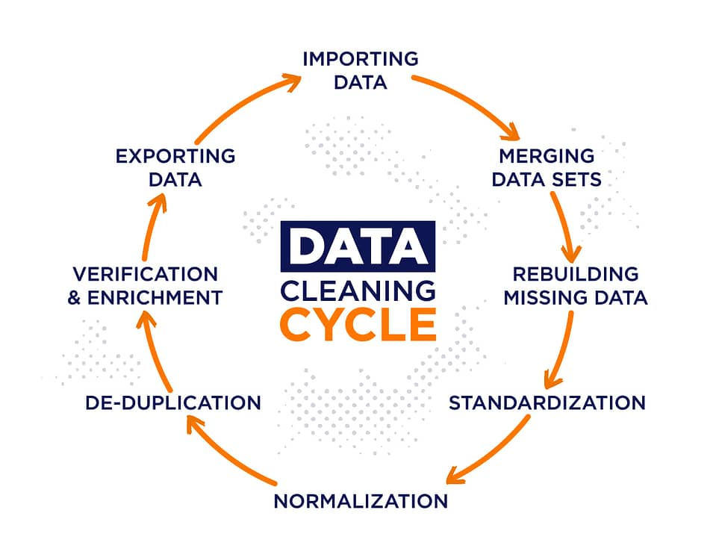
DATA CLEANING
Treating missing values
Removing irrelevant columns
Fixing incorrect data-types
Removing outliers

Slide 6
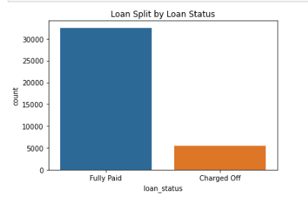
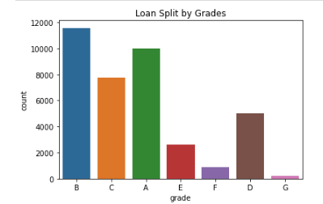
UNIvariate analysis
Most of the borrowers has fully paid the loans. However, ~17% of the loans are still charged-off.
Grades seem to have high correlation with interest rates, and are probably defined based on the categorization of interest rates. Based on #3, Higher the grade, higher the interest rate.

Slide 7
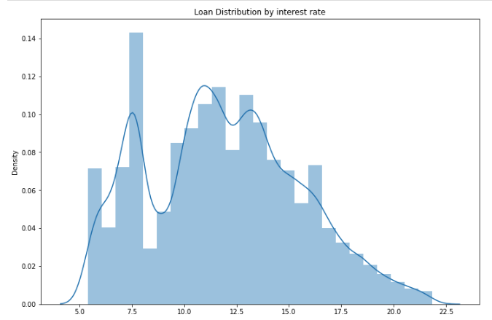
UNIvariate analysis
Loan interest varies from 5.42% to 21.82% The interest_rate of 10.99% is the most frequent interest rate, which is very close to median which is 11.71%. We also see a trend where as the loan_interest increases, the total count of loan decreases. That means, only a handful of loans being given has high interest rates.

Slide 8
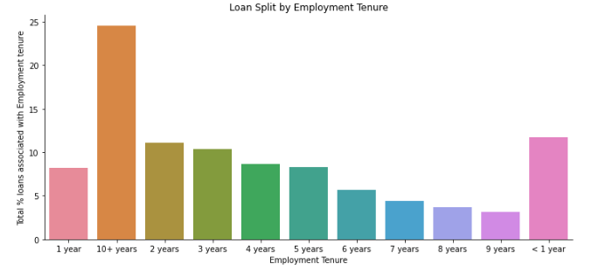
UNIvariate analysis
More than 25% of the loan is borrowed by applicants with 10+ years of experience. Also, freshers with < 1 year experience also contribute to close to 12% of total loans.

Slide 9
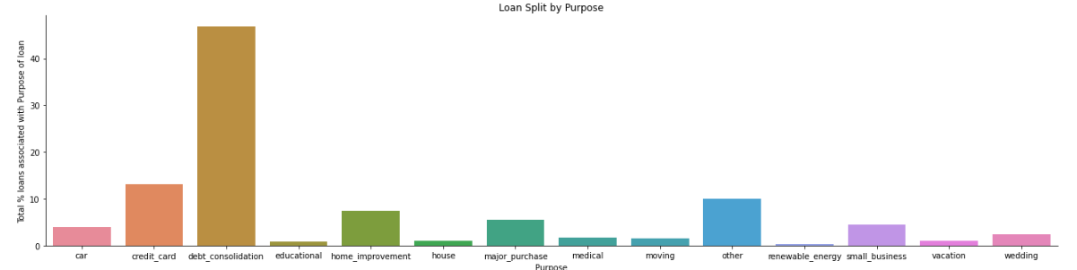
UNIvariate analysis
Close to 47% of loan is associated with debt-consolidation. While 13% is associated with credit-card payments

Slide 10
UNIvariate analysis - OBSERVATIONS
Most of the borrowers has fully paid the loans. However, ~17% of the loans are still charged-off.
Loan amount ranges from 500 to 35000. The amount of 10000 is the most frequent loan amount, which is very close to median which is 9600.
Loan interest varies from 5.42% to 21.82% The interest_rate of 10.99% is the most frequent interest rate, which is very close to median which is 11.71%. We also see a trend where as the loan_interest increases, the total count of loan decreases. That means, only a handful of loans being given has high interest rates.
Grades seem to have high correlation with interest rates, and are probably defined based on the categorization of interest rates. Based on #3, Higher the grade, higher the interest rate.
More than 25% of the loan is borrowed by applicants with 10+ years of experience. Also, freshers with < 1 yeaf experience also contribute to close to 12% of total loans.
90% of loan is associated with people who have a Mortgage or pay rent. Mortgage and Rent have almosyt similar number of loans associated.
43% of loan is associated with borrowers who are not verified.
Close to 47% of loan is associated with debt-consolidation. While 13% is associated with credit-card payments.
We observe increase in number of loans issued throghtout 2007-2011. We can say that loan applications as well as loan approval rate is increasing.
Number of loans increases towards end of month.

Slide 11
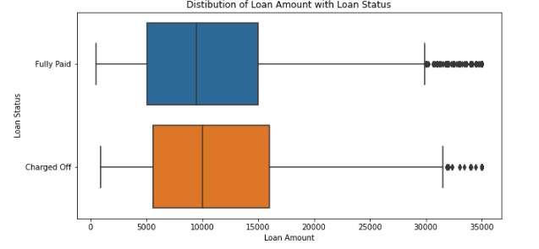
SEGMENTED UNIvariate analysis
Higher loan amounts have a higher chance of defaulting the loan. This is based on the 75th percentile numbers of the loan_amount.

Slide 12
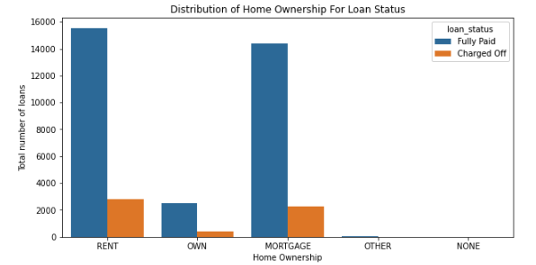
SEGMENTED UNIvariate analysis
Borrowers who Own a property have lesser chances of defaulting a loan. It is relatively safe to give to borrowers who Own a property.

Slide 13
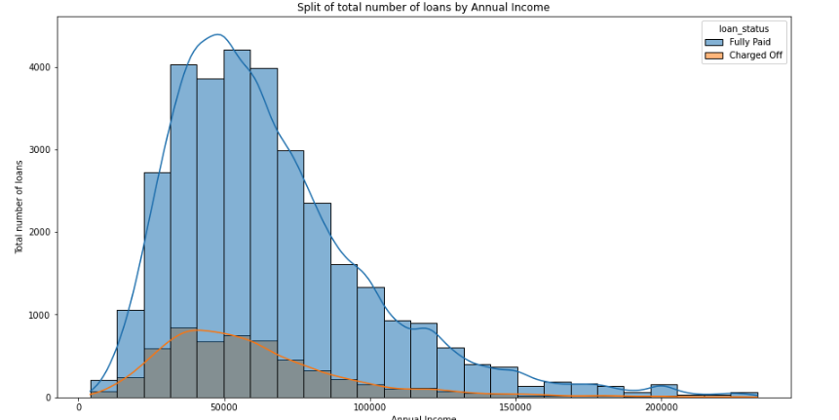
SEGMENTED UNIvariate analysis
Annual Income does not seem to play an important role in deciding if a loan will be defaulted. Loan Status seems to be uniformly distributed for "Full Paid" as well as "Charged off" loans

Slide 14
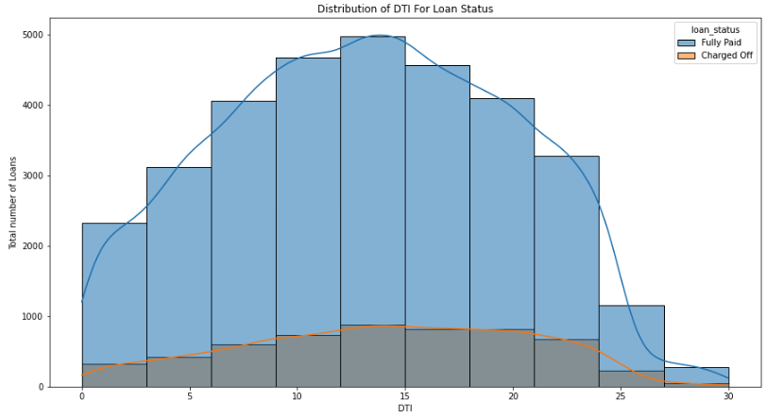
SEGMENTED UNIvariate analysis
Higher the DTI, higher the chances of a loan being defaulted. This is an important factor which should be considered while approving loan.

Slide 15
SEGMENTED UNIvariate analysis - OBSERVATIONS
Higher loan amounts have a higher chance of defaulting the loan. This is based on the 75th percentile numbers of the loan_amount.
Loan taken for a term of 60 months has higher chances of default. Close to 25% of the total loans taken for 60 months default.
Borrowers who Own a property have lesser chances of defaulting a loan. It is relatively safe to give to borrowers who Own a property.
Loan Status seems to be agnostic of the loan purpose and employment tenure. Because 47% of loan is to repay consolidated-debt, hence this bucket will have maximum number of defaulters and full-paid borrowers.
Annual Income does not seem to play an important role in deciding if a loan will be defaulted. Loan Status seems to be uniformly distributed for "Full Paid" as well as "Charged off" loans
With increase in interest_rates the percentage of loan defaults are increasing.
Higher the DTI, higher the chances of a loan being defaulted. This is an important factor which should be considered while approving loan.

Slide 16
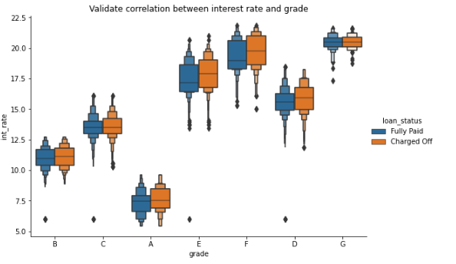
BIvariate analysis
Interest Rate and Grade are highly correlated with each other.

Slide 17
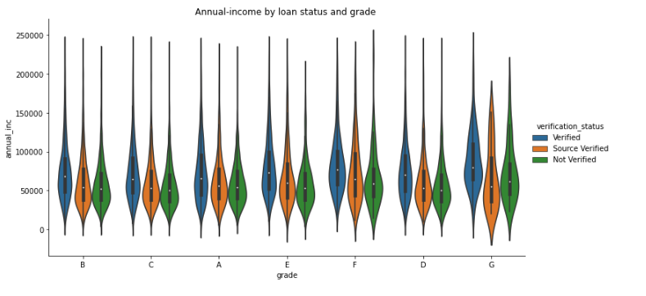
BIvariate analysis
Representation of annual income based on grade and verification status

Slide 18
BIvariate analysis - OBSERVATIONS
We have a good correlation between installment and loan_amount.
Interest Rate and Grade are highly correlated with each other.
Borrowers with a rented property, have high occurrences of defaulting the loan.
A positive public record bankruptcy denotes higher chances of a loan default.

Slide 19
Driving Factors behind Loan Default
There are a number of attributes which have a direct impact on the loan being Charged-Off. Some of the key atributes are:
Loan Amount - We observed that higher the loan amount, higher the chances of a loan being charged-off.
Term - The loan term plays an important role. If loan is given for a term of 60 months, then it has higher chances of being charged-off.
Home Ownership - Borrowers who are associated with a rented property have higher chances of defaulting a loan
Public record bankruptcy - Borrowers with positive bankruptcy record have higher chances of defaulting a loan
Grade - Borrowers with grades higher than F have higher chances of defaulting a loan
Interest Rate - Higher interest rate is a strong factor of loan default. It is to be noted that grades and interest rates are closely correlated.
To summarize, for any loan application we should genuinely study below 5 attributes:
Loan Amount, Term of Loan, Home Ownership, Public bankruptcy records and Interest rates.

