Slide 1

Git Hub Beginners
Palash kumar Dey
System Support Engineer
dkpalashbd50@hotmail.com

Slide 2
Introduction
What is GitHub
How to install git
How to create a GitHub account.
Create a local git repository.
Add a new file to the repo.
Add a file to the staging environment.
Create a new branch.
Create a new repository on GitHub.
Email add
Git Pull system local to web.
Deleting a repository
Notes:
https://bdpalash.wordpress.com/

Slide 3
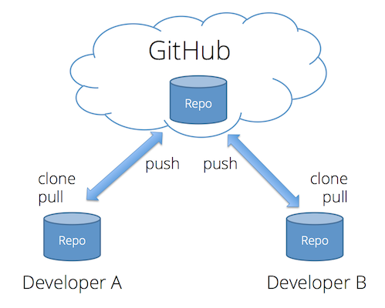
What is GitHub
GitHub is a code hosting platform for version control and collaboration. It lets you and others work together on projects from anywhere.
Notes:
https://bdpalash.wordpress.com/

Slide 4
How to install github
First two things on this project. First install git and second create a github account.
Three types of git packs on web .Based on operating system.
Windows version, Linux version and Mac version
Windows version https://git-scm.com/download/win
Linux version use this command “yum install git”
Notes:
https://bdpalash.wordpress.com/

Slide 5
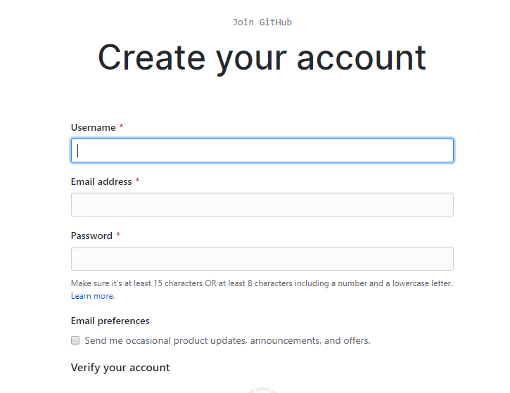
How to create a GitHub account.
Click the bellow link and create a git account https://github.com/join
After email verification your account is open .
Notes:
https://bdpalash.wordpress.com/

Slide 6
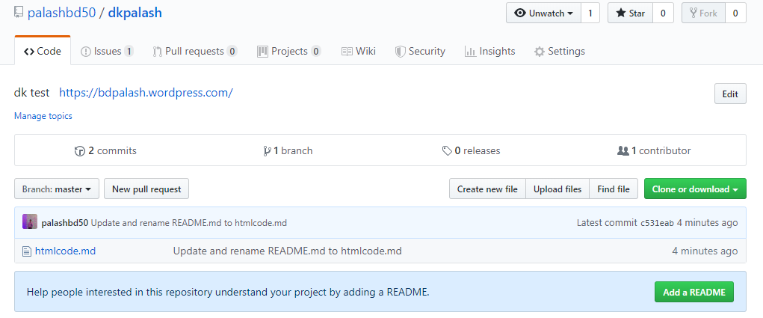
Create a local git repository
Local repository is the git subdirectory inside the Working Directory.
Go into the start project.
Type git init . (repository name)
Type git file name and add all of the relevant files.
Type git commit.
Notes:
https://bdpalash.wordpress.com/

Slide 7
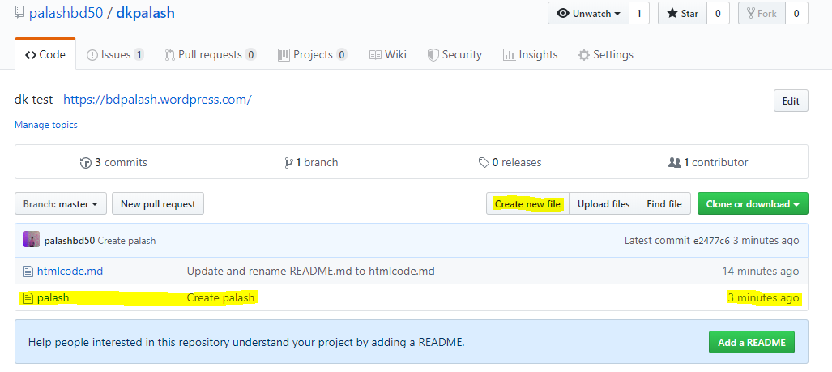
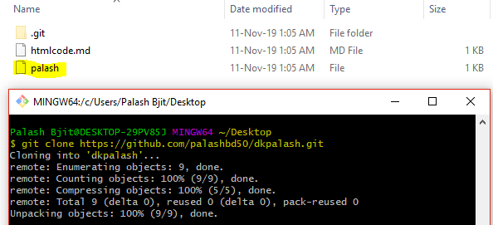
Add a new file to the repo.
If we want to add new file in repo list , then created new file command and add a new file.
Notes:
https://bdpalash.wordpress.com/

Slide 8
Add a file to the staging environment.
Git has three main states that your files can reside in: committed, modified, and staged.
Committed means that the data is safely stored in your local database.
Modified means that you have changed the file but have not committed it to your database yet.
Staged means that you have marked a modified file in its current version to go into your next commit snapshot.
Notes:
https://bdpalash.wordpress.com/

Slide 9
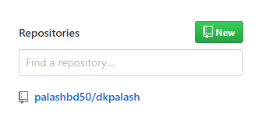
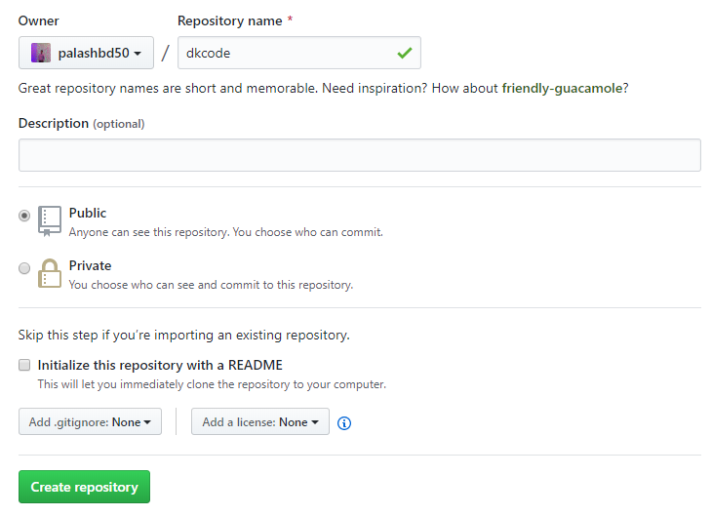
Create a new branch.
If you only want to keep track of your code locally, you don't need to use GitHub. But if you want to work with a team, you can use GitHub to collaboratively modify the project's code.
To create a new repo on GitHub, log in and go to the GitHub home page. You should see a green '+ New repository' button:
After clicking the button, GitHub will ask you to name your repo and provide a brief description:
Notes:
https://bdpalash.wordpress.com/

Slide 10
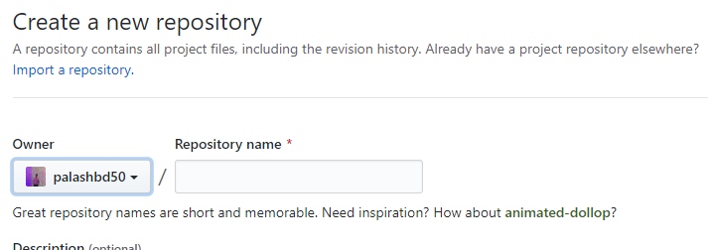
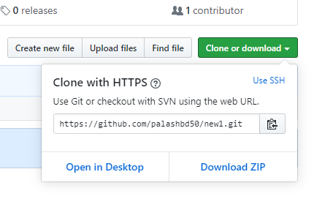
Create a new repository on GitHub.
Github.com
New
Repository name
Created file
Clone
Notes:
https://bdpalash.wordpress.com/

Slide 11
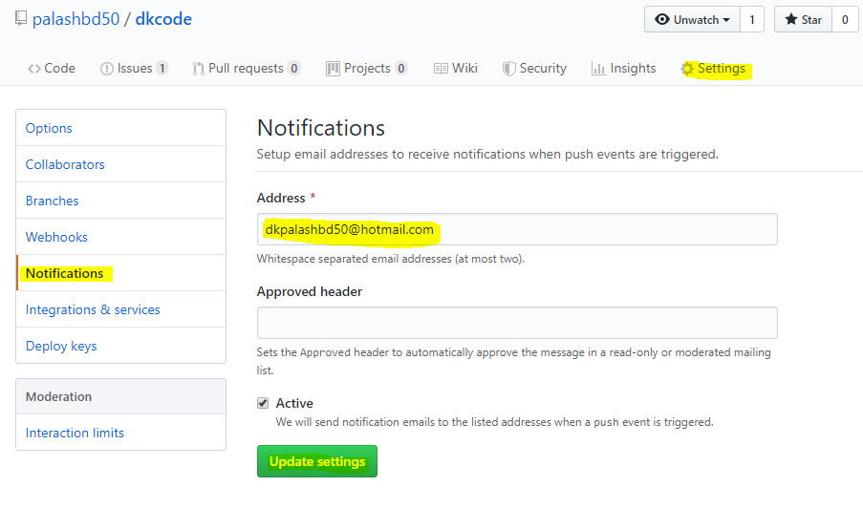
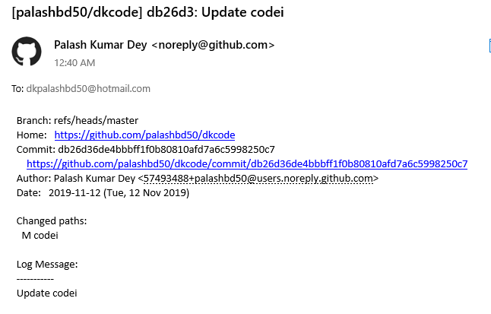
Email Add.
Github.com
Repositories
Settings
Notifications
Add email id
We can use different email in different repository.
Notes:
https://bdpalash.wordpress.com/

Slide 12
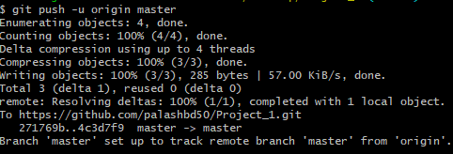
Git Pull system local to web
git clone https://github.com/palashbd50/Project_1.git
cd Project_1/
touch First.txt
ls
git status
git add .
git commit -m "Added First.txt“
git status
git remote add origin https://github.com/palashbd50/Project_1.git
git push -u origin master
Notes:
https://bdpalash.wordpress.com/

Slide 13
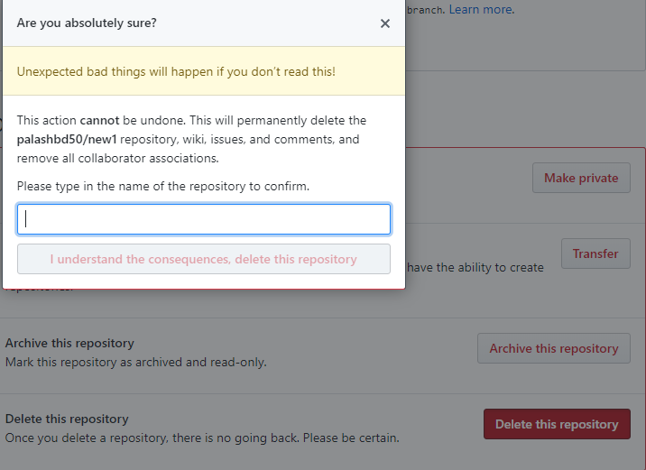
Deleting a repository
The main page of the repository.
Under your repository name, click Settings.
Under Danger Zone, click Delete this repository.
Read the warnings!
Click I understand the consequences, delete this repository.
Notes:
https://bdpalash.wordpress.com/

Slide 14
Reference
https://www.youtube.com/watch?v=0fKg7e37bQE
https://www.freecodecamp.org/news/learn-the-basics-of-git-in-under-10-minutes-da548267cc91/
https://git-scm.com/book/en/v1/Getting-Started-Git-Basics
https://guides.github.com/activities/hello-world/
https://git-scm.com/book/en/v1/Getting-Started-Git-Basics#The-Three-States
https://clubmate.fi/git-all-about-adding-files-to-the-staging-area/
https://kinsta.com/knowledgebase/what-is-github/
https://git-scm.com/book/en/v2/Git-Branching-Branches-in-a-Nutshell
https://help.github.com/en/github/creating-cloning-and-archiving-repositories/about-repositories
https://kinsta.com/knowledgebase/what-is-github/
https://www.w3schools.com/whatis/whatis_github.asp
https://help.github.com/en/github/getting-started-with-github/github-glossary
Notes:
https://bdpalash.wordpress.com/

