Slide 1

C99 IMPLEMENTATION
30
PRECONFIGURED DEMO RECORDS
30
BED SLOTS (3 WARDS × 10 BEDS)
5
DOCTORS WITH WORKLOAD CAPS
PURE STANDARD C (C99)
STRUCTURES • POINTERS • RECURSION • FILES
UNIVERSITY INSTITUTE OF COMPUTING • CHANDIGARH UNIVERSITY
SMART HOSPITAL
MANAGEMENT SYSTEM
Patient Records • Emergency Triage • Bed Allocation • Recursive Billing
Academic Project Presentation | Bachelor of Computer Applications (BCA)
Student Name : Palash Behura
UID / Section : 26BCA10216 • Section BCA-2(A)
Course Code : Computer Programming (26CAH-101)
Academic Year : 2026–2027 • Chandigarh University, Mohali

Slide 2
01 / INTRODUCTION
Problem Statement & Project Objectives
A modular C99 console system unifying intake, triage, beds, doctor loads, and billing.
PATIENT FLOW & TRIAGE
• Manual hospital desks face severe record bottlenecks and delayed emergency care.
• Sequential Auto-ID: Assigns unique patient IDs sequentially upon intake.
• Emergency-First Triage: Uses dynamic priority bubble sorting to display Priority 1 (Emergency) cases ahead of Priority 2 (Normal).
• Dual-Mode Search: Fast retrieval by numeric ID or case-insensitive name substring matching.
• In-Place Updates: Direct record editing in patients.dat without file rewriting.
RESOURCE ALLOCATION
• Fixed Ward Capacity: 30 beds partitioned across General, ICU, and Pediatric wards (10 beds each).
• 2D Matrix Tracking: Models bed status as int beds[3][10]; 0 indicates vacant, 1 indicates occupied.
• First-Fit Allotment: Automatically searches for the first available bed in the requested ward.
• Doctor Workload Balancing: 5 configured medical specialists with hard capacity limits (max 5 patients per doctor).
• Bed Release on Discharge: Clears bed slot immediately upon patient discharge.
RECURSIVE BILLING & PERSISTENCE
• Multi-Component Charges: Consultation, medication, daily room rate, and laboratory tests.
• Divide-and-Conquer Recursion: totalBill() calculates total liability by recursive summation.
• Itemized ASCII Export: Generates discharge_<id>.txt audit statement upon discharge.
• Binary File Streams: Stores records in patients.dat and bed grid in beds.dat.
• Educational Prototype: Engineered for BCA coursework, strictly standard C99 compliant.

Slide 3
02 / FEATURES
Core Functional Scope & System Architecture
12 structured operations accessible via a centralized menu dispatch loop.
01 Register Patient
Demographic intake, auto-assigned sequential ID, default zero charges, binary append.
02 Emergency Triage
Sorts non-discharged patients by priority; critical emergencies shown first.
03 Assign Doctor
Displays specialist directory; enforces strict 5-patient workload limit per doctor.
04 Show Bed Grid
Renders 3x10 matrix across General, ICU, and Pediatric wards with occupancy totals.
05 Allocate Bed
First-fit vacancy search in chosen ward; transitions patient status to Admitted.
06 Treatment Charges
Records consultation, medicine, room rate, and diagnostic test expenses.
ADDITIONAL MODULES: Option 07 (Discharge & Bill) • Option 08 (Search) • Option 09 (Update) • Option 10 (Registry) • Option 11 (Summary)
DEMO LOADER (99): Seeds 30 realistic patients with safety confirmation (y/n) | CLEAN SHUTDOWN (0): Flushes state and exits cleanly

Slide 4
03 / SYSTEM DESIGN
Data Models & Persistence Architecture
Explicit structure tags, 2D matrix allocation, and random-access binary streams.
PRIMARY DATA STRUCTURES
struct Patient: Represents complete patient record: ID, name, age, gender, disease, priority (1=Emerg, 2=Norm), doctorId, wardNo, bedNo, daysAdmitted, status (0=Wait, 1=Adm, 2=Disch), nested charges.
struct Charges: consultation, medicine, roomPerDay, tests (float values for financial audit).
struct Doctor: id, name, dept, patientCount (tracks active load; max 5).
2D Bed Grid: int beds[3][10] represents 3 wards x 10 beds = 30 total beds. Passed via pointer-to-array int (*grid)[10].
PERSISTENCE SCHEMA
patients.dat: Binary stream storing struct Patient records. Appends new patients via "ab"; performs in-place record updates via "rb+" using fseek() and ftell().
beds.dat: Binary file storing the complete 3x10 integer matrix. Reloaded on startup to preserve ward occupancy across sessions.
discharge_<id>.txt: Plain-text ASCII discharge summary generated upon patient release, itemizing all four charges and final total.
State Integrity: Status transitions: Waiting (0) -> Admitted (1) -> Discharged (2). Bed slots are released immediately upon discharge.
CONTROL FLOW & DISPATCH
• Central State Machine: Outer do-while loop drives menu selection and dispatches to modular functions.
• Input Buffer Hygiene: clearInputBuffer() and stripNewline() prevent dangling newline characters in scanf/fgets.
• Direct Pointer Addressing: (arr + i)->priority used during array traversal for high execution efficiency.
• Memory Management: Dynamically sizes triage lists with malloc() and releases memory with free().
• Zero Dynamic Memory Leaks: Verified by valgrind and compiler sanity checks.

Slide 5
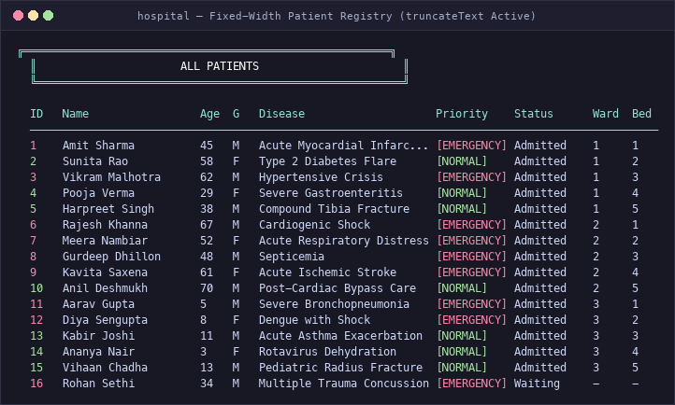
04 / CONSOLE UI DESIGN
Console Interface and Output Design
Solving column misalignment from long medical strings while preserving full record data.
THE ALIGNMENT CHALLENGE & SOLUTION
The Column Drift Problem: In C printf("%-14s"), specifiers enforce a MINIMUM width rather than a hard boundary. Long clinical diagnoses such as "Acute Myocardial Infarction" (27 chars) expanded outward, pushing Priority, Status, Ward, and Bed out of alignment.
The truncateText() Helper: Engineered a reusable standard C helper: void truncateText(char *dest, const char *src, int maxLen). If src exceeds maxLen, it copies maxLen-3 chars and appends "..." to fit the column perfectly.
Zero Data Mutation: The original medical diagnosis remains completely intact in struct Patient and patients.dat. Truncation occurs strictly in temporary display buffers during screen rendering.
Fixed-Width Grid Standard: Columns fixed: ID (4), Name (20), Age (4), G (3), Disease (26), Priority (11), Status (11), Ward (5), Bed (4). Formatted with 96 dashes; fits 100-110 col terminals.
Clean Unassigned Indicators: Unassigned ward and bed values display as "-" instead of confusing internal indices (-1).
Figure 2. Verified fixed-width output of displayAll() showing active ellipsis truncation on long diseases.

Slide 6
05 / DEMO DATASET
30-Patient Realistic Demonstration Dataset
Pre-seeded clinical scenarios for immediate demonstration, grading, and viva evaluation.
30
PATIENT RECORDS
Predefined fictional dataset (Option 99)
15
ADMITTED PATIENTS
5 General, 5 ICU, 5 Pediatric beds
10
WAITING PATIENTS
Queued for doctor and bed allotment
5
DISCHARGED PATIENTS
Historical records with saved bills
DOCTOR WORKLOADS & BED BALANCE
• 30 Total Beds: Exactly 15 occupied [X] (5 per ward) and 15 free [ ] immediately after demo loading.
• Balanced Doctor Allocations: Doctor loads {Dr. 1: 4, Dr. 2: 5, Dr. 3: 4, Dr. 4: 3, Dr. 5: 4}.
• Capacity Limit Test: Dr. Rohit Mehta (Cardiology) is seeded at full capacity (5/5), allowing immediate demonstration of workload rejection logic.
• Realistic Clinical Variety: Conditions span Acute Myocardial Infarction, Severe Asthma, Dengue, Pneumonia, and Diabetic Ketoacidosis.
SAFETY CONFIRMATION (OPTION 99)
• Reset Warning: Option 99 displays an explicit warning that patient records and bed allocations will be reset.
• Confirmation Prompt: Requires explicit input: 'Are you sure you want to load 30 demo patients? (y/n)'.
• Abort Safeguard: Entering 'n' or any invalid character immediately cancels the operation with zero data modification.
• Verified Lifecycle: Initial seed state (30 records: 15/10/5) vs. Post-workflow state (31 records: 15/10/6) after intake and discharge.

Slide 7
06 / IMPLEMENTATION
Core C99 Programming Techniques
Direct pointer manipulation, recursive algorithms, and binary stream operations.
POINTER ARITHMETIC & DYNAMIC MEMORY
• Direct Offset Traversal: Uses (arr + i)->priority instead of array subscripting to demonstrate pointer arithmetic.
• Dynamic Array Sizing: triageList() measures file size via ftell() and allocates exact memory with malloc().
• Pass-by-Reference: updatePatient(struct Patient *p) passes struct pointers to eliminate stack copy overhead.
• 2D Pointer Notation: Bed grid passed via pointer-to-array: void showBeds(int (*grid)[10]).
DIVIDE-AND-CONQUER RECURSION
• Recursive Billing: totalBill(charges, n) sums 4 charge elements recursively.
Base Case: n == 0 → return 0.0f
Recursive Case: charges[n-1] + totalBill(charges, n-1)
• Recursive Emergency Count: countEmergency(arr, n) recursively aggregates Priority 1 patients across active arrays for dashboard display.
RANDOM-ACCESS BINARY FILE I/O
• Stream Operations: fopen, fread, fwrite, fseek, ftell, fclose.
• In-Place Record Updating: Rather than rewriting the file, updatePatient() captures byte offset with ftell() and writes directly using fseek(f, pos, SEEK_SET).
• Audit Persistence: Text summaries exported to discharge_<id>.txt.
COMPILER SANITY & ZERO WARNINGS
• Strict C99 Standard: gcc -std=c99 -Wall -Wextra -Wpedantic.
• Zero Diagnostic Warnings: All format overflows and unused parameters resolved.
• Syllabus Integrity: Zero typedef, zero unions, zero enums, zero linked lists, and standard library only (<stdio.h>, <stdlib.h>, <string.h>, <ctype.h>).

Slide 8
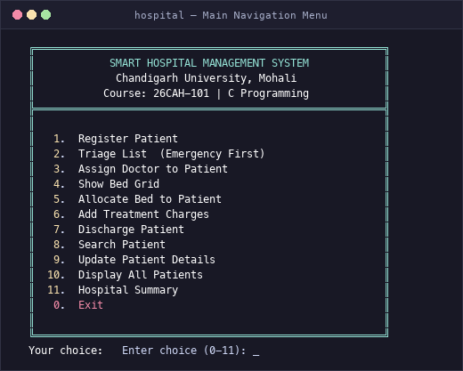
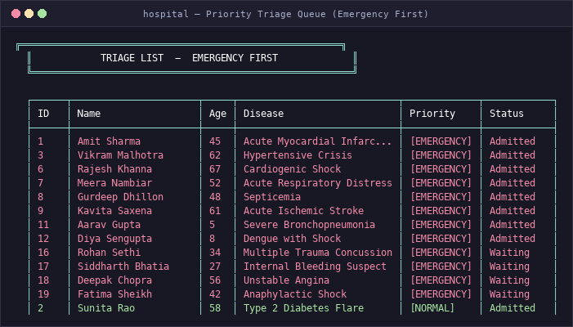
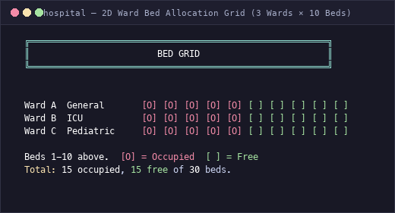
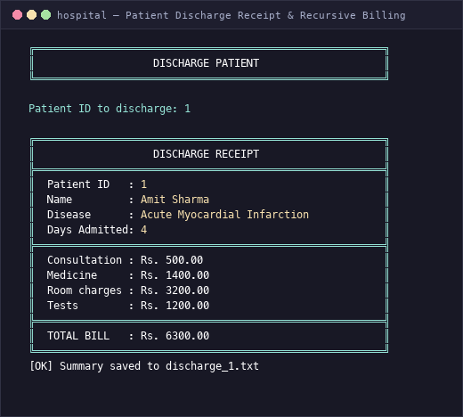
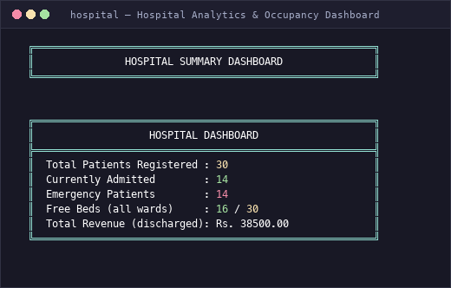
07 / LIVE DEMO
Live Demonstration & Visual Interface Gallery
Captured terminal outputs illustrating genuine program execution.
DEMO WORKFLOW SUMMARY
1. Seed 30 demo patients via Option 99.
2. Inspect triage queue sorted emergency-first.
3. Verify 2D bed occupancy (15 occ, 15 free).
4. Allocate bed to waiting patient.
5. Discharge patient with recursive billing.
6. Review real-time dashboard analytics.

Slide 9
08 / QUALITY ASSURANCE
Automated Verification & Known Limitations
Comprehensive validation via isolated sandbox testing and rigorous compiler checks.
AUTOMATED SMOKE TEST SUITE (26/26 PASS)
Test Runner: python3 tests/smoke_test.py (runs in isolated temp directory)
Compiler Check: gcc -std=c99 -Wall -Wextra -Wpedantic → Zero Warnings
Initial Seed State: Verified 30 records (15 admitted, 10 waiting, 5 discharged)
Bed Consistency: Verified 15 unique beds occupied (5 per ward), 15 free
Doctor Limit: Verified rejection of assignment to Dr. Rohit Mehta (5/5 full)
Bed Allocation: Verified first free bed in Ward 1 allotted to waiting patient
Recursive Discharge: Verified recursive summation and discharge receipt export
Post-Workflow State: Verified 31 records (15 adm, 10 wait, 6 disch) after mutations
Sandbox Isolation: Zero runtime data files leaked to repository root directory
SYSTEM SCOPE & KNOWN LIMITATIONS
Single-User Architecture: Designed for single-operator console execution; lacks concurrent multi-user database locking and network sockets.
Binary File Portability: Raw struct serialization in patients.dat is fast for coursework, but binary layout depends on compiler alignment and CPU architecture.
In-Memory Doctor Counts: Doctor active patient counters are initialized in memory during session. In a production system, these would be computed from patients.dat on boot.
Coursework Status: Developed as an academic demonstration prototype for BCA Computer Programming, not certified for clinical use.
Evaluation Defense: All functionality, data structures, and algorithms are fully implemented and defensible in viva examination.

Slide 10
09 / CONCLUSION
Conclusion & Future Enhancements
Coursework fulfillment, key engineering takeaways, and future development path.
ACADEMIC FULFILLMENT
• Successfully implements syllabus concepts: structures, pointers, dynamic memory, recursion, arrays, and binary file streams.
• Solved real-world console challenges including disease text overflow via truncateText().
• Rigid alignment and clean presentation across all terminal environments.
FUTURE ENHANCEMENTS
• Multi-User Authentication: Role-based access for receptionists, doctors, and cashiers.
• Doctor Persistence: Store doctor workload state across restarts in doctors.dat.
• Data Interoperability: Export records to standard CSV and JSON formats.
• Automated Waiting Queue: Auto-allot vacant beds to emergency triage patients.
VIVA DEFENSE READINESS
• Pure standard C99 source code (main.c).
• Zero compiler warnings (-Wall -Wextra).
• 26 automated smoke test assertions passed.
• Reproducible 30-patient demo dataset (Option 99).
• GitHub: Full version history and deliverables.
Thank You • Questions & Live Demonstration
Palash Behura (UID: 26BCA10216, BCA-2A) • Chandigarh University • GitHub: https://github.com/palashbehura54-source/smart-hospital-management-system

