Slide 1
HealthChain
enabling universal healthcare
Palash Gupta
Prasun Joshi

Slide 2
Problems
Patient’s data privacy
Data value in the Darknet:
health data = 10 * credit card data
Users don’t have their health data ownership
Medical records are not patient centric
Neither they can be shared accross healthcare bodies – Interoperability Challenge

Slide 3
Possible Solutions and their Concerns
Centralized trusted body ensuring data privacy - Single point of failure
Patients keeping their record with themselves – difficult for hospitals to access the data
Decentralized system of multiple nodes

Slide 4
Proposed Solution
Using public blockchain as an access control manager to health records that are stored off blockchain (data lake).
Patients will have the ownership and data privacy by signing and encrypting records. They can also give and modify access permissions.
Patient data can be monitored by keeping transaction for each data access request by healthcare body.

Slide 5
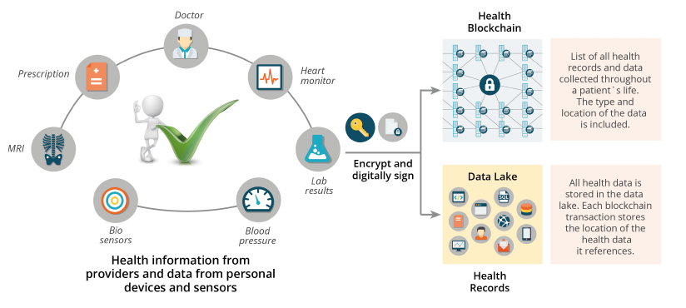
How?

Slide 6
Advantages
Universal ledger for heath care data.
Robust, availability, privacy and scalability.
Mining of latest medical research.
Patients inputs (wearable sensors) can also be stored.
Develop personalised treatment paths by analysing data lake.

Slide 7
Challenges
Healthcare bodies are trusted entities.
How the Data Lake should be designed?
Storage of keys.

Slide 8
Thanks!!

