Slide 1
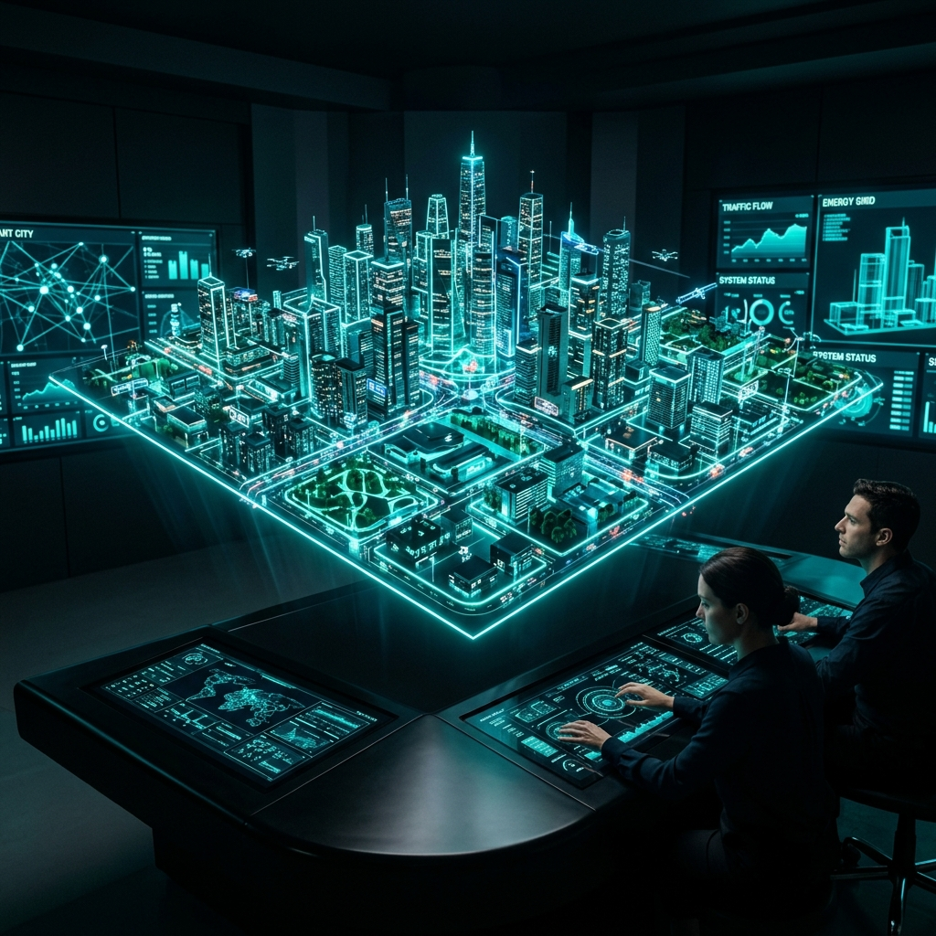
India Smart City Dashboard
Prakalp 4.0: Centralized Urban Infrastructure
Transforming Fragmented Systems into Active Intelligence

Slide 2
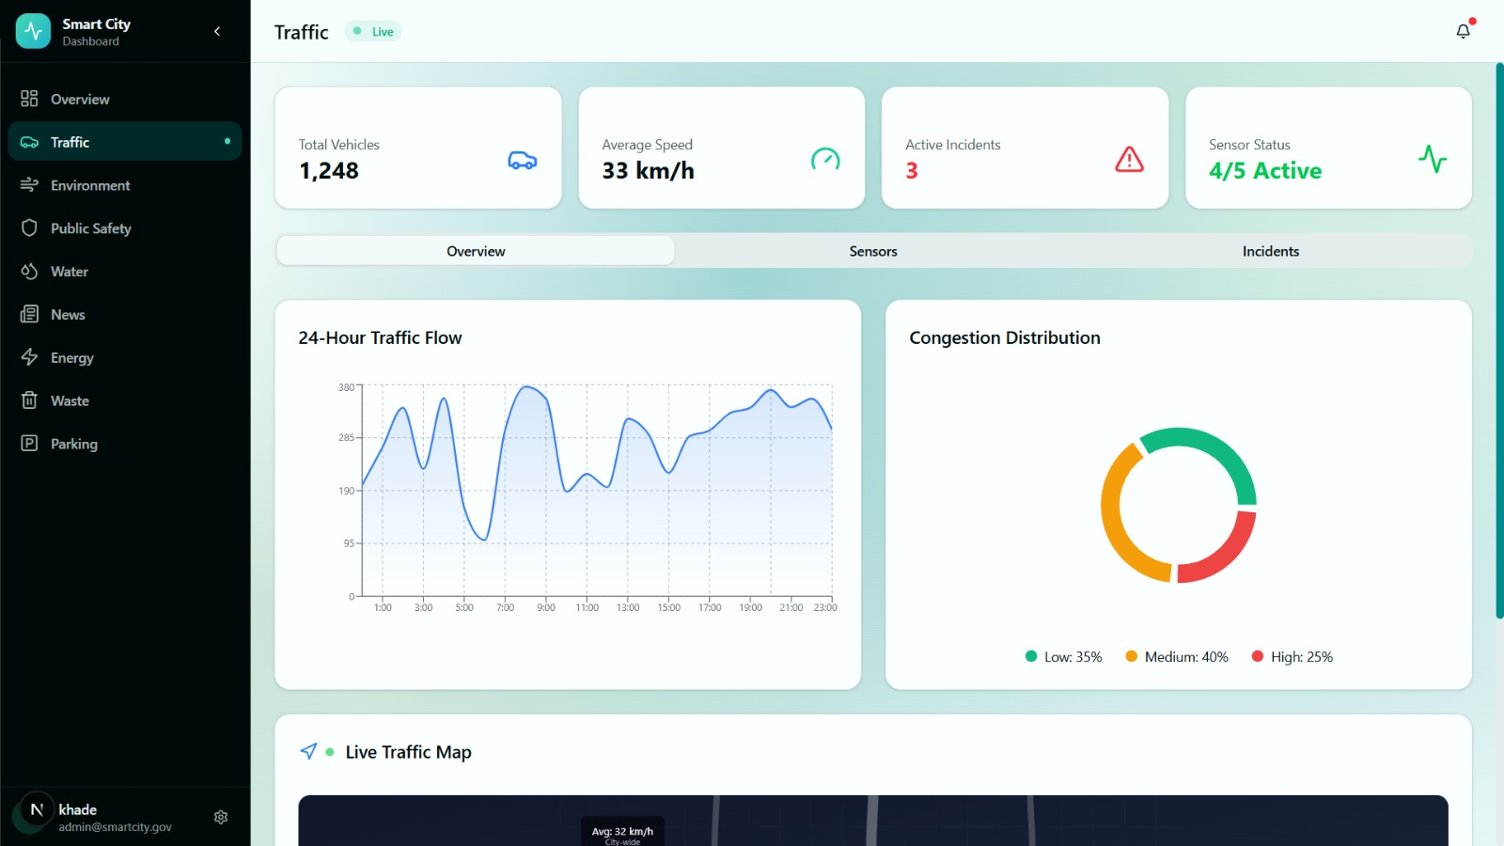
The Urban Crisis: Data Fragmentation
Massive Data Silos
Traffic, Water, and Safety run on entirely separate legacy systems.
Catastrophic Response Latency
Lack of immediate cross-department alarms stalls emergency units.
Severe Resource Wastage
Undetected reservoir leaks result in millions of liters lost daily.

Slide 3
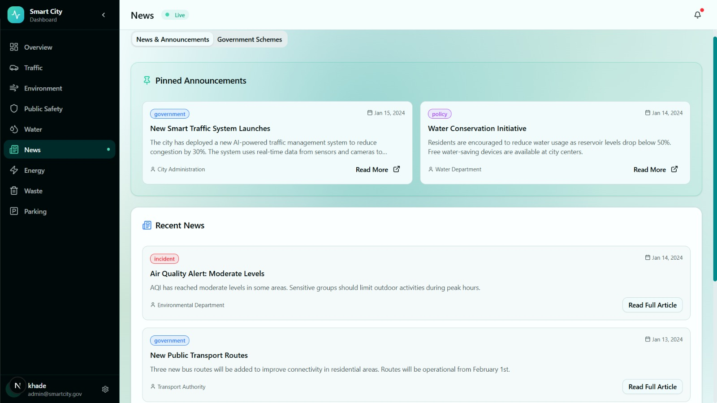
Our Solution: The Command Center
Single Pane of Glass
Overlaying 8 city verticals into one fluid mapping reality.
Actionable Real-Time Execution
From static end-of-day reports to 3-second live IoT sensor streams.
Interoperability Protocol
API layers convert fragmented legacy databases into modern structures.

Slide 4
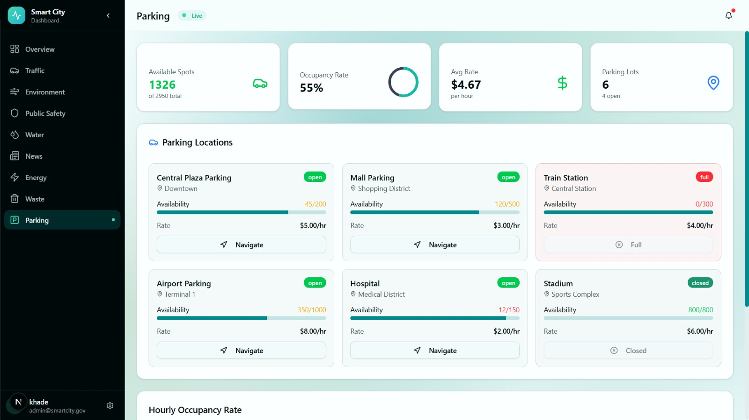
Core Modules & Conversational AI
Traffic: Live congestion and velocity logs.
Environment: Localized AQI tracking.
Utilities: Predictive reservoir leak detection.
Safety: Live CCTV parsing.
Gemini 2.5 Flash Chatbot Integration
Administrators seamlessly prompt: 'List all offline CCTVs in Zone 4' and instantly trigger maintenance dispatches bypassing manual UI hunting.

Slide 5
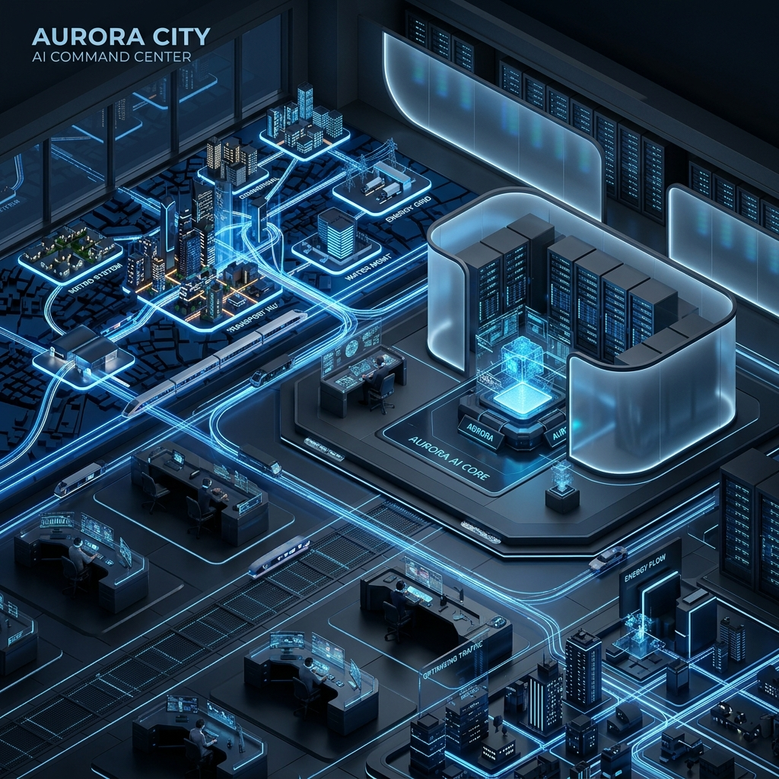
System Architecture: Data & Intelligence Flow
Hardware Edge
Server Routing
Data Core
Live IoT Sensors
CCTV & Feeds
Next.js App Router
API / WebSockets
Prisma ORM
SQLite / PostGIS
Gemini 2.5 Flash
NL Intelligence
Smart City UI Deck
Zustand Cache
shadcn/ui Render

Slide 6
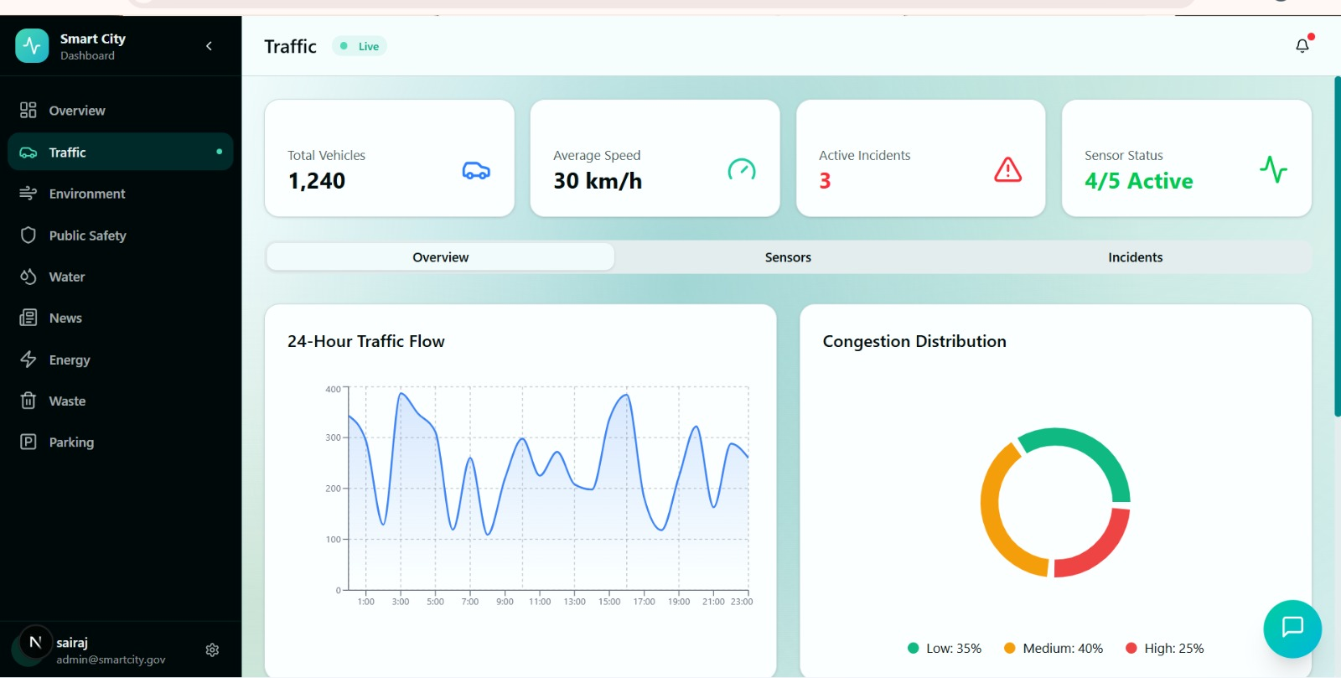
Implementation Plan & Real Impact
Rollout Phases
Phase 1: Deploy core UI & connect test AQI sensors.
Phase 2: Database transition to PostgreSQL+PostGIS.
Phase 3: Rollout Admin/Officer portals securely.
Tangible ROI
40% Emergency Response Reduction
25% Energy & Utility Conservation

Slide 7
The Future Scope & Urban Vision
Predictive Routing
AI algorithms to adjust traffic grid lights preemptively based on weather variables.
Drone Dispatch
Autonomous IoT-triggered drone mapping before fire engines arrive.
Nation-Wide Scale
Open-source deployment model allowing seamless cloning for every Indian state.

