Slide 1
CMPE 275 SURVEY APE
By
Amita Mathkar
Prateek Sharma
Palash Hedau
Aman Ojha

Slide 2
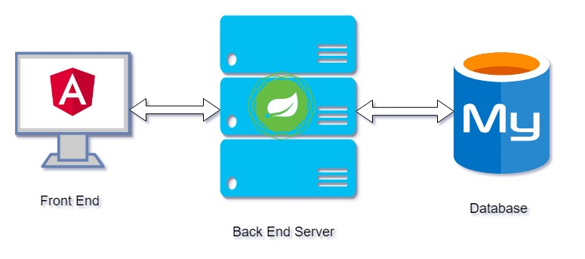
Architecture

Slide 3
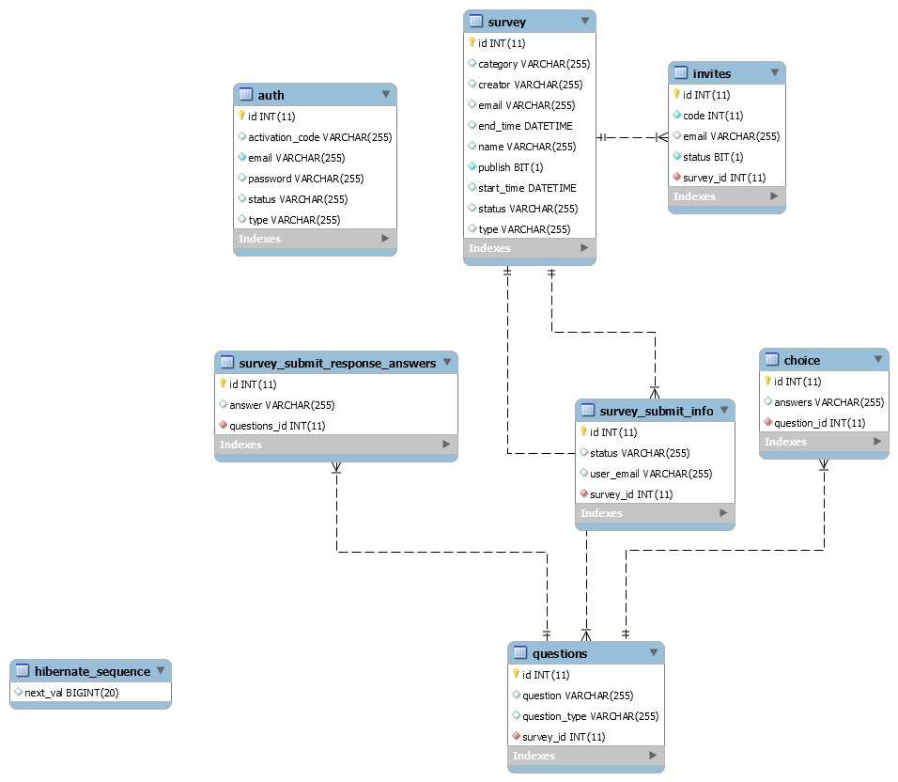
DATABASE SCHEMA

Slide 4
Tech Stack & KEY-FEATURES
Angular 5
SpringBoot
MySql
DI, AOP, Async Programming
Cron Jobs
E-mail Service
JPA Transactions
Session Management

Slide 5
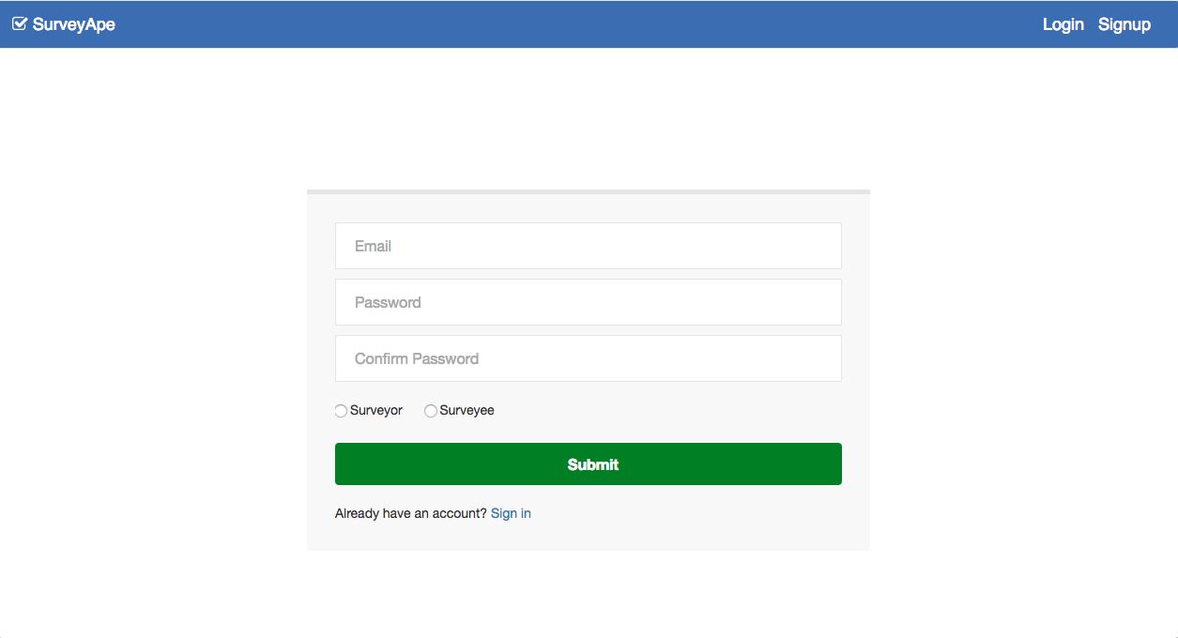
SCREENSHOTS

Slide 6
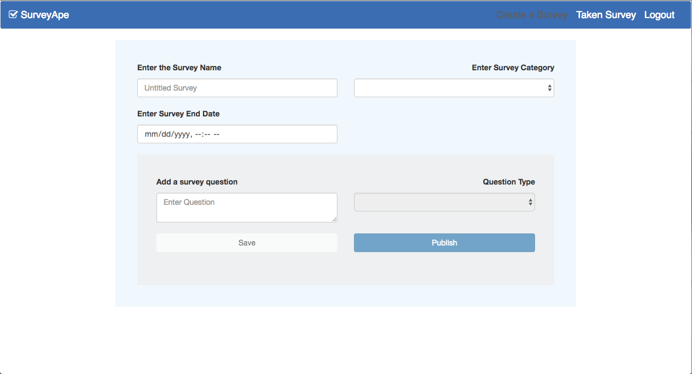
SCREENSHOTS

