Slide 1

Improved Market Forecast for Newly Launched Product
-Team liquid (07)
Palash Jadhav|Pragyan Dalmia|pratinav Chandra|Nikunj goenka

Slide 2
Approach
Target Product : Laptops
End-User Input : Features and Price
Output : Sales in a year (Units/ Year)
User-Input
Pre-Processing of Dataset
Prediction Model
Predicted Sales (Units/Year)

Slide 3
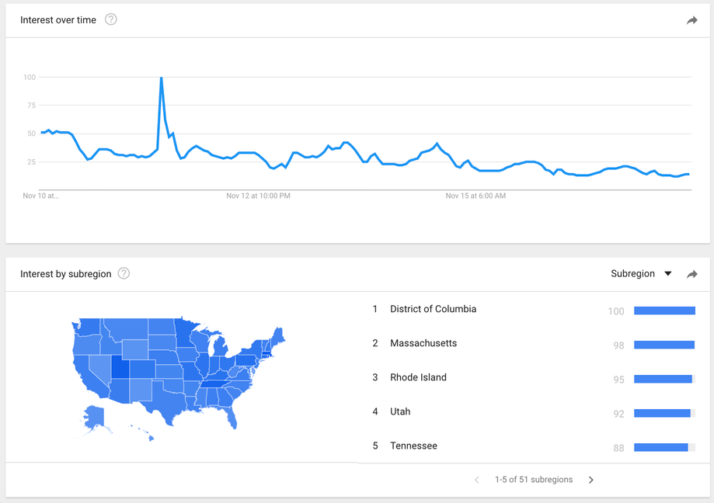
Google Trends
Google Trends is a search trends feature that shows how frequently a given search term is entered into Google’s search engine over a given period of time. It give value between 0-100.

Slide 4
Sentiment Analysis
The process of computationally identifying and categorizing opinions expressed in a piece of text, especially in order to determine whether the writer's attitude towards a particular topic, product, etc. is positive, negative, or neutral.
We have used Google Trends API and Twitter API
Score = (Positive Tweets %) *(Google Trends Value)

Slide 5
Data Set
Size :-800 different rows depicting 800 laptops
Features : Intrinsic and Extrinsic
Intrinsic: features that have to be present in a laptop
Brand name , OS, warranty, Internal Memory, Processor, processor speed, memory tech, resolution .
Extrinsic: Features that may or may not be present
Bluetooth, port replicator, docking station, Fingerprint, external battery, subwoofer, CDMA, etc.
Sales and Market Impact

Slide 6
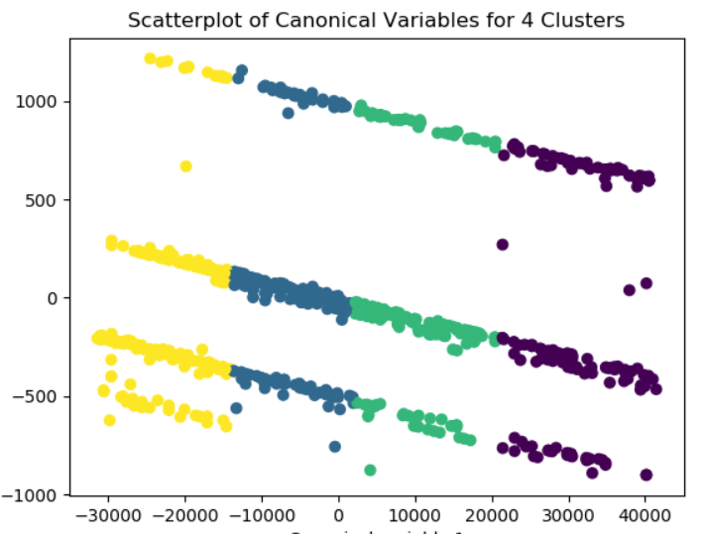
Clustering
Divides data into multiple classes
Comes under Unsupervised Learning Algorithms
K-Means Clustering is used
Graph made according to the 2 PCAs
Total number of clusters : 4
Number of clusters are being found out using the elbow technique

Slide 7
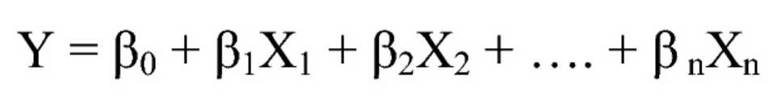
Linear Regression
Linear regression is used for finding linear relationship between target and one or more predictors. There are two types of linear regression- Simple and Multiple.
The multiple linear regression explains the relationship between one continuous dependent variable (y) and two or more independent variables (x1, x2, x3… etc).
The core idea is to obtain a line that best fits the data. The best fit line is the one for which total prediction error (all data points) are as small as possible. Error is the distance between the point to the regression line.

Slide 8
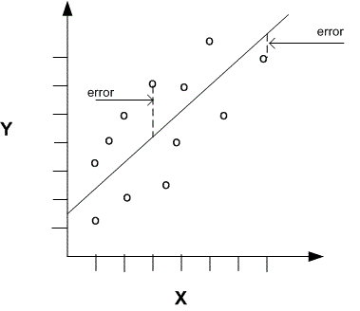
Why Linear Regression?
It is able to determine the relative influence of one or more predictor variables.
It has the ability to identify outliers, or anomalies in the dataset available.
It provides great efficiency due to its simplified approach.

Slide 9

Bass Diffusion Model
Bass diffusion model is appropriate for forecasting first purchase of a new product for which no closely competing alternatives exist in the marketplace.
It consists of two constants p, the coefficient of innovation and q, the coefficient of imitation which along with the market potential gives us an estimate of the monthly sales over a year.
The average value of p has been found to be 0.03
The average value of q has been found to be 0.38

Slide 10
What makes our model unique?
Keeping in mind the customers, we have taken into account the factors which impact the decision of a buyer the most and generated our sales values accordingly, instead of randomly generating data.
We have assigned different weights to our features according to their priorities. The most in-demand features are assigned higher weights which enhances our result.
We have estimated the demand of the new product through Twitter Sentimental Analysis combined with Google Trends of that product to further account for the estimated customer response when the product enters the market.

Slide 11
Thank You!

