Slide 1

Amazon Books Reviews Dataset Analysis
By :
Aayush Shah
Palash Kochar
Saurabh Goyal

Slide 2
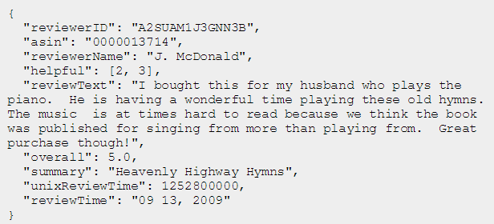
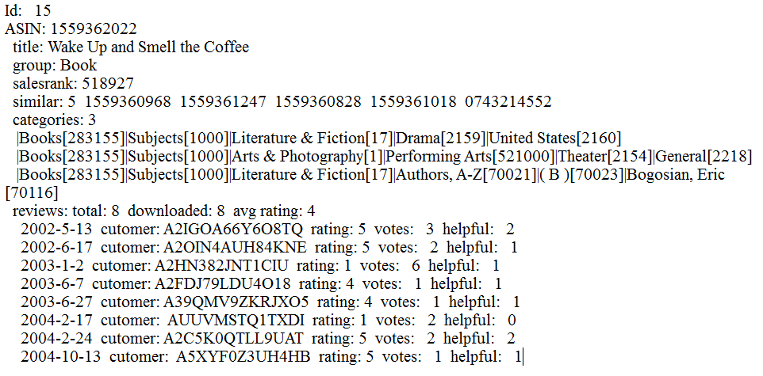
Dataset
This dataset contains product reviews and metadata from Amazon, including 142.8 million reviews spanning May 1996 - July 2014.
19 GB.

Slide 3
Analysis
Sentiment Analysis
Books Recommendation
Text Mining and information Extraction using IBM SPSS.
Analyse Most and Least Helpful Reviews in dataset

Slide 4
Technologies Used
Pig
Hive
Hbase
MapReduce
Python
IBM SPSS
R
Qlik Sense
Plotly

Slide 5
Approaching Project
Used GSON library.
Feed data into HBASE with the help of HIVE.

Slide 6
R
Specialized libraries are used to handle large datasets.
Data.table : - Fast aggression on large data set, fast file reader
Sqldf : - Provides an easy way to perform SQL selects on R data frames, great resource for RDBMS folks, easy it to express
Ggplot2 : - Offers a powerful graphics language for creating elegant and complex plots. Allows you to create graphs that represent both univariate and multivariate numerical and categorical data in a straightforward manner. Grouping can be represented by colour, symbol, size, and transparency.

Slide 7
Sentiment Analysis
Purpose :- To determine attitude of the person who was writing review with respect to overall contextual polarity of document
Used Dictionary with 20000 positive and negative words.
Assigned score of +1 for positive word and -1 for negative word in each review.
Calculated sentiment score of each review with the help of pig script.

Slide 8
Sentiment Analysis Code Snippet
reviews = LOAD 'hbase://bookReview' USING org.apache.pig.backend.hadoop.hbase.HBaseStorage('cf1:asin, cf1:reviewText', '-loadKey true') AS (id:chararray, asin:chararray, reviewText:chararray);
twords = foreach reviews generate id, FLATTEN( TOKENIZE(reviewText) ) AS word;
tsentiment = join twords by word left outer, dictionary by word using 'replicated';
wscore = foreach tsentiment generate twords::id as id, (CASE dictionary::polarity WHEN 'positive' THEN 1 WHEN 'negative' THEN -1 else 0 END) as score;
tgroup = group wscore by id;
tscore = foreach tgroup generate group as id, SUM(wscore.score) as final;
final1 = join tscore by id left outer, reviews by id using 'replicated';
final2 = foreach final1 generate tscore::id as id, reviews::asin, tscore::final as finalscore;
store final2 into 'final2';

Slide 9
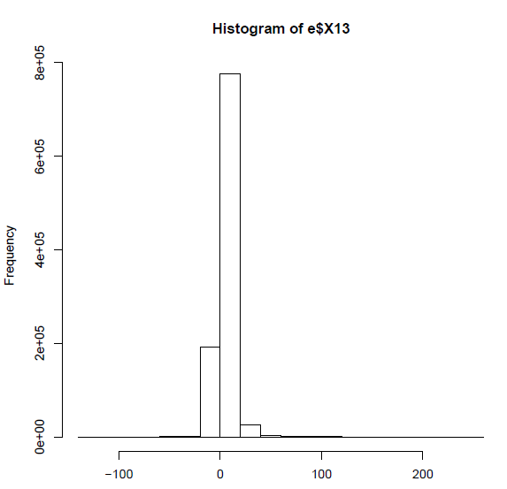
Graph of Sentiment Analysis

Slide 10
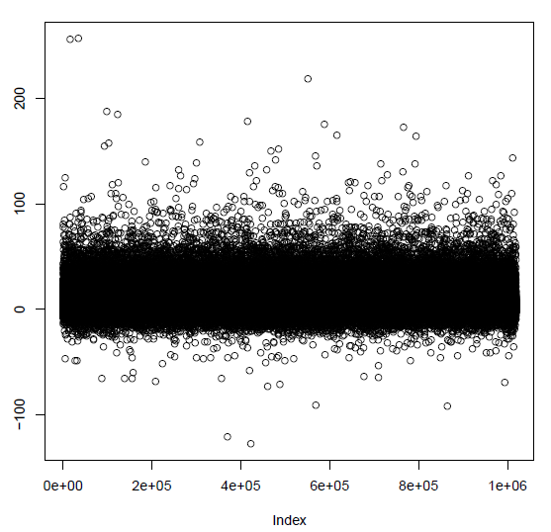
Cont..

Slide 11
Text Mining / Information Extraction
It is the process of extracting relevant information from the text.
It consists of
Structuring the input text.
Deriving patterns.
Evaluation and interpretation of output.
We have used IBM SPSS text analytics for survey.
Transform unstructured survey text into quantitative data and gain insight using sentiment analysis.
Uses natural language processing (NLP) technologies specifically designed for survey text.
It helps in building category web graph which is very essential in telling us that which categories we shall combine or we should create new one that better account shared responces

Slide 12
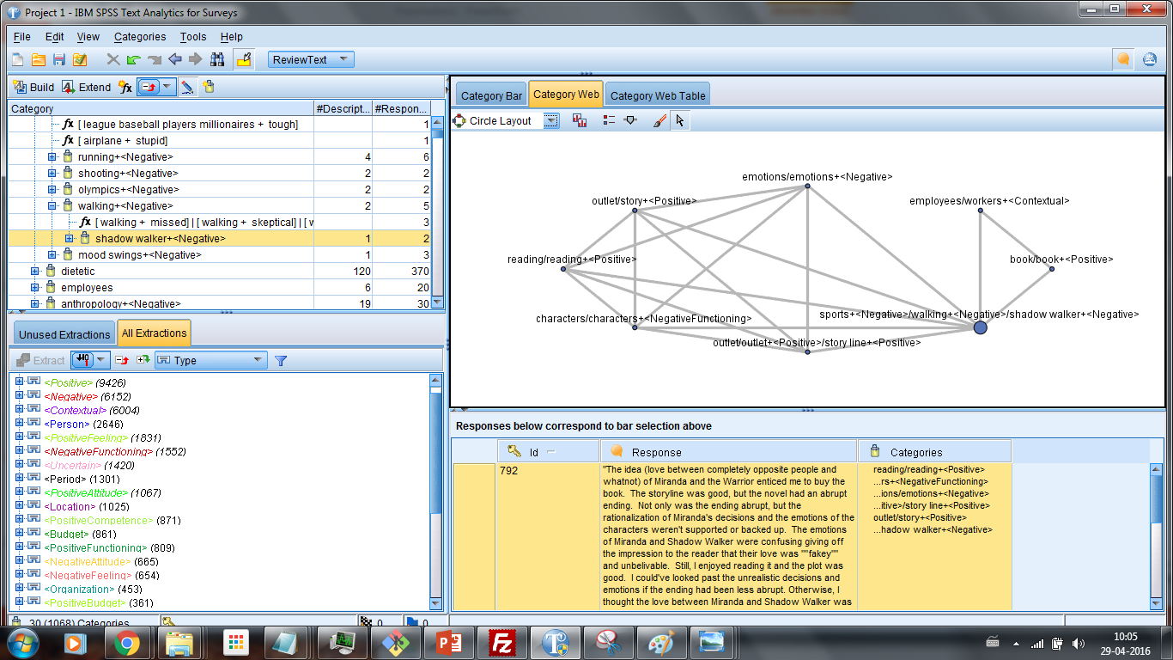
Screenshot SPSS

Slide 13
Book Recommendations
Used Apache MAHOUT library for giving recommendations
Found User-based recommendations
Generated input for mahout library using Hive and HBase

Slide 14
Code Snippet for Recommendation
//Hive
ADD JAR /home/hadoop/json-serde-1.3.8-SNAPSHOT-jar-with-dependencies.jar;
CREATE TABLE complex_json (
Id int,
ASIN string,
title string,
group string,
salesrank string,
similar array<string>,
reviews struct<total:int, downloaded:int, avgRating:float, customers:array<struct<customerid:int, rating:int, votes:int, helpful:int>>>
)
ROW FORMAT SERDE 'org.openx.data.jsonserde.JsonSerDe';
LOAD DATA LOCAL INPATH '/home/hadoop/amazonUglyMapped.json'
OVERWRITE INTO TABLE complex_json;

Slide 15
Cont..
insert overwrite local directory '/hiveout/'
row format delimited fields terminated by ','
Select customers_exp.customerid, Id, customers_exp.rating FROM complex_json LATERAL VIEW explode(reviews.customers) exploded_table as customers_exp;
*************************Shell*********************************
cat /hiveout/* > /hivefinalout/mahout_input.csv
hdfs dfs -put /hivefinalout/mahout_input.csv /mahout_input.csv
mahout recommenditembased -s SIMILARITY_COOCCURRENCE -i /mahout_input.csv -o /mOutput --numRecommendations 10 --booleanData true
hdfs dfs -getmerge /mOutput /home/hadoop/mahoutOutput.txt

Slide 16
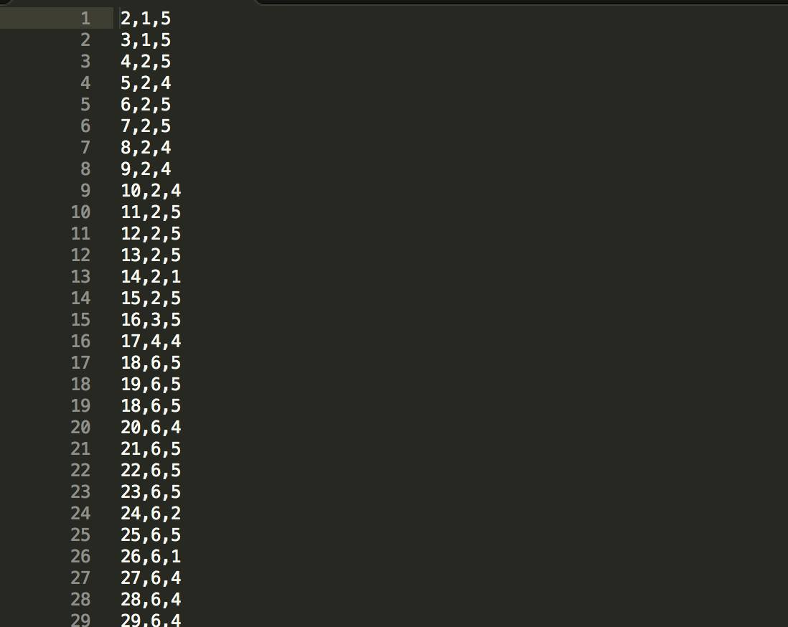
Screen shots MAHOUT
Input to MAHOUT

Slide 17
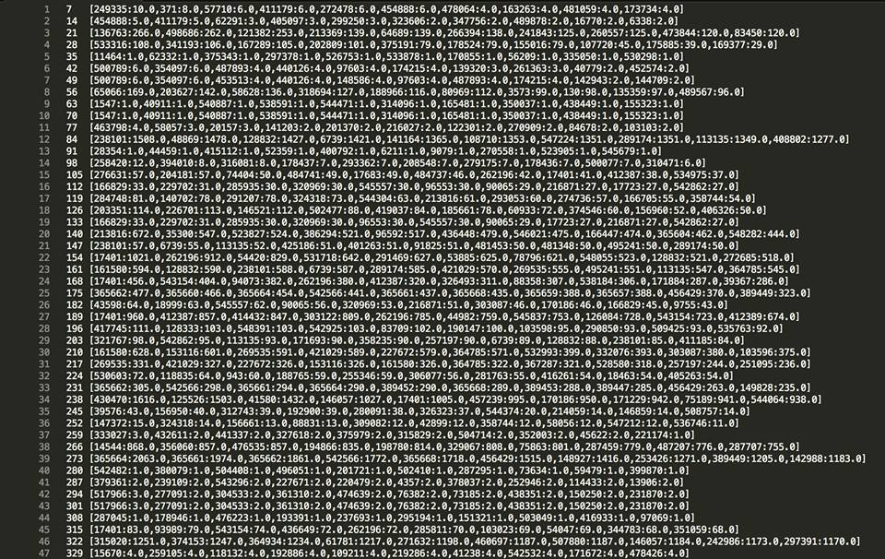
Cont..
Output to Mahout

Slide 18
Cont..
Wrote MapReduce to find out top recommended books to users.
Wrote python script to interpret the mahout output.
Plotted graph of 10 most recommended Books

Slide 19
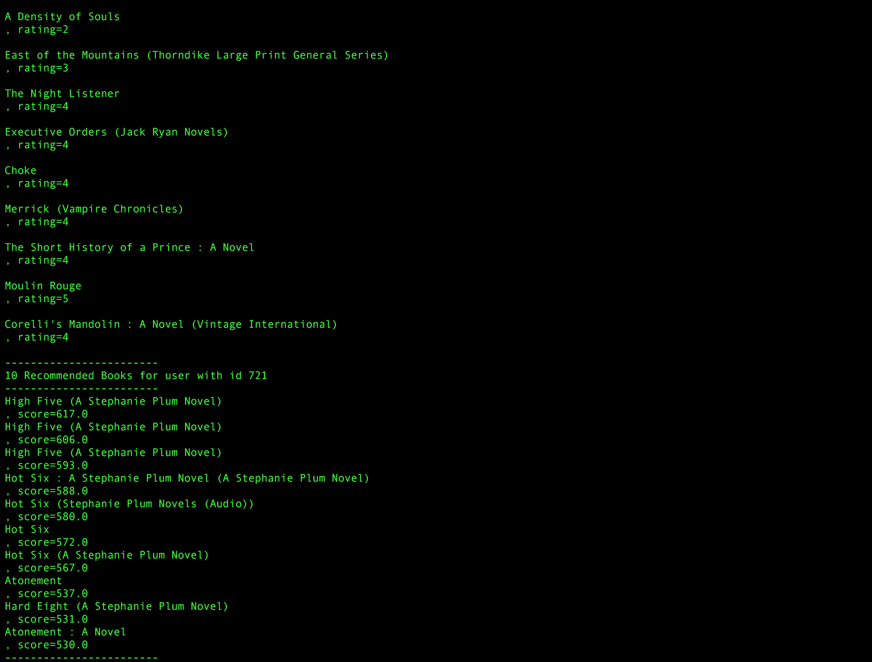
Screenshot

Slide 20
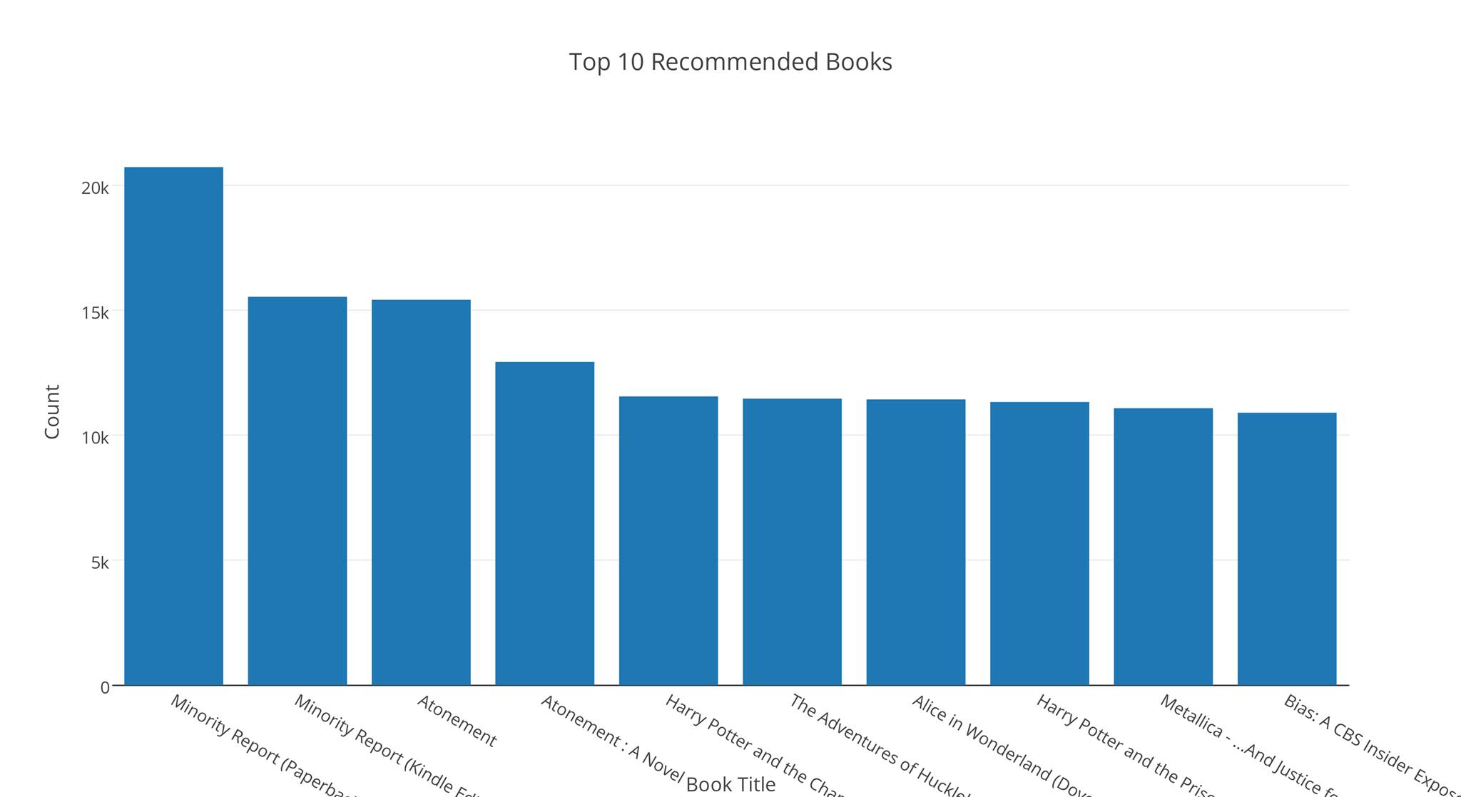
Cont..

Slide 21
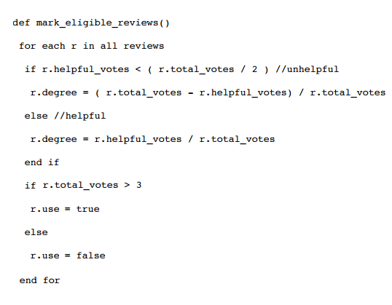
Most helpful reviews
To find this we computed degree of helpfulness with the help of Pig.
After computing degree of Helpfulness we used R to plot graph and find the count of number of reviews corresponding to each degree.
Pseudo Code →

Slide 22
Code Snippet (Helpfulness)
reviewsHelpfulness = LOAD 'hbase://bookReview' USING org.apache.pig.backend.hadoop.hbase.HBaseStorage ('cf1:asin, cf1:helpful, cf1:helpfulTotal', '-loadKey true') AS (id:chararray, asin:chararray, helpful:chararray, helpfulTotal:chararray);
rHelp = FILTER reviewHelpfulness BY $2 > ($3)/2;
rHelp1 = foreach rHelp GENERATE $0, $1, $2, $3, (($2/$3)*100);
rHelp2 = FILTER rHelp1 BY $3 > 3;
Store rHelp2 into 'HelpfulData';

Slide 23
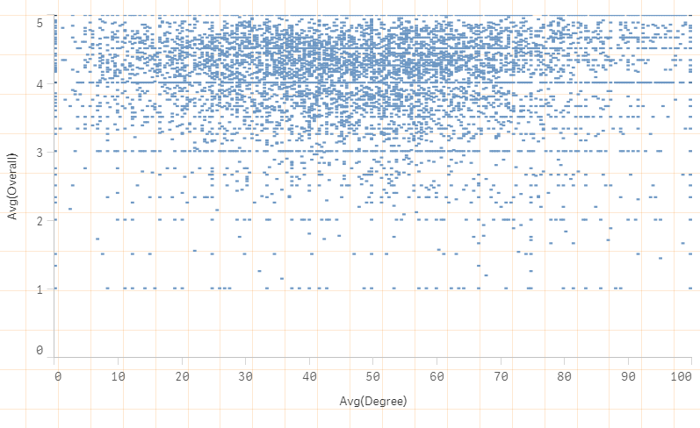
Graph analysing helpfulness

Slide 24
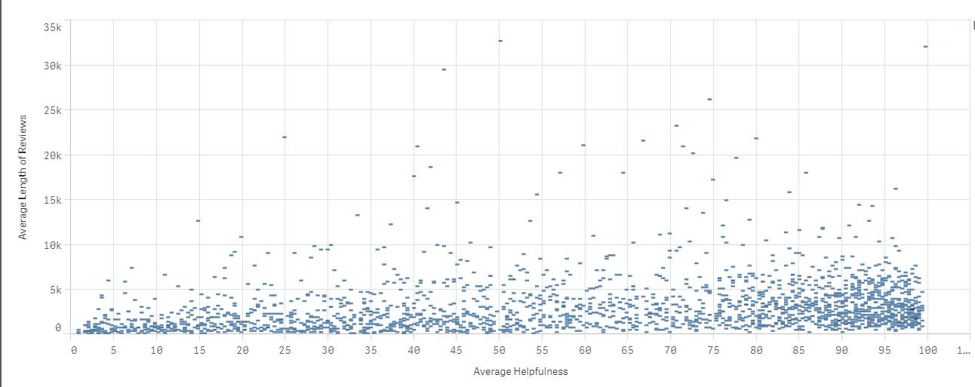
Cont..

Slide 25
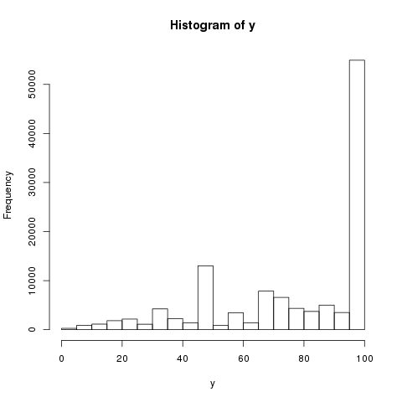
Cont..

Slide 26
Common Syntax in Reviews
In order to determine most common syntax among the reviews we analyse the first word that the review begins with.
That gives us the basic initial understanding of the tone of review, that whether it was written with perspective of first Person or third person etc.
In order to do this we wrote a map reduce program.

Slide 27
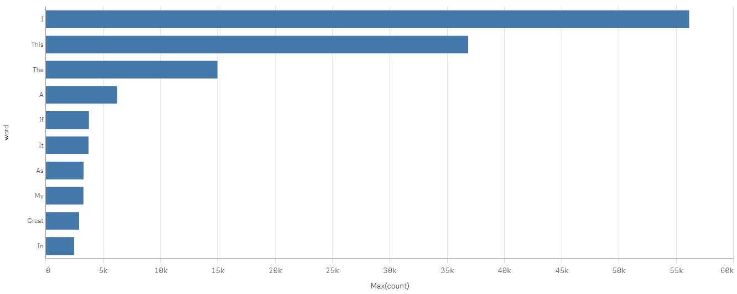
Reviews start word graph

Slide 28
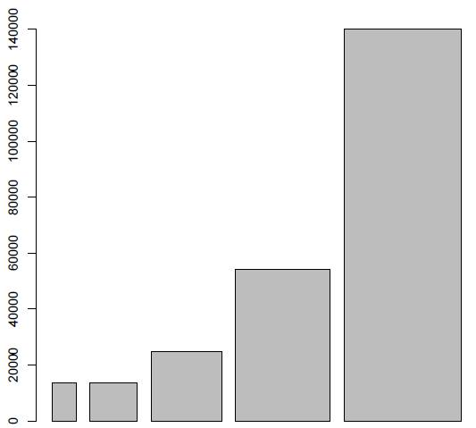
Count Of Rating
1 2 3 4 5

Slide 29
Thank You!!

