Slide 1
EXPRESSBEES Assignment
Presented by - Palash Shende

Slide 2
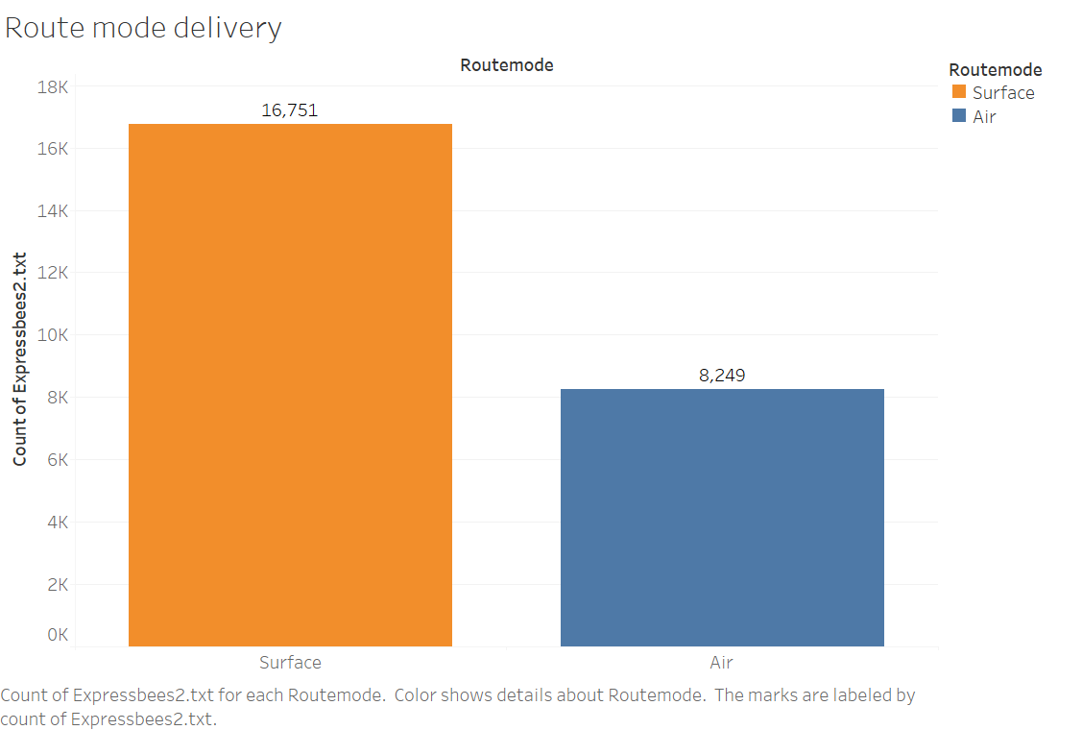

Slide 3
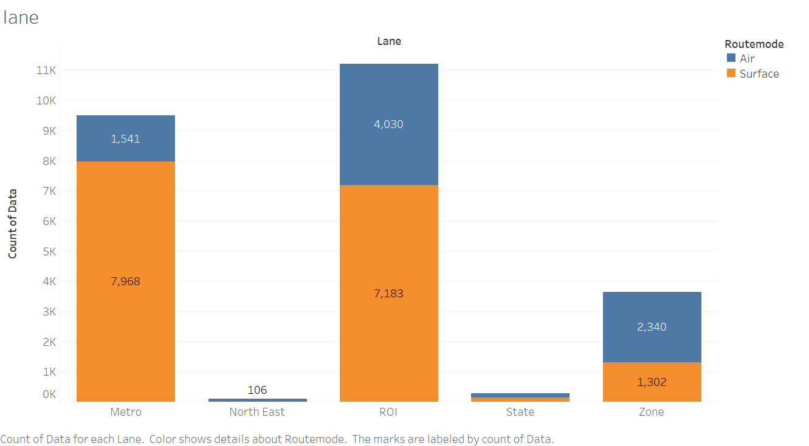
Lane with Routemode
Notes:
Vfdsvfdsvfdsgrsnb grbtfrewvccdsvsdv

Slide 4
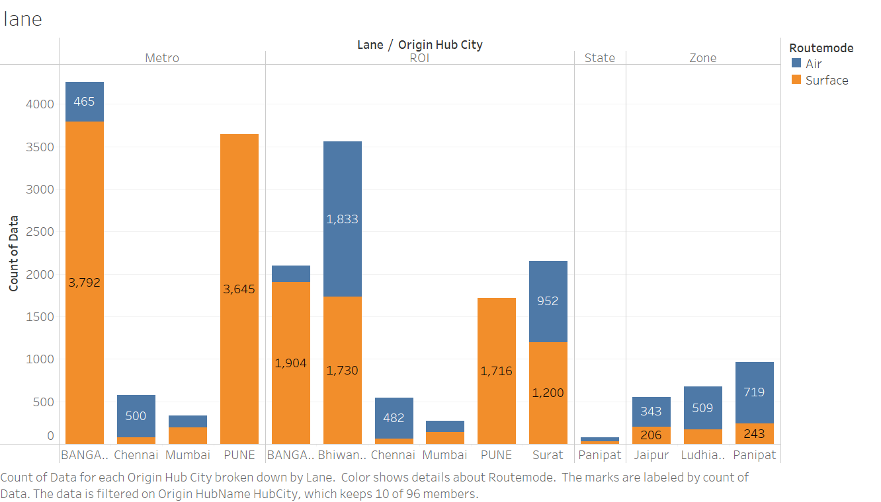
Lane Route mode origin city

Slide 5
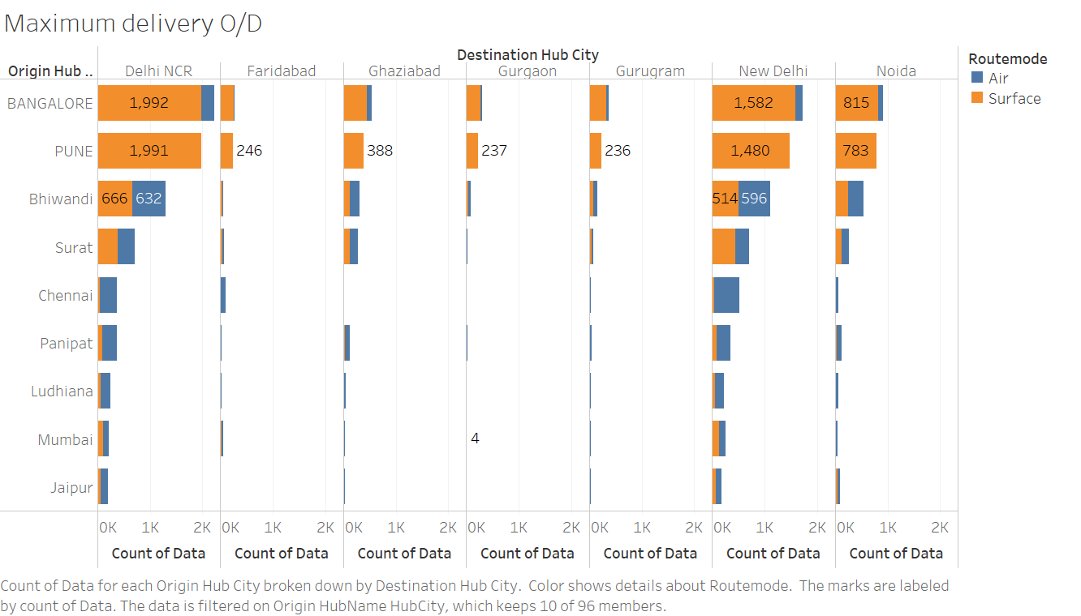

Slide 6
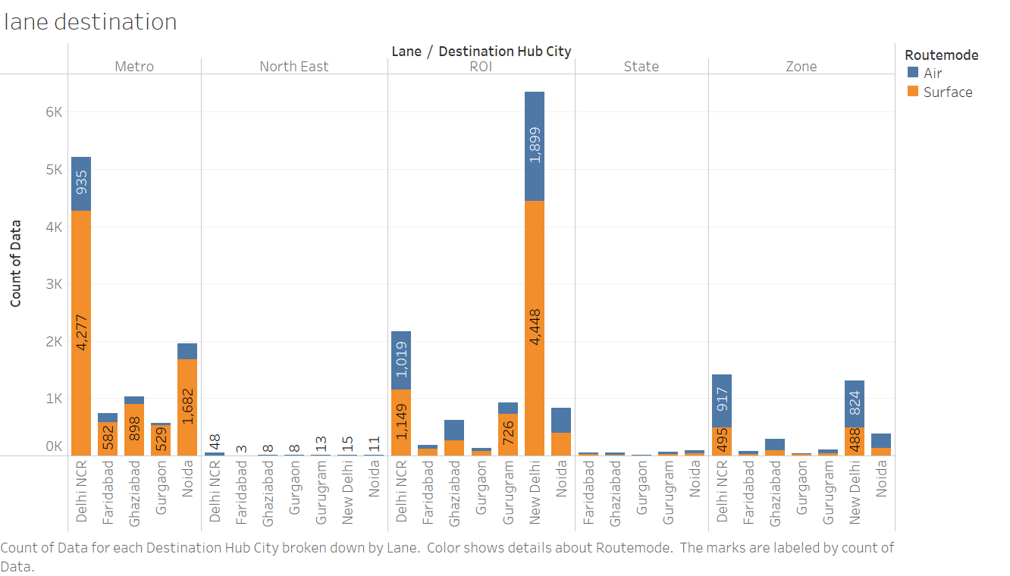

Slide 11
Conclusion
As the data says metro and ROI have maximum sales.
Surface Route mode have more delivery than Air Route mode.
Air Route mode has more capability to deliver most quickly as compare to surface.
Bangalore, Pune, Bhiwandi, Surat have contribute maximum number of importing delivery for the Delhi NCR, New Delhi, Noida .
Bangalore, Pune, Bhiwandi, Surat deliver product with short period of time with ROI and Metro Lane
We have scope to improve the delivery time in the Pune , Bangalore, Bhiwandi, Surat, Chennai, Kolkata and Hissar with Metro , ROI and Zone Lane

